Slide 1
Welcome Section
12/12/2025
Week-1

Slide 2
Course Orientation
Introduction to the course
Setting up the rules together
Important Key terms
Differences and similarities of EFL, ESL, EIL, EGL, EWL and EOL

Slide 3
Introduction to the course
Differences and similarities of EFL, ESL, EIL, EGL, EWL and EOL
Bilingual Education , Types of Bilingual programs
Bilingualism,
Coursebooks
Choosing the right course book
Feedback and error correction
The lesson: different perspectives
Revision Week
Midterm

Slide 4
Introduction to the course
Teaching vocabulary
Teaching grammar
Teaching listening, Teaching speaking
Teaching reading
Teaching writing
Revision Week
Final Test

Slide 5
Introduction to the course
Ethics and morals and discipline 10%
Attitude towards learning, Attendance, class participation
Knowledge and Cognitive Skills 30%
Assignment, Presentation, Discussion, Exam

Slide 6
Introduction to the course
Interpersonal Skills 30%
Participation, Group work discussion, group and pair presentation,
Numeral Analysis 10%
Assignment (Research Paper)
Learning Management Skill 20%
Assessed from completed tasks at home
Meet the deadline, End of the exam (mark)

Slide 7
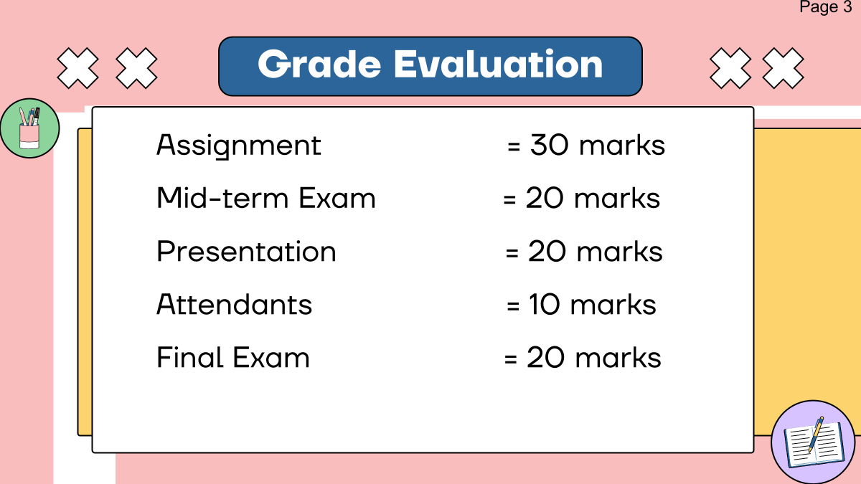
Grade Evaluation
Participation in Class/ Attention

Slide 8
Assignment (30 Marks)
Ethics and morals and discipline 5% | Knowledge and cognitive skills 10% | Numeral Skills 10 % | Learning Management Skills 5%
Mid-term Exam (20 Marks)
Knowledge and cognitive skills 5% | Learning Management Skills 5%

Slide 9
Presentation (20 Marks)
Ethics and morals and discipline 3% | Knowledge and cognitive skills 5% | Interpersonal Skills 30% | Learning Management Skills 5%
Final Exam (20 Marks)
Knowledge and cognitive skills 10% | Learning Management Skills 5%
Attendance + Participation, Attention (20 Marks)
Ethics and morals and discipline 2%

Slide 10

Setting up the rules together
Group Work

Slide 11
Classroom Rules and Expectation
Cooperation
(work together, take turns, be patient with one another, show good sportsmanship, help each other, solve disagreement smartly)
Responsibility
(follow directions, work hard, meet the deadline for every assignment, independent, complete all the tasks, use time wisely)

Slide 12
Classroom Rules and Expectation
Empathy
(kind, no bullying, no discrimination, don’t talk about others in a negative way)
Self-Control
(control your emotion and behavior, be a good listener, share ideas)

Slide 13
Classroom Rules
Be on time
Listen ( do not interrupt others)
Speak up (Participate in all activities-group discussion, presentation, share your ideas)
Clean up, switch off all the electrical appliances after class)
Be Honest (no cheating, no copying from your friends)
Silence your cell phone
Work hard and be responsible

Slide 14
Classroom Rules
Be on time, if you are late not more than 15 minutes.
Listen attentively and carefully (do not interrupt others)
Raise your hand before speaking or asking a question/
Keep your classroom clean
Submit the work in time.
Silence your cell phone/ Turn off notifications
Always start class at 9:00 am.

Slide 15
Classroom Rules
Be on time. If you are late more than 15 minutes, sit in the VIP seat in front of the class.
Listen attentively and carefully (do not interrupt others)
Raise your hand before speaking or asking a question/
Keep your classroom clean
Submit the work in time.
Silence your cell phone/ Turn off notifications
Asking for permission before go out/ answer the phone.
Speak English as much as possible.

Slide 16
Important key terms in English language teaching and learning
English as Second Language
ESL
EFL
TESOL
TEFL
TESL
ELT
English as Foreign Language
Teaching of English to speaker of other languages
Teaching English as a Foreign Language
Teaching English as a Second Language
English Language Teaching

Slide 17
Important key terms in English language teaching and learning
English for Specific Purpose
ESP
EAP
IELTS
TOEFL
TOEIC
English for Academic Purpose
International English Language Testing System
Test of English as Foreign Language
Test of English for International Communication
South Korean based test of English for higher education and employment

