Slide 1
CHAPTER 1: introduction to DIGITAL MARKETING
By Dr. Ittipoom Promma

Slide 2
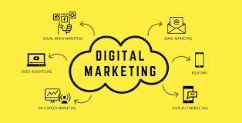
DIGITAL MARKETING
This Digital Marketing course covers the fundamentals and provides you with a practical framework to get better in understanding key digital marketing tools and techniques.

Slide 3
AGENDA
Introduction to the course.
History of Search & Social.
Digital Marketing Channels
Email Marketing
Search Engine Marketing (SEM)
Pay-Per-Click Advertising (PPC)
Search Engine Optimisation (SEO)
Display Advertising
Social Media Marketing (SMM)
Content Marketing

Slide 4
INTRODUCTION
to the course.

Slide 5
INTRODUCTION
What Is Digital Marketing?

Slide 6
INTRODUCTION
What Is Digital Marketing?
“Digital marketing” is the process of building and maintaining customer relationships through online activities to facilitate the exchange of ideas, products, and services that satisfy the goals of both parties.
It differs to traditional marketing in that involves various channels and methods to enable an organization to analyze what is and is not working in real time.

Slide 7
INTRODUCTION
Why Is Digital Marketing Important?
For information on a new product, service or location
If they have a question
If they are looking for help
If they want more information on certain individuals or organizations
Meeting attendants/Business contacts/General information (maybe about you…) /New employees /Available jobs / Etc.

Slide 8
INTRODUCTION
Why Is Digital Marketing Important?
People want brands they can trust; it’s that simple.
The ease of access to information has placed everyone under a microscope and has not only exposed consumers to what your company says, but also to what the media and other consumers have to say.

Slide 9
INTRODUCTION
There are many benefits of digital marketing over traditional marketing
Puts the consumer in control
Provides convenience
Increases satisfaction
Drives brand loyalty
Reduces the selling cycle
Reduces the cost of sales
Builds your brand
Provides targeted results
It is measurable *
Cost effective *

Slide 10
INTRODUCTION
Digital marketing objectives
Reaching the right audience
To engage with your audience
To motivate your audience to take action
Efficient spending on your campaign
Return on investment (ROI)

Slide 11
History of Search & Social

Slide 12

HISTORY
The term digital marketing was first used in the 1990s.
The coming of the Internet and the development of the Web 1.0 platform, allowed users to find the information they wanted, but it could not be shared.
The rather static platform then revolutionised in 1993, when the first clickable banner ad was introduced.
This was the first step to a new digital age

Slide 13
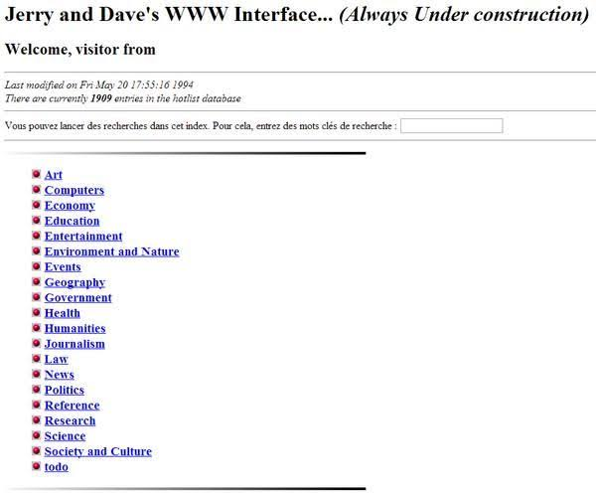
HISTORY
1994 saw the launch “Jerry’s Guide to the World Wide Web” or better known as Yahoo.
The search engine received close to 1 million hits within its first year.
This amazing feat prompted wholesale changes within the digital marketing space.

Slide 14

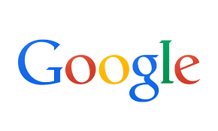


HISTORY
1998 saw the birth of Google, followed soon after by Blogger in 1999.
It was during this time that social networking sites – MySpace and then The Facebook – began to be birthed.
The social networking boom presented excellent opportunities for businesses to communicate directly with customers and implement web marketing strategies.

Slide 15
HISTORY
Google then started to expand and improve their Internet search engine algorithms, and it wasn’t long after that Google figured out how to analyse content to target users with ads that are relevant to their interests.
Google also added options like AdWords, Analytics and AdSense to improve marketing potential.

Slide 16
HISTORY
Enter The ‘Cookie’.
The cookie was first developed in an attempt to analyse user’s browsing habits, but it has since evolved into a useful part of the e-commerce sector and allows for the collection of user literal user data. This was a huge impact on the digital marketing world.

Slide 17
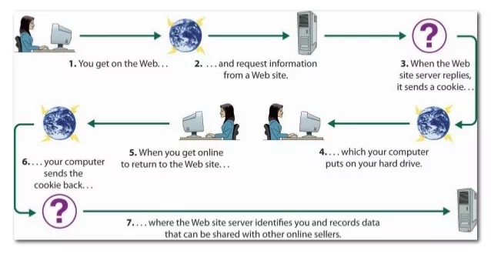
HISTORY
How Cookie works ?

Slide 18
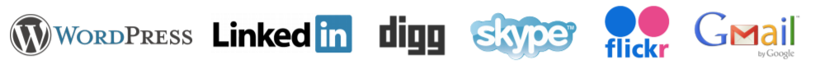
HISTORY
By 2004 Web 1.0 became Web 2.0 and saw the introduction of numerous social platforms like WordPress, LinkedIn, Digg, Skype, Flickr and Gmail.
The years following saw the introduction of YouTube and the mobile marketing revolution which boomed by 2010.

Slide 19
Digital
Marketing
Channels

Slide 20
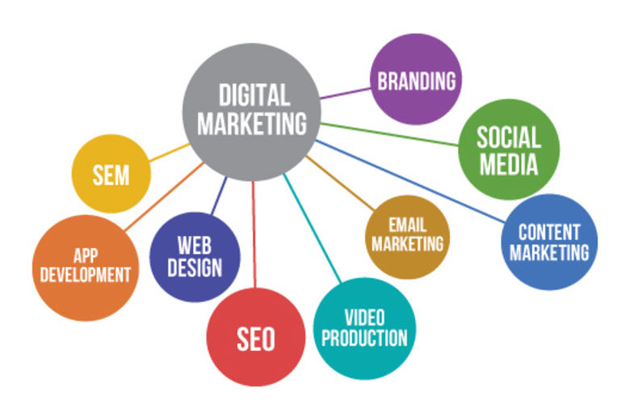
DIGITAL MARKETING CHANNELS
Before you start planning an effective digital marketing strategy, it is important to perform various tests to determine which channels will work best for your business.

Slide 21
DIGITAL MARKETING CHANNELS
What does digital marketing consist of?
Website design (user experience)
Search engine optimization (SEO)
Pay per click (PPC)
Social media marketing (SMM)
Email marketing
Display advertising (banner ads)
Affiliate marketing
Content marketing
Online reputation management (ORM)

Slide 22
DIGITAL MARKETING CHANNELS
Email Marketing
Email marketing remains to be one of the most effective digital marketing channels that guarantee ROI.
The benefits of email marketing include: low costing, audience segmenting, immediate, contain calls to action, customizable, and easy to share and track.

Slide 23
DIGITAL MARKETING CHANNELS
Search Engine Marketing (SEM)
Search Engine Marketing (SEM) refers to the process of gaining website traffic by purchasing ads on search engines.
The strategy that encompasses both PPC and SEO is one of the most effective ways to grow your business in an increasingly competitive marketplace.
Search Engine Marketing’s greatest strength is that it offers advertisers the opportunity to put their ads in front of customers who are ready to purchase at that very moment in time.

Slide 24
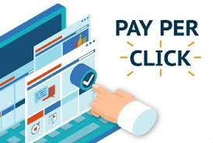
DIGITAL MARKETING CHANNELS
Pay-Per-Click Advertising (PPC)
The effectiveness of PPC advertising is measured by the allocated budget and how well keywords for targeting potential customers.

Slide 25
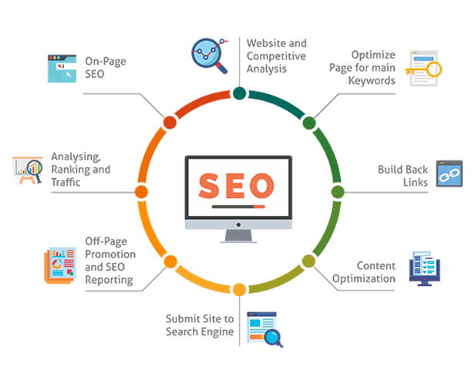
DIGITAL MARKETING CHANNELS
Search Engine Optimization (SEO)
SEO is all about getting your website to rank higher than your competitors. SEO involves activities including keyword research, on-page and off-page optimization, and organic link building.

Slide 26
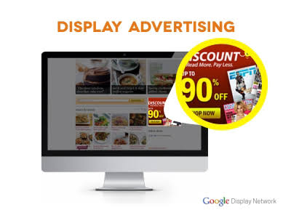
DIGITAL MARKETING CHANNELS
Display Advertising
Display advertising uses third-party websites to advertise. These ads include banners, interactive ads, videos, and overlays that are linked to a landing page or website.

Slide 27
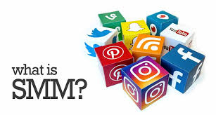
DIGITAL MARKETING CHANNELS
Social Media Marketing (SMM)
Social media provides great dividends for companies who make use appropriate content for applicable platforms.
Not only does it connect you to your customers, but it also encourages users to share opinions, participate in discussions and engage with others in real time

Slide 28
DIGITAL MARKETING CHANNELS
Content Marketing
Ever heard the saying ‘content is king’?
Captivating content which includes: text, graphic and videos, will continuously generate inbound traffic from highly targeted audiences.
Content is the engine of the web.

Slide 29
COURSE OVERVIEW
This course will identify key areas of a digital marketing, including:
Principle (customer/ads./marketer)
Platform (website/e-mail/search engine/social media)
People (content/tribe/influencer/reputation)
Practice (lead/conversion/omni-channel)

Slide 30
THANK YOU

