Slide 1
Chapter 2
The Global Marketing Environment Economic, Social, Cultural, and Technological Factors

Slide 2
Changes in the Global Economic Environment
The global economic environment has become increasingly dynamic. To achieve success, managers and marketers must consider the following realities:
Increased capital mobility: Growth in foreign direct investment (FDI), portfolio investment, international lending, and digital financial transfers through FinTech systems.
The relationship between production and employment: Manufacturing employment may remain stable or decline even when productivity increases, as industries increasingly adopt advanced technologies such as AI, robotics, and automation.
The global economy as an integrated economic unit: Business leaders and policymakers must enhance national competitiveness within the global economic system by developing products, services, and strategies that align with global market demands.

Slide 3
Economic Systems
Economic systems play a crucial role in global marketing, as they determine the framework for business operations, market access, and marketing strategy adaptation. Companies seeking success in global markets must understand the characteristics of the economic system in each country.
Capitalism : A system in which resources and factors of production (such as labor, capital, and land) are privately owned. It operates under free market mechanisms, encourages competition and innovation, and supports global market expansion. However, it may also lead to challenges such as income inequality and environmental impact.
Socialism : A system in which decisions regarding production and consumption are largely controlled by the government. The state owns most factors of production, restricts foreign company access, and requires government approval for many business activities. Competition from external markets is often limited.

Slide 4
Economic Factors Affecting Global Marketing
National income and purchasing power
Exchange rates
Inflation rates
Level of economic development
Global economic conditions
Supply chain and logistics costs

Slide 5
Global Economic Conditions
Global economic conditions affect all countries through changes in costs, pricing, and consumer purchasing power. As a result, global marketers must adapt product, pricing, and supply chain strategies flexibly. Examples include:
Supply chain disruptions
Trade wars
Oil prices
Interest rate fluctuations

Slide 6
Culture from a Marketing Perspective
Culture refers to a set of values, beliefs, norms, and behaviors that are transmitted and instilled within a society. These serve as a framework for how individuals think, feel, and make decisions. Culture directly influences:
Marketing communication
Product design (e.g., shape, functions, usage)
Colors, style, and packaging
Size and pricing
Consumption rituals and practices

Slide 7
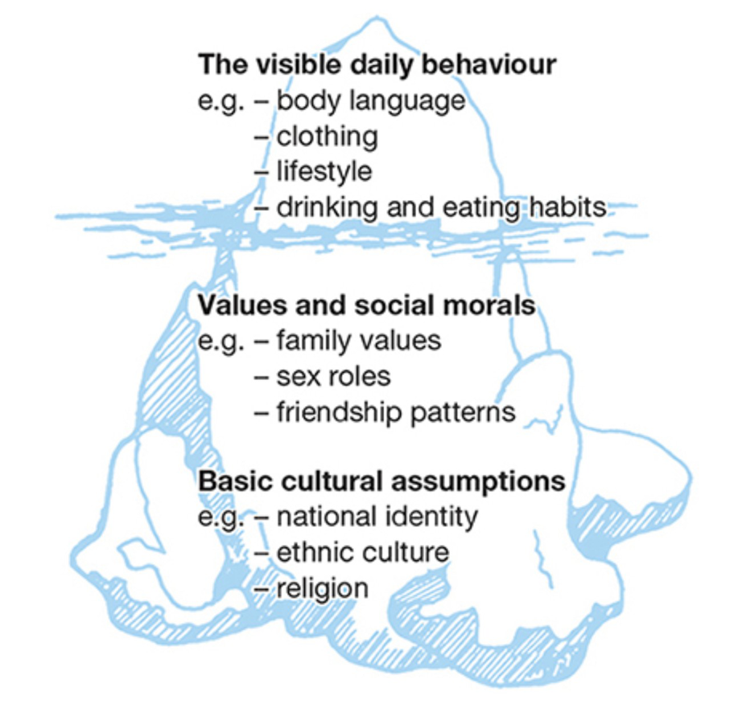
Iceberg Model of Culture

Slide 8


https://www.youtube.com/watch?v=29AfMJymGu8

Slide 9
Cultural Elements
Religious Values
Cultural Norms and Beliefs
Language and Communication
Family Structure and Gender Roles
Colors and Symbols and Aesthetics
Social Norms
Rituals and Celebrations
Time Orientation and Business Etiquette

Slide 10

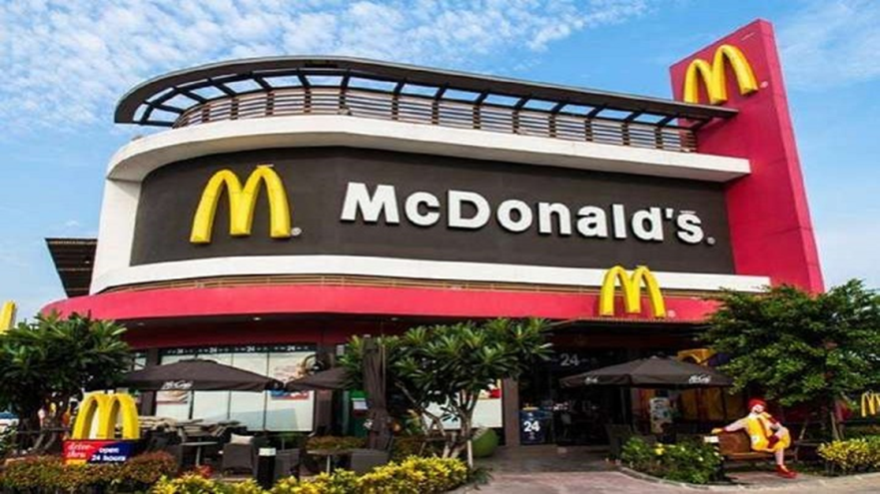


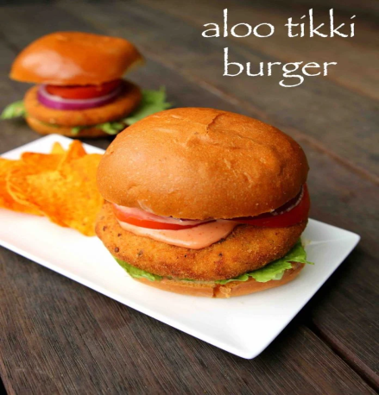
จะต้องดำเนินการทำอย่างไรในประเทศที่มีศาสนาที่แตกต่างเพื่อให้สอดคล้องกับวัฒนธรรม ?

Slide 11
Subculture
A subculture refers to a group of people within a larger society who share common values, beliefs, behaviors, and identity. These characteristics are distinct or more specific than those of the dominant culture, although they still exist within the same broader society. Subcultures often have their own ways of thinking, lifestyles, and symbols.
Examples include:
Gamer culture
Vegan culture
K-pop fan culture
Eco-friendly (environmentally conscious) culture

Slide 12
Technology as the Core of Modern Global Marketing
Technological factors significantly influence global marketing, for example:
Distribution channels: From domestic-only sales to cross-border distribution (cross-border e-commerce).
Communication methods: Enabling real-time international communication and interactive engagement.
Consumer behavior: Consumers worldwide have access to similar information, leading to more similar purchasing behaviors (Global Consumer Culture). Buying decisions are increasingly influenced by online reviews and digital content.
Service expectations: Service standards are elevated to global benchmarks, such as fast response via chat, 1–2 day delivery, user-friendly and seamless experiences, real-time order tracking, and the ability for customers to compare service experiences across countries.

Slide 13
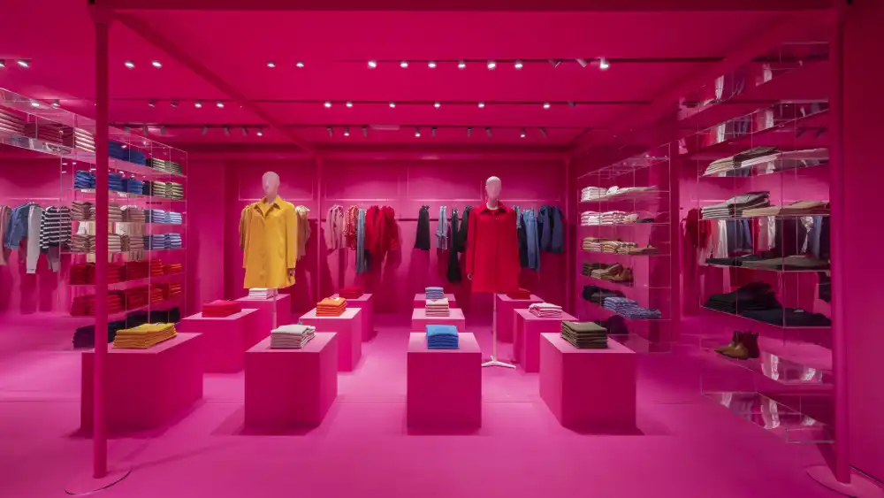
Benetton : Metaverse Retail

Slide 14
Cybersecurity Risks
Online-based marketing activities—such as e-commerce platforms, databases, cloud systems, and applications—face significant cybersecurity risks. These risks can reduce customer trust, decrease sales, compromise data security, disrupt business continuity, and interfere with personalized marketing efforts.
Examples include:
Customer data breaches (Data Breach)
Ransomware attacks
Online system attacks (DDoS Attack / System Shutdown)

Slide 15
Key Technology Trends in Global Marketing
E-commerce: Online stores and cross-border digital commerce.
AI & Automation: Customer data analysis, product recommendation systems, chatbots for 24/7 service, and automated advertising systems.
Internet of Things (IoT): Connecting the internet with devices and products.
Big Data: Businesses worldwide use customer data to analyze behavior, enable personalization, forecast demand, and implement dynamic pricing.
VR/AR (Virtual & Augmented Reality): Virtual stores and immersive customer experiences.
Blockchain: Used for tracking products within supply chains, preventing counterfeiting, and loyalty programs.
Cloud Computing: Data storage, AI analytics, online store management, and real-time customer service.
https://www.youtube.com/watch?v=UudV1VdFtuQ

Slide 16
Artificial Intelligence (AI) and Global Marketing
AI plays a crucial role in global marketing by enabling brands to better understand consumers, deliver personalized marketing (hyper-personalization), predict consumer behavior in advance, provide 24/7 customer service, and significantly reduce marketing costs.
Key applications include:
Personalization: Tailoring marketing messages, content, and offers to individual consumers.
Predictive Analytics: Forecasting customer behavior and future demand.
Chatbots and Virtual Assistants: Providing automated, real-time customer support.
AI-driven Big Data Analytics: Analyzing large volumes of data to generate insights and support marketing decision-making.

Slide 17
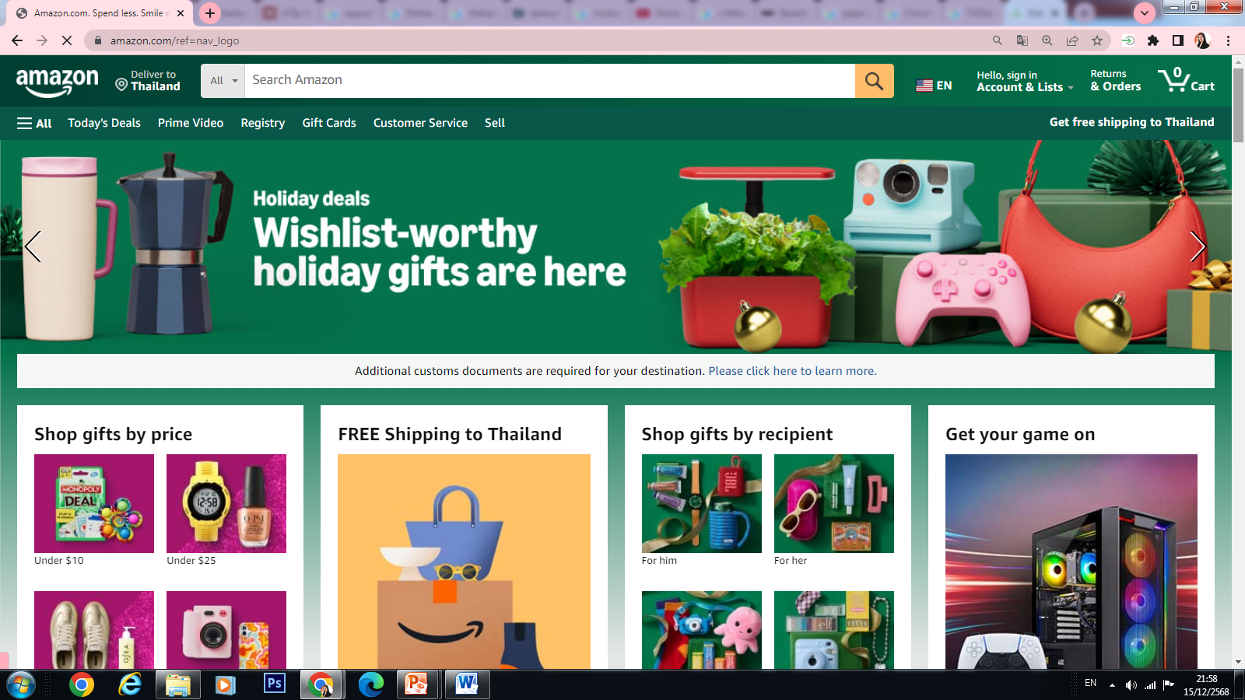
E-commerce Globalization
Having cross-border online platforms enables businesses to sell internationally more easily without the need to open physical stores or appoint overseas distributors. This allows small businesses to reach customers worldwide. Examples of cross-border platforms include Amazon, Alibaba, and Shopee.

