Slide 1
Bilingual Education
26/12/2025 3rd week

Slide 2
Bilingual teaching history and background
Types of Programs (Group Presentation)
Evaluation of Program Effectiveness(Student’s Opinion and Discussion)

Slide 3

What is bilingual?
Discuss the meaning of bilingual in your group.
Give the meaning of bilingual.

Slide 4
Bilingual education
-teaching academic content in two languages, in a native and secondary language with varying amounts of each language used in accordance with the program model.

Slide 5

•In the bilingual education system subject content will be delivered in two languages, mostly the native language of the learners and a second language which is closed connected to cultural needs.

Slide 6
•Bilingual teaching is the best way to prepare for university education and international business.

Slide 7
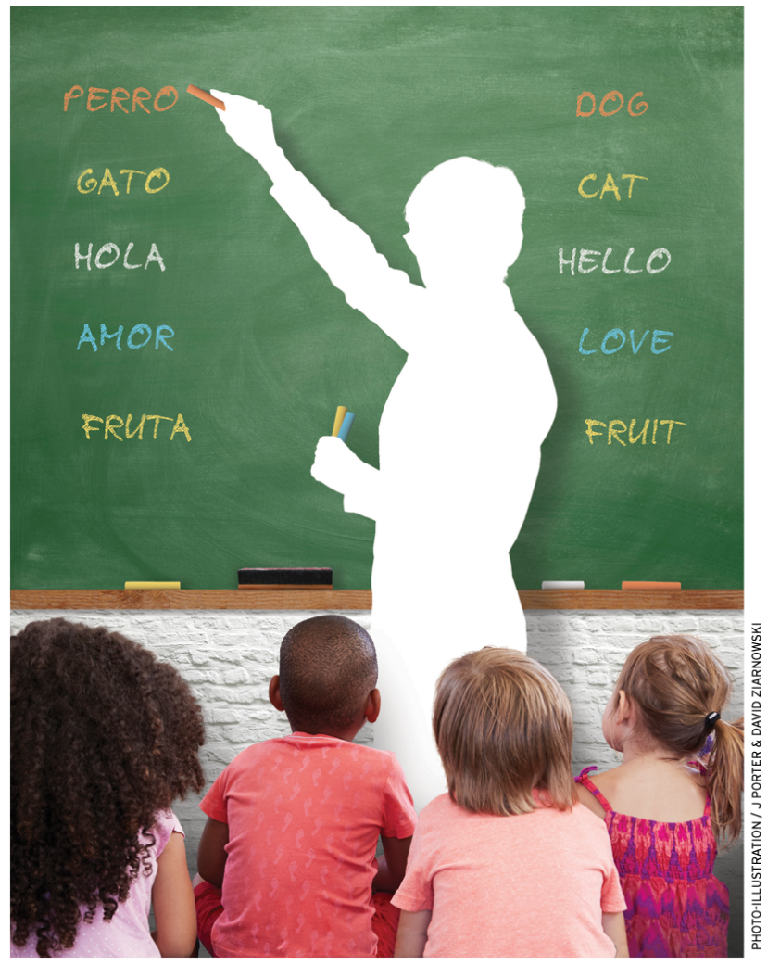
•The sooner a child starts learning a second language, the better it will speak this language.
If this language is English, the most widespread international language of business, medicine, science in general and, the better this child will perform in life.

Slide 8
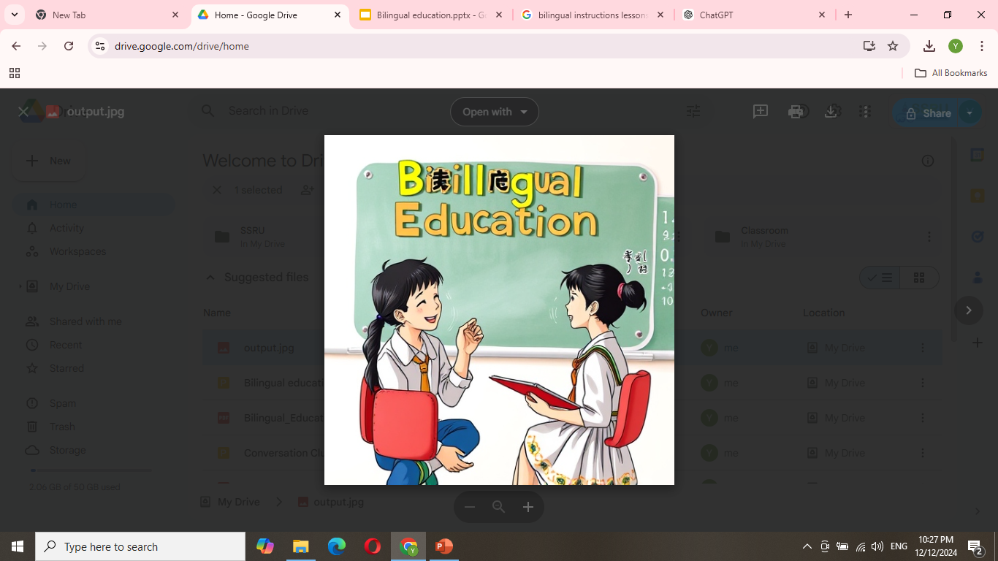
•If English is used as a language of instruction, taught subjects are at development equally in the native language as well, as research has proved.
using a foreign language in different contexts,
e.g. school lessons,
children become more and more proficient.

Slide 9
•By learning a foreign language students become more aware of their own language. So, students‘ knowledge of certain native language features (e.g., writing letters) will increase, as they have learned about this in another language

Slide 10
History and Background
•The first modern bilingual schools program worldwide which have been supported by government control and coordination started their program 1950 in the eastern part of Germany in the Lausitz.

Slide 11
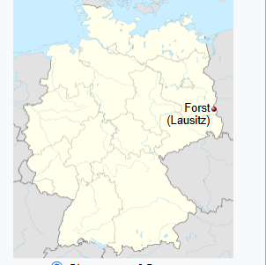
Lusatia is a historical region in Central Europe, territorially split between Germany and modern-day Poland.

Slide 12
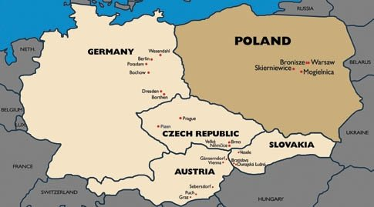
This special Region had a closed connection to Poland and so example schools were opened to force the bilingual understanding with the background.

Slide 13
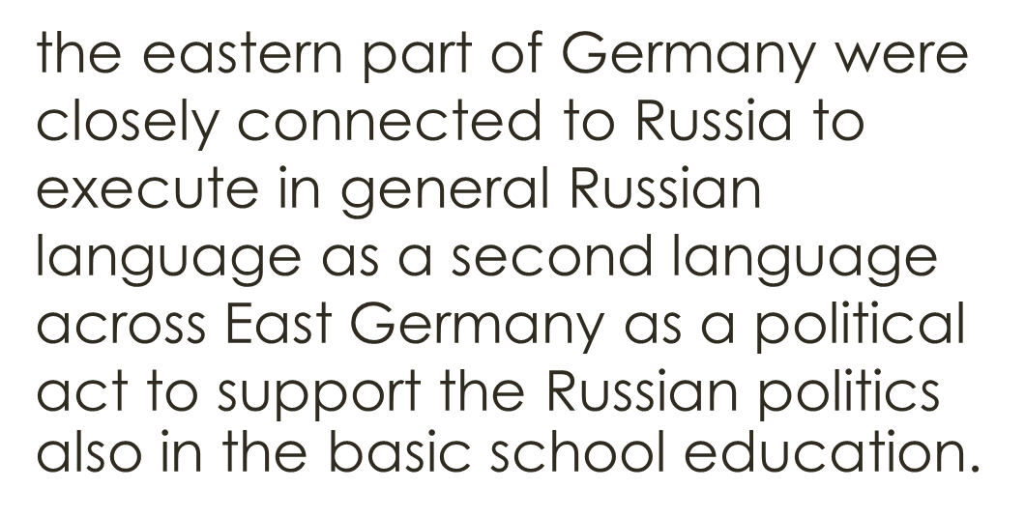

Slide 14
In East Germany, children were required to learn Russian in school to show loyalty to the Soviet Union and to strengthen the political alliance between the two countries.
After the war, the eastern part of Germany was closely tied to the Soviet Union (Russia).
Because of this political connection, the government made Russian the mandatory second language for students.
Not just for communication; it was a political move. By teaching Russian in elementary schools, the government hoped to create a stronger bond between East Germans and Russian culture and politics.

Slide 15

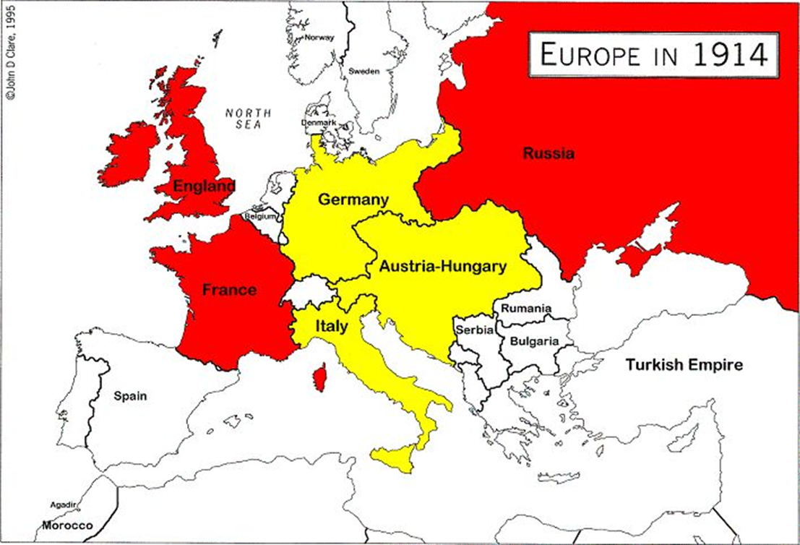

Slide 16
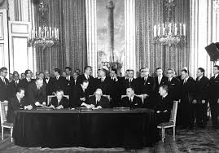
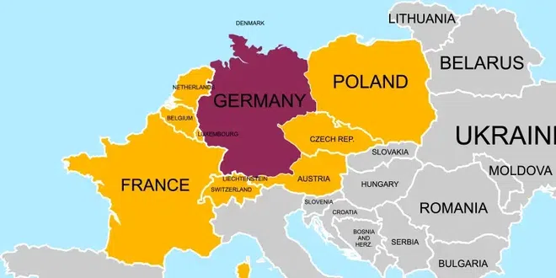
•Later on, West Germany followed 1963 based on the
Elysee-treaty between Germany and France which supports partnership exchanges also based on language background.
Notes:
Elysee-/eh-lee zay/
Elysee-Contract/treaty

Slide 17
Especially in border regions schools were equipped with a special bilingual French-German program.
In 1969, The Goethe-Gymnasium in Frankfurt am Main started to implement their bilingual program as the first German school with a German-English bilingual branch and one of the founding schools of the International Baccalaureate/Bachelor degree.
am Main = “on the main” in the name of several cities in Germany

Slide 18
History and Background in
USA
In America the bilingual education has a long history already. The first Bilingual Education schools opened prior to 1800, were not public, and were chiefly parochial institutions. German, French and Scandinavian immigrants opened bilingual schools.
Parochial= restricted or limited
Notes:
parochial=/pro-kee-al/

Slide 19


•Many of these first „bilingual schools“ were not even bilingual; they were non-English speaking schools where English was taught as a subject.

Slide 20
•In 1963 the first modern Bilingual Education program was developed for Spanish-speaking Cubans and Anglos at Coral Way Elementary School in Dade County, Miami, Florida. The program was supported by a grant from the Ford Foundation.
Cubans- the citizen of Cuba, a Caribbean country
That gained independence from Spain in 1902.
Anglo= English Speaking Person from a place English is not the primary language/European American
Miami-Dade Country – Country in Florida

Slide 21
•The Bilingual Education Act of 1968 — passed during an era of growing immigration and a civil rights movement — provided federal funding to encourage local school districts to try approaches incorporating native-language instruction. Most states followed the lead of the federal government, enacting bilingual education laws of their own or at least legalizing the use of other languages in the classroom.
Enact=make law= act out

Slide 22
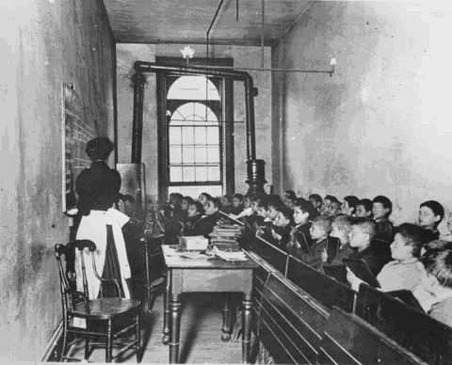

The basic idea were to make a migration for those ethnic groups very difficult, as a result of the political pressure caused by problems with these immigrants. Although the program was initiated as a means to discourage immigrant to settle in America in the long run it developed to be a positive influence to the general social development

Slide 23
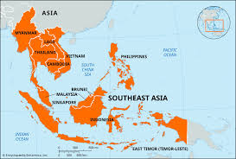
History and Background in
South East Asia
•Since the mid-1990s bilingual approaches to schooling and higher education have become popular in parts of South-east Asia, especially in Thailand and Malaysia where different models have been applied.

Slide 24
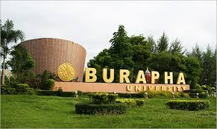

Thailand, is an exemplar of the use of English for integrated studies in Math, Science and IT, taught by non-native English speaking Thai teachers. This project is under the sponsorships of the International Study Program of Burapha University.
Panyaden School is an example of a private bilingual school in North Thailand that provides its students with a Thai-English education (each class has a Thai teacher and native-English speaking teacher).

Slide 25
•South East Asian countries followed the need of a bilingual education based the fact that the business world is placing their connection mainly on English language as well on the development of the change of the diplomatic language from French to English in the last 15 years.

Slide 26
•Indonesia is one of the latest countries to understand the need for bilingual education as a core quality to be competitive in the globalization of our world

Slide 27
•The difficulties and differences characteristic of the US experience have not been replicated in these Asian countries, though they are not without controversy.

Slide 28
there is widespread acknowledgment of the need to improve English competence in the population,
bilingual approaches, where language is taught through subject content,
the most effective means of attaining this.

Slide 29
The most significant limiting factors are the shortage of teachers linguistically competent to teach in a second language and the costs involved in use of expatriate native speakers for this purpose.
Expatriate-a person who lives in foreign country

Slide 30
Bilingual education is teaching students in two languages: their native language and the societal language (like English in the U.S.).
How many types of Bilingual programs are mentioned and what are they?
Transitional Bilingual Education (TBE)
Maintenance or Developmental Bilingual Education
Dual Language or Two-Way Immersion
Structured English Immersion (SEI)
ESL Pull-out Programs

Slide 31
1. Transitional Bilingual Education (TBE)
This is the most common type and is often called an "early-exit" program.
Goal: To move students into regular, English-only classrooms as quickly as possible (usually within 1 to 3 years).
How it works: Students start with instruction in their native language (like Spanish) for subjects like math or science so they don't fall behind while they are still learning English. As their English improves, the amount of native language instruction decreases until they are ready for the mainstream classroom.

Slide 32
2. Maintenance or Developmental Bilingual Education
Sometimes called "late-exit" programs, these focus on a longer-term approach.
Goal: To help students become fully fluent and literate in both their native language and English.
How it works: Students remain in the program throughout elementary school (from Kindergarten to 5th or 6th grade). They continue to receive a significant portion of their instruction in their native language even after they have become proficient in English. This prevents "subtractive bilingualism," where a child loses their first language.

Slide 33
3. Dual Language or Two-Way Immersion
This model is unique because it includes both English Language Learners (ELLs) and native English speakers in the same classroom.
Goal: For all students in the class—regardless of their starting language—to become "biliterate" (able to read and write in two languages) and "bicultural."
How it works: The teacher uses both languages for instruction. For example, half the day might be taught in Spanish and the other half in English. The students learn from each other: the native Spanish speakers help the English speakers with Spanish, and vice versa.

Slide 34
4. Structured English Immersion (SEI)
This program is designed specifically for English-language learners but differs significantly from the first three because it avoids native language instruction.
Goal: Rapid English acquisition through all-English instruction.
How it works: All lessons are delivered in English. Teachers use specialized English-as-a-second-language (ESL) techniques to make the content understandable. While some teachers may speak the students' native language to allow for peer interaction, there is no formal teaching in that language.
Duration: Students typically remain in this program for one to three years before moving to standard classrooms without further support

Slide 35
5. ESL Pull-out Programs
This is an auxiliary service rather than a full-day bilingual classroom model.
Goal: To provide targeted English language support while students spend most of their day in a mainstream classroom.
How it works: Students are "pulled out" of their regular all-English classrooms for a portion of the school day. During this time, they receive specialized instruction in English as a second language from a certified teacher.
Context: This is often used when students are not enrolled in one of the more comprehensive bilingual programs mentioned above

Slide 36
Summary of All Five Programs Mentioned :
Transitional Bilingual Education: Native language used as a temporary bridge to English.
Maintenance (Late-Exit): Native language developed alongside English through elementary school.
Dual Language (Two-Way): Mixed groups of native and non-native speakers learning two languages.
Structured English Immersion: All-English instruction using specialized ESL teaching techniques.
ESL Pull-out: Temporary daily withdrawal from regular classes for specific English lessons.

Slide 37
Programs vary: Some help students transition to English quickly (Transitional), while others aim to keep both languages (Maintenance or Dual Language).

Slide 38
Some people worry that students won't learn English fast enough if they use their native language. However, experts argue that knowing a first language well actually helps you learn a second one better.
While some early studies were critical, more recent "meta-analyses" (studies that combine many other studies) show that bilingual education actually has a positive effect on reading skills and student self-esteem.

Slide 39

Thank You

