Slide 1
Week 5
14/8/2025

Slide 2
Asking for Suggestions
When you need help making a decision, you can use these simple phrases to ask for advice.
"What should I do about...?”
"What should I do about the broken coffee machine?“
"Do you have any suggestions for...?”
"Do you have any suggestions for a good restaurant near the office?“
"What do you recommend for...?”
"What do you recommend for a reliable laptop?“
"What's the best way to...?”
"What's the best way to get to the airport from here?"

Slide 3
Giving Suggestions
When someone asks for your opinion, you can share your thoughts clearly and politely with these phrases.
"You should..." (This is a more direct way to give advice.)
"You should try the new cafe down the street."
"I suggest you..." or "I recommend that you..."
"I suggest you take a taxi instead of the bus."
"Maybe you could..." (This is a gentler way to give advice.)
"Maybe you could talk to your manager about it."
"How about...?"
"How about we meet for lunch tomorrow?"

Slide 4
Tips for Asking and Giving Suggestions
Be clear: When you ask, be specific about what you need help with. When you give advice, explain your reasoning if you can.
Be polite: Use phrases like "please," "thank you," and "I appreciate your help" to be courteous.
Consider the situation: The way you ask for or give a suggestion can change depending on who you're talking to. A more formal setting might require more formal language.

Slide 5
Listen!
Listen to the dialogue and try to understand the advice you hear.

Slide 6
1. Asking for general advice
We often ask questions like these to get solutions to problems we are having right now:
In his conversation with Ben, Jim asks:
So, how can I stop my tyres from going flat all the time? = I need to fix this problem with my bike tyres. What suggestions do you have?
Some other useful phrases for asking for general ways to fix problems are:

Slide 7
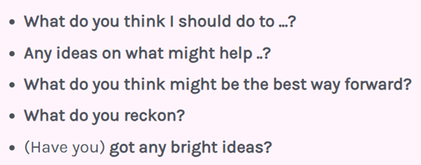

Slide 8
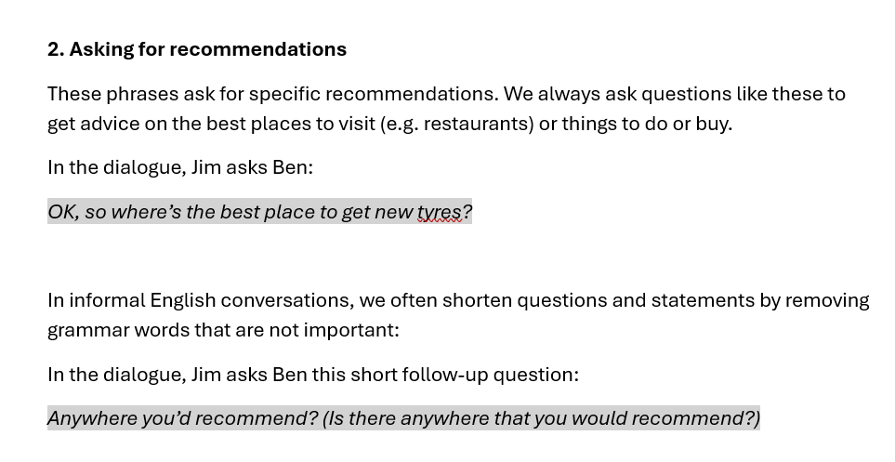

Slide 9
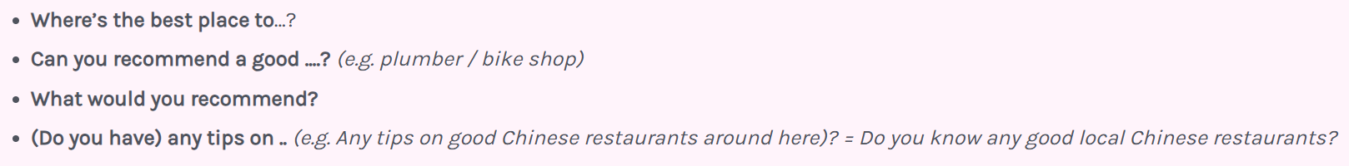
Here are a few more ways to ask for specific recommendations for different things:

Slide 10
Phrases for suggesting, recommending and warning
These phrases are commonly used when giving suggestions and recommendations. Each one can help you politely share your ideas.
1. Gentle suggestions
Gentle suggestions polite ways to suggest useful ideas. We often use modals like "might" and "could" when making gentle suggestions.
Ben uses the phrase "It's probably best to" to give gentle advice:
Well, it’s probably best to have a look online and see what you can find.
Ben also says:
It might also be worth getting some new tyres.

Slide 11
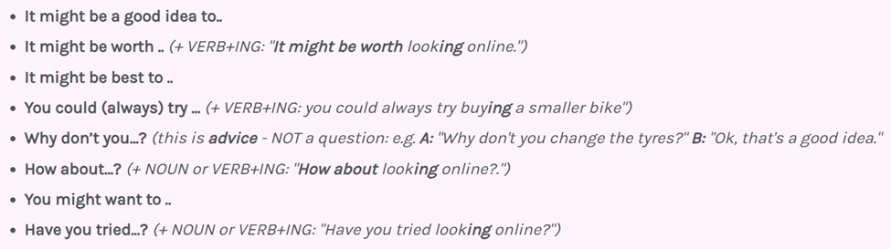
All of these other phrases are useful when you want to make gentle suggestions.

Slide 12
2. Confident recommendations
Confident recommendations are stronger than gentle suggestions. They show that you know what you're talking about!
When making confident recommendations, use 2nd Conditional expressions and phrases like "should really", and "really need to".
In the dialogue, Ben gives some confident advice about Jim's tyres. After all, Ben knows way more about tyres than Jim does!
I’d change them if I were you.

Slide 13
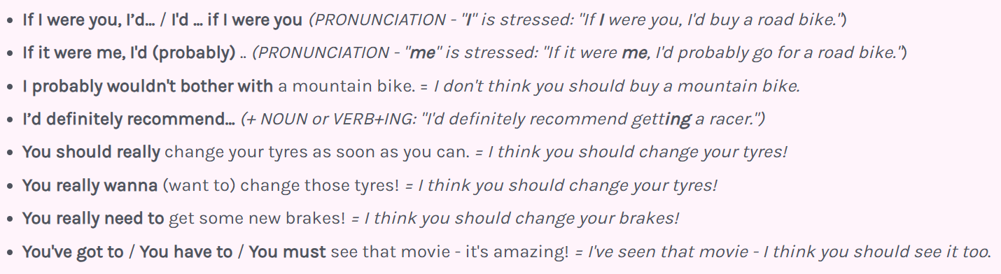

Slide 14
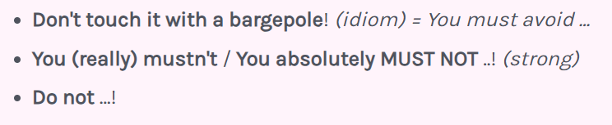
3. Warnings
These phrases are for giving strong advice or warnings. We use these kinds of phrase to tell people NOT to do things.
In the dialogue, Ben says "Whatever you do, don't.." to warn Jim not to do something:
Whatever you do, don’t let your tyres go soft.
Here are some more phrases that warn or offer very strong advice:

Slide 15
Advice phrases: useful patterns and collocations
Words like "recommend", "suggest" and "warn" follow different patterns in English. These common patterns and examples will help you remember how to use these advice words in the right way!

Slide 16
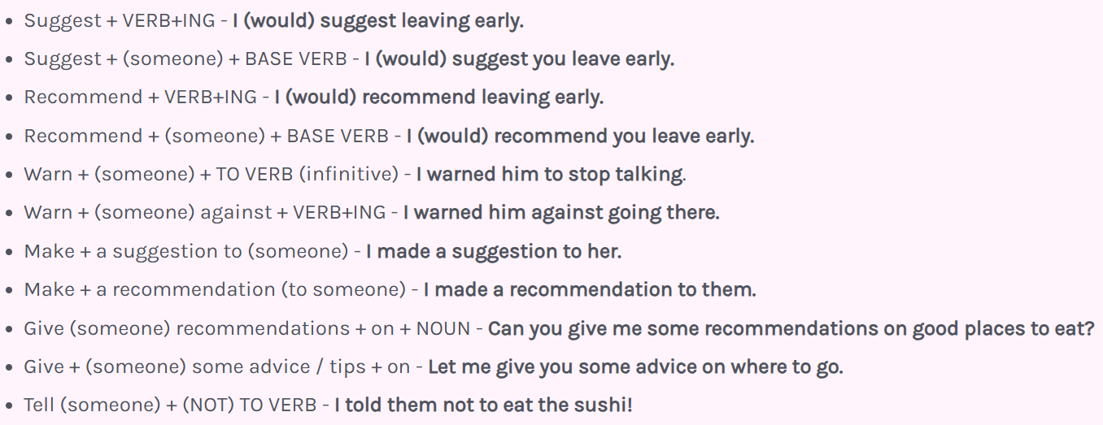

Slide 17
Asking for and giving advice: dialogue transcript
Try to follow the transcript while you're listening to the dialogue. This will help you pick up each speaker's stress, intonation and timing

Slide 18
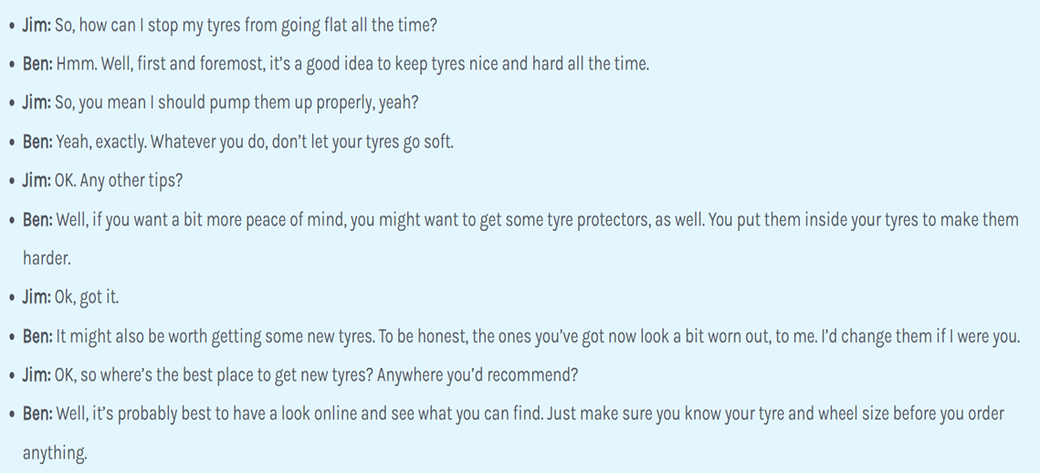

Slide 19
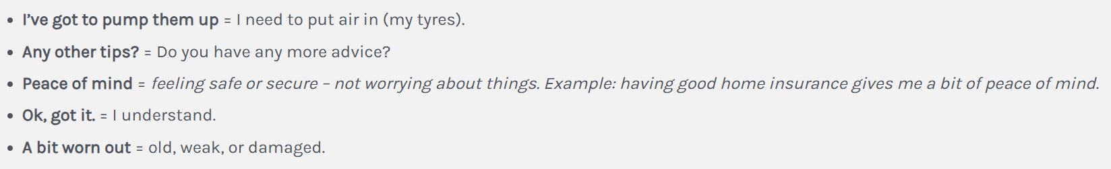
Extra vocabulary from the dialogue

Slide 20
Listening Exercise
Listen to the audio and put these actions in the correct chronological order.
Write 1 for the first action, 2 for the second, and so forth.

Slide 21
Fill out application
Submit application
Get references
Pay a deposit
Receive notification of apartment
Sign lease
Leopold Mozart published a book.
Wolfgang Mozart began to compose music.
Leopold began taking Wolfgang on tours of Europe.
Wolfgang Mozart settled in Vienna.
Wolfgang's mother died.

Slide 22
Left home
Had picnic
Made sandwiches
Went swimming
Checked into motel
Find partner
Choose topic
Get professor's approval
Design research
Start research

Slide 23
Walk through rose garden
Show tickets
View pond area
Visit greenhouse
Photograph butterfly garden

Slide 24
