Slide 1

Reading

Slide 2

Reading methods

Slide 3
Skimming

Slide 4
Skimming
Skimming In order to skim through a text quickly and efficiently one must know where to look for the main information. Procedures for skimming or rapid reading: How to Skim: 1. Read titles, headings, subheadings and any other typographical indicators of important ideas (such as word in italics or in darken print). 2. Does the first paragraph include a preview or an organizational structure for the information that is to follow? If it does, read it! 3. Read the first sentences of paragraphs. 4. Look at illustrations and read captions under pictures. 5. Note numbers, dates and words that seem to standout. 6. Note any organizational or structural clue words, such as first, second, in addition and finally

Slide 5
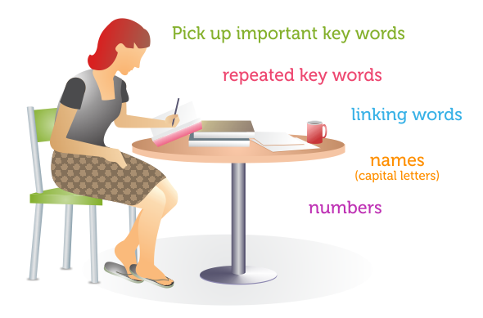
Scanning
Scanning a text or part(s) of a text for: 1. Specific information 2. Specific parts of text 3. Specific data recorded in non-verbal forms eg. diagrams, graphs, etc. Procedure for Scanning: 1. Keep in mind only the specific information to be located. 2. Decide which clues will help to find the required information. 3. Move your eyes quickly as possible down the page to find the clues. 4. Read the section containing the clues to get information.

Slide 6
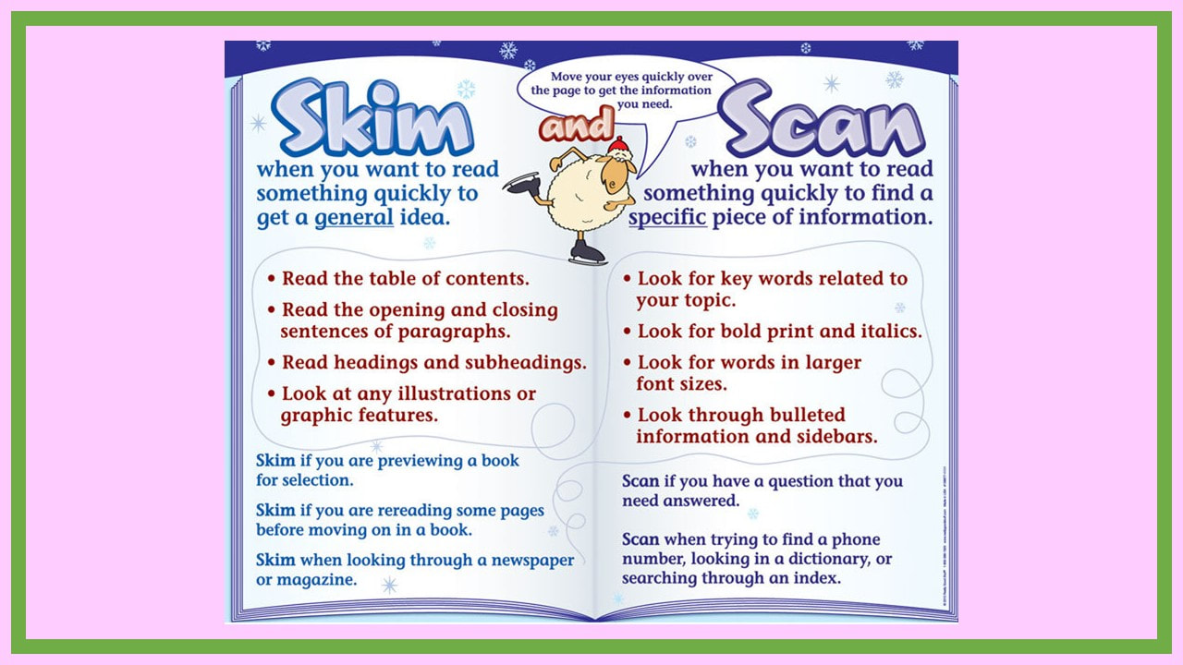

Contrast skimming and scanning

Slide 7
Improving Reading Speed

Slide 8

Word Recognition Exercise: Same Words
Activity 1: Directions: Read text 1 as quickly as possible. Mark all of the words in a line that are the same as the key word. The first one has been done for you.

Slide 9

Word recognition

Slide 10

Activity 2: Word-Recognition Exercise: Synonyms Directions: Read text 2 as quickly as possible, Mark all the words in a line that are the same or a similar meaning as the key word. The first one has been done for you.

Slide 11

Activity 3: Word-Recognition Exercise: Antonyms Directions: Read text 3 as quickly as possible. Mark all the words in line that have meanings which are opposite of that of the key word. The first one has been done for you.

Slide 12
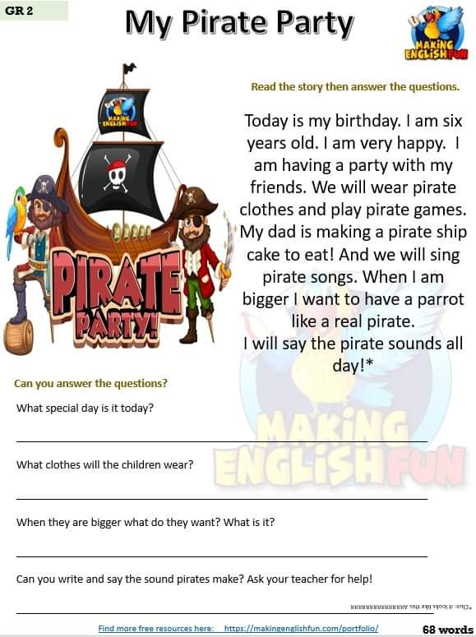

Slide 13
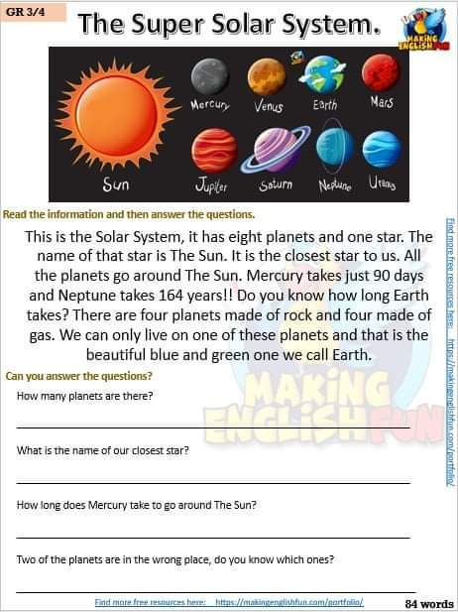

Slide 14
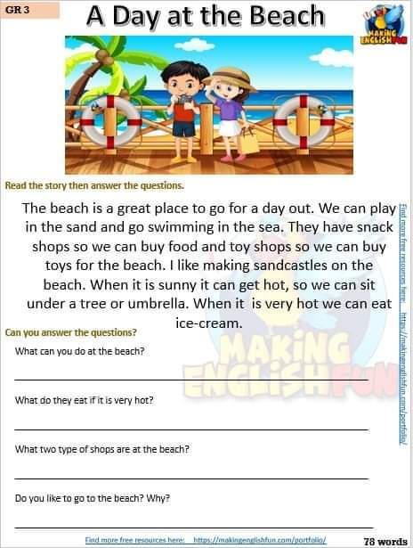

Slide 15

Writing

Slide 16

Types of Essay Writing
As a writer when you get command over processes involved in writing, one should be clear about what kind of writing is needed according to the topic. There are various types of essays and a writer can choose which is required accordingly

Slide 17

Types of Essay Writing
1. Descriptive writing (Only description of objects places, persons and process)
2. Narrative writing (Composition or story having events and characters, little facts with self created exploitation)
3. Expository writing (Essay or report based on facts and opinions)
4. Argumentative or Persuasive writing (Essay having opinion depends on the arguments and reasons)
5. Analytical writing (Comparison and contrast and assessment on the facts and results mostly after research)

Slide 18
Activity: Write an Essay on: Pollution will kill Mankind Below is a list of slogans to help you think. 1. Pollution is dangerous for human beings. 2. Pollution effects on earth and weather. 3. Pollution destroys sea life.
Try to build arguments with the help of each point. First one is done for you.
Pollution is creating alarming situation for human beings .We are facing the effects of water pollution and environmental pollution that are spoiling fresh air and food which we need to survive. As a matter of fact mankind is suffering through various pernicious diseases that are also a threat to the life of our children.
Ask the following question from yourself before developing arguments. What is the relation of problem (Pollution) to the effected (Mankind)? What are the major problems caused by that? How do they effect? What impact does it leave on mankind? What is the solution? What will the result be?

