Slide 1
Develop teamwork and unity within the team .

Slide 2
Teamwork and unity in sports teams.
The process of team sports emphasizes the role of every team member to achieve success. Team building requires an understanding of teamwork principles and team spirit. However , it's crucial to understand group processes before studying team processes in sports. Teamwork is vital in all organizations because, in addition to improving work quality, it develops knowledge, abilities, and problem-solving skills among members. Furthermore, it strengthens unity and close relationships. For example, in American football, with its large number of members, a team often consists of three smaller teams: offense, defense, and special forces. The roles in each position are different and similar, depending on the task, but the key is to lead the team to victory. Teamwork is also seen in cycling competitions, where some cyclists act as supply units, carrying food and water to teammates, or as equipment units, passing or exchanging equipment with cyclists aiming for the finish line. Similarly, in e- sports ( like the game RoV ) , each player must perform their role while simultaneously communicating and utilizing their ultimate abilities to create effective attacks.
Notes:
Create an outline to get ready:
Introduce the era (Use a mix of media and text)
Organize your artifacts to outline what life was like during the era you are presenting
Think about using a storyboard to outline your images and ideas
Make sure you prepare a clear and well rounded presentation of all aspects of the era (People, jobs, food, transportation, etc. What else should you include so the audience feels like they have visited your era?)

Slide 3
Preparing a team for success is a multidimensional process involving the sociology of sports, stemming from the values and perspectives of the group or society. Direct and indirect frameworks are crucial components in team preparation, contributing to the development of individual and team potential through consistent and long-term training. Maintaining motivation and stimulating a positive mental and physical state is not solely the responsibility of the athletes; it also involves significant direct and indirect support from those around them.

Slide 4
Unity in sports teams
Unity is a crucial factor in team sports ( Leo et al., 2010). Unity is the social link between individuals to achieve a set goal, derived from the Latin word “ Cohaerere ” meaning to unite ( Moran, 2004). There are many definitions of unity, but Bollen … Bollen and Hoyle ( 1990) explained it as follows: “The individual's feeling of being part of a group and the feeling of morale in being a member of the group,” where team unity is related to team performance ( Carron et al., 2002) . Kremmer Morran Walker Kremer et al. ( 2012) defined unity as a group process in which individuals come together as a cohesive group to pursue common goals. Similarly, Beauchamp and Eys ( 2007 ) defined unity as the group's achievement in working together.

Slide 5
Group cohesion refers to the strong bond that members have with a group . As long as group members feel that the group remains attractive to them, they will remain cohesive, committed, and regularly participate in activities. Generally, if athletes feel strong and positive relationships with their teammates and coaches, team cohesion will fundamentally be higher. Cohesion is the feeling athletes have about being on a team. Conversely, if a group can no longer attract its members, members will disregard their relationships with each other, causing respect to fade and disappear. The group will then lose its power or influence in controlling its members. Therefore, cohesion can be said to be the result of combining forces to accomplish a specific task according to the group's objectives, with harmony, without conflict, and with the common good as the priority. Yalom ( 1995 ) explains that working together as a group is about building bonds and attraction among group members so that athletes can participate in teamwork. Cohesion is a very complex matter, and there are principles that coaches should be aware of regarding teamwork, as follows:

Slide 6
1. Types of Teamwork: Teamwork is all about what the athletes do. Coaches who use a more technically focused coaching approach tend to develop higher levels of teamwork because they emphasize the actual skill requirements of the sport. While task teamwork involves what the athletes do, social teamwork focuses more on the athletes themselves. Winning is the fundamental objective of all sports, and every coach's job is to put their team in the best possible position to achieve victory. Coaches can increase the chances of winning by fostering teamwork as a whole ( Carron et al., 2002).

Slide 7
2. Factors Affecting Team Unity Numerous factors influence team unity ( Carron et al., 1985), including environmental factors such as social and physical characteristics.
Personal factors, such as personality.
Team factors , such as norms.
Leadership factors such as style of doing things.
Environmental factors such as social characteristics.

Slide 8
example
In e -sports , especially ROV , each player assumes an avatar of a character with unique abilities and roles. For example, Toro's role is to protect their teammates, minimizing the damage they receive from the opponent so that others can retaliate effectively. Furthermore, each position must understand their assigned role. Some players aim for the last-man attack to create an advantage and lead to victory. Therefore, teamwork requires understanding each player's role and performing to the best of their ability. Ultimately, victory comes from the cooperation and teamwork of the entire team.

Slide 9



Characteristics of an effective team.
Accepting the leader.
Being an appropriate follower.
Team commitment
Realizing success
Collaboration
Good team management
Neutrality
Create a strong team dig.
Positive team relationships

Slide 10
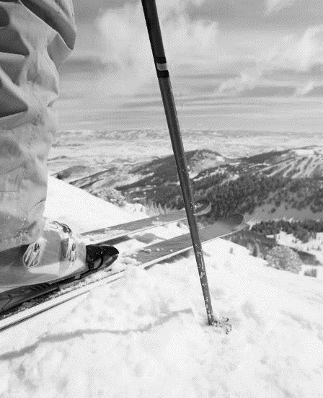
Guidelines for building an effective team.
1. Analyze the nature of the team and its needs.
2. All athletes should share responsibility for the performance of other athletes. Coaches should allow athletes to participate in training in positions they don't play, so they can see the importance of other positions within the team.
3. Coaches should know their athletes and be aware of their personal lives in order to understand them better.
4. It fosters pride within both individual and larger groups (teams), leading to positive feelings among athletes towards themselves and their team, thus energizing them to fight and pursue team goals and achieve success.
5. Develop a sense of teamwork. Foster a sense of belonging and loyalty to the team, making athletes feel loved and considered a part of it. This will motivate all athletes to train and compete to the best of their abilities.
6. Establish a shared team goal. Whether it's a team sport or an individual sport, creating a shared purpose helps to motivate and challenge the team.
7. Each athlete must understand their role and believe that everyone is important to the team's success.

Slide 11
THANK YOU

