Slide 1
Funds Analysis, Cash-Flow Analysis, and Financial Plan
Lesson 8

Slide 2
Objectives
Explain the difference between the flow of funds (sources and uses of funds) statement and the statement of cash flows – and understand the benefits of using each.
Define “funds,” and identify sources and uses of funds.
Create a sources and uses of funds statement, make adjustments, and analyze the final results.
Describe the purpose and content of the statement of cash flows as well as implications that can be drawn from it.
Prepare a cash budget from forecasts of sales,receipts, and disbursements – and know why such a budget should be flexible.
Develop forecasted balance sheets and income statements.
Understand the importance of using probabilistic information forecasting financial statements and evaluating a firm’s condition.

Slide 3
“Forecasting is very difficult, especially if it is about the future.”

Slide 4
Flow of Funds (Sources and Uses) Statement
Flow of funds statement is A summary of a firm’s changes in financial position from one period to another; it is also called a sources and uses of funds statement or a statement of changes in financial position.
example, gross changes might be thought to include all changes that occur between two statement dates, rather than the sum of these changes – the net change as defined. Although an analysis of the gross funds flow of a firm over time would be much more revealing than an analysis of net funds flow, we are usually constrained by the financial information available – namely, the basic financial statements

Slide 5
What Are Sources? Uses?

Slide 6
example, a reduction in inventory (an asset) would be a source of funds, as would an increase in short-term loans (a claim). An increase in accounts receivable (assets) would be a use of funds, and a reduction in shareholders’ equity (claims) – through, for example, a share repurchase – would also be a use of funds.

Slide 9
Accounting Statement of Cash Flows
Statement of cash flows A summary of a firm’s cash receipts and cash payments during a period of time
When used with the information contained in the other two basic financial statements and their related disclosures, it should help the financial manager to assess and identify
a company’s ability to generate future net cash inflows from operations to pay debts,interest, and dividends
a company’s need for external financing
the reasons for differences between net income and net cash flow from operating activities
the effects of cash and noncash investing and financing transactions.

Slide 10
Analyzing the Statement of Cash Flows
Implications of Cash Flow Statement Analysis. A major benefit of the statement of cash flows (especially under the direct method) is that the user gets a reasonably detailed picture of a company’s operating, investing, and financing transactions involving cash. This three part breakdown of cash flow aids the user in assessing the company’s current and potential future strengths and weaknesses. Strong internal generation of operating cash, over time,would be considered a positive sign. Poor operating cash flow should prompt the analyst to check for unhealthy growth in receivables and/or inventory

Slide 11
Question
The signs (positive or negative) of a firm’s net cash provided (used) by operating,investing, and financing activities form a particular cash-flow pattern. What type of pattern(s) should we “generally” expect to find

Slide 12
Answer
For a healthy, growing firm “generally” expect:
Positive cash flow from operating activities;
Negative cash flow from investing activities;
Positive or negative cash flow from financing activities (which may move back and
forth over time)

Slide 13
Cash-Flow Forecasting
Dot-com A company with a strong Internet presence that conducts much or all of its business through its website. The name itself refers to the period (dot) followed by the abbreviation of the commercial domain (.com) at the end of an e-mail or web address; also called dotcom or dot.com
Cash budget A forecast of a firm’s future cash flows arising from collections and disbursements, usually on a monthly basis.

Slide 14
The Sales Forecast
The key to the accuracy of most cash budgets is the sales forecast. This forecast can be based on an internal analysis, an external one, or both. With an internal approach, sales representatives are asked to project sales for the forthcoming period. The product sales managers screen these estimates and consolidate them into sales estimates for product lines. The estimates for the various product lines are then combined into an overall sales estimate for the firm. The basic problem with an internal approach is that it can be too myopic. Often, significant trends in the economy and in the industry are overlooked.
For this reason, many companies use an external analysis as well. With an external approach, economic analysts make forecasts of the economy and of industry sales for several years to come.

Slide 15
Collections and Other Cash Receipts
The sales forecast out of the way, the next job is to determine the cash receipts from these sales. For cash sales, cash is received at the time of the sale; for credit sales, the receipts come later. How much later depends on the billing terms, the type of customer, and the credit and collection policies of the firm

Slide 16
example
. Pacific Jams Company offers terms of “net 30,” meaning that payment is due within 30 days after the invoice date. Also assume that, in the company’s experience, an average of 90 percent of receivables are collected one month from the date of sale and the remaining 10 percent are collected two months from sale date if no bad-debt losses occur. Moreover, on the average, 10 percent of total sales are cash sales.

Slide 18
Net Cash Flow and Cash Balance
Once we are satisfied that we have taken all foreseeable cash inflows and outflows into account, we combine the cash receipts and disbursements schedules to obtain the net cash inflow or outflow for each month.

Slide 19
example
The cash budget shown there indicates that the firm is expected to have a cash deficit in April and May. These deficits are caused by a decline in collections through March

Slide 20
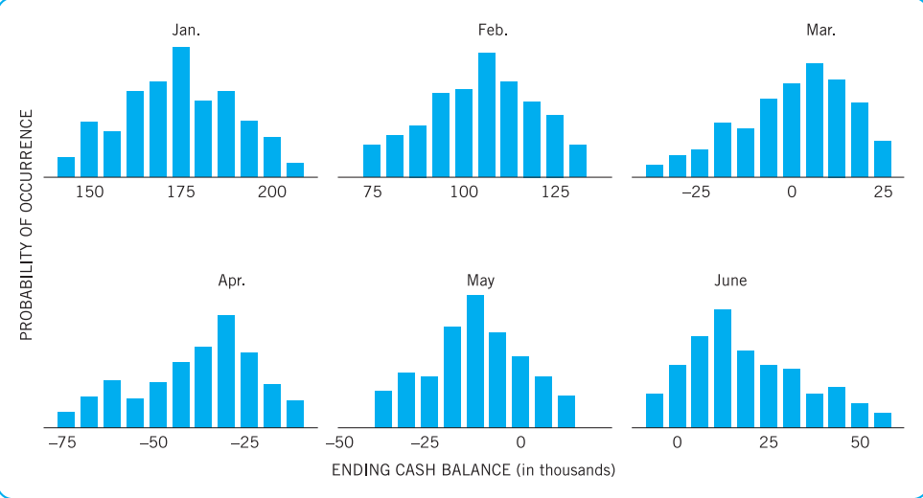
Deviations from Expected Cash Flows
The final product might be a series of distributions of end-of-month cash without additional financing

Slide 21
Forecasting Financial Statements
Forecast financial statements is Expected future financial statements based on conditions that management expects to exist and actions it expects to take.
Forecast Income Statement
Forecast Balance Sheet
Use of Ratios and Implications

Slide 22
Questions
1. Contrast flow of funds (sources and uses) statements with cash budgets as planning tools.
2. What is the purpose of a statement of cash flows?
3. In constructing a cash budget, which variable is most important in order to arrive at accurate projections? Explain.
4. Discuss the benefits that can be derived by the firm from cash budgeting.
5. Explain why a decrease in cash constitutes a source of funds while an increase in cash is a use of funds in the sources and uses of funds statement.
6. Explain why selling inventory to credit customers is considered a source of funds when in fact no “funds” were generated.
7. Why do most audited financial reports to the shareholders include a statement of cash flows in addition to the balance sheet and income statement?

