Slide 1
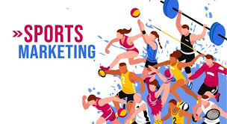
Sports Marketing
Master’s Degree in Sports Management

Slide 2
Course Description
This course focuses on developing knowledge and marketing skills related to the sports industry. Students will study marketing strategies, sports brand analysis, consumer behavior, and the application of digital technology in the sports sector. The course emphasizes applying marketing theories and approaches to create value and sustainability in the sports market.

Slide 3
Course Objectives
To develop an understanding of marketing strategies in the sports industry.
To enable students to analyze sports brands and consumer behavior in the sports market.
To enhance skills in creating digital marketing strategies and managing sports marketing campaigns.
To study methods for building relationships with sponsors and partners in the sports industry.

Slide 4

Course Structure
Module 1: Fundamentals of Sports Marketing
Concepts and importance of sports marketing.
Market and sports brand analysis.

Slide 5
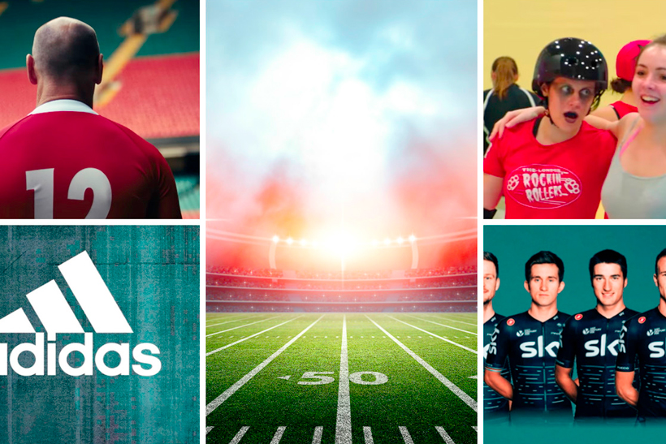
Course Structure
Module 2: Consumer Behavior in the Sports Market
Factors influencing consumer decision-making.
Creating valuable experiences for sports fans.

Slide 6

Course Structure
Module 3: Digital Marketing in the Sports Industry
Using social media and digital platforms.
Data analysis for sports marketing.

Slide 7

Course Structure
Module 4: Managing Sports Sponsors and Partnerships
Strategies for building relationships with sponsors.
Long-term relationship management in the sports industry.

Slide 8

Course Structure
Module 5: Measuring and Evaluating Sports Marketing Success
Defining Key Performance Indicators (KPIs).
Evaluating ROI of sports marketing campaigns.

