Slide 1
Chapter 4: Directions
Choose the correct response.

Slide 2
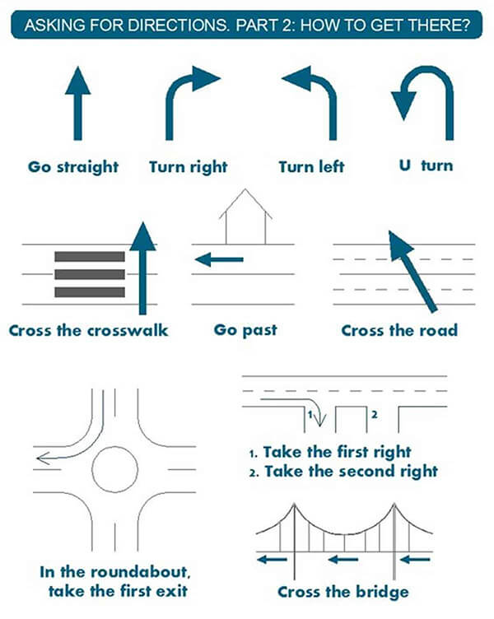

Slide 3
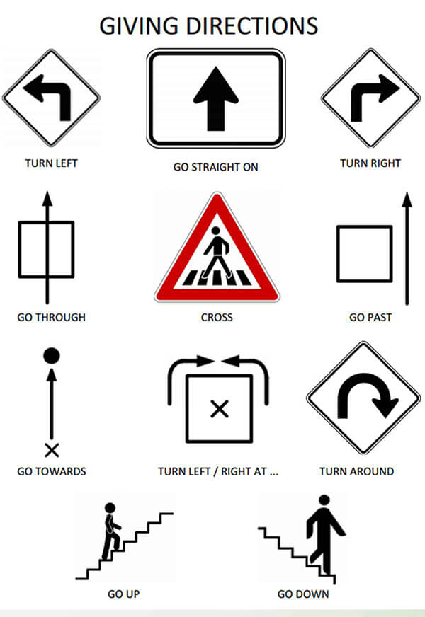

Slide 4
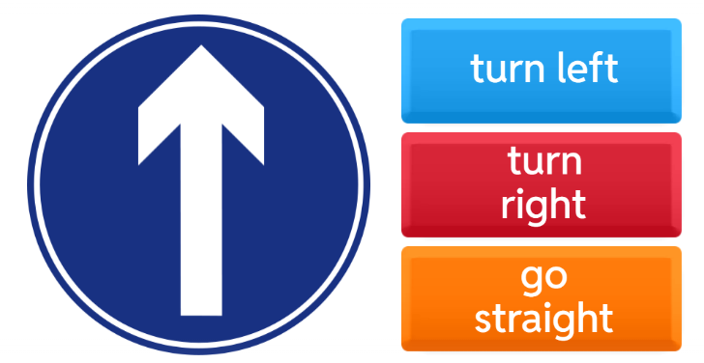

Slide 5
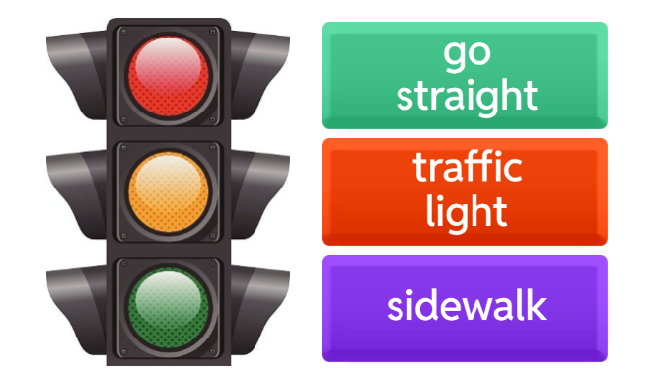

Slide 6
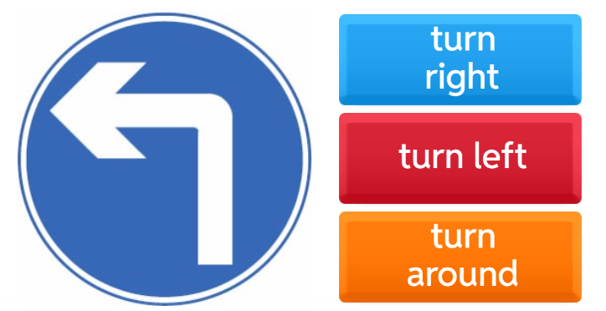

Slide 7
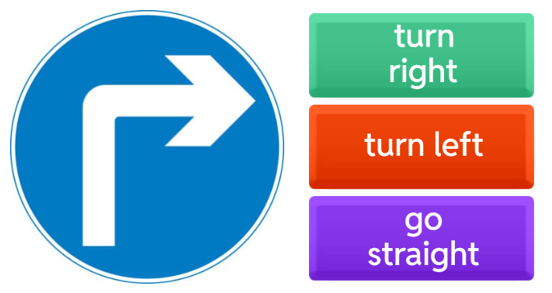

Slide 8
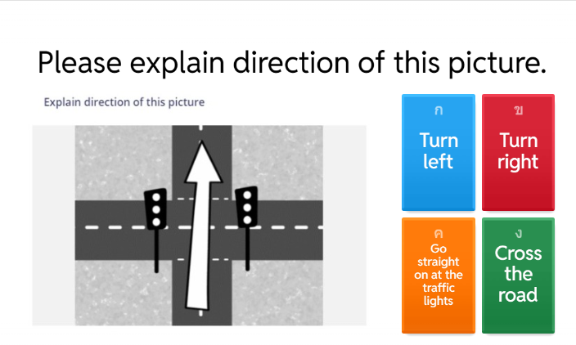

Slide 9
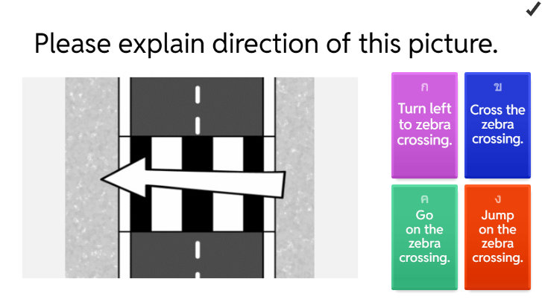

Slide 10
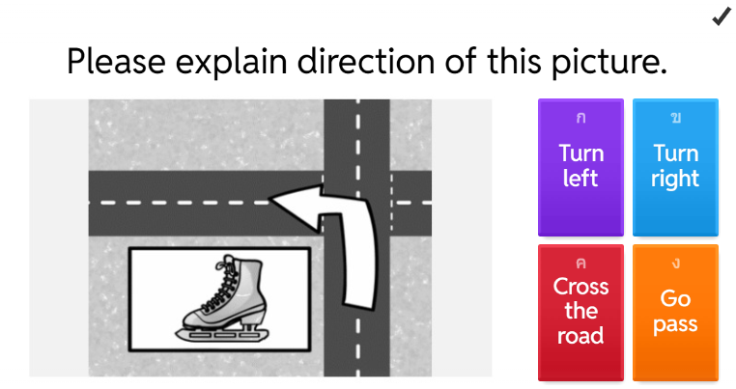

Slide 11
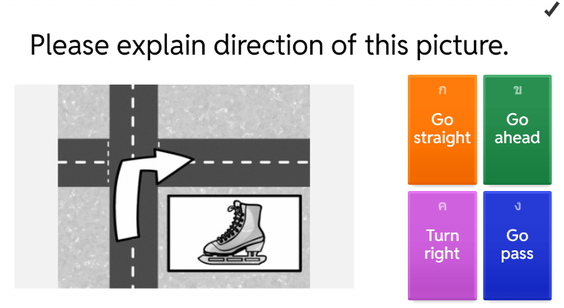

Slide 12
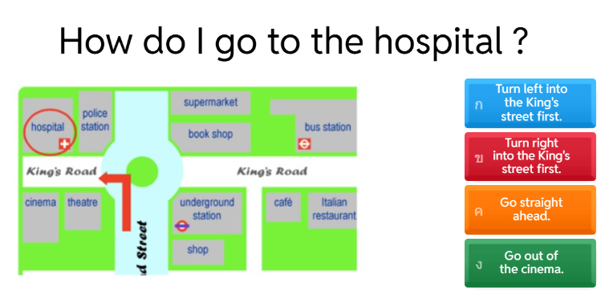

Slide 13
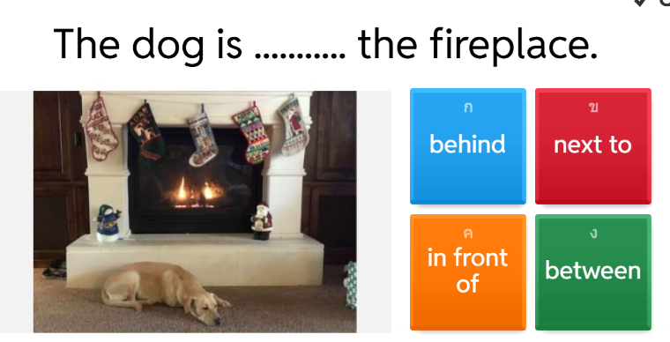

Slide 14
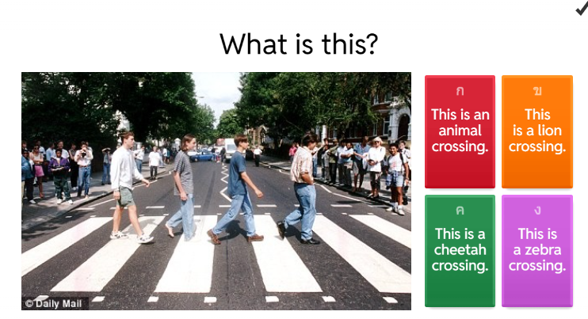

Slide 15
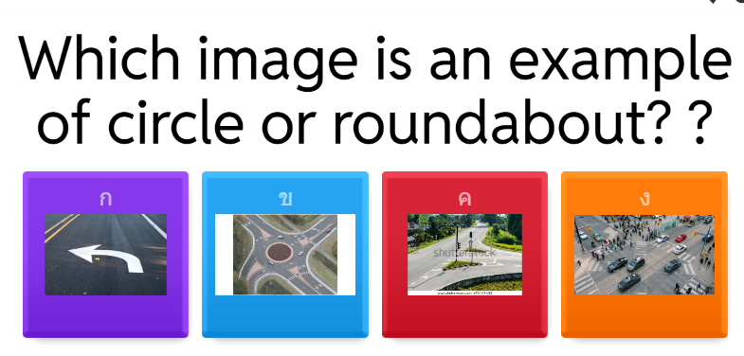

Slide 16
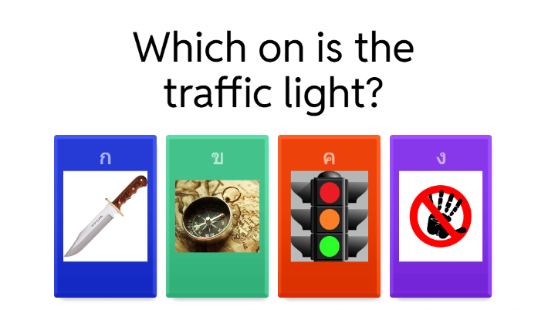

Slide 17
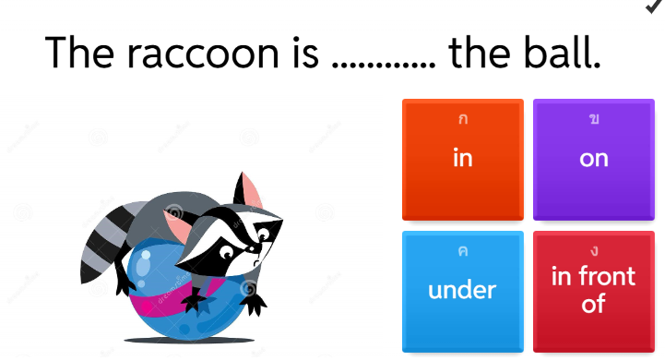

Slide 18
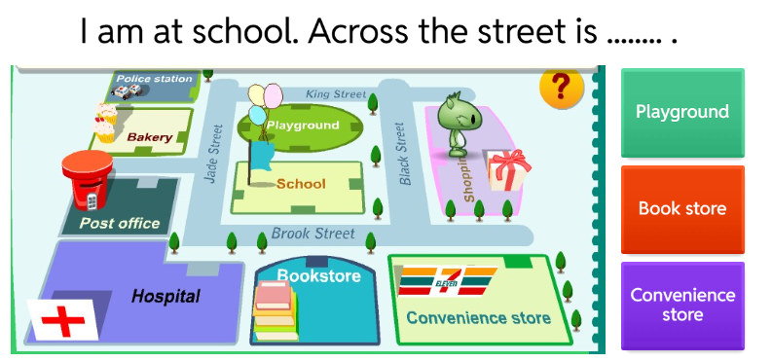

Slide 19
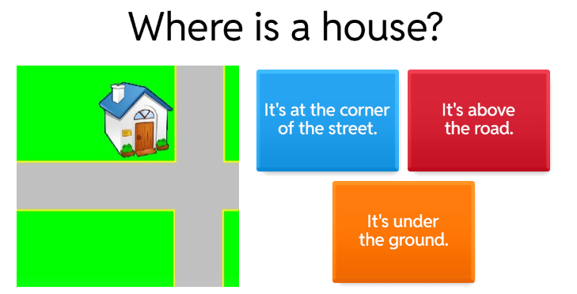

Slide 20
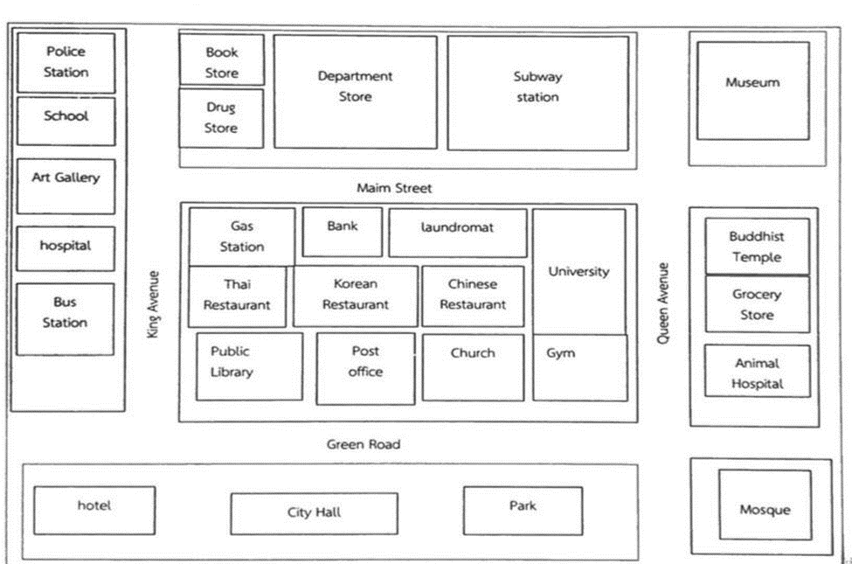
Question 1
Look at the map. Where is the book store?
a. It’s opposite the department store. b. It’s opposite the police station. c. It’s opposite the drug store. d. It’s opposite the gas station.

Slide 21
Question 2
Look at the map. Where is the drug store?
a. It’s at the corner of Queen Avenue and Main Street. b. It’s at the corner of Green Road and Queen Avenue. c. It’s at the corner of King Avenue and Green Road. d. It’s at the corner of Main Street and King Avenue.

Slide 22
Question 3
Look at the map. Where is the hospital?
a. It’s between the mosque and the City Hall. b. It’s between the Art Gallery and the bus station. c. It’s between the gas station and the Thai restaurant. d. It’s between the Thai restaurant and the Chinese restaurant.

Slide 23
Question 4
Look at the map. Where is the public library?
a. It’s at the corner of Queen Avenue and Main Street. b. It’s at the corner of Green Road and Queen Avenue. c. It’s at the corner of King Avenue and Green Road. d. It’s at the corner of Main Street and King Avenue.

Slide 24
Question 5
Look at the map. Where is the gym?
a. It’s at the corner of Queen Avenue and Main Street. b. It’s at the corner of Green Road and Queen Avenue. c. It’s at the corner of King Avenue and Green Road. d. It’s at the corner of Main Street and King Avenue.

Slide 25
Question 6
Look at the map. Where is the subway station?
a. It’s at the corner of Queen Avenue and Main Street. b. It’s at the corner of Green Road and Queen Avenue. c. It’s at the corner of King Avenue and Green Road. d. It’s at the corner of Main Street and King Avenue.

Slide 26
Question 7
Look at the map. Where is the museum?
a. It’s behind the church. b. It’s next to the mosques. c. It’s opposite the subway station. d. It’s at the corner of Main Street and King Avenue.

Slide 27

Question 8
Look at the map.
Directions: You are the local person of this town and want to help a visitor to get to the place he wants to go.
A visitor: Excuse me. How do I get to the hospital?
You: _______________________ (นักศึกษาตอบโดยดูในแผนที่จุดเริ่มต้นอยู่ที่ ✗ You are here.)
a. Go straight on Green Road around two blocks. Turn right at King Avenue. The hospital is on your left hand. b. Go straight on Green Road around two blocks. Turn right at King Avenue. The hospital is on your right hand. c. Go straight on Queen Avenue around two blocks. The hospital is on your left hand. d. Go straight on Queen Avenue around two blocks. The hospital is on your right hand.

Slide 28
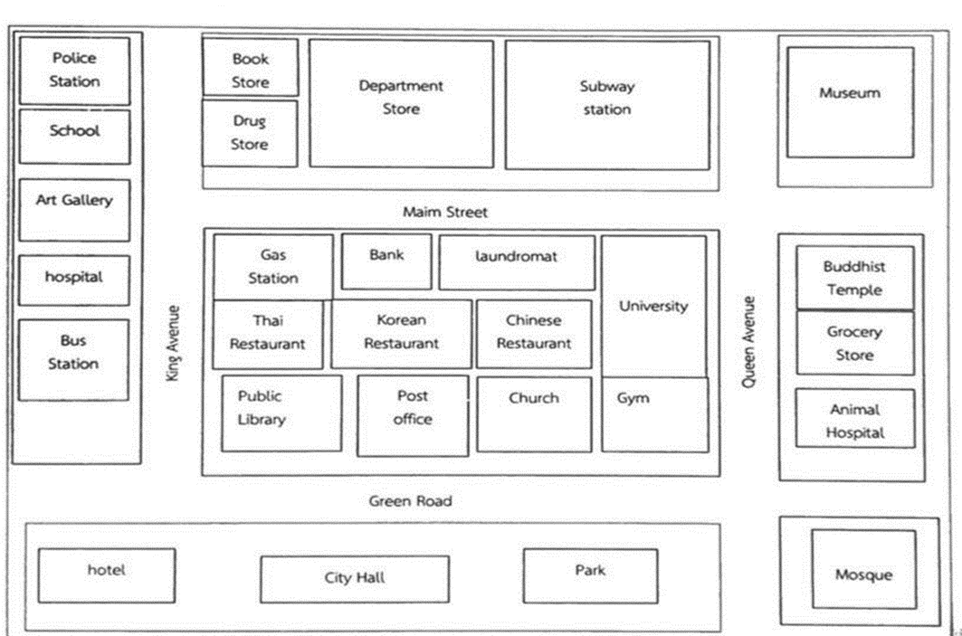

Question 9
Directions: You are the local person of this town and want to help a visitor to get to the place he wants to go.
A visitor: Excuse me. How do I get to the museum?
You: _______________________ (นักศึกษาตอบโดยดูในแผนที่จุดเริ่มต้นอยู่ที่ ✗ You are here.)
a. Go straight on Green Road around two blocks. The museum is on your left hand. b. Go straight on Green Road around two blocks. The museum is on your right hand. c. Go straight on Queen Avenue around two blocks. The museum is on your left hand. d. Go straight on Queen Avenue around two blocks. The museum is on your right hand.

Slide 29

Question 10
Directions: You are the local person of this town and want to help a visitor to get to the place he wants to go.
A visitor: Excuse me. How do I get to the subway station?
You: _______________________ (นักศึกษาตอบโดยดูในแผนที่จุดเริ่มต้นอยู่ที่ ✗ You are here.)
a. Go straight on Green Road around two blocks. The subway station is on your left hand. b. Go straight on Green Road around two blocks. The subway station is on your right hand. c. Go straight on Queen Avenue around two blocks. The subway station is on your left hand. d. Go straight on Queen Avenue around two blocks. The subway station is on your right hand.

Slide 30
Question 11
Look at the map.
Directions: You are the local person of this town and want to help a visitor to get to the place he wants to go.
A visitor: Excuse me. How do I get to the police station?
You: _______________________ (นักศึกษาตอบโดยดูในแผนที่จุดเริ่มต้นอยู่ที่ ✗ You are here.)
a. Go straight on Green Road around two blocks. Turn right at King Avenue. The police station is next to the school. b. Go straight on Green Road around two blocks. Turn right at King Avenue. The police station is next to the Art Gallery. c. Go straight on Green Road around two blocks. Turn right at King Avenue. The police station is next to the hospital. d. Go straight on Green Road around two blocks. Turn right at King Avenue. The police station is next to the bus station.

Slide 31
Question 12
A visitor: Excuse me. How do I get to the subway station?
You: _______________________ (นักศึกษาตอบโดยดูในแผนที่จุดเริ่มต้นอยู่ที่ ✗ You are here.)
a. Go straight on King Avenue. Turn left at the gas station. The subway station is on your left hand. b. Go straight on King Avenue. Turn left at the gas station. The subway station is on your right hand. c. Go straight on Green Road. Turn left at the gym. The subway station is on your left hand. d. Go straight on Green Road. Turn left at the gym. The subway station is on your right hand.

Slide 32

Question 13
Look at the map.
Directions: You are the local person of this town and want to help a visitor to get to the place he wants to go.
A visitor: Excuse me. How do I get to the police station?
You: _______________________ (นักศึกษาตอบโดยดูในแผนที่จุดเริ่มต้นอยู่ที่ ✗ You are here.)
a. Go straight on King Avenue. The police station is next to the school opposite the Art Gallery. b. Go straight on King Avenue. The police station is next to the school opposite the drug store. c. Go straight on King Avenue. The police station is next to the school opposite the book store. d. Go straight on King Avenue. The police station is next to the school opposite the department store.

Slide 33
Question 14
Look at the map.
Directions: You are the local person of this town and want to help a visitor to get to the place he wants to go.
A visitor: Excuse me. How do I get to the City Hall?
You: _______________________ (นักศึกษาตอบโดยดูในแผนที่จุดเริ่มต้นอยู่ที่ ✗ You are here.)
a. Go straight on Queen Avenue. Turn right at the gym. Go along Green Road. The City Hall is next to the mosque. b. Go straight on Queen Avenue. Turn right at the gym. Go along Green Road. The City Hall is next to the Park. c. Go straight on Queen Avenue. Turn right at the gym. Go along Green Road. The City Hall is next to the post office. d. Go straight on Queen Avenue. Turn right at the gym. Go along Green Road. The City Hall is next to the public library.

Slide 34

Question 15
Look at the map.
Directions: You are the local person of this town and want to help a visitor to get to the place he wants to go.
A visitor: Excuse me. How do I get to the public library?
You: _______________________ (นักศึกษาตอบโดยดูในแผนที่จุดเริ่มต้นอยู่ที่ ✗ You are here.)
a. Go straight on Main Street. Turn right at the gas station. Go along King Avenue. The public library is on your left hand. b. Go straight on Main Street. Turn right at the gas station. Go along King Avenue. The public library is on your left hand. c. Go straight on Main Street. Turn left at the gas station. Go along King Avenue. The public library is on your right hand. d. Go straight on Main Street. Turn left at the gas station. Go along King Avenue. The public library is on your left hand.

