Slide 1
Strategic Management
Dr. ( Prof. ) Natha Yuwanthayakun​​
Suan Sunandha Rajabhat University​
College of Innovation and Management, Bachelor of Business Administration ( Bilingual Program )

Slide 2
Strategic Management
strategy
Strategic Management
The importance of strategic management.
The process of business strategy.
Levels of business strategy

Slide 3
strategy
Senior executives , as leaders and decision-makers in the future of organizations , constantly face diverse environmental challenges. They must be able to guide their organizations through rapidly evolving and varied environments, which sometimes result in ambiguous, incomplete, uncertain, and unstructured problems. Furthermore, they must respond to opportunities and problems under constraints and pressures of circumstances and time. Decision-making in each problem requires careful consideration, analysis , and forecasting . Senior executive decisions directly impact the success or failure of the organization's operations. Therefore, strategic management is a crucial activity that executives must support and implement to ensure the survival and sustainable growth of their business in the future.

Slide 4
Furthermore, the intense business competition and volatile situations in many industries necessitate that personnel at all levels understand the organization 's strategic direction in order to perform their duties effectively and meet the needs of management. As Sanoh Tiyaw (2003) stated , "In any industrial business organization, its managers and employees must have the knowledge, understanding, and ability to determine strategies and implement them correctly and in accordance with changing circumstances."

Slide 5
Strategic Management
In the current environment of rapid, drastic, and uncertain changes in the business world, strategic management has become increasingly crucial for the survival and growth of businesses. For a business to thrive, managers must possess the ability and understanding to adapt and seize opportunities arising from changes in the business environment appropriately. As leaders , managers must be able to set direction and guide the organization effectively towards its desired goals. Therefore, strategic management is a vital task for managers in every organization . The term "strategic management " refers to this crucial aspect of business operations.

Slide 6
Pakphachong Wattanasin (1998) stated that “ Strategic management refers to management that emphasizes the importance of the environment that affects internal management, which requires preparing action plans that are appropriate to the changing environment or responding quickly to competitive conditions , and allocating resources appropriately.” Strategic management must consider the following factors:

Slide 7
Figure 1.1 Factors that strategists must consider in strategic management.
Nature of the business being operated.
strategist
Performing the tasks to achieve the objectives.
Future business characteristics
Resource allocation
environment

Slide 8
1. Nature of the business you are operating .
What is the business currently doing, in what industry , and what is its overall status?

Slide 9
2. Characteristics of future business ( Where do you want to go?)
The future needs of a business should be considered by taking into account both long-term and medium-term goals, as well as the feasibility of achieving those goals.

Slide 10
3. Environment
The state and characteristics of the environment that will influence the operation, competition, and survival of a business.

Slide 11
4. Resources Allocation
limited and varying resources. Therefore , it is necessary to prioritize and determine the importance of their use in order to maximize benefits for the organization.

Slide 12
5. Objective Achievement
Strategic management focuses on achieving various levels of organizational goals, particularly the ultimate objectives of the organization.

Slide 13
We can say that strategic management refers to the process of analyzing the business environment and key business data used in decision-making, planning operational guidelines , and controlling the strategic operations of an organization. This ensures that the organization can operate in accordance with the environment and prevailing circumstances, and can develop and compete effectively in the industry. Strategic management has two main goals:

Slide 14
1. Build and maintain competitive capacity . We see that changes in the environment require businesses to constantly adapt. Defining and implementing strategies helps businesses be prepared for change and continuously develop their competitive potential.

Slide 15
2. Creating Value : Strategic management helps create value for owners or shareholders , as well as satisfaction for business stakeholders such as employees , suppliers, and customers .

Slide 16
Figure 1.2 Goals of strategic management.
Competitiveness
Strategic Management
value

Slide 17
Currently, strategy is no longer limited to senior management. Many organizations have established strategic business units, staffed by individuals with authority and responsibility related to management. Typically , strategic managers assess the organization's capabilities and compare them to the influence of the external environment to determine the future and appropriate course of action. Especially in the current rapidly changing environment, it is crucial for organizations to adapt appropriately and continuously to these dynamics in order to create and maintain a competitive advantage.

Slide 18
The importance of strategic management.
If we observe important news on television, radio, and in business- related magazines , both domestic and international, we will find that the content concerns changes occurring and their potential impact on future business operations. Examples include investment promotion in industries, economic indicators , or trade liberalization . These reflect the importance of studying business strategy, especially in today's world of rapid change in various factors— economic, social, political, and technological—as well as the groups involved in business operations such as suppliers, customers, and competitors . These changes affect various aspects of organizational operations , including marketing, finance, production, and services, and even internal operations themselves .

Slide 19
The changes that have occurred have put pressure on organizations, both in terms of shorter response times and the increased complexity of business processes. As a result , executives need to have a broad vision and be able to make decisions about opportunities or problems they face , considering both the short-term and long-term consequences for the organization.

Slide 20
For individuals, especially those interested in studying business administration, to successfully apply the knowledge, skills, and expertise from their various fields of study in their work, a thorough understanding of strategy is necessary. Strategic management helps students integrate business knowledge and experience to fully understand the potential of a business, thereby developing well -rounded managers. Furthermore, the principles of strategic management enable managers to apply them to business operations for greater efficiency. Strategic management benefits organizations in four main ways:

Slide 21
Figure 1.4 The Importance of Strategic Management
Define the direction of the organization.
Enhance competitiveness.
Strategic Management
Create consistency.
In practice
Preparing the organization for future challenges.

Slide 22
1. Setting the Organization's Direction : The strategic management process helps executives understand changes and have a vision for the future, enabling them to define objectives and the direction of the business in a concrete way.

Slide 23
2. Creating Harmony in Practice : Strategic management focuses on defining, applying, monitoring, and controlling an organization 's strategies as a system composed of various interconnected components . This concept fosters a shared vision and understanding of objectives and business approaches, leading to unified resource allocation and operations for the greatest benefit of the organization.

Slide 24
3. Provide Readiness : Studying and analyzing the environment and defining strategies helps executives , managers in various departments, and members of the organization understand the overall picture and potential of the business, as well as the influence of environmental factors on the organization. This enables the organization to be prepared for changes or challenges that may arise.

Slide 25
4. Improve Competitive Efficiency: Strategic management helps build efficiency and competitive potential for businesses because strategic operations develop the capabilities of managers while simultaneously preparing and developing the potential of team members. It also fosters understanding and adaptation to changing environmental conditions and competitors. Importantly, strategic management helps stakeholders understand the overall picture, the organization's needs, and its current capabilities. This enables prioritization of operations and goals, leading to appropriate business operations and efficient resource utilization.

Slide 26
Strategic Management Process
It can be seen that decisions made by senior management, such as expanding production capacity , developing new products, changing business structures , increasing or decreasing capital, or withdrawing from competition, all have an impact on the operations and future of the organization . These types of decisions are called "strategic decisions, " and they form a fundamental basis of the "strategic management process, " which has the following key components:

Slide 27
Figure 1.5 Strategic Management Process
Environmental analysis
Direction setting
Strategy formulation
Implementing the strategy.
Strategic control

Slide 28
SWOT
Strengths : Advantages or strengths are results of internal factors, stemming from the company's internal environment. Examples include financial strengths, production advantages, and human resource advantages. Companies must leverage these strengths to develop marketing strategies.
Weaknesses : Disadvantages or shortcomings result from internal factors. These are problems or deficiencies arising from various internal environments of the company, such as lack of funding, inconsistent policies and direction, inconsistent service, or unqualified personnel. The company must find ways to improve or eliminate these weaknesses for its own benefit.

Slide 29
Opportunities arise from external factors, resulting from a favorable or supportive external environment for the company's operations. Opportunities differ from strengths in that opportunities stem from the external environment, while strengths result from the internal environment. Good entrepreneurs must constantly seek opportunities by analyzing the ever-changing external environment, such as the economy, society, politics, technology, and market competition, and then capitalize on those opportunities.
Threats : These arise from external factors and are limitations stemming from the external environment that negatively impact the business, such as rising oil prices, higher interest rates, and a slowing economy. Businesses need to adapt their marketing strategies accordingly and strive to overcome these obstacles.

Slide 30
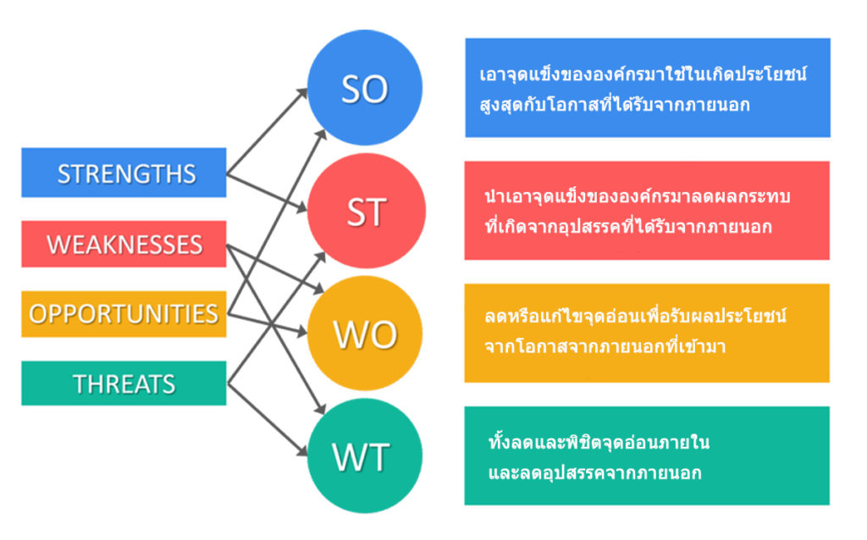

Slide 31
Marketing strategy
S
There is a new innovation.
Strong brand​
O
The market has grown tremendously.
Tax deductions
Adding factories and expanding production.

Slide 32
1. Environmental Analysis : Managers or strategists must study and analyze various factors that affect the organization's operations. This can be divided into two levels: the external environment and the internal environment . The analysis involves identifying the organization's strengths , weaknesses , opportunities , and threats , also known as a " SWOT analysis ," to determine how each factor contributes to or hinders the organization's operations.

Slide 33
2. Setting Organizational Direction : Management will process the information gathered from the analysis of opportunities and limitations to determine the strategic direction of the organization. This direction can be achieved through the establishment of the organization 's mission and goals.

Slide 34
3. Strategy Formulation refers to taking the broadly defined direction of the organization and developing it into a guideline for the organization 's future operations . Strategies are typically formulated at different levels within the organization, starting with corporate strategy, then business strategy, and finally functional strategy , which will be discussed in the next section.

Slide 35
4. Strategy Implementation refers to the concrete application of the established strategy in operations through systematic structuring of personnel and collaboration.

Slide 36
5. Strategy Evaluation and Control refers to monitoring, analyzing problems , determining improvement strategies, and developing strategies to align with the actual situation. This ensures the organization maximizes value from its operations and evaluates the effectiveness of the strategy to determine its goals. This information is then used to inform future strategy development.

Slide 37
Levels of business strategy
At these levels of business strategy, strategic management is not limited to top management but extends throughout the organization to ensure that all components of the business operate in a supportive and coordinated manner, with the business goal as the primary focus . Those responsible in each area are tasked with defining strategies, which can be categorized into three levels as follows:

Slide 38
Figure 1.6 Levels of Business Strategy
Corporate strategy
Senior executives
Business strategy
Head of Business Unit
Functional level strategies
Department Manager

Slide 39
1. Corporate strategy is determined by the organization's senior management, such as the Managing Director , President , or Chief Executive Officer (CEO), in collaboration with the executive team and strategic advisors. This involves anticipating future situations and needs to define the organization's vision , mission , and objectives or goals. Corporate strategy serves as the core business strategy, acting as a template and guideline for defining strategies and planning at other levels.

Slide 40
2. Business strategy is determined by managers or executives who head business units ( BUs ) with autonomy and responsibility for their own operations. Their goal is to create competitive advantages for their business unit. Typically, business-level strategies involve competition and are sometimes referred to as "competitive strategy ."

Slide 41
3. Functional Strategy : This is determined by managers in each business function, such as production, finance, marketing, and human resources. It focuses on the efficient and effective use of organizational resources and aligns with organizational and business-level strategies.

Slide 42
2 km
bathroom

