Slide 1

Course Code: PIM9104
Knowledge-based Economy Social Management
Instructor: Assoc. Prof. Dr. Kuncharee Kakhai
Management Innovation Program, College of Innovation and Management,
Suan Sunandha Rajabhat University Semester 1, Academic Year 2025

Slide 2
Course Description
Theories and principles of knowledge-based economic society and development directions of the country; Principal pillars of knowledge-based economic society; Knowledge management; Educational Management and Training; Creativity and critical thinking and open innovation; Assessment of the state of knowledge-based economic society; Case studies from foreign countries and in the country.

Slide 3
Course Objectives: After completing the study, students will be able to
1.Design a model for the development of a knowledge-based economy
by integrating theories, principles of knowledge management, education, innovation, creativity, and case studies to be consistent with the current and future contexts of the country.
2. Develop strategic practices to promote a knowledge-based economy at the organizational or national level by using creative work skills, integrating knowledge, technology, knowledge management, and stakeholder participation.
3. Demonstrate values ​​and ethics in the process of developing a knowledge-based economy, focusing on public benefits, sustainability, transparency, and social responsibility, and convey such concepts into real-life practice or professional roles.
4. Develop characteristics of citizens in the 21st century by adhering to the principles of morality, ethics, systematic thinking, creativity, working with others, and social responsibility to lead to creative participation in the sustainable development of the country’s knowledge-based economy.

Slide 4
Evaluation: 1.Academic writing
Students are required to choose one topic within the scope of the course and write an academic article that is approximately 10 pages long (excluding references). The article must include the following elements:
1.Title of article
2. Abstract and Key words
3. Introduction (1 paragraph)
4. Content (must have internal reference at least 10 research papers published within the last 5 years, as well as at least 10 textbooks or articles, following APA citation style)
5. Conclusion (1 paragraph)
6. Bibliography (APA style)
7. Additionally, the paper must undergo a plagiarism check using Turnitin, with a similarity rate of no more than 12%.
The deadline for submissions is October 15, 2025. Please send your entries via Ms. Belle for checking plagiarism.

Slide 5
Example of Academic writing
Moruzzi, C. (2025) Artificial Intelligence and Creativity
Philosophy Compass http://doi.org.10.111/phc3.70030
pp1-8

Slide 6
2. Paper exam
The assessment consists of three questions and must be completed within a specified time limit of three hours.

Slide 7
Supporting documents (available on google.co.th)
1. Obrom Aranyapruk (2022) Strategies for Building a Knowledge-Based Economy for Community
Enterprises in the Eastern Economic Development Zone https://doi.org/10.57260/rcmrj.2022.261618
2. Bermeo Giraldo, M.C., Patiño Toro, O.N., Valencia Arias, A., Benjumea Arias, M.L., & Bran Piedrahita, L. (2022). Research trends of the knowledge-based economy: A bibliometric study. Intangible Capital, 18(2), 290-313. https://doi.org/10.3926/ic.2048
3. Pettis, M. (2025) How to Predict China’s Economic Performance for 2025: A Sectoral Approach
https://carnegieendowment.org/
4. Xuepeng Liu (2025) China’s Governance Model and Market Reforms: Insights from the Third Plenum of
the 20th Central Committee https://www.printfriendly.com/
5. Xuepeng Liu (2025) China’s Governance Model and Market Reforms: Insights from the Third Plenum of the 20th Central Committee https://www.printfriendly.com/
6.Kun M (2022) Linkages Between Knowledge Management Process and Corporate Sustainable Performance of Chinese Small and Medium Enterprises: Mediating Role of Frugal Innovation. Front. Psychol. 13:850820. doi:
10.3389/fpsyg.2022.850820
7. Mayur Jariwala (2024) Contingency Planning: The Need, Benefits, and Implementation of Scenario Planning
International Journal of Trend in Scientific Research and Development (IJTSRD) Volume 8 Issue 3,
May-June 2024 Available Online: www.ijtsrd.com e-ISSN: 2456 – 6470
8. Haowen Song (2025) The use of soft power in China's policy towards South Korea from unilateral visa waivers A d v a n c e s i n S o c i a l B e h a v i o r R e s e a r c h V o l.1 6 I s s u e 2

Slide 8

Background of work
and study
Research interests
related to your thesis
Level of English communication skills.

Slide 9
Module 1: Theories and principles of a knowledge-based economy and the direction of national development.
Learning Outcomes: Upon completion of this subject, learners will be able to:
Systematically identify the significance, key concepts, meanings, and components of a knowledge-based economy.
Examine the theories and principles associated with the development of a knowledge-based economy.
Compare case studies of countries that have successfully established a knowledge-based economy.
Analyze the development trajectory of Thailand's knowledge-based economy.
Recommend strategies for the sustainable growth of the Thai economy through the application of knowledge and innovation.

Slide 10
A framework for understanding and applying knowledge
Know What
Know why
Know How
Care Why

Slide 11
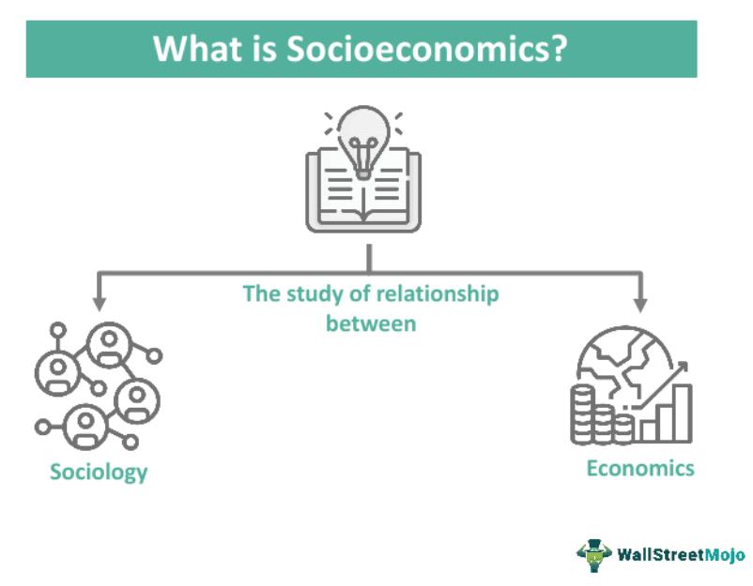
What is social economy
Social is made up of people
who share values, norms, culture,
and family, school, and religion.
Resource production, consumption,
exchange, and distribution comprise
a nation's economy.
Social
Economy
Social economy is the relationship between people's way of life (society) and their livelihood through production and consumption (economy).

Slide 12
Important components of social economy
Natural resources
Labor
Economic systems
Social structures
Technology and innovation

Slide 13
Synopsis of Social Economy
Aspects | Points
Focus | Social objectives, sustainable development, and inclusive growth
Values | Solidarity, community, and social impact
Examples | Cooperatives, mutual societies, social enterprises, and non-profit organizations.
Key Characteristics | Social mission, Democratic governance, Reinvestment of profits
Goal | To create a more equitable and sustainable society through social and economic initiatives.

Slide 14
What is A Knowledge-based Economy?
A knowledge economy is one in which knowledge is created, acquired, transmitted, and used effectively by enterprises, organizations, individuals, and communities.
World Bank. (2007). Building knowledge economies: Advanced strategies for development. Washington, DC: The World Bank.
The knowledge-based economy is an expression coined to describe trends in advanced economies towards greater dependence on knowledge, information and high skill levels, and the increasing need for ready access to all of these by the business and public sectors. (https://ec.europa.eu/)
A knowledge-based economy (KBE) is an economic system where knowledge, rather than traditional factors like land or labor, is the primary driver of growth, wealth creation, and employment. It focuses on the creation, distribution, and application of knowledge, emphasizing innovation, research, and a skilled workforce. (https://www.adb.org/)

Slide 15
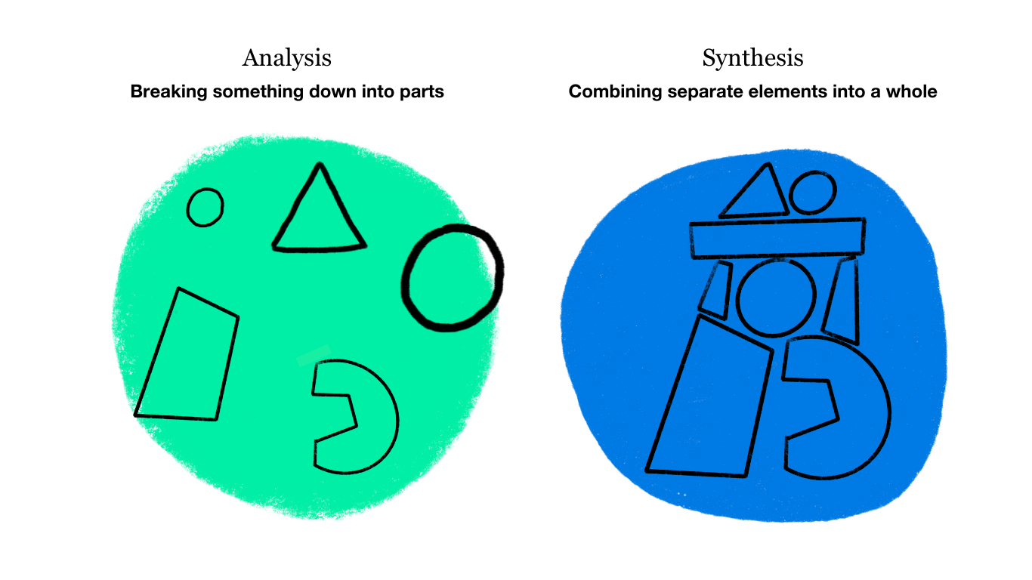
Create one theoretical definition
How to crate one definition from three sources

Slide 16
Group Activity 1: Create a theoretical definition of Knowledge-Based Economy (KBE) from three sources using artificial intelligence (1) DeepSeek (2) ChatGPT (3) Gemini
How do you learn the AI process of creating one definition from variety sources?
What is the definition of KBE?

Slide 17
Why a Knowledge-Based Economy Matters
The ability to manage knowledge, engage in continuous learning, and foster innovation are crucial for economic development.
For Developing countries, adapting to a KBE is urgent and essential.
This transition is vital to escape the middle-income trap and achieve sustainable economic and social development.

Slide 18
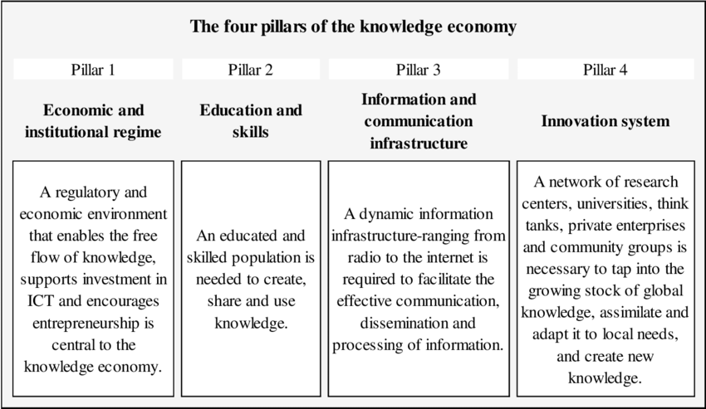
How to drive KBE: The World Bank Four Pillars of the KBE
(World Bank. 2018, Retrieved 18/03/2019 from http://web.worldbank.org/

Slide 19
Care why to develop knowledge-based economy
Drives sustainable economic growth
Enhances global competitiveness
Improves quality of life
Creates better jobs
Increases resilience

Slide 20

From Industrial to Knowledge-Based Economy Agricultural Economy Industrial Economy Knowledge-based Economy

Slide 21
Key Characteristics of the KBE Shift
Knowledge and skills become outdated more rapidly
Lifelong learning is critical for adaptability.
Countries now compete more on knowledge and innovation
Less reliance on traditional resources or cheap labor
Digital technology, AI, and Big Data are transforming production, consumption, and communication
Future jobs demand higher-level skills
Emphasis on analytical skills, creativity, and technological proficiency

Slide 22
Synopsis of Knowledge-Based Economy
Aspects | Points
Focus | Intellectual capital, innovation, and knowledge-intensive activities
Values | Economic growth, technological advancements, and high-skilled workforce.
Examples | Technology companies, research institutions, and universities
Key Characteristics | Intellectual property, Skilled workforce, Information technology
Goal | To increase the value of goods and services through innovation and knowledge application

Slide 23
If poor countries want to develop towards KBE, what challenges must they face?
Lack of infrastructure
Lack of investment in R&D/innovation
Shortage of highly skilled personnel
Poor quality of education
Lack of good governance

Slide 24
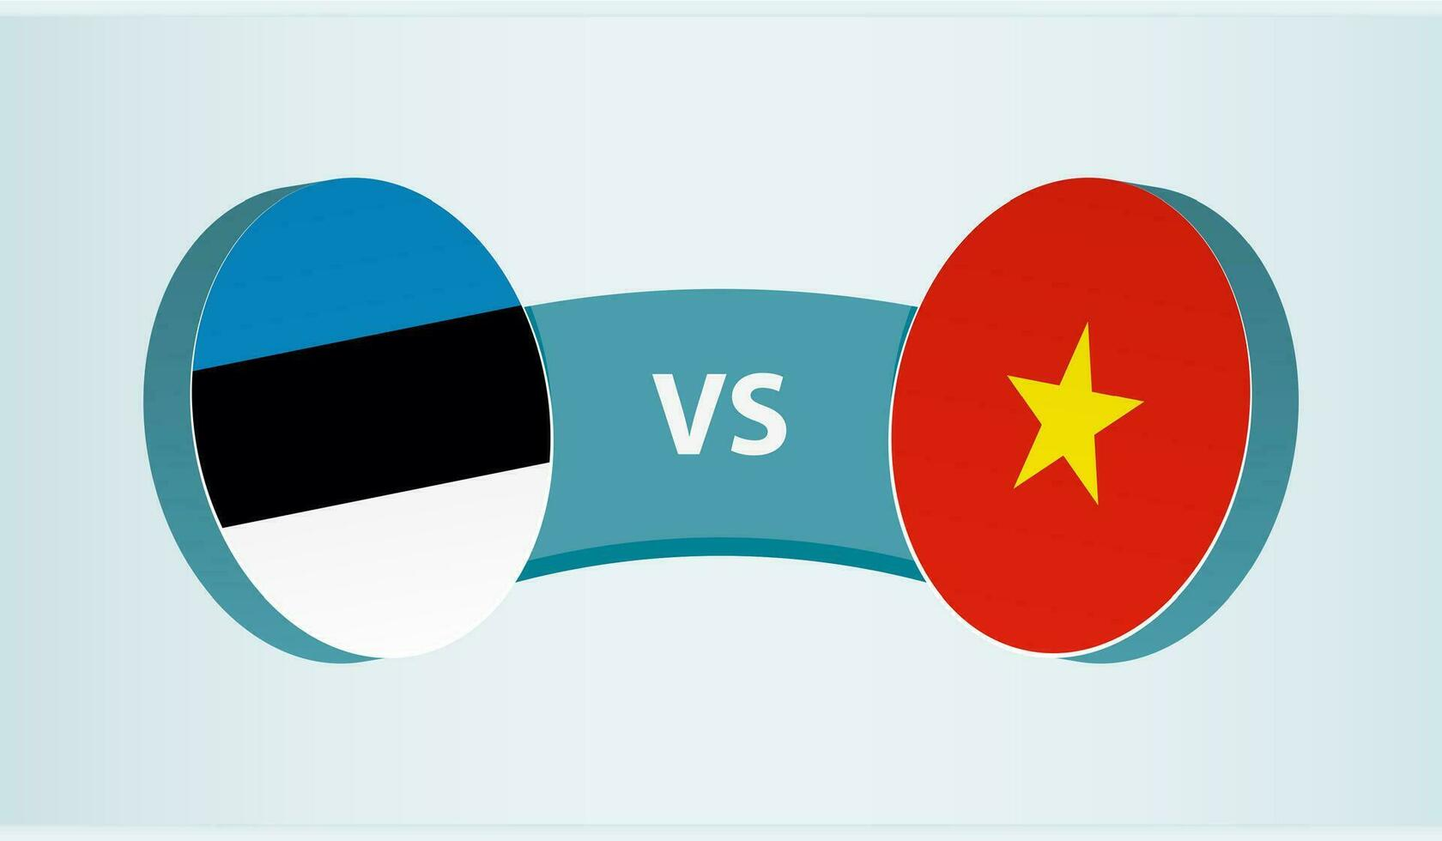

Examples of success practices and not yet
Success Practices | Not Yet
Estonia | Central African Republic – CAR
Vietnam | Niger

Slide 25
Estonia and Vietnam
Dimension | Estonia | Vietnam (Transforming)
Economic Drivers | Tech exports, e-governance, flat tax | State-led industrialization, FDI (Foreign Direct Investment) in manufacturing
Education Focus | Teacher autonomy, STEM, lifelong learning | Curriculum reform, Industry 4.0 integration
Innovation Ecosystem | Startup-friendly policies, Nordic investment | Government incubators, weak R&D spending
Key Challenges | Brain drain, energy security | Skills gap, infrastructure deficits
S – Science T – Technology E – Engineering M – Mathematics
STEM:An educational and skills development approach emphasizing the integration of knowledge across four fields to prepare individuals
for a modern world driven by innovation, technology, and systemic problem-solving

Slide 26
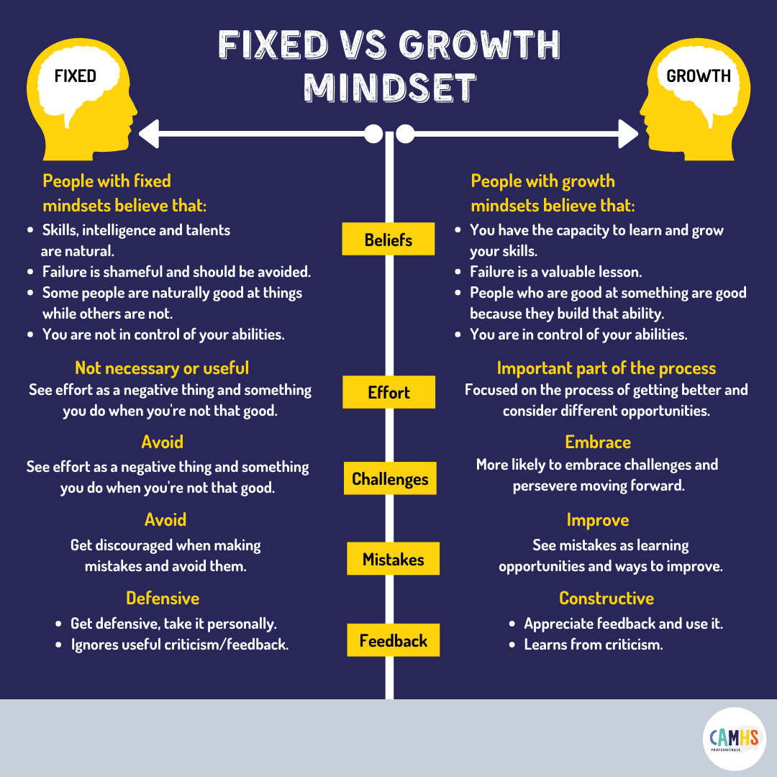
“Not Yet” — The Most Important Mindset for Growth
Developing a Growth Mindset with Carol Dweck- https://lnkd.in/eTQdvki

Slide 27
Success-Practice refers to a standard or set of guidelines known to yield positive outcomes when followed.
Key aspects of success practices Hierarchy of Practices
Best Practice
World Class
Individual
Best in Class
Best in Group
Proven effectiveness
Efficiency
Adaptability
Continuous improvement

Slide 28
Current State of Social and Economic Conditions in China –
Economic Development
Social Challenges
Government Policy
Regional Development
Global Influence

Slide 29
Aging Population
Income Inequality
Regional Disparities
Environmental Degradation
Education and Skill Gaps
Urbanization Pressures
Transition to Innovation Economy
Social Stability Concerns
Major challenge of
Social and Economic
Conditions in China

Slide 30
A broader idea behind KBE Theory
Intangible assets that contribute
to its value and competitive advantage.
Results
Intellectual Capital
The value derived from an individual's or group's social networks, relationships,
and connections.
The collective knowledge, skills,
abilities, experience, creativity,
and health embodied in individuals
within an organization or society.
Human Capital
Social Capital
Amplifies

Slide 31

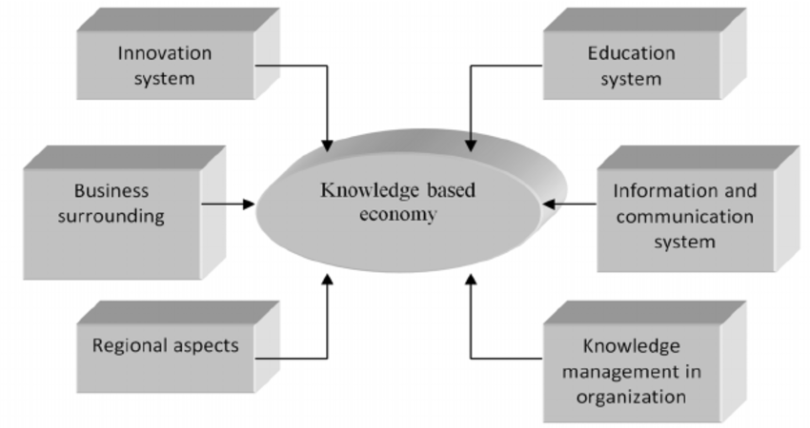
The Knowledge-Based Economy (KBE) Theories
Knowledge is the key to creating economic value, especially in an age of information technology and innovation.
Zwiefka, A.& Nycz, M (2013)

Slide 32
Knowledge Based economy theories
Knowledge as a Capital
Networked Economy
Learning Economy
Innovation-Driven Growth

Slide 33
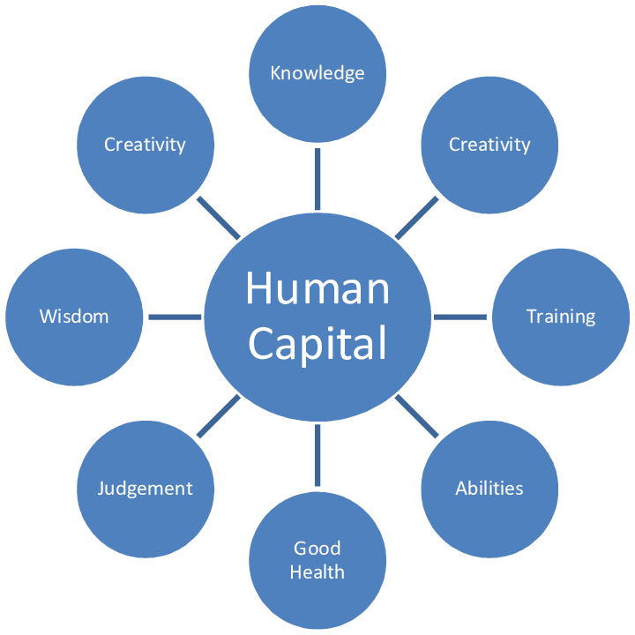
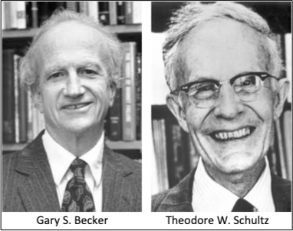
1.Knowledge as a Capital
Modern economies depend
heavily on human capital
Zaric &Babi (2020) CREATING HUMAN CAPITAL RESPONSIVE TO REQUESTS OF
SUSTAINABLE DEVELOPMENT GOALS: SOME EVIDENCE FROM SERBIA

Slide 34
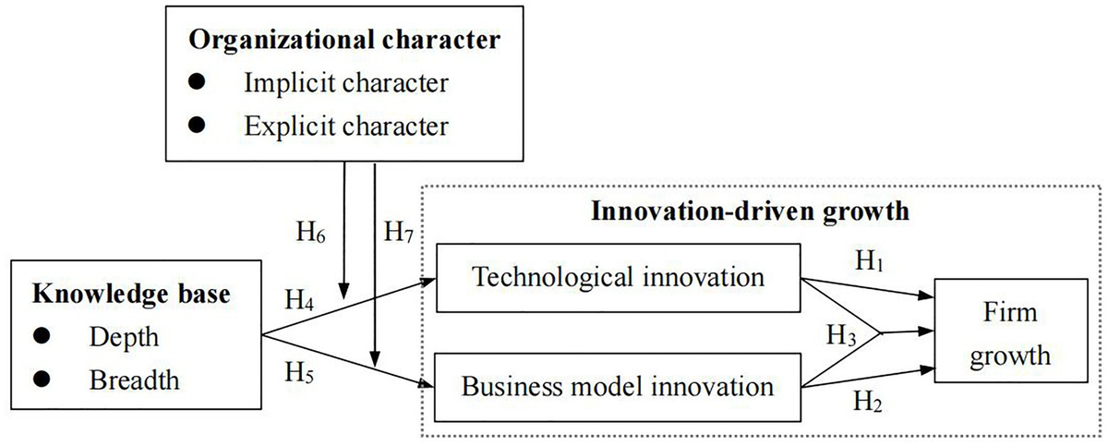
2.Innovation-Driven Growth
Innovation and economic growth
Produce higher value products and services
Innovation Ecosystem
Educational and research sector
Business sector
Increase labor productivity
Heart of economic that must compete globally
Government support
ICT infrastructure
Yu D and Yan H (2021) Relationship Between Knowledge Base
and Innovation-Driven Growth: Moderated by Organizational Character.
Front. Psychol. 12:663317. doi: 10.3389/fpsyg.2021.663317

Slide 35
3.Learning Economy An economic system where learning serves as the primary mechanism for boosting productivity, fostering innovation, and competing in the global market.
Learn through childhood, work,
and retirement.
Reskilling / Upskilling
Future Skills
R&D
Lifelong Learning
Critical Thinking, Creativity,
Digital Literacy, AI & Data Skills,
Entrepreneurship
Linking universities – research centers – business sector

Slide 36
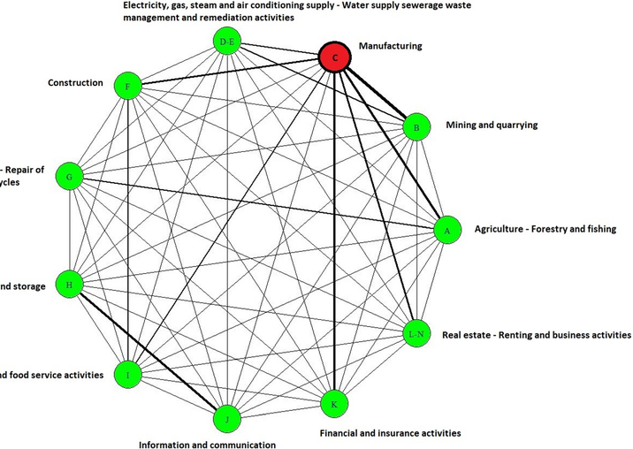
4.Networked Economy: An economic system that is driven by networks of information, knowledge, and participants through digital technology.
Daglis, et al, (2023)

Slide 37
Proposals for driving the developing country economy towards sustainable growth based on knowledge and innovation
Strong innovation ecosystem and R&D investment
Human capital development with future talent
Promoting AI and digital technology in numerous sectors
Target and high-potential industries are promoted.
Fostering sustainable growth

Slide 38
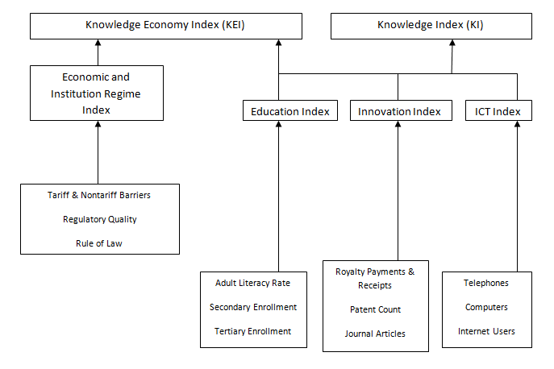
How to assess knowledge-based Economy
The latest version of the World Bank framework was released in 2015.

Slide 39
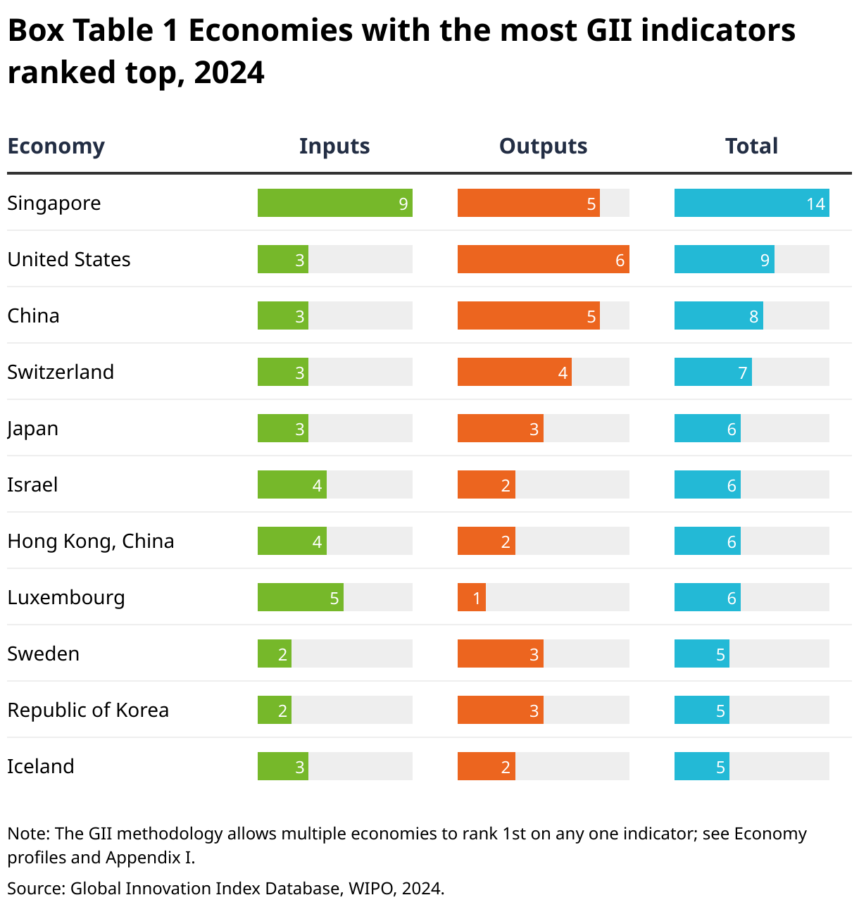
The Global Innovation Index (GII)

Slide 40
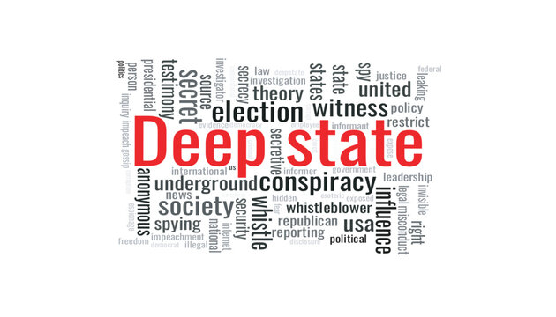
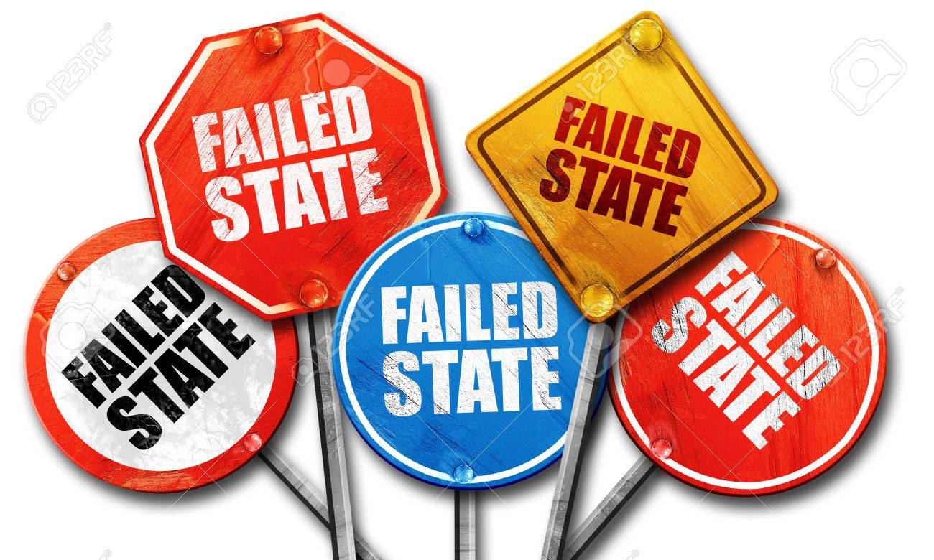
The "deep state" refers to a concealed, influential, and unelected
faction within the government that allegedly seeks to control
or subvert official policy.
A failed state is one that cannot ensure safety for its citizens,
lacks effective governance, and fails to provide essential services
that the government should offer.

Slide 41
Assignment 1: Read and present Articles for Module 1: (Retrieved from google.co.th)
Obrom Aranyapruk (2022) Strategies for Building a Knowledge-Based
Economy for Community Enterprises in the Eastern Economic
Development Zone https://doi.org/10.57260/rcmrj.2022.261618
2. Bermeo Giraldo, M.C., Patiño Toro, O.N., Valencia Arias, A., Benjumea Arias,
M.L., & Bran Piedrahita, L. (2022). Research trends of the knowledge
-based economy: A bibliometric study. Intangible Capital, 18(2), 290-313.
https://doi.org/10.3926/ic.2048
3. HADAD, S. (2017) Knowledge Economy: Characteristics and Dimensions
Management Dynamics in the Knowledge Economy Vol.5 (2017) no.2, pp.203-225;
DOI 10.25019/MDKE/5.2.03 https://core.ac.uk/
4. Tshetshe, Z. (2025) Recognizing ‘Being’ in the BANI world
International Journal for Multidisciplinary Research (IJFMR)

Slide 42
Assignment 2: At the end of Lesson 1, you are required to write a brief reflection note in one page divided into four sections
Section 1: A summary of the insights gathered today.
Section 2: Issues of particular concern to the area where
you stay in China.
Section 3: Choose a benchmark area in China.
Section 4: Strategies for overcoming benchmark-related concerns.
Please send all your assignments to kuncharee.ka3556@gmail.com on 19 July 2025

