Slide 1
Working Capital Management
Lesson 10

Slide 2
Objectives
Explain how the definition of “working capital” differs between financial analysts and accountants.
Understand the two fundamental decision issues in working capital management – and the trade-offs involved in making these decisions.
Discuss how to determine the optimal level of current assets.
Describe the relationship between profitability, liquidity, and risk in the management of working capital.
Explain how to classify working capital according to its “components” and according to “time” (i.e., either permanent or temporary).
Describe the hedging (maturity matching) approach to financing and the advantages/disadvantages of short- versus long-term financing.
Explain how the financial manager combines the current asset decision with the liability structure decision

Slide 3
Working Capital Concepts
Net working capital Current assets minus current liabilities.
Gross working capital The firm’s investment in current assets (like cash and marketable securities, receivables, and inventory).
Working capital management The administration of the firm’s current assets and the financing needed to support current assets.

Slide 4
Significance of Working Capital Management
is important for several reasons. For one thing, the current assets of a typical manufacturing firm account for over half of its total assets. For a distribution company, they account for even more. Excessive levels of current assets can easily result in a firm realizing a substandard return on investment

Slide 5
Profitability and Risk
Underlying sound working capital management lie two fundamental decision issues for the firm.
1.They are the determination of l the optimal level of investment in current assets
2. the appropriate mix of short-term and long-term financing used to support this investment in current assets.

Slide 6
Although short-term interest rates sometimes exceed long-term rates, generally they are less. Even when short-term rates are higher, the situation is likely to be only temporary. Over an extended period of time, we would expect to pay more in interest cost with long-term debt than we would with short-term borrowings, which are continually rolled over (refinanced) at maturity
These profitability assumptions suggest maintaining a low level of current assets and a high proportion of current liabilities to total liabilities. This strategy will result in a low, or conceivably negative, level of net working capital. Offsetting the profitability of this strategy, however, is the increased risk to the firm. Here, risk means jeopardy to the firm for not maintaining sufficient current assets to l meet its cash obligations as they occur l support the proper level of sales (e.g., running out of inventory).

Slide 7
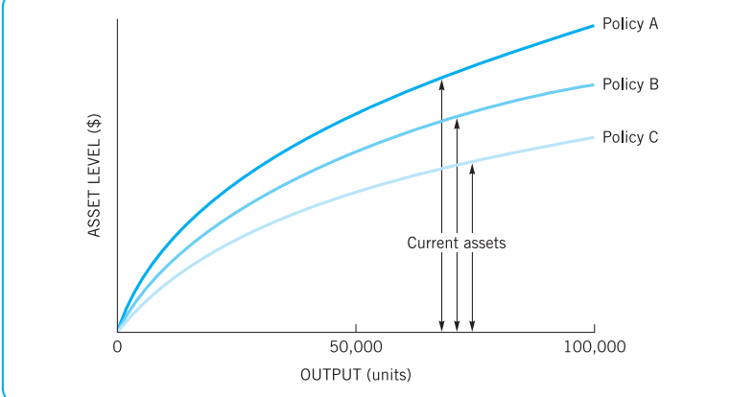
Current asset levels for three alternative working capital policies

Slide 8


Working Capital Issues
Optimal A mount (or Level) of Current Assets

Slide 9
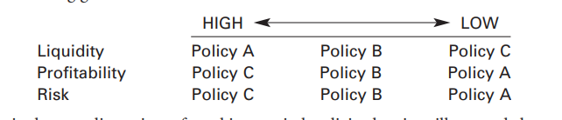
we can now make the following generalizations:

Slide 10
Detour: Classification of Working Capital
Permanent working capital is the amount of current assets required to meet a firm’s long-term minimum needs.
it can now be classified according to
1. Components, such as cash, marketable securities, receivables, and inventory (subsequent chapters will focus on these components), or
2. Time, as either permanent or temporary

Slide 11
Working capital needs over time

Slide 12
what is temporary working capital
Temporary working capital The amount of current assets that varies with seasonal requirements

Slide 13
Financing Current Assets: Short-Term and Long-Term Mix
Spontaneous financing Trade credit, and other payables and accruals, that arise spontaneously in the firm’s day-to-day operations.
Hedging (maturity matching) approach A method of financing where each asset would be offset with a financing instrument of the same approximate maturity

Slide 14
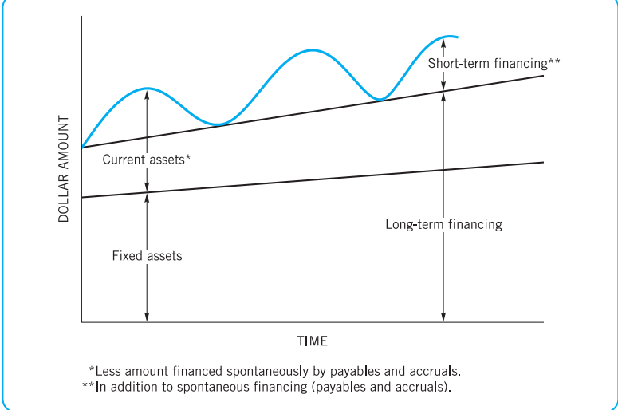
Financing (and asset) needs over time: hedging (maturity matching) financing policy

Slide 15
Short-Term versus Long-Term Financing
This depends on management’s attitude to the trade-off between risk and profitability
1.The Relative Risks Involved. In general, the shorter the maturity schedule of a firm’s debt obligations, the greater the risk that the firm will be unable to meet principal and interest payments.
2.The Risks versus Costs Trade-Off. Differences in risk between short- and long-term financing must be balanced against differences in interest costs.

Slide 16
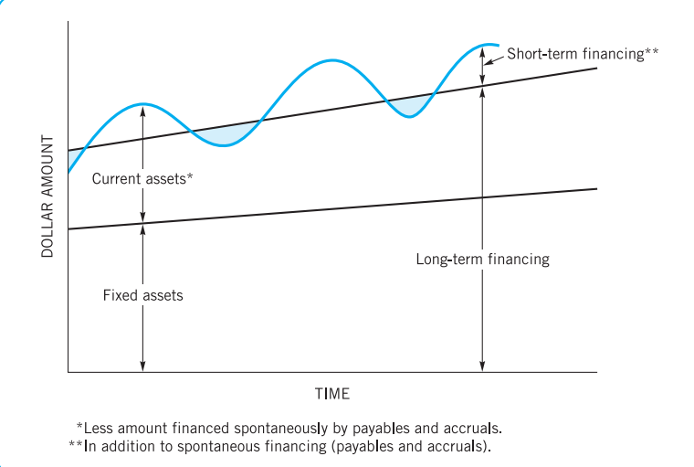
Financing (and asset) needs over time: conservative financing policy

Slide 17
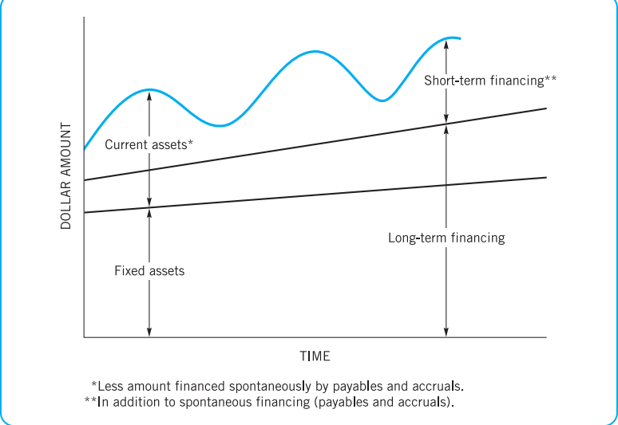
Financing (and asset) needs over time: aggressive financing policy

Slide 18
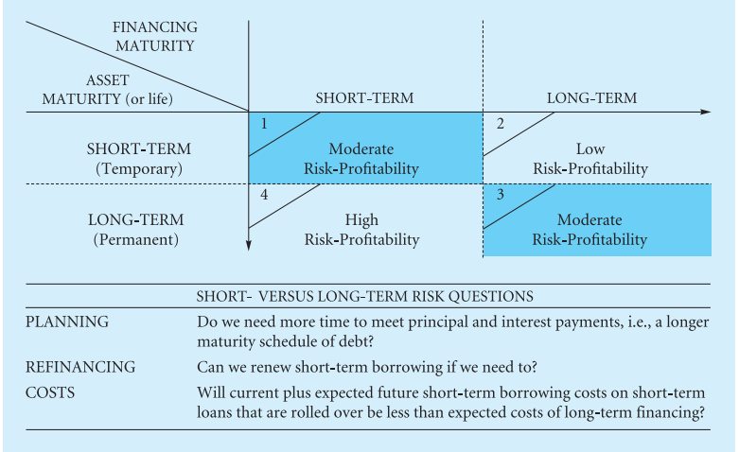
Short- versus long term financing

Slide 19
Combining Liability Structure and Current Asset Decisions
Uncertainty and the Margin of Safety If the firm knows with certainty its future sales demand, resulting receivable collections, and production schedule, it will be able to arrange its debt maturity schedule to correspond exactly to the schedule of future net cash flows.
Risk and Profitability A decision on the appropriate margin of safety will be governed by considerations of risk and profitability and by management’s attitude toward bearing risk. Each solution (increasing liquidity, lengthening the maturity schedule, or a combination of the two) will cost the firm something in profit-making ability

Slide 20
Questions
1.What does working capital management encompass? What functional decisions are involved, and what underlying principle or trade-off influences the decision process?
2. A firm is currently employing an “aggressive” working capital policy with regard to the level of current assets it maintains (relatively low levels of current assets for each possible level of output). The firm has decided to switch to a more “conservative” working capital policy. What effect will this decision probably have on the firm’s profitability and risk?
3. Utilities hold 10 percent of total assets in current assets; retail trade industries hold 60 percent of total assets in current assets. Explain how industry characteristics account for this difference.
4. Distinguish between “temporary” and “permanent” working capital.
5. If the firm adopts a hedging (maturity matching) approach to financing, how would it finance its current assets?
6. Some firms finance their permanent working capital with short-term liabilities (commercial paper and short-term notes). Explain the impact of this decision on the profitability and risk of these firms.

