Slide 1
Lesson 6 The language of negotiation: Verbal and non-verbal negotiation

Slide 2
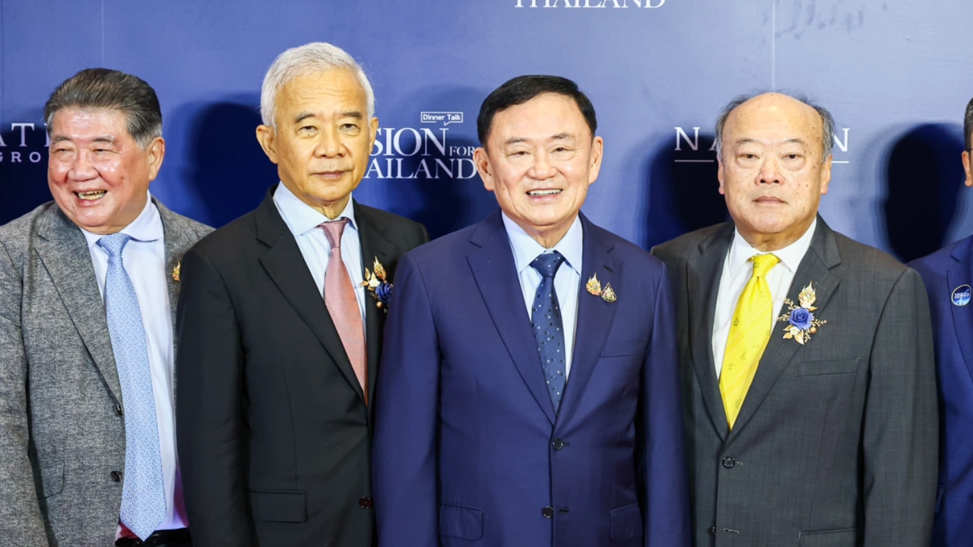
What does body language tell us?

Slide 3
Body Language
Body language has its skeptics though, as some feel that they may not have any underlying meaning attached to it at all and may make a situation more complicated than it actually is. In today's global environment where different cultures interaction is commonplace, there is a significant risk of these cues being misinterpreted. Kinesics signals are either innate (inborn) or learned, and can be a mix of both when innate actions are shaped by cultural rules. Hence, awareness of context is critical, espcially when engaging cross culturally.

Slide 4


Slide 5
How to Read Body Language?
Facial Expressions: Pay close attention to a person's facial expressions because they often reveal their feelings, such as pleasure, anger, or suspicion, with, for example, a smile, pursed lips, or furrowed brow will reveal a lot about what another individual is thinking and feeling.

Slide 6
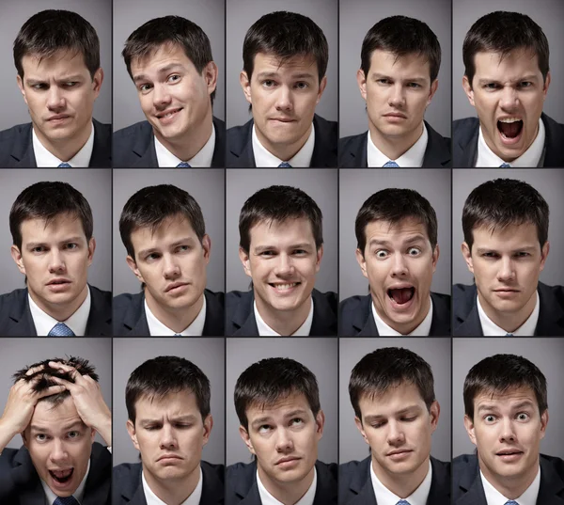
Facial expressions

Slide 7
How to Read Body Language?
Gestures and Posture: Watch an individual's gestures and posture. Do they lean forward to show curiosity, or do they lean back to show indifference or defensiveness? Additionally, body posture and hand gestures might show participation or reluctance.

Slide 8
How to Read Body Language?
Eye Contact: Direct eye contact is a potent sign of focus and interest. Avoidance of eye contact may indicate awkwardness or insincerity. Maintaining eye contact demonstrates interest and confidence. However, cultural variations should be taken into account.

Slide 9

Eye Contact Communication
A
E
B
F
C
G
H
D

Slide 10
Using Non-Verbal Communication in Negotiation
It is proven that more than half of our communication is non-verbal. But contrary to popular belief, non-verbal communication is not based solely on body language. The key types of non-verbal communication that commonly affect negotiations are the body language, physical environment and the negotiators' personal attributes. Being aware of these will better equip you when engaging in a negotiation and give you a competitive edge.

Slide 11
Using Non-Verbal Communication in Negotiation (cont.)
Most negotiators are usually unaware that they are throwing out involuntary non-verbal cues. You may be actively present in the negotiation process, but your silent involuntary non-verbal cues may be influencing the negotiation process more than you are aware, as they are judged subconsciously.

Slide 12
Body Language Tips for Negotiation
The efficacy of your negotiations can be considerably increased by developing your body language abilities. Consider the following useful advice
1.Keep Eye Contact: Good eye contact communicates sincerity and attention. It promotes trust and demonstrates regard towards the other individual's perspective.
2.Use Mirroring Moderately: Use mirroring strategies naturally and subtly to establish rapport. Refrain from going overboard since it may come across as mimicking or insincerity.
3.Project Satisfaction: With a straight spine and a wide, relaxed stance, standing or sitting. Even amid trying circumstances, keep a cool, collected manner. Infectious confidence has a good impact on negotiating tactics.

Slide 13
Body Language Tips for Negotiation ( cont.)
4.Listen Actively: Use gestures, grinning, and other nonverbal signals to demonstrate active listening. This encourages a cooperative negotiation climate by demonstrating your interest and comprehension of the other person's viewpoint.
5.Be Aware of Your Gestures: Use deliberate, controlled gestures to draw attention to important details, but avoid making exaggerated, confusing, or tense motions.
6. The Firmness of Handshakes: The handshake is often the first physical interaction in a negotiation encounter, and its impact should not be underestimated. A firm handshake exudes confidence and professionalism, instilling trust and credibility in your negotiation counterpart. Conversely, a weak or limp handshake may convey uncertainty or lack of conviction, potentially weakening your negotiation stance from the outset.

Slide 14

7. Voice Tone and Pace: Your voice tone and pace are potent non-verbal cues that can influence negotiation dynamics. Speaking with a calm, steady tone conveys assurance and composure, while erratic or nervous speech patterns may betray insecurity or apprehension. Additionally, varying your vocal pace can emphasize key points, maintain engagement, and command attention during negotiations.
8. Space and Proximity: The spatial dynamics of a negotiation setting play a significant role in shaping interactions and power dynamics. Pay attention to proxemics — the study of personal space — and be mindful of how you navigate physical proximity during negotiations. Invading personal space can be perceived as aggressive or intrusive while maintaining an appropriate distance fosters comfort and respect.

Slide 15
Physical Environment
The physical environment, also known as Proxemics communication, is the usage of physical space and territory to convey trust and intimacy.

Slide 16
Physical Environment (cont.)
Commonly known as your ‘comfort zone’, being able to read the other party’s level of comfort with you during a negotiation extends towards knowing how cooperative they would be with you. For example, people in authority such as government officials usually command a bigger ‘personal bubble’.
Your personal bubble may be threatened when someone invades your personal space. You may feel uncomfortable when someone you are not close to breathes down your neck. Likewise, in a negotiation you want to foster rapport and gain cooperation. Where you are and how close you position yourself to the other party can help you avoid unnecessary tension

Slide 17
Personal Attributes
Probably the most familiar (and some say superficial) non-verbal cues of all would be your personal physical appearance. “Dress for Success” would be the expression here, and we all know how we attribute attractiveness to being better perceived. Personal attributes are not just limited to how you look – it extend to vocal cues (auditory communication) and touch (tactile communication) as well. How well you articulate and/or how firm your handshake is all reflect the way you carry yourself to the other party.

Slide 18
Personal Attributes( cont.)
Positive attributes of body language in negotiation exude confidence, sincerity and security — three attributes that were found to be key impressions during negotiations. Unwavering eye contact can come across as intimidating, so find a balance by smiling, just as you would have to find a balance in the gestures you use during negotiations

