Slide 1
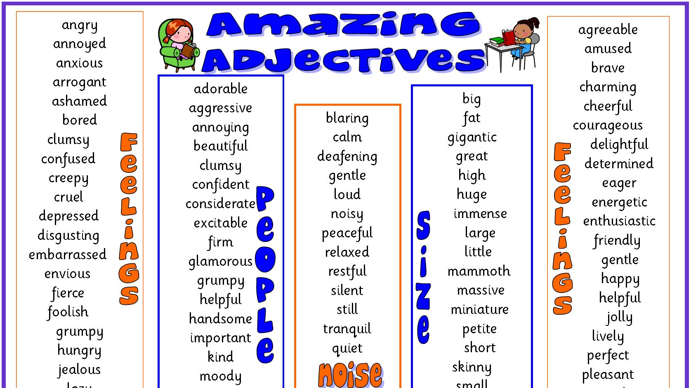
Unit 2: How to Describe a Person in English

Slide 2
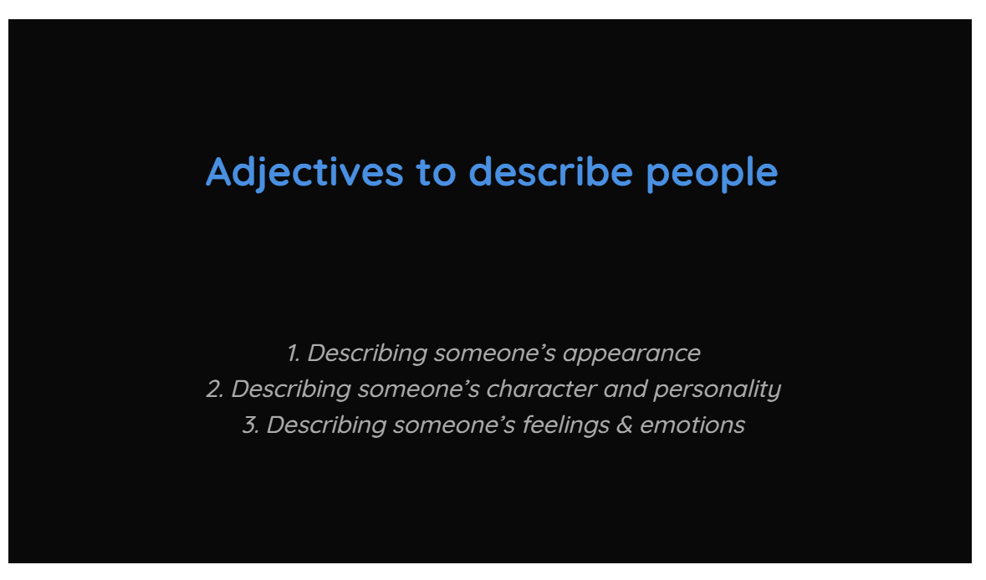

Slide 3

DESCRIBING PEOPLE
PERSONALITY TRAITS

Slide 4
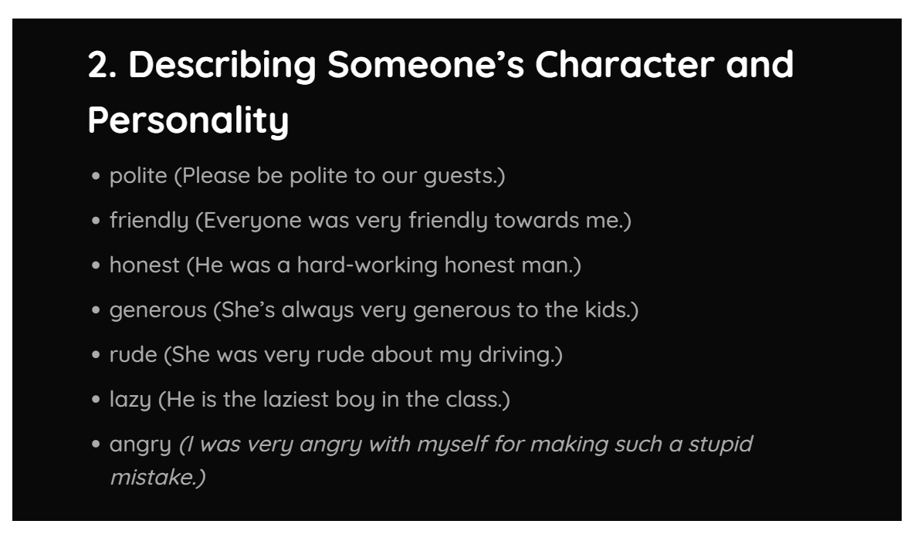

Slide 5
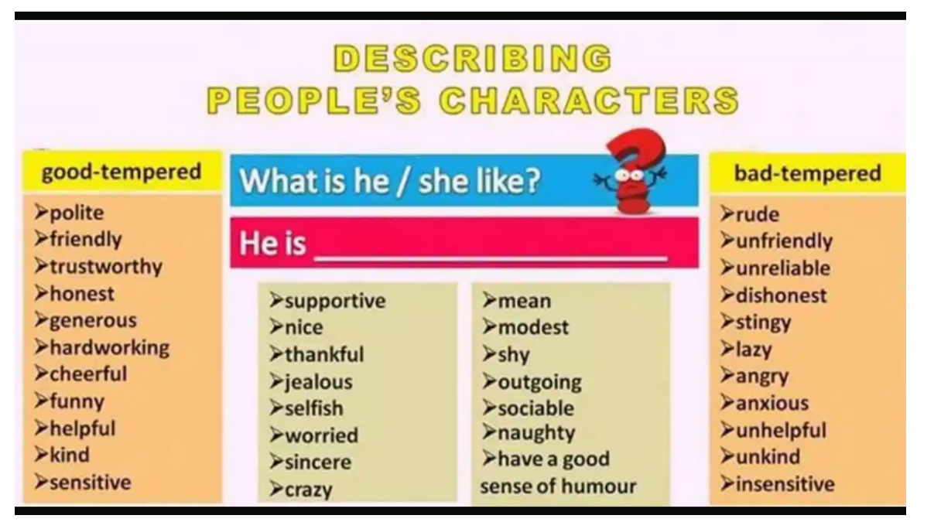

Slide 6

QUESTION:
What am I like?
What are you/we/they like?
What is he/she like?

Slide 7
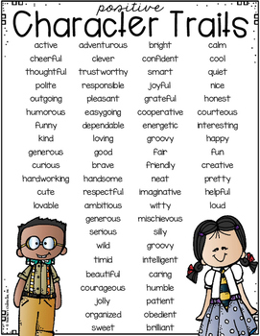
What about you? / What are you like?
Take a look at the adjectives on the picture “Positive Character Traits”. And use your dictionary for find a definition.

Slide 8
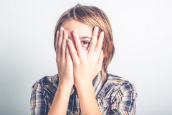
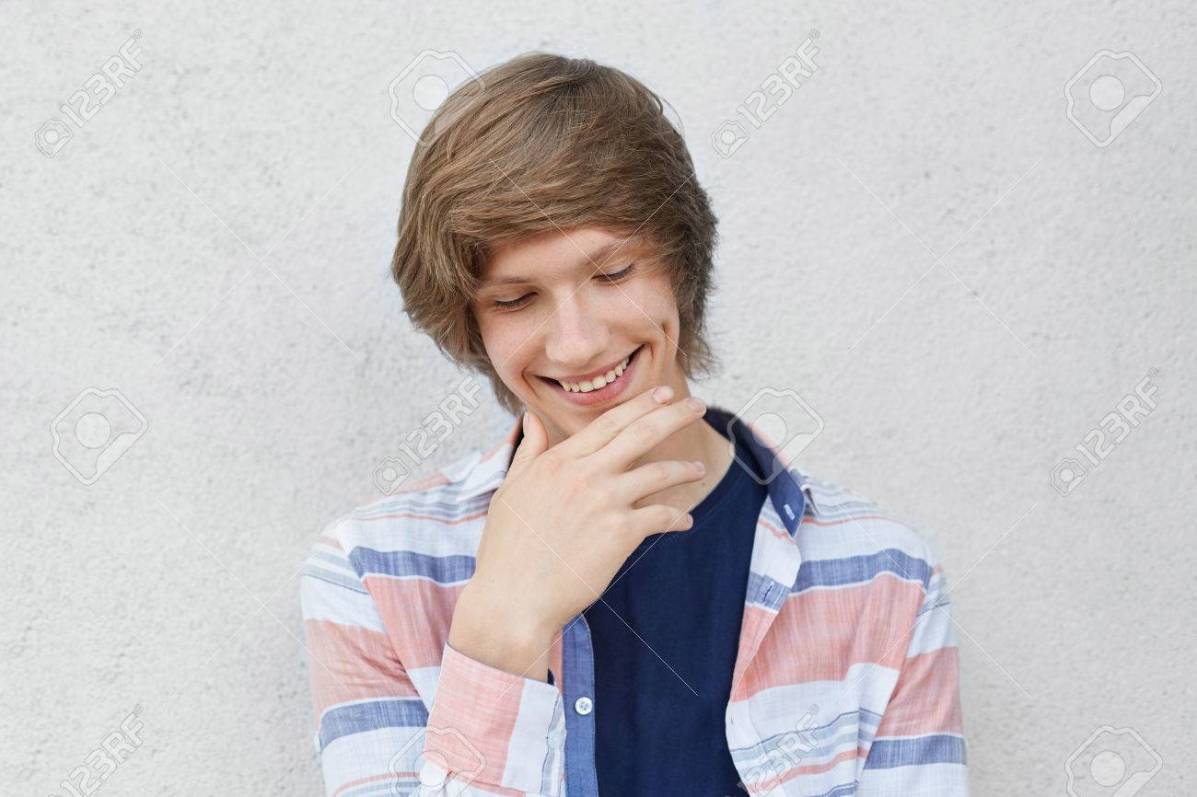
Look at Picture 1:
What is the boy like?
He is _____.
Clumsy
Shy
Talkative
Polite

Slide 9
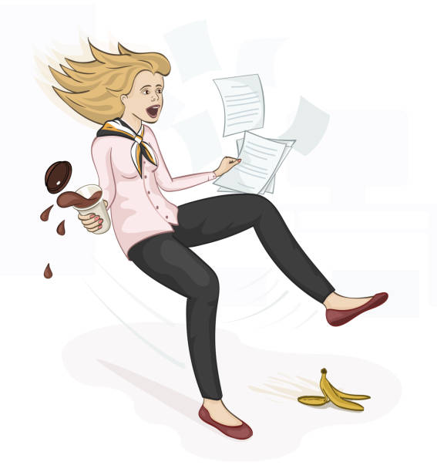
Look at Picture 2:
What is the girl like?
She is _____.
Clumsy
Shy
Talkative
Polite

Slide 10
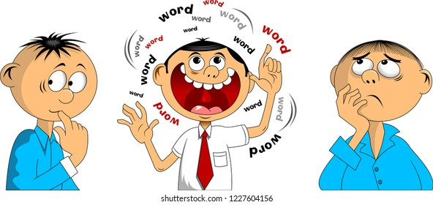
Look at Picture 3:
What is the man like?
He is _____.
Clumsy
Shy
Talkative
Polite

Slide 11
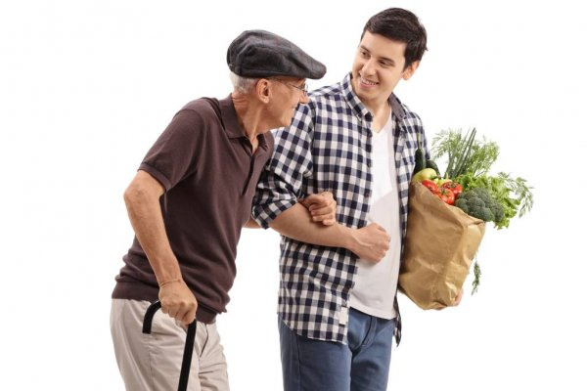
Look at Picture 4:
What is the man like?
He is _____.
Polite
Shy
Talkative
Polite

Slide 12
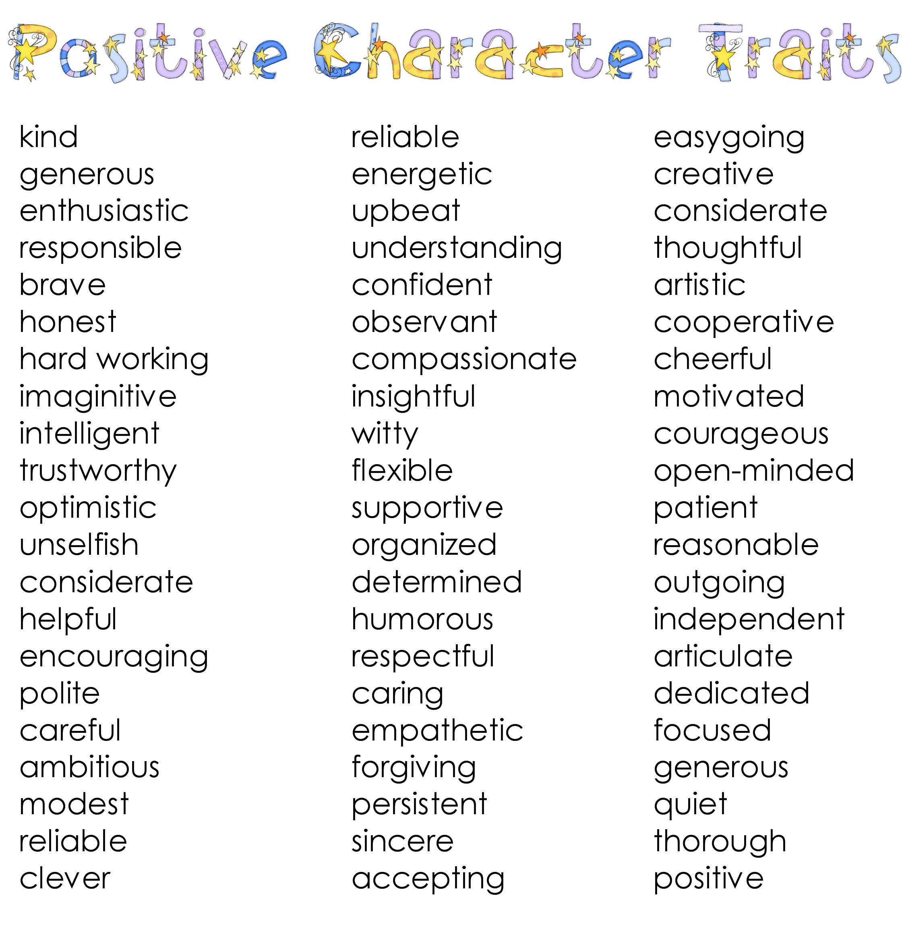
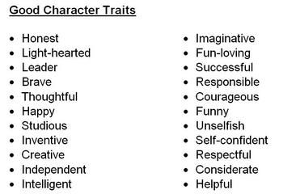

Slide 13
DESCRIBING PEOPLE
PHYSICAL FEATURES

Slide 14
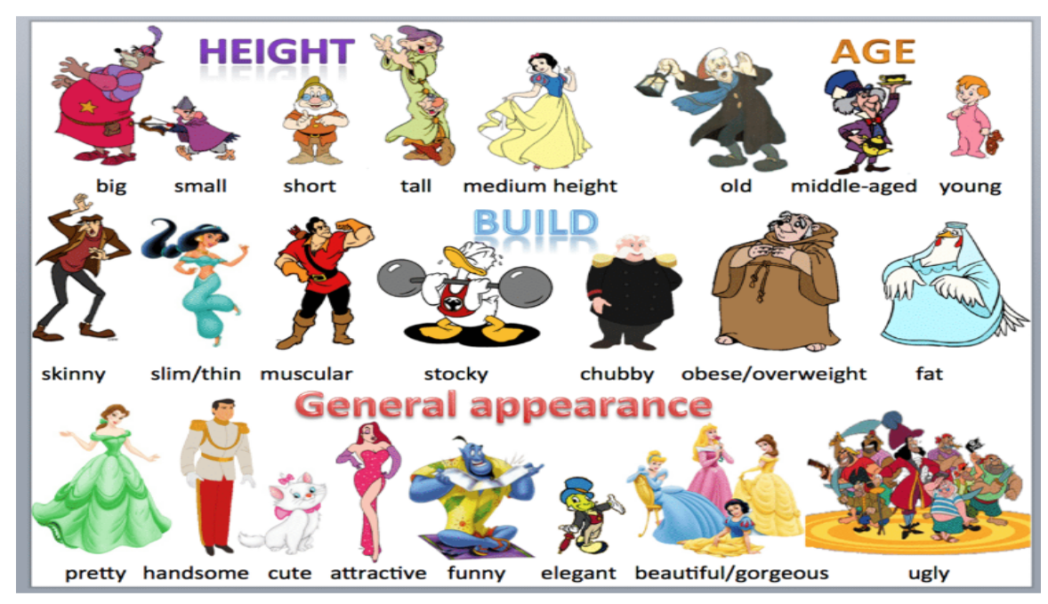

Slide 15
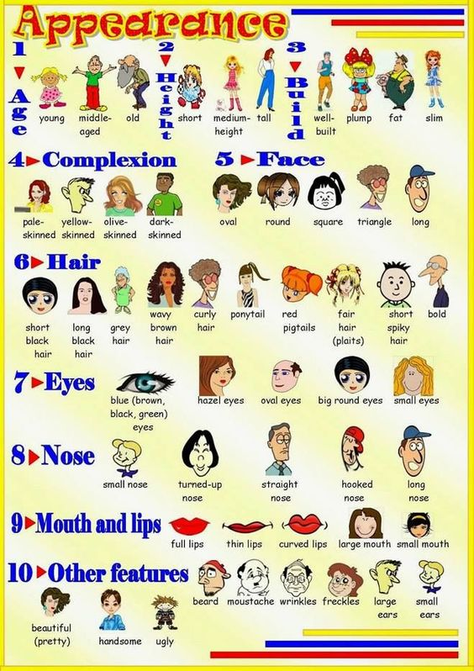
What about you? /
What do you look like?
Take a look at the picture “Appreance”. And use your dictionary for find a definition.

Slide 16
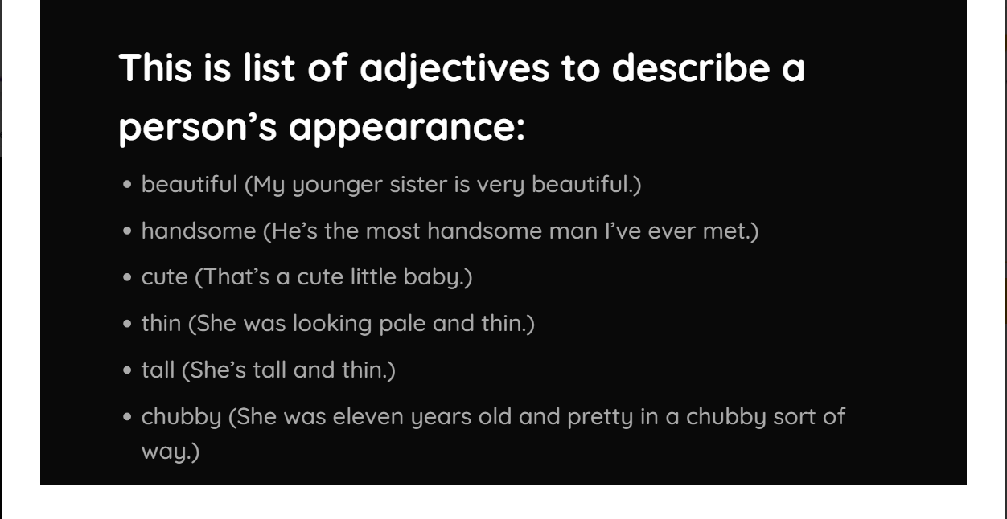

Slide 17
QUESTION:
What do I/you/we/they look like?
What does he/she look like?

Slide 18
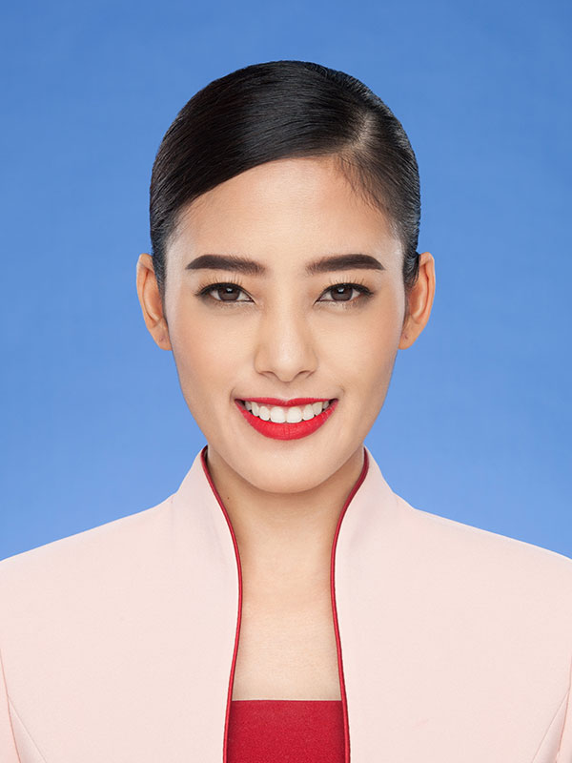
Look at Picture 1:
What does your English teacher look like?
She has got _____.
a. Big ears and a big nose
b. Small ears and a small nose
Small ears and big nose.
No answer

Slide 19
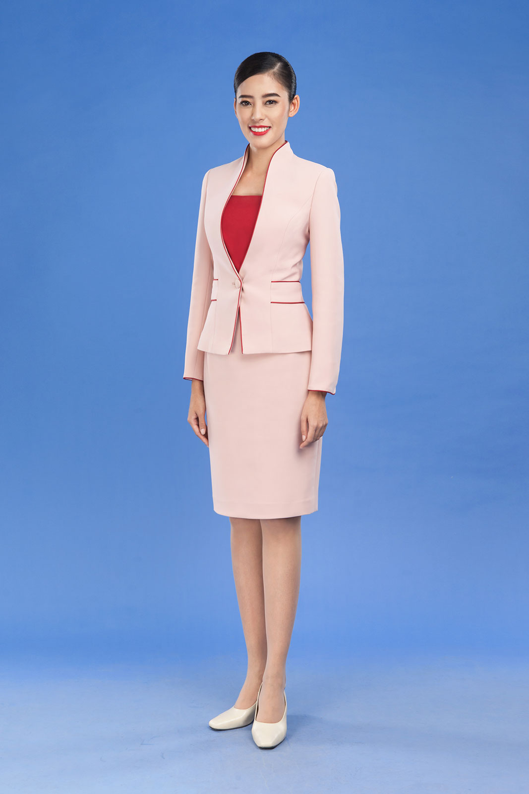
Look at Picture 2:
What does your English teacher look like?
She is _____.
Tall
Medium – height
Short
No answer

Slide 20
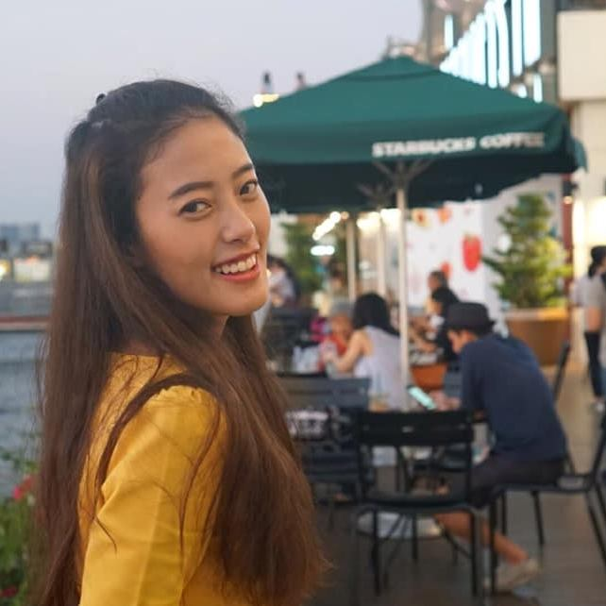
Look at Picture 3:
What does your English teacher look like?
She has got _____.
a. Short curly brown hair.
b. Short straight black hair
Long curly brown hair
No answer

Slide 21
DESCRIBING PEOPLE
Feelings & Emotions

Slide 22
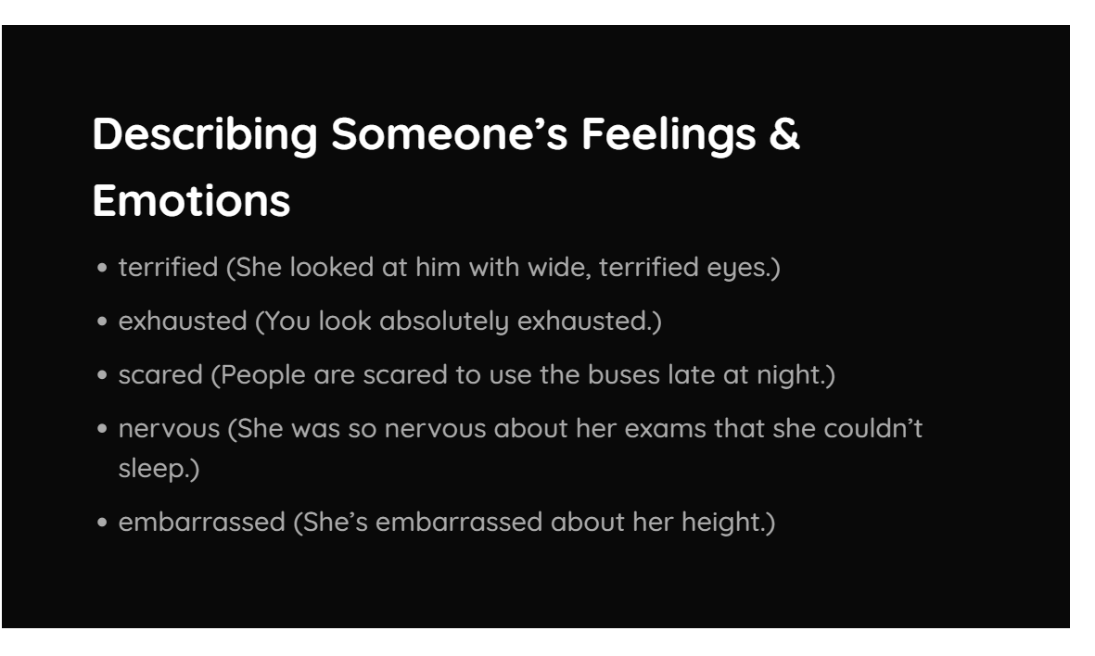

Slide 23
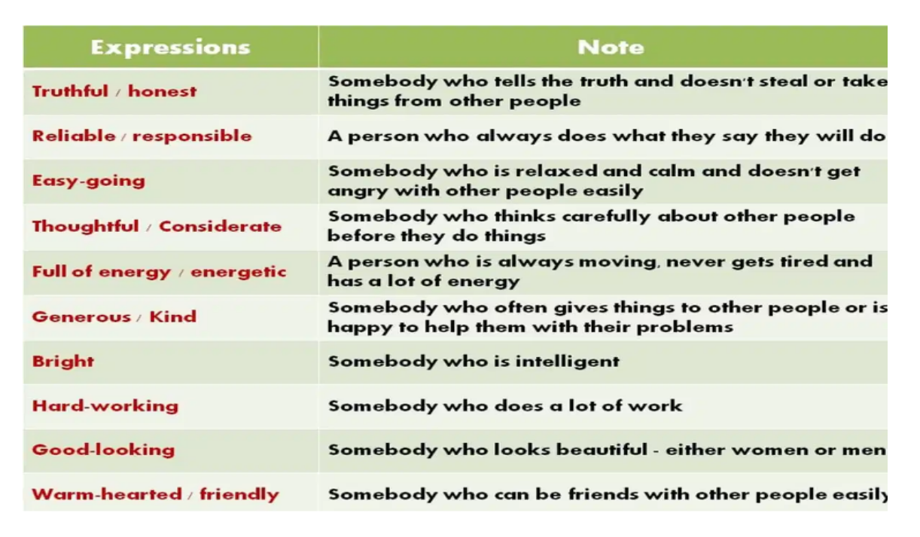

Slide 24


Slide 25
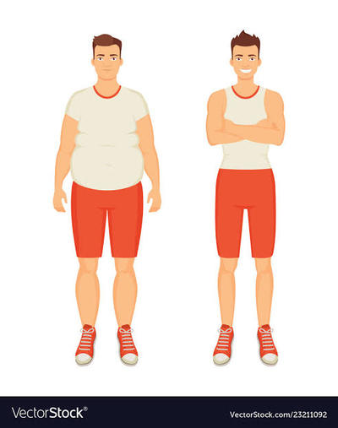
Look at Picture:
They are ______.
a. Fat and Thin
b. Big and Small
Fat and Tall
Thin and small

Slide 26
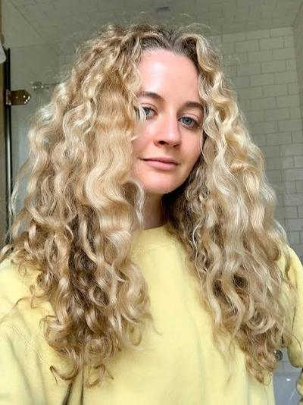
Which one is the correct description?
a. She has curly blonde hair
b. She has straight brown hair
c. She has short black hair
d. She has long black hair

Slide 27
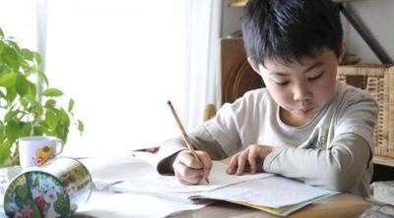
Farel is a ____ person. She always does his homework everyday.
Diligent
b. Angry
c. Honest
d. Hungry

Slide 28
I love my mom. She is very ... and never angry. She always smile and never complains.
Patient
b. Angry
c. Honest
d. Rude

Slide 29
