Slide 1
Developing English Skill for Technical Presentation
Sarisak Soontornchai
sarisak.so@ssru.ac.th

Slide 2
Developing English Skill for Technical Presentation
Going to International Conference
-Registration
-During the Conference
-Content of Research Article Presentation
-Social Activities

Slide 3
Registration
Preregistration
Convention-a meeting in the definition of a meeting is a gathering of people who meet at an arranged place and time to discuss or share common interests.
Conference-a formal meeting in which many people gather in order to talk about ideas or problems related to a particular topic (such as medicine or business) usually for several days.
Symposium-a meeting typically allow experts in a given field to meet, discuss papers/topics in question, and examine the issues and trends associated with the topic. The findings from a symposium can be used to help others within the field of research and can endure testing if applicable.
Workshop-an interactive meeting in which a group of people goes through a series of activities to achieve to solve a problem or work on a project. Workshops are often led by a facilitator and can range from a couple of hours to multiple days.

Slide 4
Registration
Call for papers/Abstracts
Call for papers and an invitation to participate
Public relations documents
-Introduction/Rationale
-Aims/Objectives/Purposes
-Content of the conference/List of topics/Topic areas
-Venue and date of the conference
-Correspondence
-Registration form/Participation form
Registration fee/payment
-Information for presenters (criteria for selection of presentation, abstract, synopsis, deadline of submission, notification of acceptance)

Slide 5
Registration
Type of registration
-preregistration
-on-site registration
Registration at a Conference
-Convention packet/package/kit/bag/envelope (program book, convention planner/schedule, notepad, name tag, food coupon or voucher, etc.)
Type of participant
-speaker/presenter
-participant
-exhibitionist
-organizer

Slide 6
Registration
Greeting
-Good morning. I’d like to register for the conference.
-Excuse me. Do I register for the conference here?
-May I have your name?, please?
-My name is Somchai Bovornkitti from Thailand. I would like to register for the conference.
Good morning. I’m a speaker at this convention or session A, and I’d like to register.
How do you spell your last name? Spell your last name, please?
Thank you very much.
Thank for your help.
I really appreciate your help.

Slide 7
Registration
Convention Schedule and Educational Tours
-Plenary session-a plenary session or plenum is a session of a conference or deliberative assembly in which all parties or members are present, and there are no absentees.
-Parallel session- allow the organizer to add presentations and activities to the program that take place at the same time. Concurrent sessions save valuable time by providing participants with an even wider range of presentations from which to choose the most integrative topics
-Panel discussion- a group of people gathered to discuss a topic in front of an audience, typically at scientific, business, or academic conferences. Panels usually include a moderator who guides the discussion and sometimes elicits audience questions.

Slide 8
Registration
Excuse me. Can/Could you please tell me…….?
what time registration starts?
when registration starts?
where I can register?
During the Conference

Slide 9
During the Conference
Attending a presentation
-Well, ladies and gentlemen. Professor Somchai would like to welcome any questions or comment from the floor.
-Are there any questions or comments from the floor.-What do you think about …….?
How do you feel about………………?
What’s your opinion/your view on………………………………?
In my opinion/view………..
I think…….
I believe (that)………………………………
If you ask me, I think…….
As far as I’m concerned,………

Slide 10
During the Conference
Emphasis
Examples
▧It should be emphasized that…
▧I would like to draw your attention to this point…
▧Another significant point is that…
▧The significance of this is…
▧This is important because…
▧We have to remember that…

Slide 11
During the Conference
Handling Questions
Always repeat each question so everyone knows what was asked
Always be respectful
Avoid long one-on-one discussions
Finish by asking person who asked that question if you answered it sufficiently for them
If you can’t answer questions that’s alright. “That’s a very good question. I hadn’t thought of that before…”
Offer to research answer, then get back to the questioner later
Suggest resources which would help address question
Ask for suggestions from audience

Slide 12
During the Conference
Questions during the Presentation
Examples
▧Does anyone have any questions or comments?
▧I am happy to answer your questions now.
▧Please feel free to interrupt me if you have questions.
▧If you have any questions, please don’t hesitate to ask.
▧Please stop me if you have any questions.
▧Do you have any questions before I move on?
▧If there are no further questions at this point, I’d like to…

Slide 13
During the Conference
Inquiries
Examples
▧Does this answer your question?
▧Did I make myself clear?
▧I hope this explains the situation for you.

Slide 14
During the Conference
Unknown Answer
Examples
▧That’s an interesting question. I don’t actually know off the top of my head, but I’ll try to get back to you later with an answer.
▧I’m afraid I’m unable to answer that at the moment. Perhaps, I can get back to you later.
▧Good question. I really don’t know! What do you think?
▧That’s a very good question. However, I don’t have any figures on that, so I can’t give you an accurate answer.
▧Unfortunately, I’m not the best person to answer that.

Slide 15
During the Conference
Questions at the End of the Presentation
Examples
▧There will be time for questions at the end of the presentation.
▧I’ll gladly answer any of your questions at the end.
▧I’d be grateful if you could ask your questions after the presentation.

Slide 16
During the Conference
Summary and Conclusions
Examples
I’d like to conclude by…
▧In conclusion, let me sum up my main points.
▧Weighing the pros and cons, I come to the conclusion that…
▧That brings me to the end of my presentation. Thank you for listening/your attention.
▧Thank you all for listening. It was a pleasure being here today.
▧Well, that’s it from me. Thanks very much.
▧That brings me to the end of my presentation. Thanks for your attention.

Slide 17
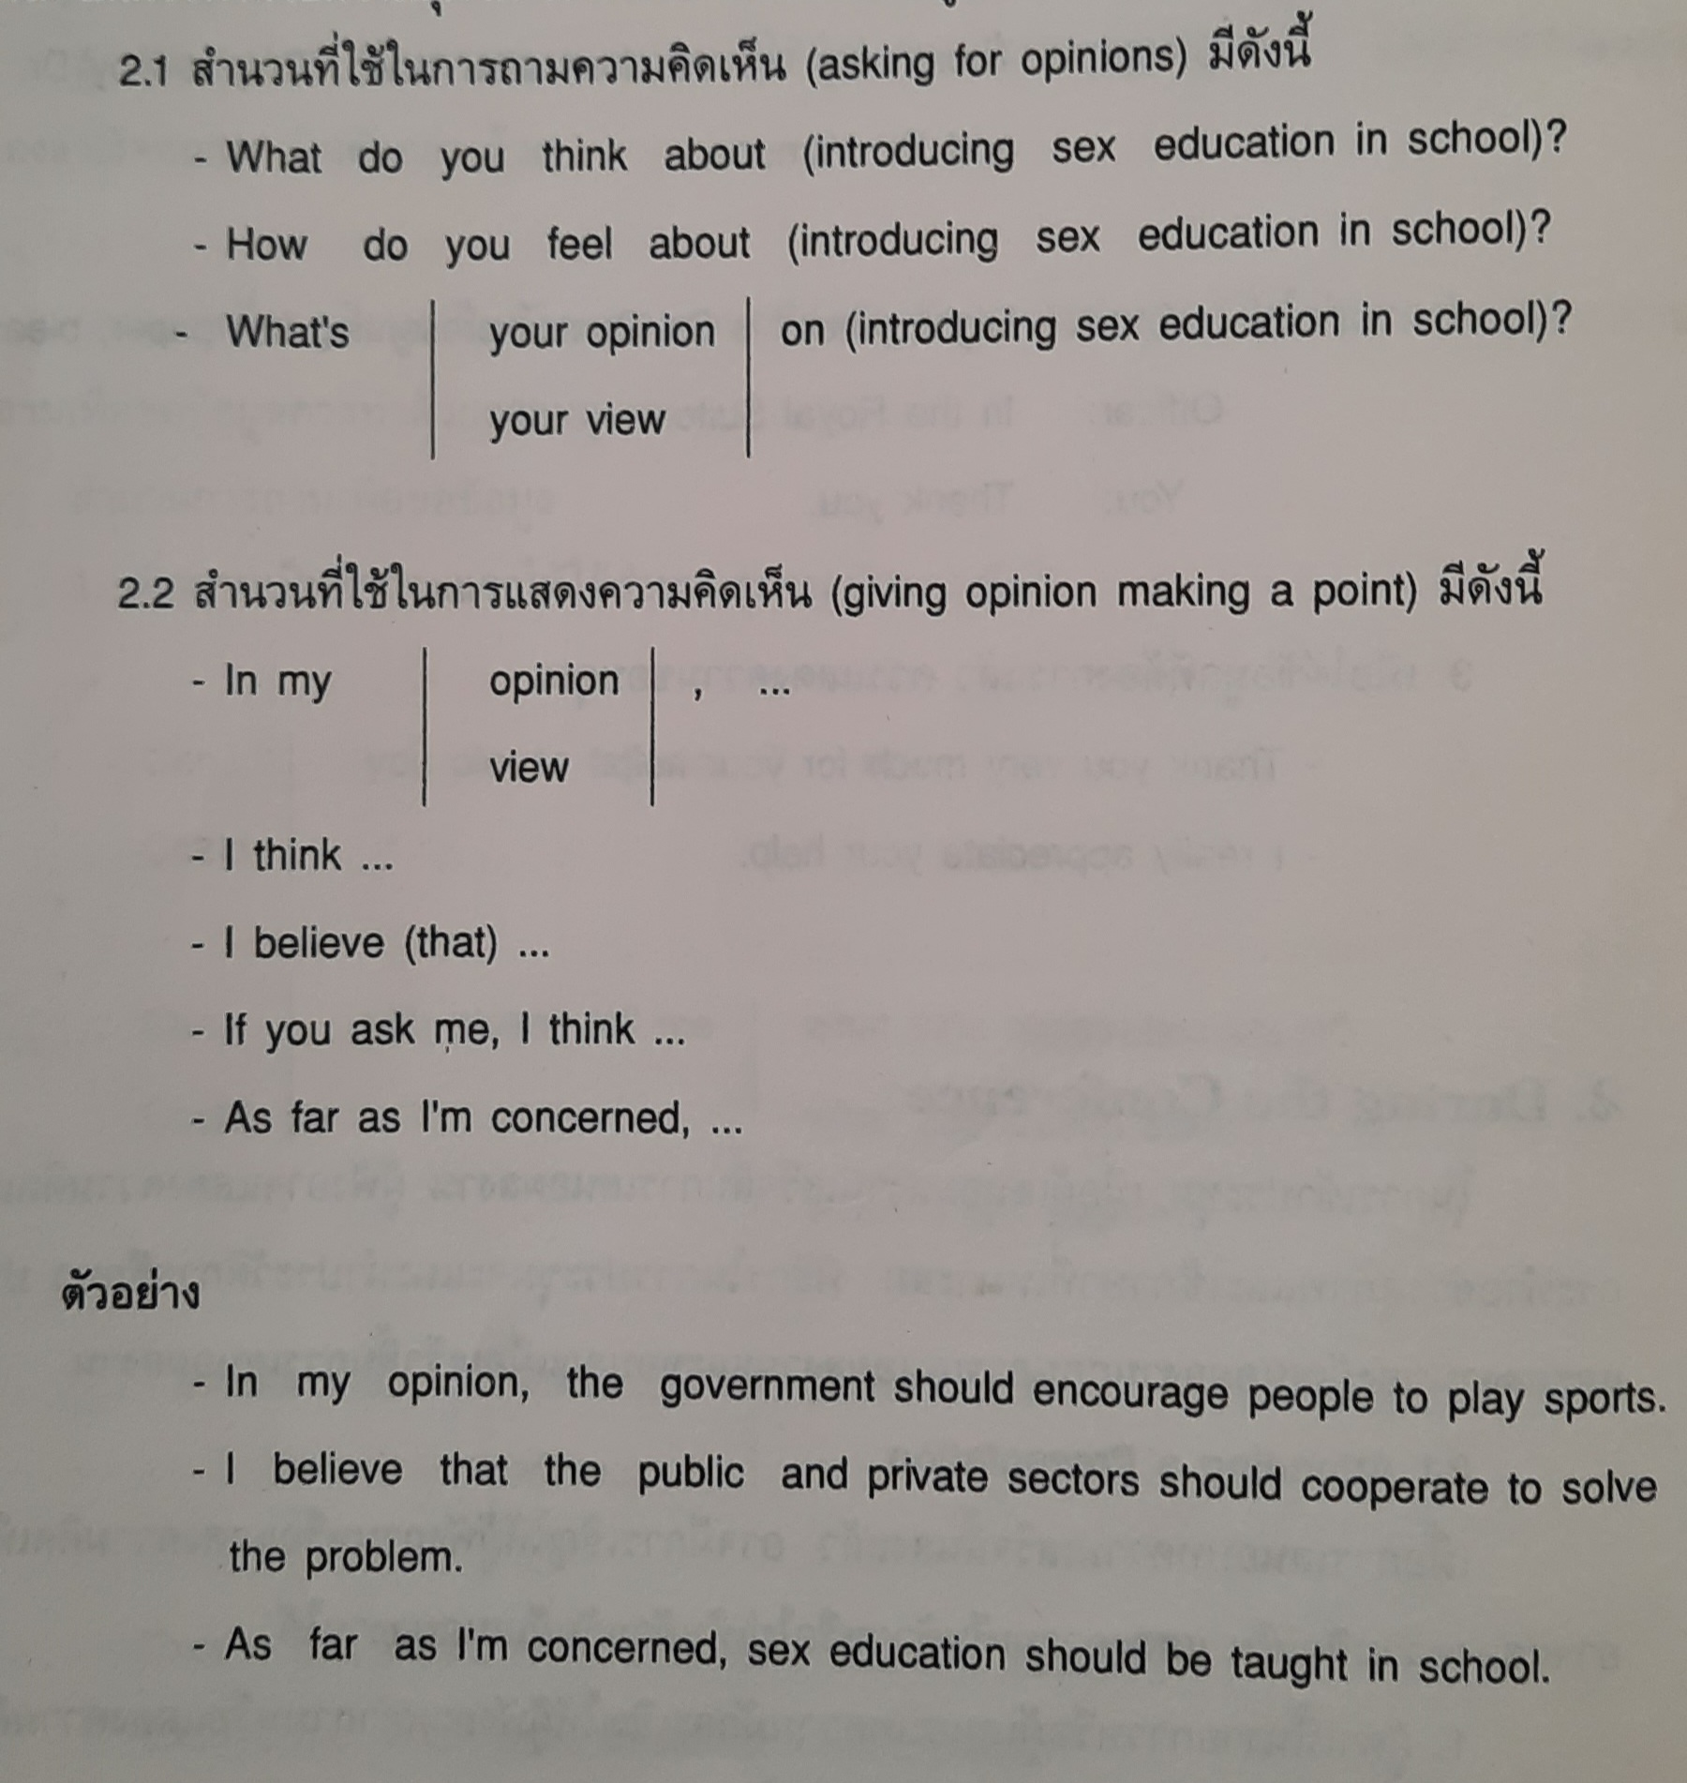
Asking for Opinions
Giving Opinion

Slide 18
During the Conference
Agreeing
-Exactly, That’s true, I think so too, I agree, I couldn’t agree more, You’re absolutely right.
Disagreeing
-I don’t think so….., I don’t agree with you….., I totally disagree…., Well, perhaps you’re right, but……, You may be right, but……, I see your point, but…….

Slide 19
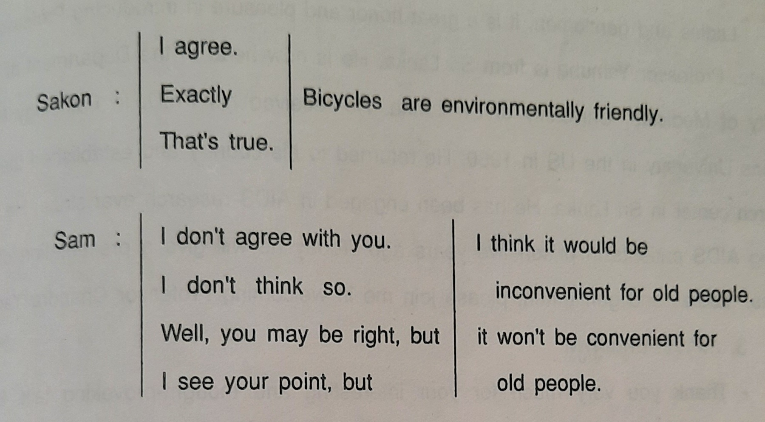
Agreeing and Disagreeing

Slide 20
During the Conference
MC Functions
Ladies and gentlemen, it is my great pleasure to introduce to you Professor Somchai Borvornkitti.
Ladies and gentlemen, I would like to introduce Professor Somchai Borvornkitti.
Ladies and gentlemen, Professor Somchai Borvornkitti.
Please join me in welcoming Professor Somchai Borvornkitti.
Please welcome Professor Somchai Borvornkitti.

Slide 21
Content of Research Article Presentation
*Background and significance of research (1 Slide)
* Research objectives & hypothesis (1 Slide)
*Scope of research (2 Slides)
-Study population and sample (sample sampling)
-Content/Variables (dependent and independent variables)
-Study area
-Time of data collection
*Research expected benefits (1 Slide)
*Research conceptual framework (1 Slide)
*Population and sample (1 Slide)
*Research tools/equipment (1 Slide)
*Data collection and analysis (1 Slide)
*Research Results and discussion (It dependent on your results)
*Suggestions (1 Slide)

Slide 22
Presentation
Usually 10-20 minutes
Audience is usually students and academics
Talks are categorized by topic (remember not everyone will know about your topic)
Objective is to get people interested in your work
Don’t have time to present every detail
Organize slides to emphasize
Big picture
Use short, clear bullet points
Don’t use complete sentences
Fill in details verbally or refer to your paper

Slide 23
Presentation
Practice, practice, practice
Don’t rush through paper
Stay within the time limit
Dress appropriately
Make eye contact with audience
Make sure your presentation makes sense
Don’t apologize for being nervous or unprepared
Check room before hand to become familiar with the environment
Speak enthusiastically about your research

Slide 24
Social Activities
On Arrival
On the Field Trip
Departure

Slide 25
On Arrival
Filling out forms
Name-First name, Middle name (maiden name), Family name (last name, surname)
Sex (male, female)
Nationality
Date of birth
Place of birth
Passport number
Place of issue passport
Date of issue passport
Visa number
Place of issue visa
Date of issue visa
Airline and flight number/Ship name

Slide 26
On Arrival
Purpose of visit
Accompanying persons
Residence
Citizenship/Nationality
Address (address while in the country, current address, permanent address, contact address)
Signature
Embarkation
Disembarkation

Slide 27
On Arrival
Getting to the Venue
Where can I get a bus/taxi/underground/sky train/monorail?
How can I get to the Airport/the hotel……../railway station
How much does it cost/What does it cost?
When will the train/bus leave?/What time will it arrive?/How often does it come?
It comes/leaves every + time (minute/hour).

Slide 28
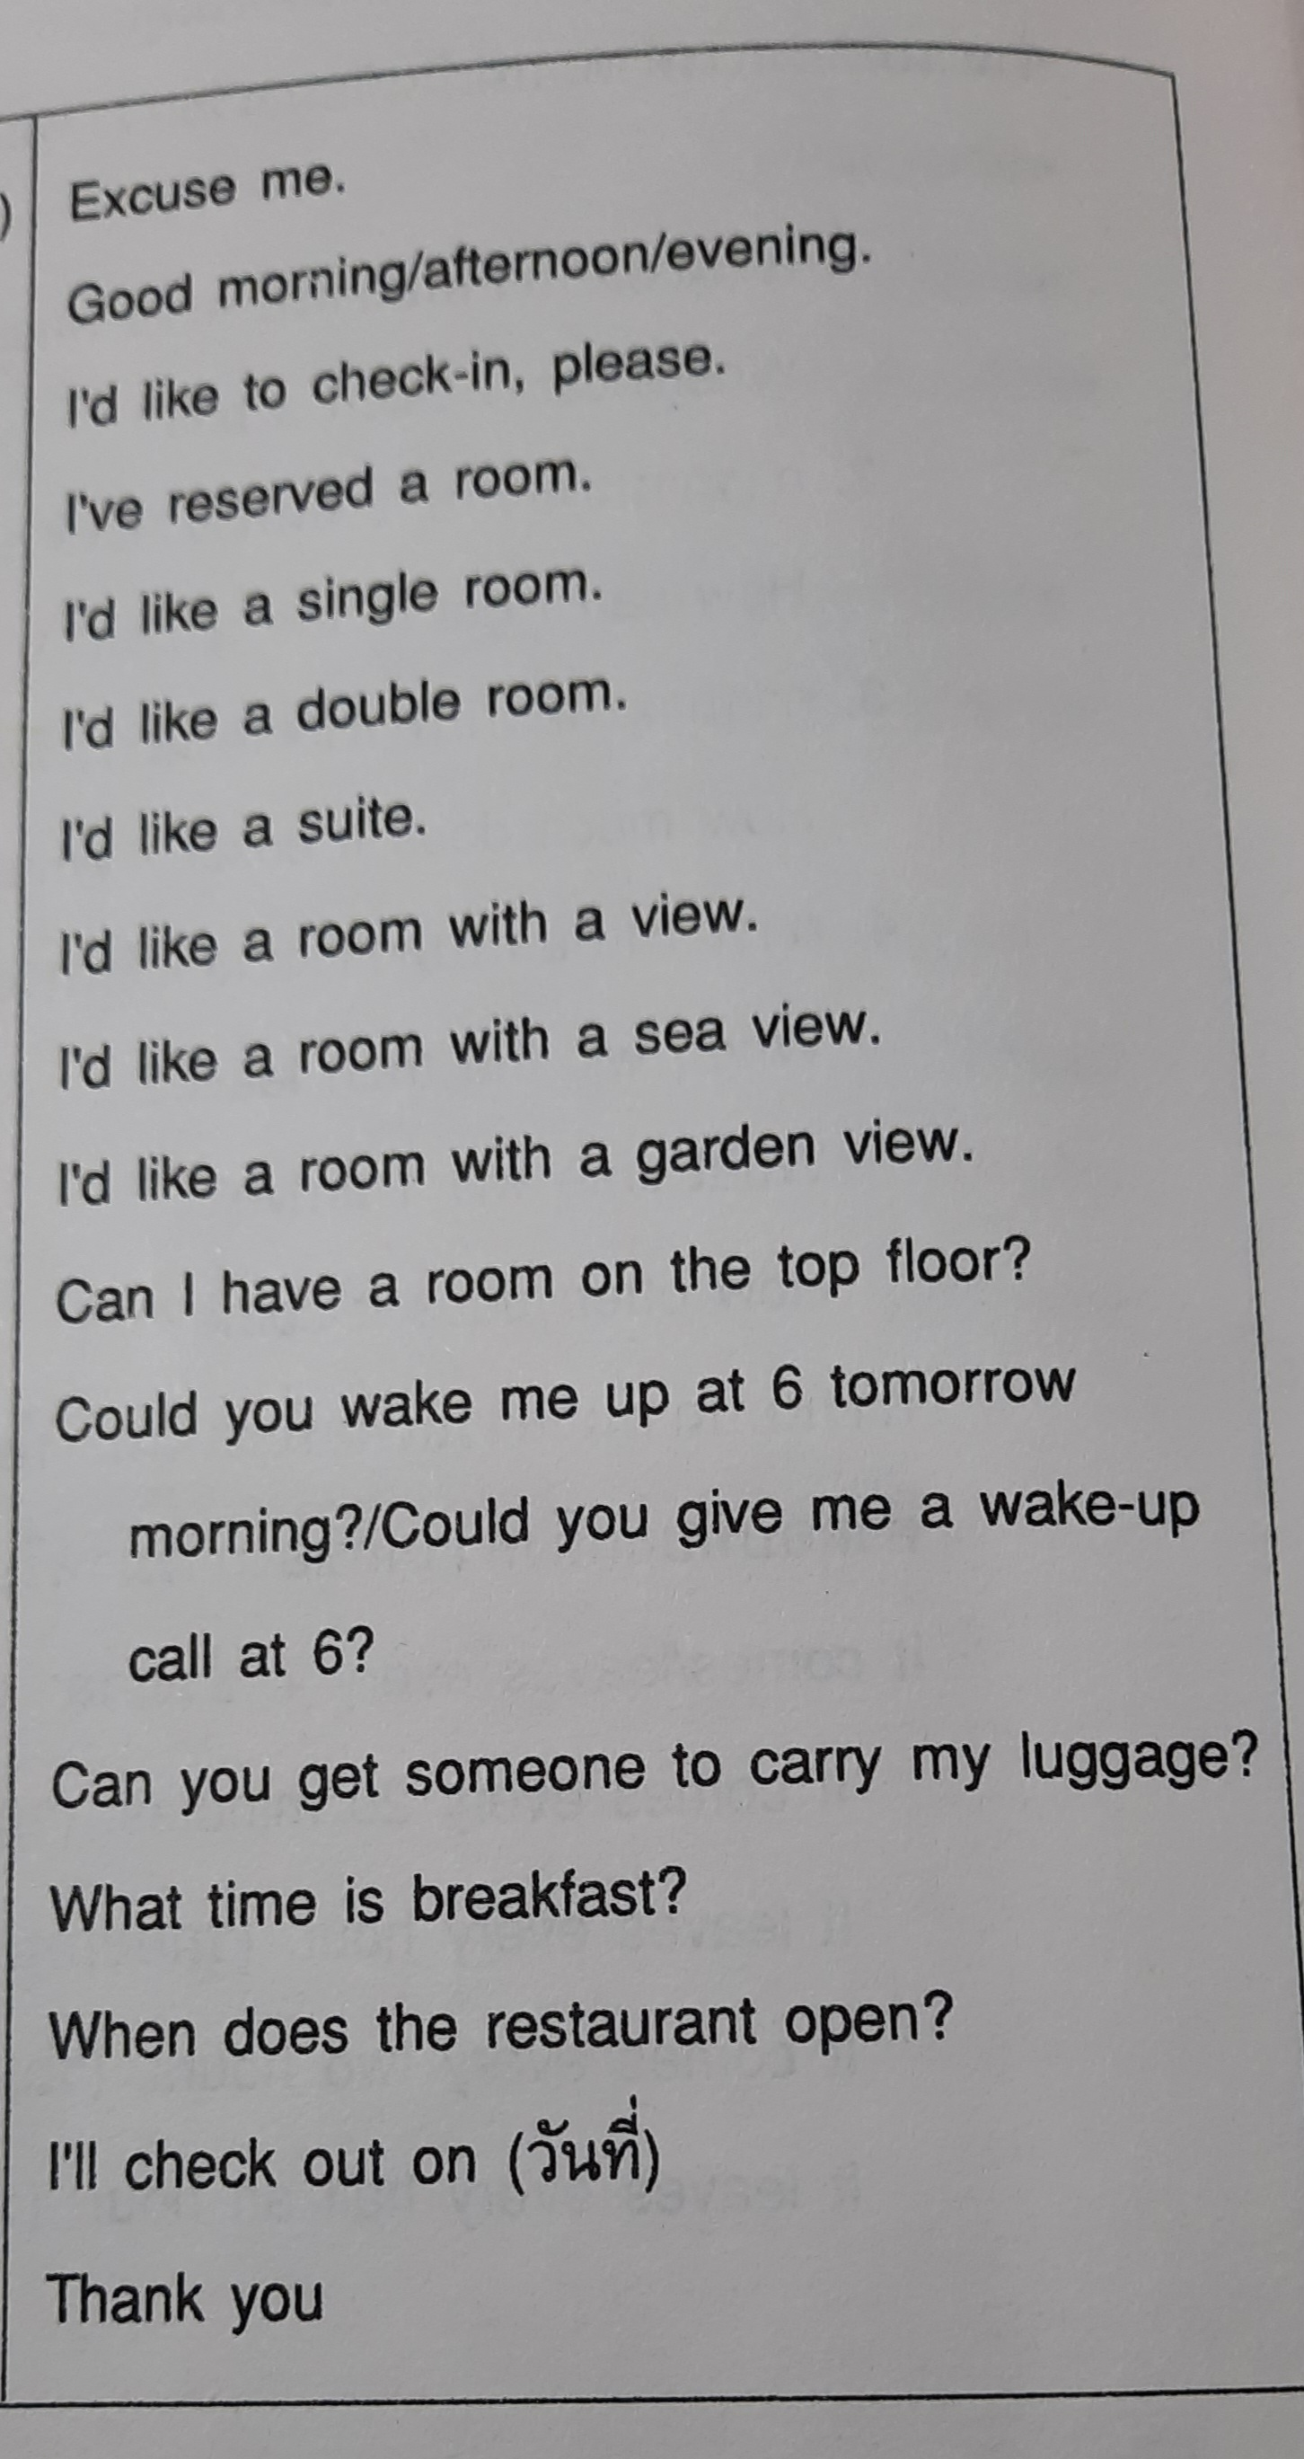
On Arrival
Checking in at the hotel

Slide 29
On the field trip
Study tours/visit
We’re having a welcoming ceremony/reception ceremony at (time)
We’re having breakfast/lunch/dinner/coffee break) at (time).
Greeting
Introducing oneself/one’s group
Expressing thanks
Stating the work (My/Our works/work deals/deal with(focuses/focus on) ……
Stating benefits (The information we will receive from you/your instution will certainly be helpful to our work/project.

Slide 30
On the field trip
Briefing
1. Good morning/Good afternoon/Good evening Distinguished guests/academicians/ladies and gentlemen…….
2. Stating details
3. Welcoming greeting
It is indeed an honor and privilege for me to welcome you to ……
On behalf of ………., I’d like to welcome you to………
Introduction
I’d like to start by……
May I now present to you…………?
I’d like to start by stating the scope of work we’re doing here.
Now, may I take this opportunity to brief you on what we are doing in ………………..?

Slide 31
On the field trip
Presentation
If you (will) look at…….
May I draw your attention to…….
If you (will) look at the bar graph, you can see that……..
May I draw your attention to page……of the handout.
Conlusion
Once again, on behalf of………., I am very pleased to have you as our guests.
Please feel free to let me know if there is anything we can do to make your stay more pleasant.

Slide 32
On departure
Reconfirming flights
p.m./a.m.
Have a seat assignment
Aisle/window seat
I’d like to reconfirm my flight.
It is possible to have a seat assignment.
Check-out from the hotel
Room number (348 = three forty-eight, 1234 = twelve thirty-four)
How would you like to pay?
I’d like to pay my bill now.
I’d like to make a payment now.
I’d like to pay by/in credit card/traveler’s cheque/check/cash/dollars/Visa card.

Slide 33
Q & A

