Slide 1

TIH4311
Tourism Project Management
Benjaporn Yaemjamuang / benjaporn.ya@ssru.ac.th

Slide 2
Tourism Project Management:
A Comprehensive Guide
This presentation provides an in-depth exploration of project management principles tailored specifically for the tourism industry. Designed for students and aspiring professionals, this guide covers the complete project lifecycle—from initial concept through to successful closure—equipping you with practical frameworks, analytical tools, and contemporary approaches essential for managing tourism projects effectively. Whether you're planning a destination marketing campaign, developing a new tourism attraction, or coordinating an international travel event, the systematic methodologies presented here will enable you to deliver projects on time, within budget, and to the highest quality standards. Understanding these fundamental principles is crucial for navigating the complex, dynamic landscape of modern tourism management.

Slide 3

CHAPTER 1
Defining Tourism Project Management: Core Concepts and Frameworks
Understanding Tourism Projects
Types and Categories
Tourism projects represent temporary endeavours with defined start and end points, designed to create unique services, experiences, or products within the tourism sector. Unlike routine operational activities, projects are characterised by their distinctive objectives, specific deliverables, and constrained resources. Examples include developing a heritage tourism trail, launching a sustainable ecotourism initiative, organising an international tourism conference, or implementing a digital marketing campaign for a destination. Each project possesses unique characteristics including temporal boundaries, specific resource allocations, cross-functional team collaboration, and measurable outcomes that contribute to broader tourism development goals.
Tourism projects span diverse categories: infrastructure development (hotels, transport hubs), event management (festivals, conferences), marketing campaigns (destination branding), product development (tour packages, experiences), sustainability initiatives (conservation programmes), and technology implementation (booking systems, virtual tours). Understanding these typologies helps managers select appropriate methodologies and tools tailored to specific project requirements.

Slide 4
CHAPTER 1
Defining Tourism Project Management: Core Concepts and Frameworks
Industry Significance
Project Manager's Role
Critical Insight:
Tourism projects differ fundamentally from permanent operations. They require specialised management approaches that accommodate uncertainty, stakeholder complexity, and the industry's seasonal dynamics.
Effective project management drives innovation, competitive advantage, and sustainable growth in tourism. It enables organisations to respond to market changes, capitalise on emerging opportunities, and deliver exceptional visitor experiences whilst managing risks and optimising resource utilisation.
The tourism project manager serves as the central orchestrator, responsible for planning, coordinating, and controlling all project elements. Key responsibilities include stakeholder liaison, team leadership, risk management, quality assurance, budget oversight, and ensuring alignment with organisational strategy and industry standards.

Slide 5





CHAPTER 2
The Project Management Lifecycle: A Systematic Approach
Tourism project management follows a structured lifecycle comprising five distinct yet interconnected phases. Each phase has specific objectives, deliverables, and success criteria that collectively ensure systematic progression from concept to completion. Understanding this cyclical framework is essential for maintaining control, managing stakeholder expectations, and achieving project objectives efficiently.
The initiation phase establishes the project foundation. Activities include identifying opportunities or problems, conducting feasibility studies, defining preliminary scope, securing stakeholder buy-in, and obtaining formal authorisation. A project charter documents the business case, high-level requirements, constraints, and assigned project manager authority. For tourism projects, this might involve market research, destination analysis, competitive assessments, and preliminary financial projections to justify investment.
Parallel to execution, monitoring and control activities track performance against baselines, identify variances, implement corrective actions, and manage changes. Key processes include progress tracking, budget monitoring, quality audits, risk reassessment, and stakeholder communication. Performance metrics and regular reporting ensure transparency and enable proactive issue resolution before minor problems escalate.
Planning transforms vision into actionable strategy. Comprehensive planning encompasses scope definition, activity sequencing, resource allocation, schedule development, budget formulation, quality standards establishment, risk identification, communication protocols, and procurement strategies. The planning phase produces detailed documentation including project management plans, work breakdown structures, Gantt charts, and risk registers that serve as roadmaps throughout execution.
Formal closure ensures orderly project completion. Activities include final deliverable verification, stakeholder acceptance, contract closure, documentation archiving, resource release, celebration of achievements, and lessons learned capture. Proper closure provides accountability, enables knowledge transfer, and establishes foundations for future project improvements within the tourism organisation.
Execution brings plans to life through coordinated team efforts. Project managers direct activities, manage resources, ensure quality standards, engage stakeholders, and facilitate communication. In tourism contexts, this might involve construction activities, marketing campaign implementation, staff training, partnership development, or service delivery preparation. Effective execution requires strong leadership, problem-solving capabilities, and adaptability to emerging challenges.

Slide 6
CHAPTER 2
The Project Management Lifecycle: A Systematic Approach
Defining Objectives and Outcomes
Clear, measurable objectives guide all project activities. Tourism projects must establish SMART (Specific, Measurable, Achievable, Relevant, Time-bound) objectives aligned with organisational strategy and stakeholder expectations. Outcomes should address tangible deliverables (e.g., completed facilities, launched products) and intangible benefits (e.g., enhanced destination reputation, improved visitor satisfaction). Well-defined objectives facilitate performance measurement, enable informed decision-making, and provide criteria for project success evaluation.

Slide 7


CHAPTER 3
Resource Analysis and Stakeholder Management in Tourism Projects
Human Resource Management
Stakeholder Analysis and Engagement
People represent the most critical project resource. Effective human resource management encompasses team assembly, role definition, skill development, performance management, conflict resolution, and motivation. Tourism projects often require multidisciplinary teams including marketing specialists, operations managers, financial analysts, sustainability experts, and customer service professionals. Successful project managers recognise individual strengths, foster collaborative environments, provide clear direction, and empower team members to contribute their expertise towards shared objectives.
Tourism projects involve diverse stakeholders with varying interests, influence, and expectations. Stakeholders may include investors, government agencies, local communities, environmental groups, tourism operators, visitors, employees, and media. Systematic stakeholder analysis identifies all parties, assesses their power and interest levels, and develops tailored engagement strategies. Tools such as stakeholder mapping matrices prioritise engagement efforts, ensuring critical stakeholders receive appropriate attention whilst managing competing interests effectively.
1
2
3
Define Team Structure
Identify Required Competencies
Foster Team Cohesion
Establish clear organisational hierarchy, reporting relationships, and accountability frameworks. Define roles such as project sponsor, steering committee, core team members, and extended contributors. Document responsibilities using RACI matrices (Responsible, Accountable, Consulted, Informed) to eliminate ambiguity and ensure comprehensive task coverage.
Assess skill requirements across technical, managerial, and interpersonal domains. Tourism projects may need expertise in destination marketing, sustainable tourism practices, cultural heritage management, digital technologies, financial modelling, or regulatory compliance. Gap analysis identifies development needs addressable through training, mentoring, or external recruitment.
Build trust, encourage open communication, and cultivate shared commitment to project success. Team-building activities, regular meetings, collaborative problem-solving, and recognition of contributions strengthen interpersonal bonds essential for navigating project challenges and maintaining momentum through difficult phases.
Communication and Teamwork Excellence
Effective communication underpins project success. Develop comprehensive communication plans specifying what information needs sharing, with whom, when, through which channels, and in what format. Tourism projects benefit from regular status meetings, progress reports, stakeholder briefings, and transparent issue escalation processes. Foster cultures of openness where team members feel safe raising concerns, sharing ideas, and seeking assistance. Strong teamwork transforms individual capabilities into collective achievements exceeding the sum of individual contributions.

Slide 8
CHAPTER 4
Activity Design and Project Structure Development
01
02
Scope Definition
Work Breakdown Structure (WBS)
Project scope establishes boundaries defining what is included and explicitly excluded from the project. Scope definition prevents scope creep—the uncontrolled expansion of project boundaries that jeopardises timelines and budgets. For tourism projects, scope statements detail specific deliverables (e.g., "develop 10 new tour packages targeting millennial travellers") and constraints (e.g., "launch within 6 months using existing distribution channels"). Clear scope documentation with stakeholder validation ensures shared understanding and provides baselines for change management.
The WBS hierarchically decomposes project scope into manageable work packages. This structural framework organises complex projects into smaller, more easily planned and controlled components. Each WBS level provides increasing detail, ultimately reaching work packages assignable to specific team members with clear completion criteria. For example, a tourism festival project's WBS might break down into marketing, operations, entertainment, logistics, and finance branches, each further subdivided into specific activities.
03 Activity Sequencing
04 Priority Assignment
Identify logical relationships between activities, determining which tasks must complete before others can begin (predecessors/successors), which can occur simultaneously, and which dependencies exist. Tourism projects often feature complex interdependencies—for instance, marketing materials cannot finalise until product features are confirmed, whilst venue booking must precede detailed event planning. Proper sequencing optimises schedules and resource utilisation.
Not all activities hold equal importance. Prioritisation considers factors including critical path impact, stakeholder importance, risk levels, and resource availability. High-priority activities receive preferential resource allocation and closer monitoring. In tourism contexts, customer-facing elements and regulatory compliance activities typically warrant highest priorities, whilst internal documentation might accept lower urgency.
"A project without a clear work breakdown structure is like a journey without a map—you may eventually arrive somewhere, but probably not where you intended, and certainly not via the most efficient route."
Effective activity design and project structuring transform abstract objectives into concrete action plans. These frameworks provide clarity, facilitate coordination, enable accurate estimation, and establish foundations for effective monitoring and control throughout project execution.

Slide 9

CHAPTER 5
Duration Estimation
Accurate time estimation is crucial for realistic scheduling. Estimation techniques include expert judgement (leveraging experienced practitioners' insights), analogous estimating (using historical data from similar projects), parametric estimating (applying statistical relationships between variables), and three-point estimating (calculating optimistic, pessimistic, and most likely durations). Tourism projects must account for seasonal factors, weather dependencies, permit approval timelines, and stakeholder availability when estimating durations. Build contingency buffers for uncertainty whilst maintaining realistic stakeholder expectations.
Schedule Development
Transform activity sequences and duration estimates into comprehensive project schedules. Gantt charts provide visual timeline representations showing activity start/end dates, durations, dependencies, and milestones. Critical Path Method (CPM) analysis identifies the longest dependent activity sequence determining minimum project duration. Activities on the critical path have zero float—any delay directly impacts project completion. Non-critical activities possess float, allowing some scheduling flexibility without affecting overall timelines.
Industry Consideration: Tourism projects often face seasonal constraints. A beach resort renovation must complete before peak summer season, whilst a winter festival requires completion before weather deteriorates. Factor such industry-specific temporal constraints prominently in scheduling.
Time Management and Project Trajectory Forecasting
Planned Progress
Actual Progress
Progress Tracking and Monitoring
Regular progress monitoring compares actual performance against planned schedules, enabling early variance detection and corrective action. Tracking mechanisms include milestone reviews, percentage completion assessments, earned value analysis, and status reporting. Tourism projects benefit from visual dashboards displaying schedule status, highlighting critical activities, and flagging delayed tasks. Proactive monitoring prevents small slippages from cascading into major delays, maintaining project momentum and stakeholder confidence.

Slide 10
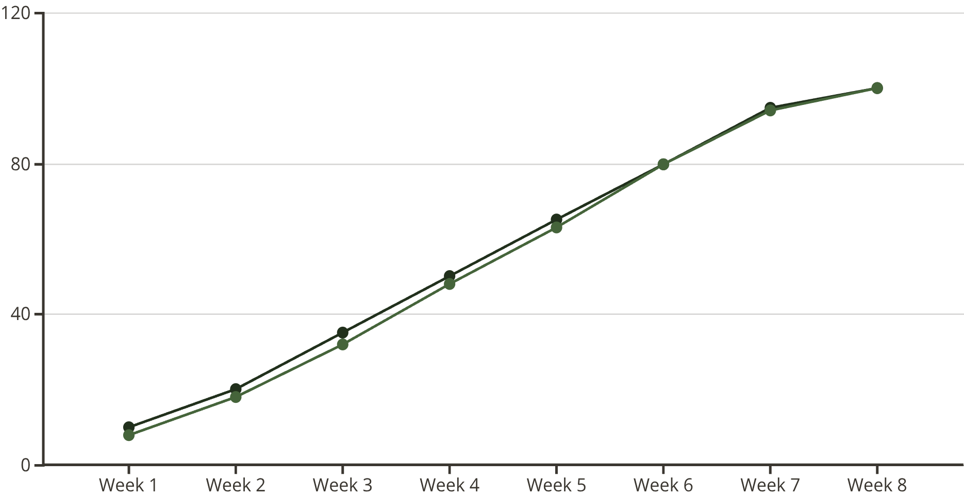
Resource-Time-Activity Relationships
Time, resources, and activities form interconnected variables. Increasing resources may accelerate activities (crashing), whilst resource constraints may extend durations. Resource levelling smooths resource usage over time, avoiding peaks and valleys that create inefficiencies. Tourism project managers must balance competing demands—aggressive schedules may require premium resource costs, whilst extended timelines risk market opportunity losses or increased holding costs. Optimisation seeks the sweet spot balancing time, cost, and quality objectives.

Slide 11


CHAPTER 6
Budget Management and Value Optimisation
Budget Development Fundamentals
Project budgets aggregate estimated costs across all activities, resources, materials, services, and contingencies required for project completion. Tourism project budgets typically encompass personnel costs (salaries, contractors), marketing expenditures (advertising, promotional materials), operational expenses (venue hire, equipment rental, utilities), capital investments (infrastructure, technology), professional services (consultants, legal), and overhead allocations. Bottom-up estimating builds budgets by costing individual work packages and aggregating upwards, ensuring comprehensive coverage and realistic financial planning.
Cost Estimation Techniques
Cost Control Strategies
Historical data analysis from comparable projects
Regular expenditure tracking against budget baselines
Vendor quotations and market rate research
Variance analysis identifying over/under-spending patterns
Parametric models using cost per unit metrics
Change control processes for scope modifications
Reserve analysis for contingencies and management reserves
Value engineering to reduce costs without quality compromise
Expert judgement from finance professionals
Earned value management integrating cost and schedule performance
Cost-Benefit Analysis
Quality Assurance
Cost-benefit analysis evaluates whether project investments generate sufficient returns. Quantify expected benefits (revenue increases, cost savings, market share gains, brand value enhancement) and compare against total project costs. Tourism projects may deliver tangible financial returns (ticket sales, accommodation bookings) and intangible benefits (destination awareness, community pride, environmental conservation). Calculate metrics including return on investment (ROI), payback period, net present value (NPV), and benefit-cost ratio to inform go/no-go decisions and prioritise project portfolios.
Quality management ensures project deliverables meet specified standards and stakeholder expectations. Define quality criteria early, establish measurement processes, conduct regular audits, and implement corrective actions for deficiencies. In tourism, quality encompasses service standards, safety compliance, environmental sustainability, cultural sensitivity, and visitor satisfaction. Budget adequate resources for quality assurance activities—prevention costs typically prove far lower than rectification expenses or reputational damage from quality failures.
Effective budget management balances financial constraints with quality imperatives. Tourism project managers must optimise value delivery within available resources, making strategic trade-offs that maintain project viability whilst satisfying stakeholder expectations and achieving intended outcomes.

Slide 12
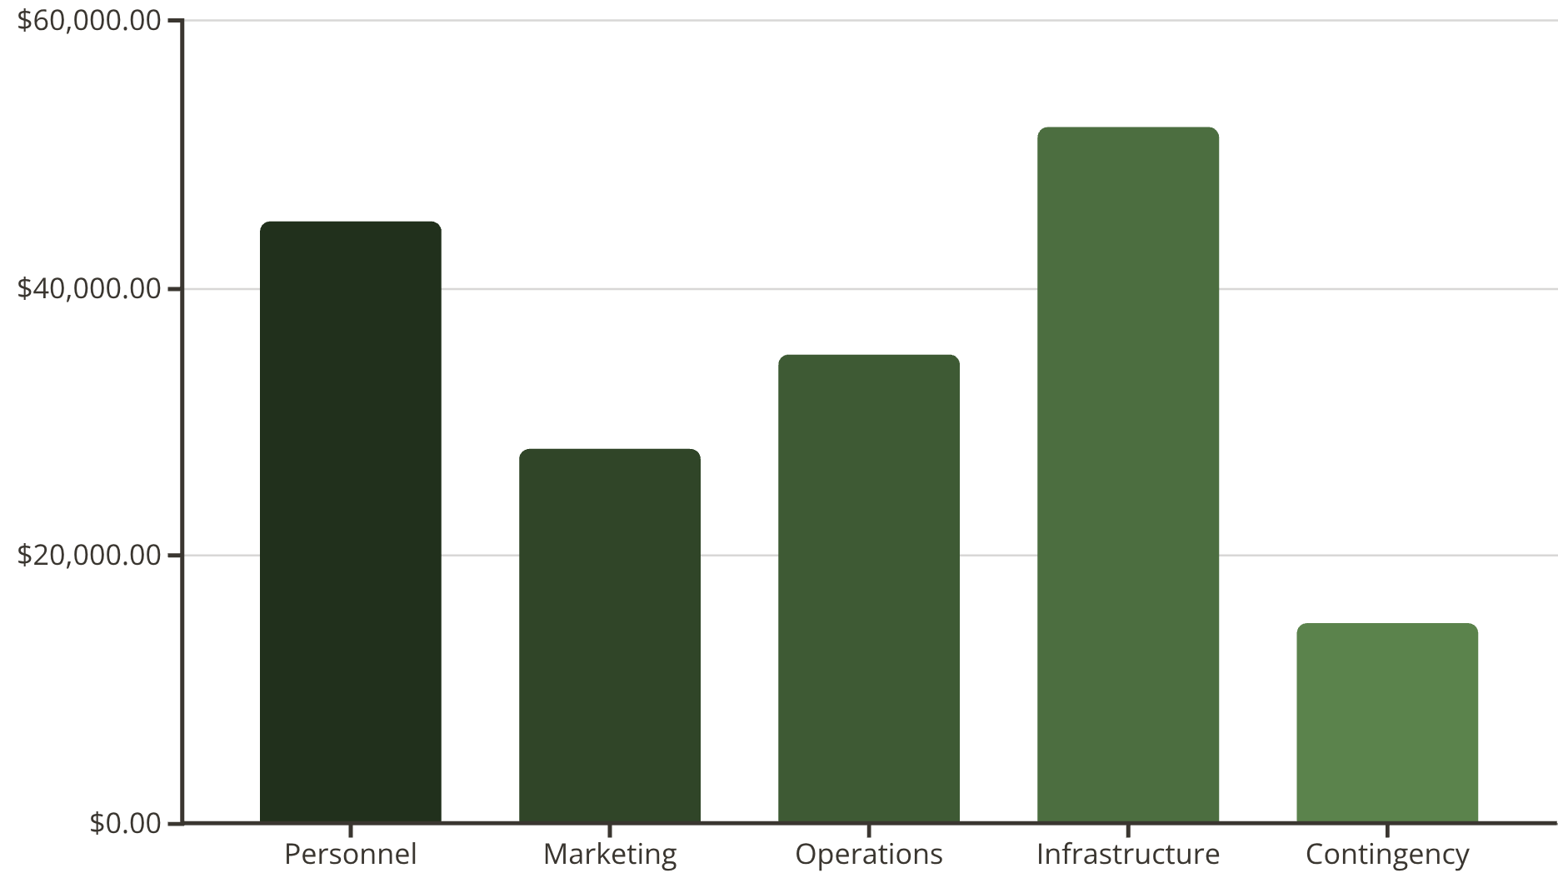

Slide 13

CHAPTER 7
Modern Tools, Technology, and Applied Knowledge
Digital Project Management Platforms
Tourism-Specific Technologies
Data-Driven Decision Making
Contemporary project management increasingly relies on sophisticated software tools. Platforms such as Microsoft Project, Asana, Trello, Monday.com, and Smartsheet provide comprehensive functionality including task management, resource allocation, timeline visualisation, collaboration features, and real-time reporting. Cloud-based solutions enable distributed teams to coordinate seamlessly, access updated information instantaneously, and maintain project documentation in centralised repositories.
The tourism sector benefits from specialised technologies including booking systems, customer relationship management (CRM) platforms, revenue management tools, visitor analytics, virtual reality experiences, and social media management solutions. Integrate these technologies into project planning for tourism initiatives—for example, implementing a new booking platform requires technical configuration, staff training, system testing, and customer communication activities within the project plan.
Modern project management emphasises evidence-based approaches. Leverage data analytics to inform planning, monitor performance, and predict outcomes. Tourism projects can utilise visitor statistics, market research, competitive intelligence, social media sentiment analysis, and financial modelling to reduce uncertainty and improve decision quality. Business intelligence tools transform raw data into actionable insights supporting strategic project choices.
Case Study: Sustainable Community Tourism Initiative
Consider a practical example: developing a community-based ecotourism project in a rural region. The project charter defined objectives including creating employment opportunities, preserving cultural heritage, protecting natural resources, and generating sustainable income streams. Planning involved stakeholder consultations with local communities, environmental assessments, tourism product development, infrastructure improvements, capacity building programmes, and marketing strategy formulation. Technology tools facilitated virtual stakeholder meetings, collaborative document creation, financial tracking, and promotional campaign management. Implementation faced challenges including limited digital literacy, infrastructure constraints, and balancing tourist access with conservation needs. Adaptive management, regular monitoring, and strong community engagement enabled successful navigation of these challenges. The completed project delivered homestay accommodation, guided nature walks, cultural demonstrations, and handicraft sales, creating economic benefits whilst maintaining environmental and cultural integrity.
"Technology amplifies capability, but people drive success. The most sophisticated tools cannot substitute for clear vision, strong leadership, and committed teamwork in delivering tourism projects that create lasting value."

Slide 14
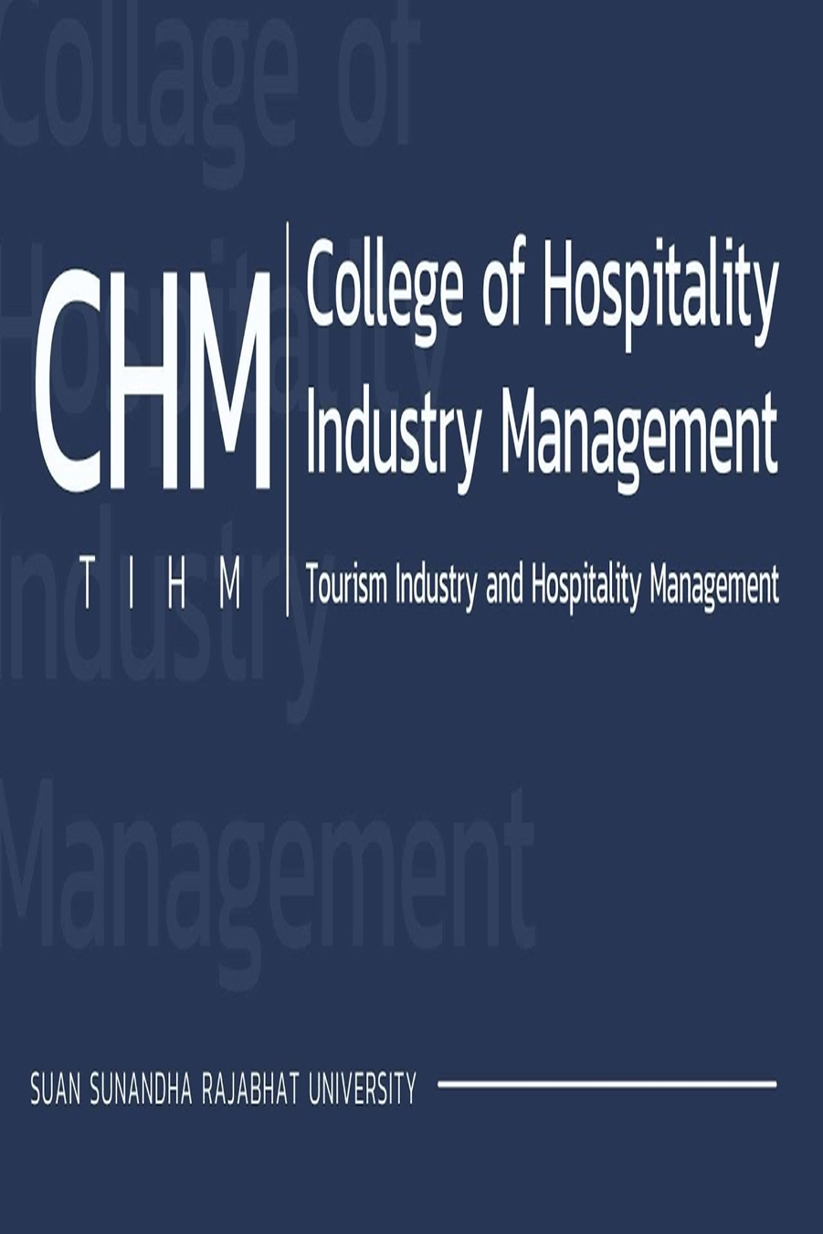


Tourism Project Management
Q & A
Benjaporn Yaemjamuang / benjaporn.ya@ssru.ac.th

