Slide 1
Lesson 8
International Investments

Slide 2
What Is International Investments?
international Investments are those investments that are made outside the domestic markets and offer portfolio diversification and opportunities for risk minimization. An investor can make international investments, thereby broadening his portfolio and expanding his horizon of returns.

Slide 3
international investments also serve as a means of adding different financial instruments to the list when domestic markets are confined and limited by their variety. International investments aim to assure investors of two probabilities; the counter of domestic market risks and the opportunities in foreign markets

Slide 4
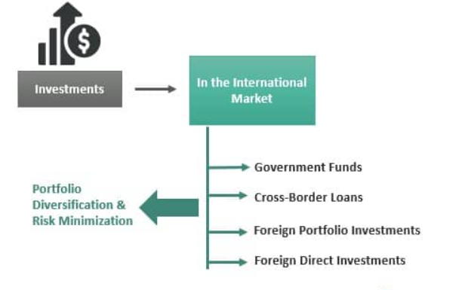
International Investments

Slide 5
Key Take aways
International investment refers to the allocation of funds in assets, securities, or projects outside one’s home country, aiming to diversify portfolios and capture opportunities in global markets.
International investments offer the benefit of diversifying one’s investment portfolio, allowing investors to spread their risk across different markets and economies.
By investing internationally, investors can counterbalance risks associated with domestic markets.
International investments provide access to a wider range of financial instruments, allowing investors to explore combinations of equity and debt instruments that may not be available in their domestic markets.

Slide 6
Types
Best international investments types can be broadly classified into the following categories:
Government Funds/Aids – These are funds that flow from one economy to the other with the purpose of aid or assistance to the economy as a whole. These transactions are carried out between the governments.
Cross Border Loans – A loan arrangement where a government or institution seeks loan financing from a foreign bank is known as cross border loans. Cross-border financing became a popular financing vehicle because of its easier accessibility and fewer collateral restrictions.
Foreign Portfolio Investment – When investors express investment interests in foreign companies, they are known as FPIs. These investors may not have long-term interests necessarily but can be traded easily through exchanges.
Foreign Direct Investment – FDIs are investments made by foreign multinational companies in an economy. Foreign direct investment is more of a long-term concern and takes any form of investing from equities and debts to property and assets

Slide 7
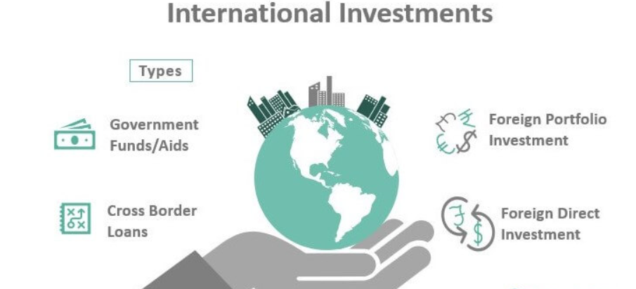

Slide 8
Financial Instruments
The global international investments can be done through these financial instruments.
American Depository Receipts – These are the most common forms of investing internationally. An investor in the international investment companies of United States can trade in foreign stocks with the help of ADRs The stock will be listed on an American exchange and underlying being held by an American custodian bank.
Global Depository Receipts – These are similar in nature as the ADRs. GDRs have issued certificates for investors in more than one country to trade with foreign company stocks.
Foreign Currency Convertible Bonds – A convertible bond that is issued in a foreign currency. A Euro bond issued by a US company in the UK is an example of FCCB wherein the principal repayment, and coupon payments will be made by the US company in Euro. However, the dividend payment upon conversion of the bond to equity will be made in US dollars.
Examples

Slide 9
Some examples of global international investments made across the globe:
The Indian economy saw a tremendous influx of foreign direct investment in recent years.
FDIs grew from US$ 17 billion in 2013-14 to US$ 36 billion in 2017-18. This was mostly attributed to greater ease of doing business coupled with strengthening the Indian equity market.
FDIs from Asia have reduced during the period 2015 to 2017. This was large because of the tax-related treaty between the Mauritius and Indian governments. The decline was a remarkable 30% during this period.
FDI fell by over one third during the global recession period in 2009 but later recuperated in 2010.

Slide 10
important Points To Note
Some important points to note regarding international investment companies are as given below.
There is not much difference between FDIs and FPIs if both have long term interests. However, FDIs may seek ownership and voting rights provisions as well.
With increasing technological advances and global reach, FPIs and FDIs have outplayed cross border financing in recent years. ‘
FPIs can take several forms, most common being equity and mutual funds.
Foreign direct investment is a subset of international investment.

Slide 11
Advantages
While the domestic market attracts investors in its own right, international investment theories too have advantages.
Access to opportunities existing in different markets that indigenous markets might not provide.
Access to instruments that allow negating currency exchange risk and may guarantee greater gains.
Offsetting risks pertaining to domestic markets and diversification of a portfolio

Slide 12
Disadvantages
Political and economic turbulence can greatly affect such investments
Accessibility to and availability of vital information related to foreign firms and markets is also a concern
Complications are rendered by legislation and varying operating conditions of foreign markets.

Slide 13
Risks
investments in international markets come with many drawbacks. Some of them are cited below:
Currency Exchange Rate – Foreign investment at the outset is prone to the risk of currency exchange. Fluctuations in currency exchange can affect big transactions drastically. Currency exchange can affect an equity instrument such that the investor may find different exchange rates at the time of buy and sell.
Credit Risk – Credit risk can as much affect an international investment as domestic investment. Investors should carefully exercise trades with due prominence to credit ratings.
Liquidity Risk – One of the biggest concerns of investing in international markets is liquidity risk issues. An investor sitting in the USA might not find buyers for his sale of securities in Japanese markets.

Slide 14
What Is Portfolio Investment?
Portfolio investments are investments made in a group of assets (equity, debt, mutual funds, derivatives, or even bitcoins) instead of a single asset to earn returns commensurate with the investor’s risk profile. Portfolio investments might vary from a small segment of one industry to a wide-ranging – entire market.

Slide 15
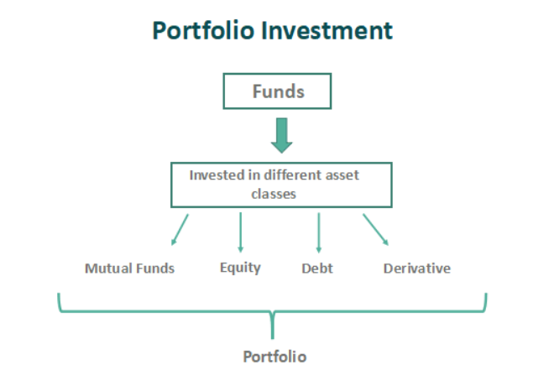

Slide 16
Portfolio Investment Explained
Portfolio investment management is the process of allocation the funds into a wide range of financial instruments which may include mutual funds, stocks, bonds, exchange traded funds(ETFs) or any other types of securities with the aim of earning are turn according to the risk profile and return expectations

Slide 17
Types
An investment gives returns in proportion to its risk factor. If one invests in highly risky assets like bitcoin, they can either get absurdly high returns or go to zero. But if one invests in treasury bonds, the risk factor is almost zero, but the returns are also very low. And each financial investor will have their risk profile tailored to their specific investments.
But the investments available in the market are not tailored to such needs. Hence each investor will have a specific requirement that can be maintained using a portfolio. The different types of diverse portfolio investment are as follows

Slide 18
Risk-Free Portfolios – Risk-free portfolios are the ones that have investment securities regarding treasury bonds and such where the risk is almost nil but low returns.
Low-Risk Portfolios – A portfolio with majorly risk-free assets combined with risk-based securities gives a blend of low-risk, decent returns.
Medium Risk Portfolios – A portfolio with more risk-free securities than the high-risk portfolio but fewer risk-based assets.
High-Risk Portfolios – This portfolio investment includes many high-risk securities that benefit with high returns.

Slide 19
The thought that one can attain high returns with low risk is a difficult one to perceive. The free market dynamics call it arbitrage – when two similar risk profiles pay off at different scales, one of them has a benefit over the others. Such a difference slows the investors to pounce on the opportunity and neutralizes the benefit of the difference in returns for similar risk portfolios. This is called the law of one price, and such a law of one price does not allow the same risk assets to have the same price. One should keep this in mind while preparing a portfolio – any returns more than that for the specific risk rate will not stand the test of time

Slide 20
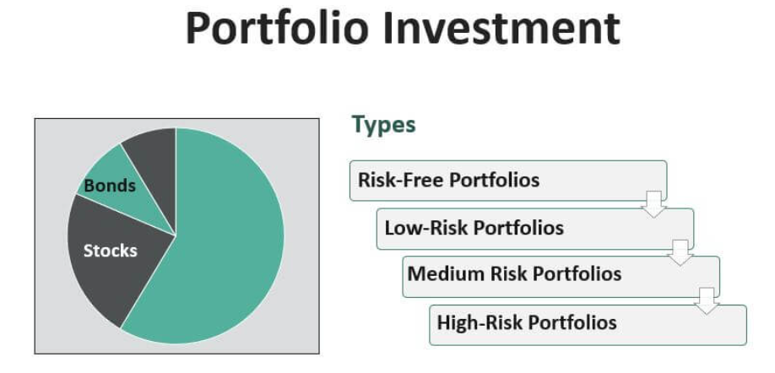

Slide 21
Strategies
Risk and return – Putting money in a portoilio of assets require a balance of return and risk. Investors should understand that a higher return will carry a higher risk and low risk does not have the potential to generate high return. Such options include bonds, certificate of deposits, treasury bills, etc. which have a guaranteed return that will be low along with low risk.
Diversification – This strategy emphasises on selecting different asset classes across sectors and regions in order to spread the risk. This is very important because in this portfolio investment management, the loss of one will get compensated by the other, bring a balance to the entire investment and reducing the impact of any one asset’s performance on the overall portfolio.
Allocation – As per the risk and return profile of the investor, it is necessary to allocate the fund in a systematic manner by determining a percentage for each financial instrument like stock, bond, etc, This is done after carefull analysis of market condition, investor’s risk and return profile and their financial goal.
Focus on long-term- Investment in a diversified portfolio will involve a focus on a long term strategy which will spread overa number of years. It also involves regular and systematic monitoring, rebalancing and required adjustment in case the investor’s requirement and market conditions change.
Alignment with objective – The portfolio should be aligned with the objective of designing it so that it serves the purpose of meeting the investor needs in the best way possible and with the time limit required.
Professional management – The portfolio should be managed by professional who have proper knowledge and skill to understand and analysis it so that appropriate selection of investments take place and monitored form time to time in order to meet the requirements.

Slide 22
Example
us take an example scenario to see how best portfolio investment returns and risks are calculated and represented.
For this, we will imagine a treasury bond that yields a return of 2% per annum. Treasury bonds are considered risk-free because the US government backs them. So, the return’s net variability/risk/variance will be zero. This means that the returns will be only 2% per annum a hundred percent of the time
Let us assume a stock with an average return of 10% and a variance of 2%. This means that if the returns are normally distributed, the net returns lie between 8% and 12% for 68% of the time.

Slide 23
Advantages
An individual’s risk profile can be met using diverse portfolio investment. It cannot be done by searching for a financial investment that allows the individual his risk profile.
An individual can decide how to diversify his investments -by stocks, markets, or types of investments.
Suppose the investor wants to manage different points of liquidity. It cannot be managed by one stock or one bond. But having a portfolio of assets will help him have a steady flow of income or flow of income at a necessary time.
Not all stocks pay dividends. Some stocks pay dividends, and some stocks are growth stocks. If the investor’s requirements from an investment stand somewhere in between, they can choose to invest in a portfolio that helps them benefit from dividends and growth stocks.
Investing in such multiple assets requires minimal management. This will reduce the transactional cost of investment and help save additional costs.
For people investing in multiple securities, the individual security analysis is not as important as the conjoint analysis. This helps in reducing the social cost of the investment.

Slide 24
Disadvantages
The following are the disadvantages of diverse portfolio investment.
One of the important reasons for proper stock market functioning is the information flow. Information flow is the theory where, because of the money involved, the decision-making during the stock price movement helps the company gauge the market’s conditions and the general public. If the stock price moves after a certain decision, it helps the company decide whether it is a good decision. However, with balanced portfolio investment, the movement of such stock prices becomes more uncertain as the risk is gauged as a whole, and hence the flow of information is uncertain.
If proper research is not done and a proper risk profile is not calculated, the portfolio will not yield optimum returns.
To calculate the returns for a certain amount of risk, the person has to analyze multiple stocks and form a portfolio. Though companies available analyze these sorts of portfolios and provide them, that still does not benefit the user to a full extent.
Financial knowledge is mandatory for people trying to invest by using a portfolio instead of individual stocks. The relations between individual stocks, stocks, and markets are difficult to analyze.

Slide 25
Portfolio Investment Vs Direct Investment
The former refers to putting money in a varied range of financial instruments with the aim of diversifying risk and earning a suitable return, whereas the latter refers to making a large investment in corporations or ventures with the aim of controlling and influencing the business operations.
The control level for the former is very limited whereas the latter involved high level of control with active participation on management as well as company policies and directions.
The risk level in case of the former is very less due to diversification according to the investor’s profile and financial aim The latter involves higher risk which totally depends on the performance of the company that in turn depends on internal operations and external factors like market conditions, economic stability, to name a few.
The balanced portfolio investment is generally more liquid than direct investment. The latter, once done, is very difficult to change into cash. It involves various steps and is a time consuming process.

Slide 26
What Is Portfolio Diversification?
Portfolio Diversification refers to choosing different classes of assets to maximize the returns and minimize the risk profile. Each investor has his risk profile, but there is a possibility that he does not have the relevant investment security that matches his risk profile.

Slide 28
Diversification is generally for long-term investors. Diversification will not help in trading. Traders who usually look for profits on a short term basis, has the ability to take high amount of risk in the hope of making high profits. They directly invest their money in one or two types of short term investment options without diversifying them. Thus, this clarifies the fact that high diversifying the portfolio may also reduce return along with mitigating the risk.

Slide 29
know where to put the money, one should have an idea about what different type of assets are. Because of the growth in technology and the availability of different finance products, there are an infinite number of ways I can diversify my portfolio. To keep the difficulty of the concepts low, let us consider a few classes of assets.

Slide 30
As we know, stocks represent the ownership of a part of the company – which comes with some obligations and benefits. This says that the investor (owner of stocks) is not eligible for anything except for ownership in the company. If the company goes down, the value of the investment goes down, and vice versa.
Therefore, the owner will not be safe from the company’s risks. Without proper information, it is impossible to gauge the company’s risk. This makes stocks a risky asset. If a person invests in them, they ought to be aware of the risks they are taking and should be willing to take those risks.

Slide 31
– Bonds: Treasury and Non-Treasury
Bonds are one way to raise money for the company, where they guarantee cash flows. Unlike stocks, bonds have a guarantee on them. A pre-specified amount will be paid to the bond owner for each duration. In short, a bond is like a fixed deposit except that it is tradeable. Therefore, the price of bonds goes down and goes up. Treasury bonds are bonds backed by the US Government, which makes them pretty much risk-free. Hence, this article will consider Treasury Bonds as the risk-free rate for all practical purposes.

Slide 32
investment portfolio diversification, one has to know about systematic and unsystematic risk.
Systematic risk is the risk that is existent in the market. One cannot hedge himself against the market with high returns. If he diversified enough, he would have market returns and risks. This makes systematic risk an unavoidable risk.
Unsystematic risk is the opposite of this. If a person buys the entire market, this risk is zero. So this risk can be used to measure how risky a person’s portfolio is. This risk can be reduced with enough diversification.

Slide 33
Strategies
Let us look at the above graph, which provides an idea about the entire topic of good portfolio diversification. The safest bet is to invest in an area filled with green. The bad investment is the investment in yellow.
Risk-free – US or Germany government bonds.
Low Risk – Stocks of companies that are well settled and have a steady cash flow. For Example, companies in Energy, Steel, and Utility industries.
Medium Risk – Companies that are well settled, but there are risks that the company is facing. The company might be big or small – Apple or Amazon will be a good example.
High Risk – Companies that have a high probability of growing but also, on the other hand, are closer to bankruptcy than the rest. Companies like Tesla are in this place.

Slide 34
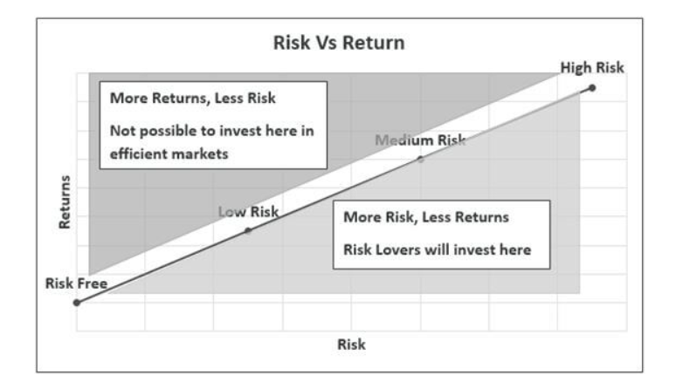

Slide 35

Methods
Spread the wealth. Do not invest in one place. Look for a portfolio where the risk matches the returns. There are a lot of details regarding what are the different sectors, how they are correlated, and how each one of them affects the portfolio.
Do not invest where risk and returns do not match. There is no free lunch out there.
Consider investing in index or bond funds. Mutual fund and bond funds will do the portfolio diversification. We need not study the history of finance to see how to diversify stocks and buy them. Look at the details of an index fund and trust in the index. Indexes like the S&P 500 and DJIA, in most cases, reflect the entire market. In addition, some funds follow and try to match the returns of these indexes for a very small (and sometimes zero) fee. Choose such a fund and invest in it.

Slide 36
Go away from the country and market. Investing in a variety of places will help in diversification.
Buying and holding have different costs from active investing. Try to see which makes more sense. Invest in the one that has the least opportunity and real cost.
Know the different types of financial assets that are available. There are almost enough types of investments to suit every risk profile. The point of diversification is too old. Knowing about this will help, but one need not go out and do the diversification themselves. Find out diversified funds and choose.
Beware of asset bubbles – by following government and other regulations.

Slide 37
portfolio diversification theory
Stable returns – This method provides a stable and low risk return to its investors because the risk is spread over a longer period of time. Since different assets perform differently the risk and retuen balances out.
Maximise return – It helps in earning the maximum return possible for a given level of risk. It optimises the trade-off between the two and captures the best possible gain by mitigating losses.
Exposure to different assets – The process gives access to different kinds of asset classes across sectors and investors can identify them as per their financial goals.
Aligns the financial aim – The diversification is the best way to achieve the financial goal within the set time horizon because it considers the investor profile and then frames the portfolio.
Capital preservation – It helps to preserve the capital and protect the money from any substantial fall in its value because there is a balance between the risk and return.

Slide 38
Limitations
Apart from importance of portfolio diversification, some limitations of the concept are as given below:
Only unsystematic risks can be diversified. Systematic risks cannot be diversified.
Over diversification is very expensive because of the number of assets available in a portfolio. The higher the number of assets, the higher the cost to manage the portfolio.
The more the investor diversifies, the less it is invested in the best companies that provide great returns (but also with great risk).

Slide 39
The process of diversification is too complex, and many people find it difficult to gauge the effort it takes to diversify. The best way is to pay someone a small amount to do it.
Customized diversification methods might be very expensive.
It isn’t easy to track a portfolio when it is diversified. Only the net change is monitored; each stock cannot be tracked individually.
There is a chance of below-average diversification because of high fees.

