Slide 1
Selection of Statistics in Public Health Research
Sarisak Soontornchai
hsasosar123@gmail.com
+66-818105395

Slide 2
The importance of using statistics is evident in almost every stage of research, especially in the critical steps outlined as follows:
Data Collection: This stage is crucial for statistical analysis because the quality and reliability of statistical analysis depend on the quality and reliability of the collected data. Therefore, it is necessary in this stage to consider what data needs to be collected, how it should be collected, and to what extent, all while aligning with the research hypotheses.
Data Organization: In this stage, if appropriate statistics are selected and there is a clear understanding of the correct analysis methods, it helps researchers manage data so that it can be easily accessed, categorized, utilized, and understood. This enables researchers to use collected data efficiently and effectively.
Data Analysis: The findings from research are the answers derived from data analysis. Therefore, to ensure accuracy in the data analysis process, obtaining results that align with the research objectives and are suitable for the type, quantity, and nature of the data, it's essential to study and understand statistical analysis methods, limitations, and assumptions.

Slide 3
Data Interpretation: This step involves conveying study results or conclusions derived from data analysis concerning the research topic. Therefore, selecting appropriate statistics and employing correct analysis methods aid researchers in accurately summarizing and interpreting analysis results, making them reliable and suitable for future use.
Data Presentation: Appropriate statistical analysis helps in presenting analysis results directly addressing the research objectives in quantitative format along with statistical analysis outcomes. This makes the presentation clearer and more understandable to readers of the research work.

Slide 4
some precautions to consider when using statistics:
1. Misusing statistics can lead to erroneous decision-making or incorrect conclusions, both unintentionally and intentionally. Generally, improper use of statistics can stem from various causes, including:
Researchers being experts in their field but lacking understanding or skills in statistics.
Researchers having statistical skills but lacking expertise in the field of research being conducted.
The research topic not being clearly defined enough.
Common errors in the misuse of statistics include:
1.1 Faulty Analogy: Comparing entities erroneously due to superficial similarities. For instance, comparing apples and oranges, which are different fruits. If not carefully considered, it may lead to improper comparisons or the use of inappropriate criteria for comparison.
2 Over-Complexity: Overly complex data analysis may hinder readers' understanding and lead to misinterpretations. For example, attempting to present detailed data with multiple colors and numerous variables in a pie chart which could make it difficult for readers to interpret the findings accurately. Simplifying the graph to focus on the main points would be more effective in conveying the information to the readers.

Slide 5
2. Misinterpretation of analysis results can occur both unintentionally and intentionally. Some common causes include:
2.1 Misinterpreting Correlation as Causation: For example, from accident statistics, it might be observed that gray cars have fewer accidents than cars of other colors. However, this does not mean that the color gray inherently makes cars safer. There may be other factors involved in the occurrence of accidents. For instance, individuals who purchase gray cars may generally be older and more cautious drivers, leading to fewer accidents. Therefore, assuming causation solely based on correlation can lead to misinterpretation.
2.2 Garbage In, Garbage Out: The quality of analysis results depends on the quality of data and the analysis methods employed. Statistical analysis cannot yield reliable findings or study results if the data is of poor quality. Even with good data, if incorrect or inappropriate statistical analysis methods are used, the resulting findings or study conclusions may lack credibility. Therefore, quality findings or study results must stem from both accurate data and appropriate statistical analysis methods.

Slide 6
3. Bias
Bias in research can lead to unrepresentative outcomes, often stemming from researchers' excessive interest in or concern about the study results, which may lead them to neglect proper research processes. This bias can manifest in various forms:
3.1 Incorrect Data Collection Process: This may involve selectively choosing or not adequately diversifying the sample group. For instance, in a study on water quality in a river, water samples should be collected at various times because water quality may vary seasonally.
3.2 Incorrect Data Analysis Process or Laboratory Analysis: This may occur due to the use of incorrect analysis methods, lack of expertise by the analyst, or inadequate quality control, resulting in inaccurate interpretation of the analysis results.
3.3 Inappropriate Presentation of Study Results: This can lead to misinterpretation of the study results by readers due to inadequate presentation.

Slide 7
Source: Brown, D.B., 2018

Slide 8
Selecting statistics for data analysis
Nature of data
Research Question
Measurement level of the variable
Data distribution

Slide 9
Measurement level of the variable
Data refers to the facts obtained through measurement or observation. It can be classified into qualitative data and quantitative data, which are related to the levels of measurement. These levels include nominal, ordinal, interval, and ratio scales. Alternatively, data can be categorized into two types: categorical data and continuous data. Categorical data includes nominal and ordinal levels, while continuous data includes interval and ratio levels.
When selecting statistics, it is crucial to consider the level of measurement. Some statistics can be applied to data at all levels, while others are only suitable for certain levels. Therefore, before deciding on which statistics to use, it is essential to consider the level of measurement of the data to ensure the appropriate selection of statistics.

Slide 10
Type of Data
Qualitative Data
Quantitative Data
- Continuous Data
- Discrete Data

Slide 11
Data can be broadly categorized into two main types:
Qualitative Data: Also known as categorical data, qualitative data describes qualities or characteristics and cannot be measured numerically. This type of data is often non-numeric and can be further divided into nominal and ordinal data.
  Nominal Data: Nominal data represents categories or labels without any inherent order or ranking. Examples include colors, names, or categories like gender or marital status.
  Ordinal Data: Ordinal data has a natural order or ranking, but the intervals between values are not uniform or well-defined. Examples include rankings (1st, 2nd, 3rd) or ratings (poor, fair, good).
Quantitative Data: Quantitative data represents quantities or numerical measurements and can be further divided into discrete and continuous data.
  Discrete Data: Discrete data consists of whole numbers or countable items and has distinct, separate values. Examples include the number of students in a class or the number of cars in a parking lot.
  Continuous Data: Continuous data can take any value within a given range and can be measured more precisely. Examples include height, weight, temperature, or time.

Slide 12
Variable measurement level refers to the scale or level of measurement associated with a particular variable in a dataset. There are four main levels of measurement:
Nominal Level: Variables at the nominal level are categorical and represent qualitative differences in the data. They have no inherent order or ranking. Examples include gender, ethnicity, or marital status.
Ordinal Level: Variables at the ordinal level also represent qualitative differences, but they have a natural order or ranking. However, the intervals between values may not be uniform or precisely defined. Examples include educational attainment levels (e.g., high school diploma, bachelor's degree, master's degree) or Likert scale responses (e.g., strongly agree, agree, neutral, disagree, strongly disagree).
Interval Level: Variables at the interval level are quantitative and represent measurable quantities. They have a meaningful order, and the intervals between values are equal. However, there is no true zero point, meaning that ratios of measurements are not meaningful. Examples include temperature measured in Celsius or Fahrenheit, where zero does not represent the absence of temperature.
Ratio Level: Variables at the ratio level are also quantitative and have all the properties of interval-level variables but with a true zero point. This means that ratios of measurements are meaningful. Examples include height, weight, time, and income.

Slide 13
Non-Normal Distribution
Non-Parametric Statistics
Data Distribution
Normal Distribution:
Parametric Statistics

Slide 14
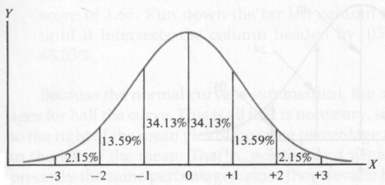

Slide 15
Skewness is a statistical measure that describes the asymmetry of the probability distribution of a real-valued random variable about its mean. In simpler terms, it indicates the degree to which the data distribution is skewed or lopsided.
A distribution is symmetric if the left and right sides are mirror images of each other. When a distribution is skewed, it means that one tail is longer or extends further than the other. Skewness can be classified into three main types:
Positive Skewness (Right Skewness): In a positively skewed distribution, the tail on the right-hand side of the distribution is longer or fatter than the left-hand side. This means that the majority of the data points are concentrated on the left side, with a few extreme values on the right side.
Negative Skewness (Left Skewness): In a negatively skewed distribution, the tail on the left-hand side of the distribution is longer or fatter than the right-hand side. This indicates that the majority of the data points are concentrated on the right side, with a few extreme values on the left side.
Zero Skewness: A distribution is considered to have zero skewness if it is perfectly symmetric, with both tails being equal in length.
Skewness is an important measure in statistics as it helps to understand the shape of the distribution of data. It is often used in various statistical analyses and data modeling techniques to assess the normality of the data and make appropriate adjustments if necessary.

Slide 16
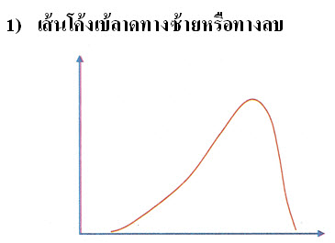
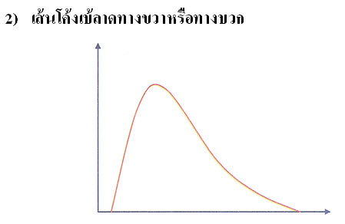
Negative Skewness
Positive Skewness

Slide 17
Normal Distribution
Negative Skewness
Positive Skewness

Slide 18
A test of normal distribution, also known as a normality test, is a statistical method used to determine whether a dataset follows a normal distribution or not. The normal distribution, also called the Gaussian distribution or bell curve, is characterized by its symmetric, bell-shaped curve.
Several statistical tests can be employed to assess the normality of a dataset. Some of the commonly used normality tests include:
Shapiro-Wilk Test: The Shapiro-Wilk test is a widely used test for normality. It calculates a test statistic based on the correlation between the observed data and the data expected under normality. If the p-value associated with the test statistic is less than a chosen significance level (e.g., 0.05), then the null hypothesis that the data is normally distributed is rejected.
Kolmogorov-Smirnov Test: The Kolmogorov-Smirnov test compares the cumulative distribution function (CDF) of the sample data with the expected CDF of a normal distribution. If the sample data significantly deviates from the expected normal distribution, the null hypothesis of normality is rejected.

Slide 19
3. Anderson-Darling Test: The Anderson-Darling test is similar to the Kolmogorov-Smirnov test but places more emphasis on the tails of the distribution. It calculates a test statistic based on the differences between the observed data and the normal distribution at various quantiles. The null hypothesis is rejected if the test statistic exceeds a critical value.
4. Jarque-Bera Test: The Jarque-Bera test is another test for normality that assesses whether the skewness and kurtosis of the sample data match those expected under a normal distribution. If the p-value associated with the test statistic is below a specified threshold, the null hypothesis of normality is rejected.
5. D'Agostino-Pearson Test: The D'Agostino-Pearson test combines measures of skewness and kurtosis to assess normality. It calculates a test statistic based on these measures and compares it to a chi-squared distribution. If the test statistic exceeds a critical value, the null hypothesis of normality is rejected.
These tests provide valuable information about the distributional characteristics of a dataset, which is essential for making valid statistical inferences and selecting appropriate analytical techniques. However, it's important to note that no single test is perfect, and the choice of test may depend on factors such as sample size, data type, and research context
.

Slide 20
The normal distribution can be tested using the Kolmogorov-Smirnov Test or the Shapiro-Wilk W test.
The Kolmogorov-Smirnov Test (K-S Test) is used when there are more than 50 cases, while the Shapiro-Wilk Test is used when there are fewer than 50 cases.
In the analysis, it is defined as follows:
H₀ (Null Hypothesis): The data follows a normal distribution.
H₁ (Alternative Hypothesis): The data does not follow a normal distribution.
For the Kolmogorov-Smirnov Test, if the significance value (Sig.) is greater than the chosen significance level (alpha), it indicates acceptance of the null hypothesis H₀, suggesting that the data follows a normal distribution.
Similarly, for the Shapiro-Wilk Test, if the significance value (Sig.) is greater than the chosen significance level (alpha), it indicates acceptance of the null hypothesis H₀, suggesting that the data follows a normal distribution.

Slide 21
Parametric
N0n-Parametric
Data Type Statistics
Nominal
Ordinal
Non-Parametric
Interval
Ratio

Slide 22
Research Question
Descriptive Questions
Relationship Questions
Difference Questions

Slide 23
Research questions or objectives are crucial in setting the direction for research and linking to the consideration of appropriate statistical choices for data analysis. Generally, research questions can be categorized as follows:
Descriptive Research Questions: These research questions aim to describe the characteristics of a population or sample group, such as the number and percentage of the sample group, demographic characteristics, or variables under study. Examples include:
  Determining the distribution of a sample group by gender, education level, age range, and work experience.
  Analyzing the statistics of students' exam scores in statistics by gender.
  Investigating how the quality of water in a water source changes over time.
Statistical techniques used for research questions of this nature include descriptive statistics such as frequency distributions, means, standard deviations, and graphs or charts. The choice of statistical method depends on the nature of the variables and the distribution of the data.

Slide 24
2. Differences Research Questions: Statistical analysis techniques in this group aim to compare differences between the characteristics of populations with expected characteristics or between the characteristics of populations from different groups. The analysis may involve comparing frequencies, proportions, or means. Examples of research questions in this group include:
1. Controlling the quality of heavy metal analysis in water. This may involve preparing standard solutions of known concentrations, then sending them to the laboratory as a sample group to determine if the analysis results differ from the standard solution.
2. Determining if trainees in a hospital wastewater management course gain knowledge from the training. This may involve testing the difference in knowledge before and after the training to see if trainees have increased their knowledge in the trained area.
Statistical techniques used for analysis in this group include inferential statistics such as Z-tests, t-tests, ANOVA, depending on the type of variable, the number of variables, population independence, and data distribution.

Slide 25
3. Relationship Research Questions: Explaining the Relationship between Variables or Predictions Research questions in this category involve studying whether the independent variable (the variable that occurs first) studied by the researcher causes changes in the dependent variable (the variable that occurs afterward) or not, and to what extent. Examples of research questions in this group include:
1. The relationship between gender and safety behavior.
2. The relationship between the type of vehicle and the level of noise pollution.
Statistical techniques used for analysis in this group include inferential statistics such as the Chi-square test, Pearson correlation, Linear regression, depending on the type of variable, the number of variables, population independence, and data distribution

Slide 26
Research Questions | Statistics Used
 | Continuous Data with Normal Distribution | Continuous Data with Non-Normal Distribution | Values ​​divided into multiple groups 2 groups Ordinal Scale | The value is the time from the start point to the outcome of interest (survival time)
Descriptive question | Mean, SD | Median, Inter-quartile range | Proportion | Kaplan-Meier survival curve
Different question between two independent groups | Unpaired t test | Mann-Whitney test | Fisher’s test (chi-square for large samples) | Log-rank test or Mantel-Haenszel
Comparing the differences between two pairs of groups is directly related or the results of measuring one variable twice from the same group | Paired t test | Wilcoxon’s test | McNermar’s test | Conditional proportional hazards regression
Comparing differences between 3 or more independent groups. | One-way ANOVA | Kruskal-Wallis test | Chi-square test | Cox’s proportional hazard regression
Comparing differences between 3 or more groups that are directly related pairs or compare the results of measuring one variable 3 or more times from the same group. | Repeated measures ANOVA | Friedman’s test | Cochran’s Q | Conditional proportional hazards regression
Expressing the relationship between 2 variables | Pearson correlation | Spearman correlation | Spearman correlation, Odds Ratio (OR) Relative Risk (RR)

Slide 27
Research Questions
 | Continuous Data with Normal Distribution | Continuous Data with Non-Normal Distribution | Values ​​divided into multiple groups 2 groups Ordinal Scale | The value is the time from the start point to the outcome of interest (survival time)
Predicting the value of an outcome variable from another variable | Simple linear/ mon-linear regression | Simple non-parametric regression | Simple logistic regression | Cox’s proportional hazard regression
Predicting the outcome variable from other multiple variables. | Multiple linear/ non-linear regression | Multiple non-linear regression | Multiple logistic regression | Cox’s proportional hazard regression
Comparing the values ​​of an outcome variable that are common components of one or more variables simultaneously. | Multiple ANOVA, General Linear Mixed Model (GLMM) |  | General Linear Mixed Model (GLMM) | Multiple Cox’s proportional hazard regression
Predicting/comparing the value of an outcome variable from other variables, one or more variables simultaneously, and measuring the same outcome variable repetitively. | Generalized Estimation Equation (GEE) |  | Generalized Estimation Equation (GEE) | Multiple Cox’s proportional hazard regression

Slide 28
Guidelines for considering the selection of measures of central tendency and measures of distribution
Type of Variable | Measurement Level | Descriptive statistics
qualitative variable or categorical variable) | Nominal sacle | Mode, Frequency distribution, and Percentage
 | Ordinal scale | Median, Frequency distribution, and Percentage
quantitative variable or continuous variable | Interval scale Ratio scale | Normal distribution: Mean and Standard deviation
 |  | Outliers: Median, Range, and Interquartile deviation.

Slide 29
Guidelines for selecting statistics for testing differences according to the purpose
Objective | Parametric Statistics | Non-Parametric Statistics
Comparison of mean for 1 group average | t-test for 1 group | -
Comparison of means for 2 independent groups | t-test (Independent t-test) | Mann-Whitney U Test หรือ Wilcoxon Rank Sum Test
Comparison of means for 2 dependent groups | Paired t test | Wilcoxon (Matched Pairs) Signed Rank Test
Comparison ​​of mean for more than two independent groups. | One Way ANOVA | Kruskal Wallis Test
Comparison ​​of mean for more than two dependent groups. | Repeated Measurement | Friedman Test
Analysis of the relationship of 2 variables (quantitative) | Pearson’s Product Moment Correlation Coefficient | Spearman’s Rank Correlation Coefficient
Analysis of the relationship of 2 variables (enumeration) | - | Chi Square test หรือ Fisher’s Exact Test
Comparison of differences in independent proportion values. | Z Test | Chi Square test or Fisher’s Exact Test
Comparison of differences in proportional values ​​that are dependent of each other. (Qualitative variables which measure before-after) | - | McNemar

Slide 30
Considerations in choosing to use parametric statistics and non-parametric statistics
-
Considerations |  | Parametric Statistics |  | Non-Parametric Statistics
Advantages | - | High testing efficiency - | - | Can be used for both continuous and discrete variables.
 | - | Popular and well-known | - | Can be used in small sample sizes
 |  |  | - | Not based on population distribution
Disadvantage | - | Data must conform to specifications such as normal distribution | - | Lower efficiency (If the data meets the requirements of parametric statistics)
 | - | Data must be intersections or ratios.
 | - | The sample size must be large enough.

Slide 33
Guidelines for choosing statistics to explain relationships
Source: (Statistics Solutions, 2018)

Slide 34
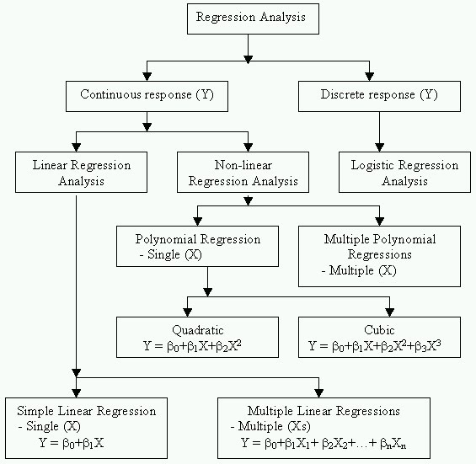
Guidelines for choosing statistics to explain relationship to prediction

Slide 35
Guidelines for selecting statistics to describe and predict relationships
Objective |  | Type of Variable |  | Statistics
 |  | Independent | Dependent
1. | To explain the relationship between one variable and another variable that is obtained from measurement. |  |  | - Pearson or Spearman correlation analysis - simple linear regression analysis
2. | To explain the relationship between one variable and another variable that is a variable obtained from counting. |  |  | - Chi-square test for association
3. | To explain the relationship between several independent variables and a continuous dependent variable in order to select independent variables that are important to the dependent variable. | many variables of both continuous and discrete. | only 1 continuous variable | - Multiple regression Analysis (MRA)
4. | To explain the relationship between one continuous dependent variable with nominal independent variables | only 1 discrete variable / nominal / obtained by counting | only 1 continuous variable | - MRA - Analysis of variance (ANOVA)
5. | To explain the relationship between several continuous dependent variables with 1 nominal independent variable | Discrete / nominal obtained from measurement | many continuous variables | - MANOVA (Multivariable Analysis of Variance)

Slide 36
 | Objective | Type of Variable |  | Statistics
 |  | Independent | Dependent
6. | To explain the relationship between a continuous dependent variable with discrete independent variables when controlling for other continuous variables (control variables) | Discrete independent variable and all continuous control variables | only 1 continuous variable | - ANCOVA (Analysis of Covariance)
7. | To explain the relationship between a nominal independent variable and several nominal and ordinal dependent variables | Discrete/Nominal/Ordinal | Discrete/Nominal | - Categorial Data Analysis using Linear Model
8. | To create a prediction equation for only one dependent variable. | Many variables | 1 variable | - MRA - Discriminate Analysis - Logistic Multiple Regression
9. | To create equation to predict multiple dependent variables simultaneously. | Many variables | Many variables | - Canonical Analysis - Structural Equation Model

Slide 37
Question????

