Slide 1
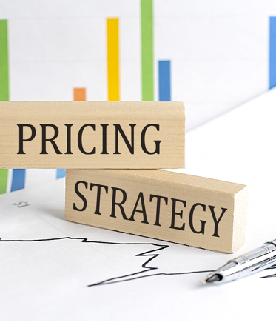
Week 9: Pricing Strategies in Different Markets
Subtitle: Understanding How Companies Set Prices Around the World

Slide 2
Class Objectives
After this class, you will be able to:
Understand the main pricing strategies and why they are used.
Compare pricing strategies across different markets.
Apply strategies to real-life products and services.

Slide 3
Icebreaker Question
01
Why does the same product (like iPhone or Starbucks coffee) have different prices in different countries?
02
Discussion Points: Costs, demand, income, taxes, exchange rates, regulations.

Slide 4
Agenda for Today
01
Key Pricing Strategies 1hour
02
Global Market Differences
03
Real-world Case Studies 30 mins
04
Interactive Activities 1hour

Slide 5
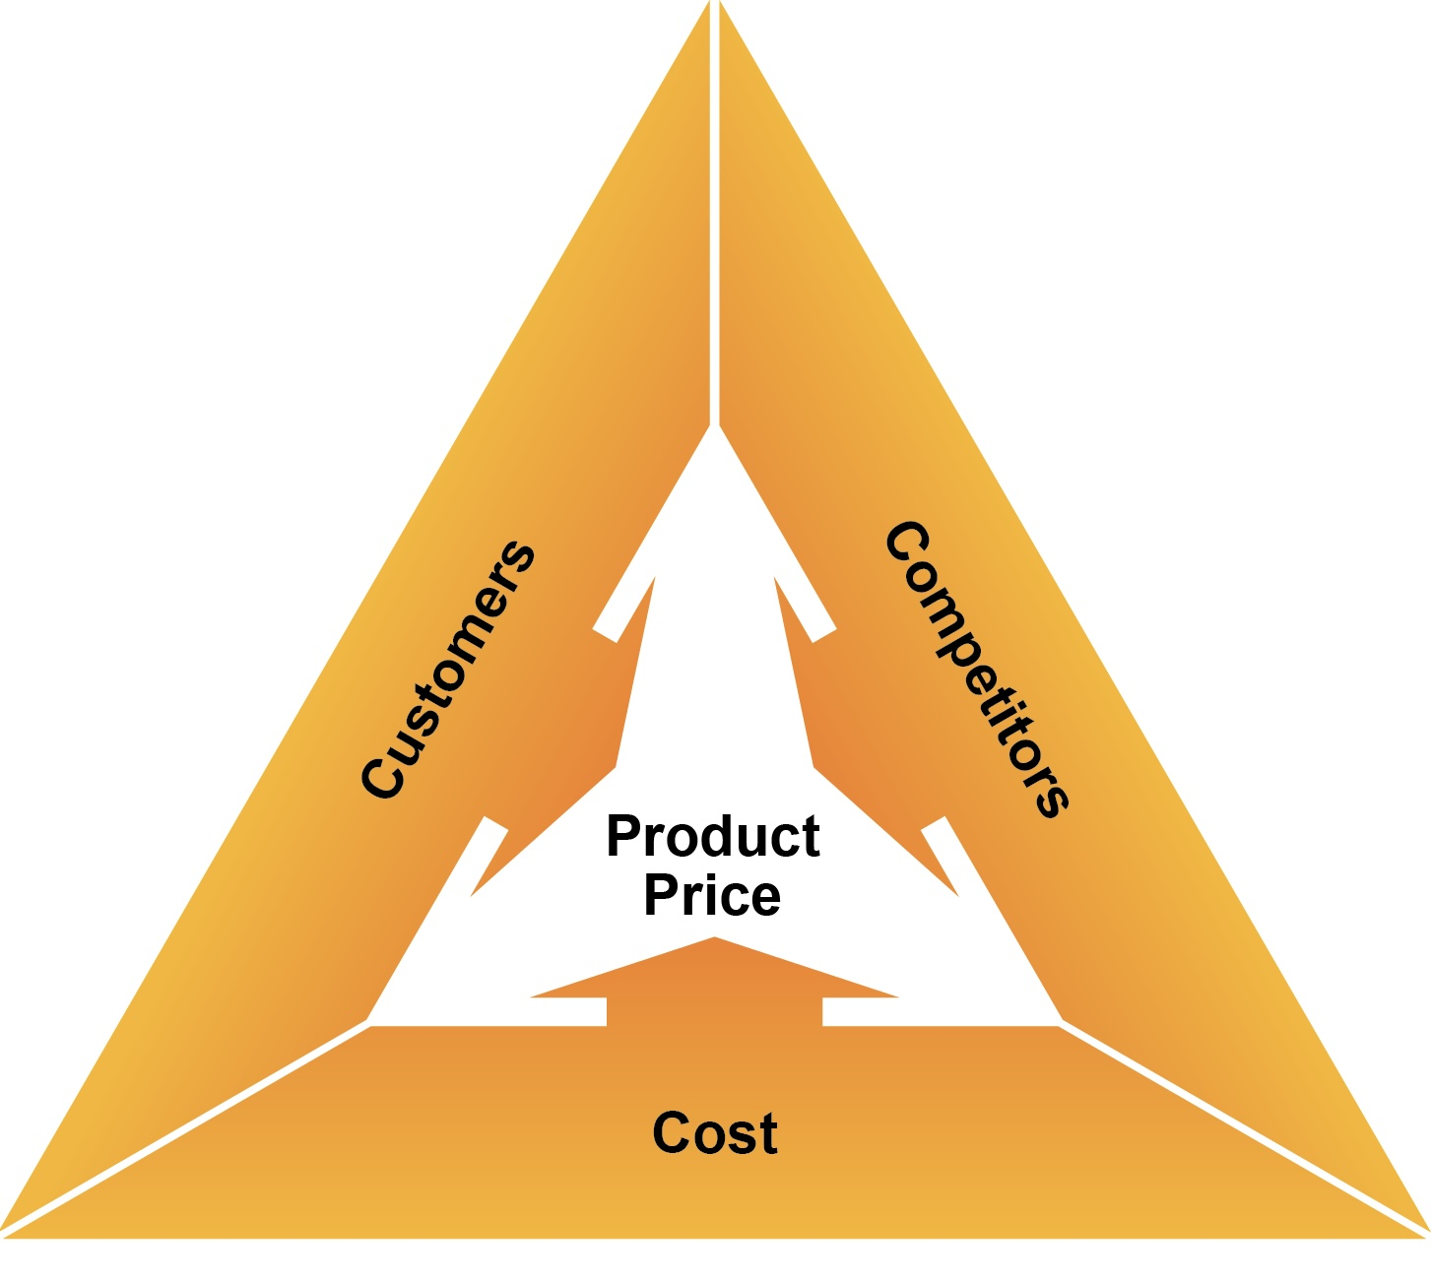
What is Pricing Strategy?
Definition: A pricing strategy is the method a company uses to price its products or services based on costs, value, competition, and market conditions.
Why is important?
Affects sales and profit.
Builds brand image.
Influences customer perception.

Slide 6
Cost-based Pricing
Definition: Price = Cost + Markup（the difference between the selling price of a good or service and its cost.）
Key Features:
Easy to calculate.
Guarantees cost recovery.
Weakness:
Ignores competitor prices and customer perception.
May lead to overpricing or underpricing.
Example: IKEA, local grocery stores.
When to use: For products with stable costs and low competition.

Slide 7
Competition-based Pricing
Definition: Setting prices based on competitors.
Key Features:
· Good for competitive markets.
· Requires monitoring rivals.
Risks:
· Price wars may occur.
· Less focus on product value.
Example: Airline tickets, hotel prices.
Tools for monitoring competitors: Price tracking software, market reports.

Slide 8
Value-based Pricing
Definition: Price based on what customers think the product is worth.
Why use it?
Maximize profit if perceived value is high.
Builds customer loyalty.
Challenges:
Difficult to measure perceived value.
Requires deep customer insight.
Example: Apple iPhones, luxury hotels.
How to measure value: Surveys, focus groups, conjoint analysis.

Slide 9

Penetration Pricing
Definition: Set a low price to attract customers quickly.
Goal:
Gain market share.
Encourage trial.
Risk:
Low short-term profit.
May attract price-sensitive customers.
Example: Netflix entering new markets, Amazon Prime.
When to use: For new products or entering new markets.

Slide 10
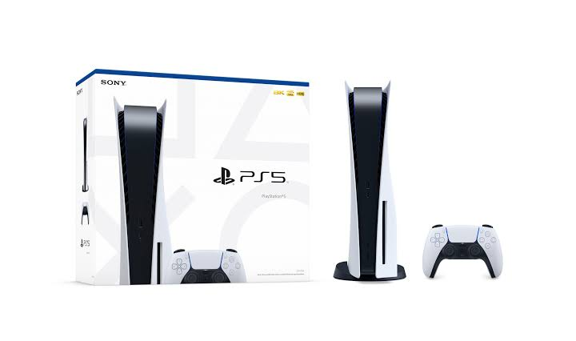
Price Skimming
Definition:Start with a high price, lower over time.
Goal:
Capture early adopters willing to pay more.
Recover R&D costs quickly.
Example: PlayStation 5 launch, new tech products.
Risks: May discourage mass market adoption if price is too high.

Slide 11
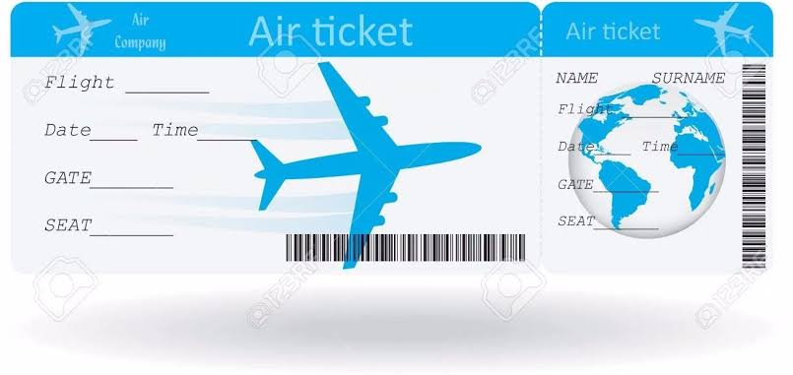
Dynamic Pricing
Definition: Price changes based on demand or time.
Why use it?
Maximize revenue during peak demand.
Balance supply and demand.
Example: Uber surge pricing, airline tickets.
Algorithms used: Machine learning, real-time data analysis.

Slide 12
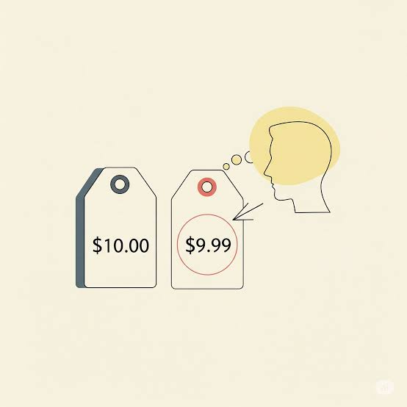
Psychological Pricing
Definition: Prices ending in .99 or .95 to seem cheaper.
Why it works:
· Left-digit effect (e.g., $9.99 vs. $10).
· Creates perception of a deal.
Example: $9.99 instead of $10.
Cultural differences: In some countries, rounding up is preferred.

Slide 13
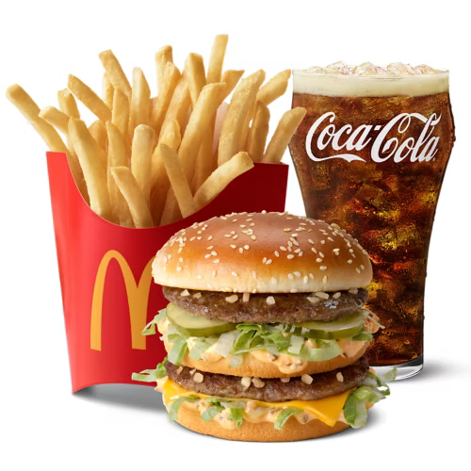
Bundle Pricing
Definition: Selling products together at a discounted price.
Benefits:
· Increase average transaction value.
· Clear slow-moving inventory.
Example: McDonald’s combo meals, software suites.
How to create effective bundles: Complementary products.

Slide 14
Premium Pricing
Definition: Setting a high price to signal luxury.
Why use it?
· Enhances brand perception.
· Attracts status-conscious customers.
Example: Louis Vuitton, Rolex.
Risks: Requires consistent quality and marketing to justify high price.

Slide 15
Case Study 1 – Apple iPhone
Step 1: Compare iPhone prices in USA, China, Thailand.
Step 2: Identify reasons: taxes, costs, currency exchange, import duties.
Question: Why is iPhone more expensive in Thailand?
Additional Content:
Impact of local regulations and tariffs on pricing.

Slide 16
Case Study 2 – McDonald’s Global Pricing
Observation: Big Mac price differences across countries.
Reason: Local cost, wages, competition.
Activity: Students search information which country has the cheapest Big Mac.
How McDonald’s adapts menus and prices to local markets.

Slide 17
Case Study 3 – Uber Surge Pricing
What happens during high demand? Price increases.
Why? To balance supply and demand.
Question: Do you think this is fair? Why or why not?
Visual Suggestion:
Screenshot of Uber app with surge pricing.
Additional Content:
Ethical considerations: How Uber communicates surge pricing to users.

Slide 18
Case Study 4 – Netflix
Strategy: Penetration pricing when entering new markets.
Question: What are the risks of keeping low prices too long?
Visual Suggestion:
Netflix subscription prices in different countries.
Additional Content:
How Netflix adjusts prices over time as it gains market share.

Slide 19
Activity 1 – Price Your Product
(30 mins)
Instructions:
· Choose a product (shoes, phone, coffee).
· Decide which pricing strategy you will use and why.
· Share in pairs.
Tips: Consider target market, competition, and costs.

Slide 20
Activity 2 – Group Debate
30 mins
Topic: “Should companies use the same price worldwide?”
Groups: For vs Against
Time: 20 minutes prepare, 10 minutes present.
Visual Suggestion:
Debate icons (microphone, timer).
Moderator tips: Encourage evidence-based arguments.

Slide 21
Scenario: You are a marketing manager launching a product in a new country.
Task: Set a price, explain your strategy.
Bonus: Compare with another group.
Debrief: How different groups approached the problem.
Activity 4 – Simulation

Slide 22
Summary of Key Points
· Pricing strategies.
· Why prices differ globally.
· How companies choose strategies.
Key takeaway: "There is no one-size-fits-all pricing strategy."

Slide 23
Thanks For Watching.

