Slide 1
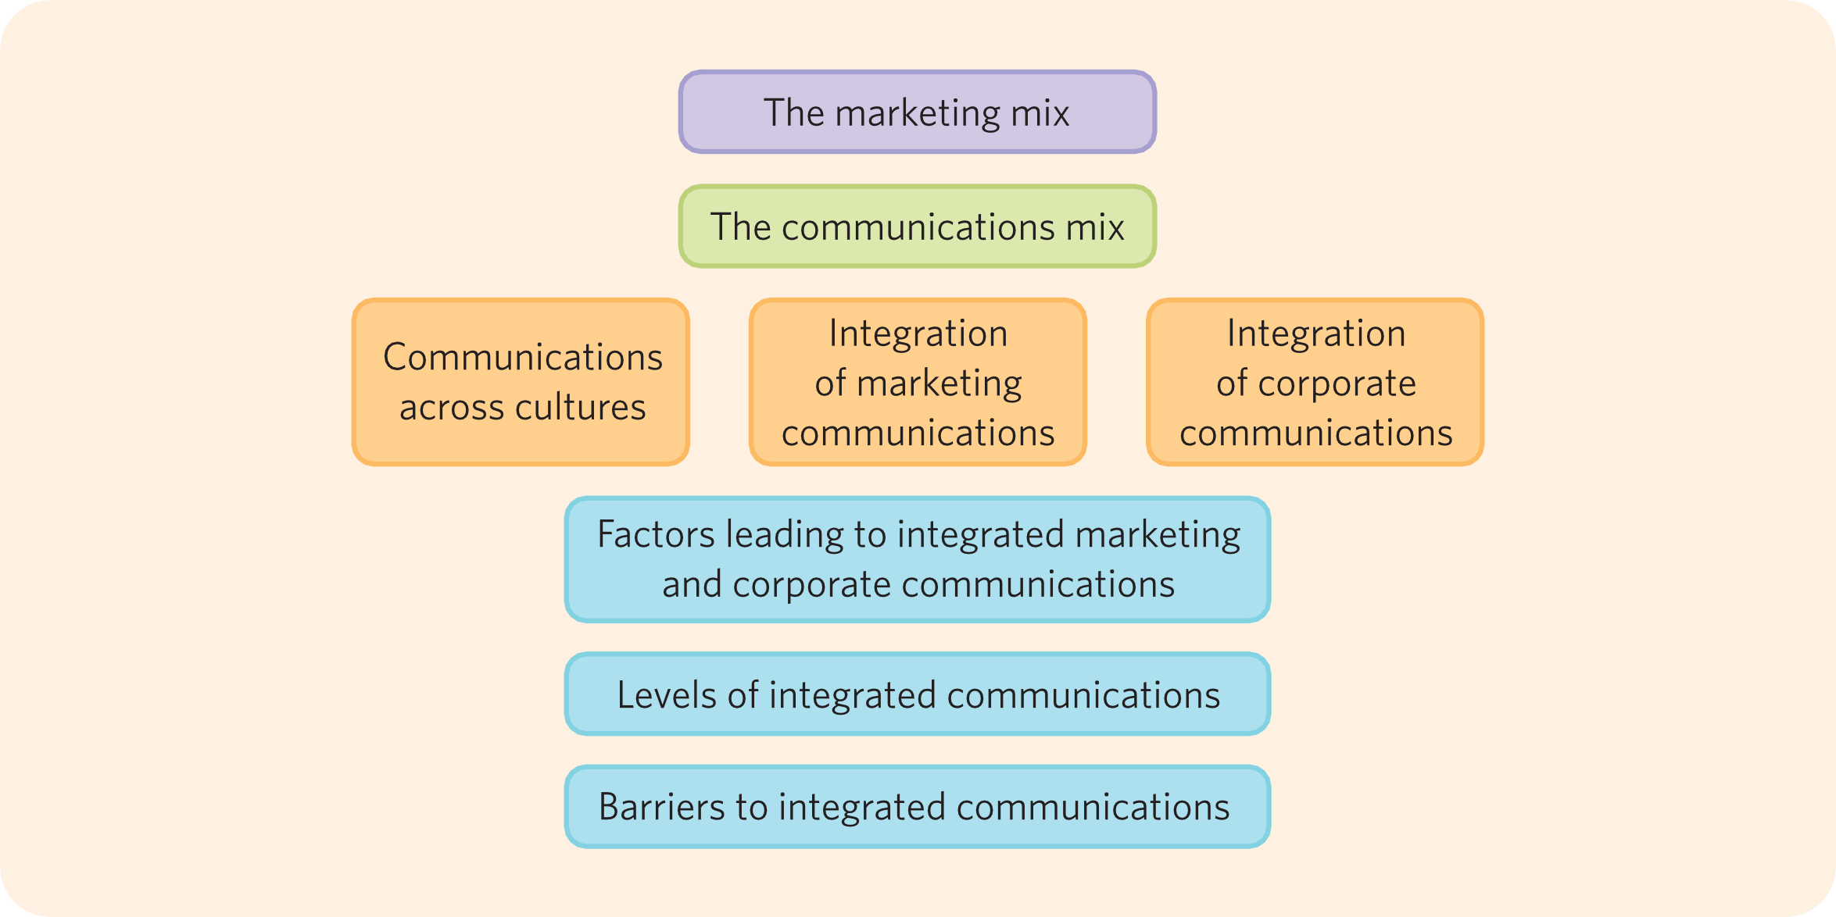
Chapter 1: Integrated communications

Slide 2
Chapter objectives
01
Situate marketing communications in the marketing mix
02
Get an overview of the instruments of the marketing communications mix
03
Understand what integrated marketing and corporate communications mean, and their implications

Slide 3
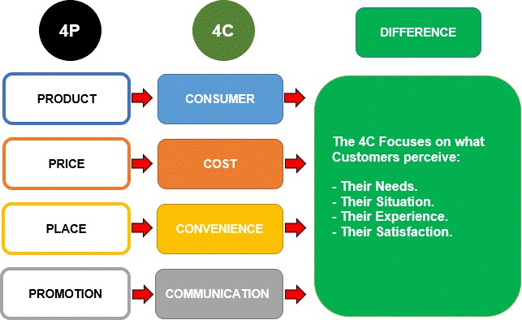
Review: 4Ps => 4Cs

Slide 4
Instruments of the marketing mix
Product (Customer need) | Price (Cost to the customer) | Place (Convenience) | Promotion (Communication)
Benefits | List price | Channels | Advertising
Features | Discounts | Logistics | Public relations
Options | Credit terms | Inventory | Sponsorship
Quality | Payment periods | Transport | Brand activation
Design | Incentives | Assortments | Direct marketing
Branding |  | Locations | Point-of-purchase
Packaging |  |  | Exhibitions and trade fairs
Services |  |  | Personal selling
Warranties |  |  | Online communication

Slide 5






Your turn?
Brighter mornings for brighter days
To reinforce its claim ‘We bring brighter mornings’, juice brand Tropicana developed a full-round integrated market- ing communications campaign. On its website it explains the healthiness of its orange juice. As a juicy, delicious, nourishing orange only needs water and bright sunshine, Tropicana claims its juice is actually a bit of sunshine which brings mornings to life with a nutritious boost. Why? Because ‘brighter mornings develop into brighter days’. This message is also stressed in its TV commercials. To further bring the message alive, Tropicana organised several events in which it literally brought sunshine to people in the farthest reaches of Canada, but also in a more iconic place, Trafalgar Square in London. The event in London was on the same day that the TV campaign kicked off. A giant helium sun was installed which was 30 000 times bigger than a football, had a surface area of 200 m² and weighed over 2500 kg. The internal light source of the Trafalgar sun produced the equivalent of 60 000 light bulbs: 4 million lumens of light. The sun rose an hour earlier than normal sunrise and set three hours later than normal sunset, giv- ing people in London four additional hours of sunlight. Next to delivering this unique brand experience to people, informing them on the website and bringing the message in advertisements, the claim that a glass of Tropicana tastes delicious and energises your day was reinforced by digital and point-of-purchase communications, free samples, a PR campaign, a movie on YouTube, and a Facebook action.
Who would not believe that if Tropicana can bring sunshine to the darkest places of Canada and light up London like this, it would not be able to bring a little bit of sunshine to your breakfast table?¹²

Slide 6



















Marketing communication tools
Which marketing communication tools are used to achieve each objective?

