Slide 1
Segmenting, targeting, positioning
Chap 2

Slide 2
WHY STP? STEPS OF STP
Definition of segmentation criteria
Definition of segment profiles
Assessment of the attractiveness of segments
Selection of target groups
Definition of the desired unique position in the mind of targeted consumers

Slide 3
Market Segmentation vs. Market segment
Market segmentation is the division of a market into distinct groups of buyers who have different needs, characteristics, or behaviors and who might require separate products or marketing mixes.
Market segment is a group of consumers who respond in a similar way to a given set of marketing efforts.
Copyright © 2018, 2016, 2014 Pearson Education, Inc. All Rights Reserved.

Slide 4
Market Segmentation
Segmenting Consumer Markets
groups customers and potential customers together by focusing on certain traits
divides the market into different geographical units such as nations, regions, territories, cities, neighborhood, and population density
Geographic segmentation
Demographic segmentation
such as age, gender, income, occupation & family status
divides the market into segments based on their knowledge, attitudes, uses, or responses concerning a product
divides buyers into different segments based on social class, lifestyle, values, and psychological/personality traits.
Psychographic segmentation
Behavioral segmentation
Copyright © 2018, 2016, 2014 Pearson Education, Inc. All Rights Reserved.

Slide 5
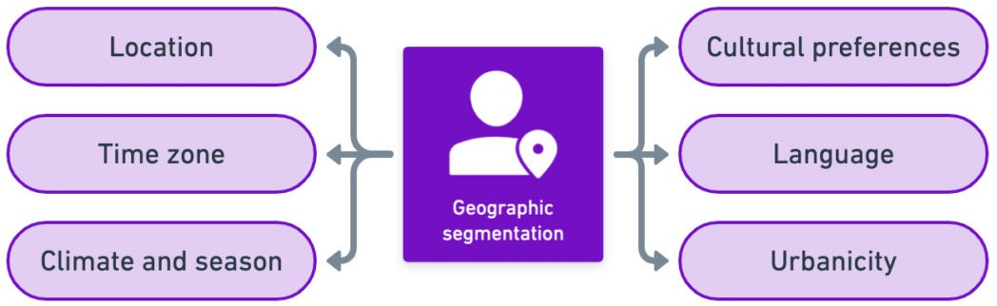
Geographic segmentation: WHERE?
Geographic segmentation divides the market into different geographical units such as nations, regions, states, counties, cities, or even neighborhoods.

Slide 6
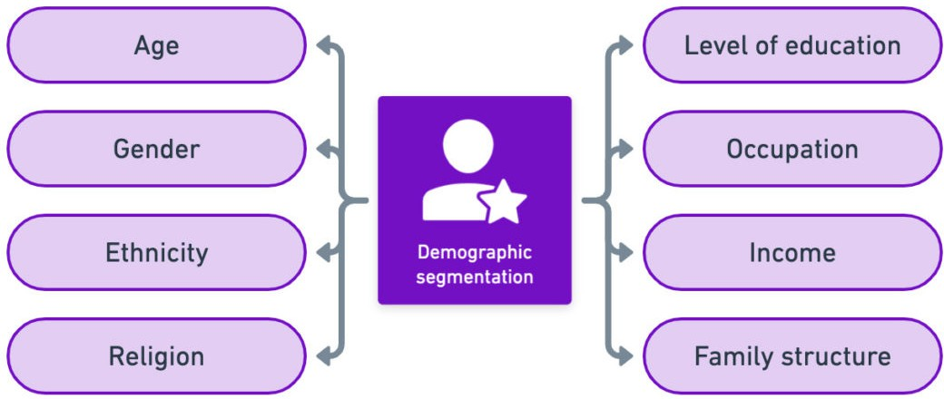
Demographic segmentation: WHO?
Geographic segmentation divides the market into different geographical units such as nations, regions, states, counties, cities, or even neighborhoods.

Slide 7
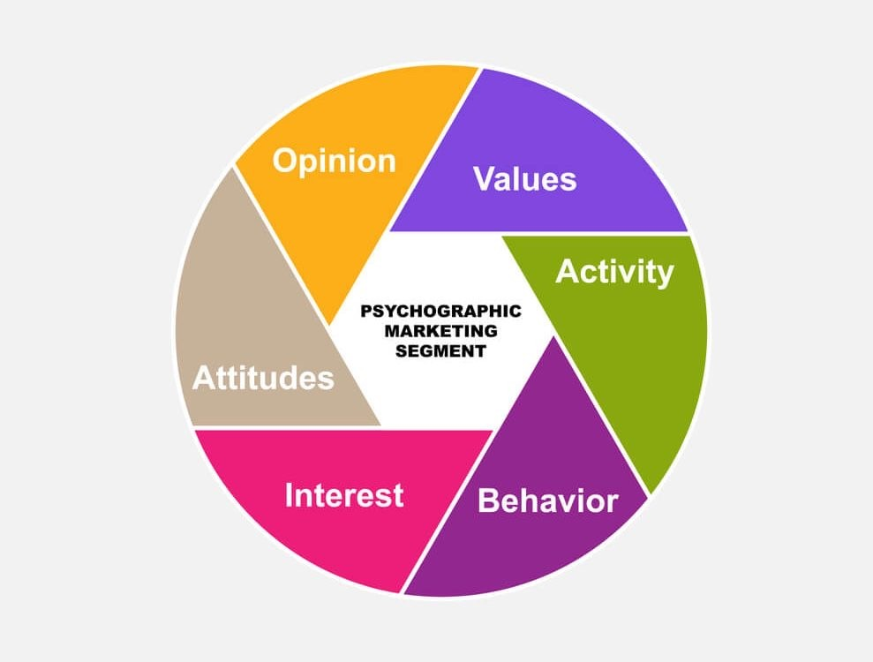
Psychographic segmentation: WHY?
Psychographic segmentation divides a market into different segments based on social class, lifestyle, or personality characteristics.
What motivates my customers?
What principles do my users have?
What are their inherent beliefs?
What drives users to make conscious and/or unconscious decisions?

Slide 8
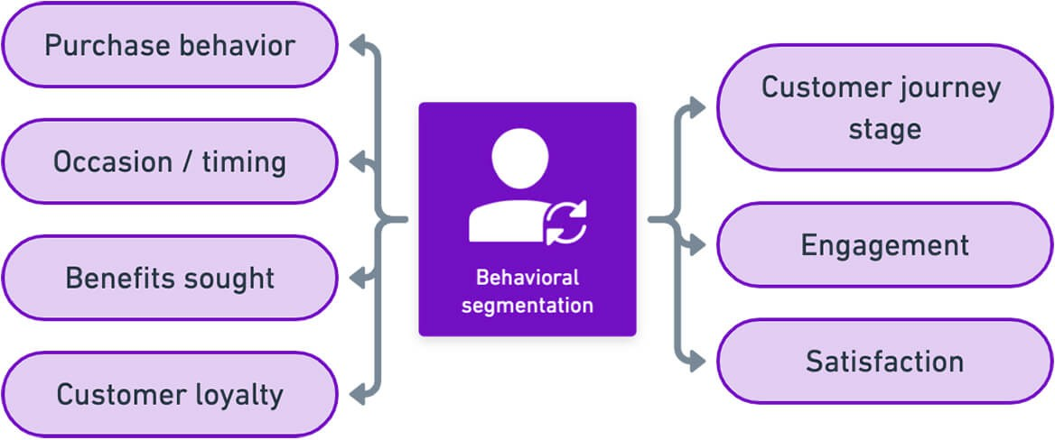
Behavioral segmentation: HOW?
Behavioral segmentation divides a market into segments based on consumer knowledge, attitudes, uses of a product, or responses to a product.

