Slide 1
Consumer Behavior

Slide 2
Buyer behavior
It is the decision-making process and actions of individuals (consumers) regarding the purchase and use of goods (Etzel, Walker and Stanton. 1997: 102). From this definition, it can be seen that marketers need to study and analyze buying behavior for several reasons:
The way buyers act or express themselves in response to a business's marketing strategy will greatly affect the business's success.
Based on the marketing concept that businesses should create a marketing mix that satisfies customers, in order to increase understanding of what satisfies consumers, marketers must consider the main factors that influence consumer purchasing.

Slide 3
Internal Factors That Affect Purchasing Behavior.
A consumer behavior model illustrates the motivations that lead to purchasing decisions, starting with a stimulus that enters the consumer's mind (Buyer's Black Box). This black box is unpredictable by producers or marketers. Once the consumer perceives the stimulus and develops a need, a purchase or response occurs. Various factors influence consumer behavior, including:
1. Marketing factors such as product design, pricing, promotion, packaging, positioning, and distribution.
2. Personal factors such as age, gender, education, and income level.
3. Psychological factors such as purchasing motivation, product perception, and attitudes towards the product.
4. Situational factors such as the physical environment at the time of purchase, social environment, and temporal factors.
5. Social factors such as social status, family, and reference groups, which refer to individuals or groups that have a significant influence on an individual's behavior.
6. Cultural factors such as religion and social class.

Slide 4
Internal Factors That Affect Purchasing Behavior.
Stimuli
External Stimuli: Consumer desire can arise from internal bodily stimuli such as hunger and thirst, as well as other stimuli. Marketers primarily focus on external stimuli, aiming to strategically arrange these, especially marketing stimuli, to motivate consumers to purchase products.
Marketing Stimuli: Marketing stimuli are those that marketers can control and manage. They are related to the marketing mix, which includes product stimuli (e.g., attractive product design), price stimuli (e.g., favorable payment terms or discounts compared to competitors), distribution channel stimuli (e.g., widespread product availability), and promotional stimuli (e.g., discounts, giveaways, consistent advertising).
Other Stimuli: Other stimuli are external to the organization and beyond the control of marketers. These include economic stimuli (e.g., economic conditions and consumer income affecting purchasing power) and technological stimuli (e.g., advanced and rapid communication technology increasing consumer demand for mobile phones). Legal and political stimuli, such as laws increasing or decreasing taxes on certain goods, will affect the demand for those goods. Similarly, cultural stimuli, such as customs and traditions during festivals, will boost the demand for certain goods during those festivals.

Slide 5
Internal Factors That Affect Purchasing Behavior.
Customer
Buyer behavior is influenced by buyer characteristics, which are derived from cultural, social, personal, and psychological factors (details will be discussed later). It is also influenced by the buyer's decision-making process, which comprises five steps: problem recognition, information gathering, alternative evaluation, purchase decision, and post-purchase behavior (details will be discussed in the section on the buyer's decision-making process).

Slide 6
Internal Factors That Affect Purchasing Behavior.
Responses
Consumer responses or purchasing decisions involve various factors such as product choice (e.g., choosing shrimp porridge for breakfast or fresh milk), brand choice (e.g., which brand of milk to drink for breakfast), dealer choice, purchase time, and purchase amount.

Slide 7
ปัจจัยภายในที่มีผลกระทบต่อพฤติกรรมการซื้อ
Motivation is the internal drive that determines an individual's behavior in pursuing a goal.
Perception is the process by which an individual selects, organizes, and interprets information received through the five senses: hearing, smell, sight, taste, and touch, based on their feelings. For example, seeing or hearing an advertisement can increase one's knowledge of the product.
Learning is the change in an individual's behavior resulting from information and experiences. Actions that receive praise or positive reinforcement will be repeated, while actions that receive criticism or negative feedback will be avoided.
Attitude is an individual's feeling towards something and the way they evaluate those feelings, both positive and negative, that influences consumer decisions.
Personality is the behavior or character traits of an individual that reflect their self-identity through various personality traits.

Slide 8
motivation
Maslow developed a theory of human motivation (Maslow’s General Theory of Human Motivation). In it, Maslow explained human needs as a hierarchy from lower to higher levels (Hierarchy & Needs). This theory is widely accepted and its assumptions relate to human behavior as follows (Abraham H. Maslow, 1954: 80-106).

Slide 9
Maslow's hierarchy of needs.
Humans have needs; needs are always present and endless. However, what humans need depends on whether they already possess it. Once one need is satisfied, another will take its place. This process is endless and begins from birth until death.
A need that has been satisfied is no longer a motivator for behavior. Only unsatisfied needs motivate behavior.
Human needs have a hierarchy of importance. That is, once lower-level needs are satisfied, higher-level needs will immediately demand satisfaction.
According to Maslow's theory, the hierarchy of needs is divided into five levels, from lowest to highest.

Slide 10
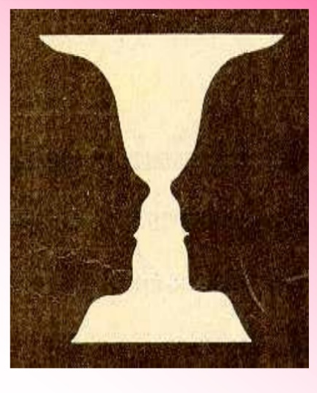
Gestalt ‘s Theory
The core concept of this theory is that learning is a cognitive process, an internal human being. Individuals learn better from stimuli as a whole than from parts. Teaching principles based on this theory emphasize the thinking process, presenting the big picture before the details, and encouraging learners to have diverse and varied experiences. This helps learners develop problem-solving skills, initiative, and insightful learning.
Look at the image on the left. Students, do you see it as a tray or as two people facing each other? If you see the white as the image and the black as the background, it's a tray. If you see the black as the image and the white as the background, you might see two people facing each other.

Slide 11
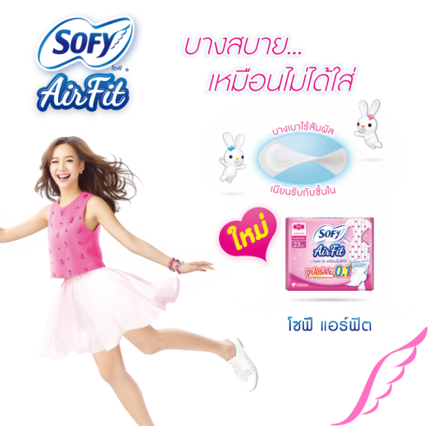
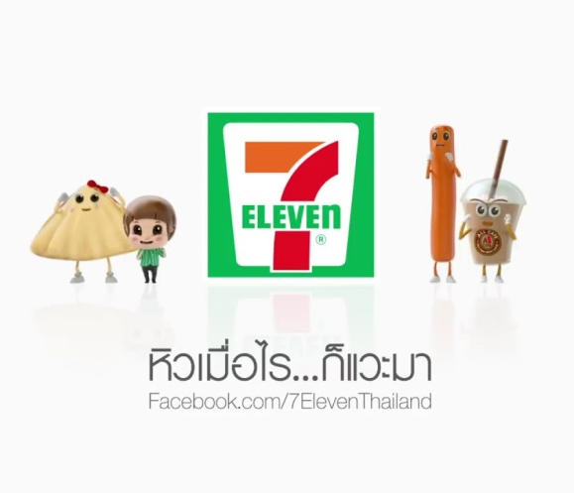
Personality
Freud also studied the structure of the mind and found that it consists of: 1. Id 2. Ego 3. Superego
Id (or Id)
refers to the basic, unrefined desires or needs of human beings. It drives humans to act for their own satisfaction or according to the pleasure principle. It's comparable to the raw, primal instincts of humans, which can be divided into life instincts (such as the need for food, sexual desire, and the need to escape danger) and death instincts (such as aggression or harming oneself and others).

Slide 12

Personality
2. Ego
This refers to the part of the body that controls behavior stemming from the Id's needs, relying on social norms and the reality principle to aid decision-making. It's not simply about acting according to one's own desires, but also about rational thought and action. In other words, individuals behave with reasons and logic that are appropriate to the social context and time. This is why personality types that are widely accepted in society, and who can adapt and live happily within society, are believed by Freud to be due to a strong structure in this area.

Slide 13

Personality
3. Superego
This refers to conscience, or the part of the mind that develops from experience and upbringing, based on moral principles, customs, traditions, and values ​​of that society. The superego controls and regulates thoughts to behave in a way that makes one a good member of society, adhering to societal values ​​(value principles) that determine what is considered good in society. In other words, individuals will behave within the boundaries set by society, but sometimes this may be inappropriate. For example, someone might be bitten by mosquitoes all over their arms and legs but refuse to swat them because they fear sin, or they might feel sorry for a beggar and give them all their money while they are hungry and have no money to buy food, thus enduring hunger themselves.

Slide 14
attitude
This refers to conscience, or the part of the mind that develops from experience and upbringing, based on moral principles, customs, traditions, and values ​​of that society. The superego controls and regulates thoughts to behave in a way that makes one a good member of society, adhering to societal values ​​(value principles) that determine what is considered good in society. In other words, individuals will behave within the boundaries set by society, but sometimes this may be inappropriate. For example, someone might be bitten by mosquitoes all over their arms and legs but refuse to swat them because they fear sin, or they might feel sorry for a beggar and give them all their money while they are hungry and have no money to buy food, thus enduring hunger themselves.
Experience
Attitude
Behavior

