Slide 1

International Science Curriculum
Welcome to this presentation on an international science curriculum for KG, primary, and secondary levels. We will explore key components, pedagogical approaches, and assessment strategies.
The curriculum aims to foster scientific literacy, critical thinking, and a passion for discovery in students worldwide. We will also discuss how to adapt the curriculum to meet local needs while maintaining international standards.
Let's embark on this journey to transform science education!
YK
by Yu Mon Kyaw

Slide 2
Core Components of the Curriculum
Fundamental Scientific Concepts
The curriculum should be built upon fundamental scientific concepts. This includes topics such as matter, energy, forces, motion, and life processes. Ensuring these concepts are introduced early and revisited throughout different grade levels to promote a deep understanding.
Inquiry-Based Learning
Promote inquiry-based learning to enhance student engagement and critical thinking. Encourage students to ask questions, design experiments, and analyze data. Inquiry-based learning fosters a deeper understanding of scientific concepts. This approach enhances students' problem-solving skills and promotes a lifelong love for learning.

Slide 3

Adapting to KG Level
Hands-On Activities
For kindergarten, focus on hands-on activities that introduce basic scientific concepts through play. Use sensory experiences and simple experiments to engage young learners. Activities like exploring textures, colors, and sounds can make learning fun and memorable.
Storytelling and Visual Aids
Incorporate storytelling and visual aids to explain scientific phenomena in an accessible way. Use picture books, songs, and interactive games to capture their attention. These tools help make abstract concepts more concrete and relatable for young children.

Slide 4
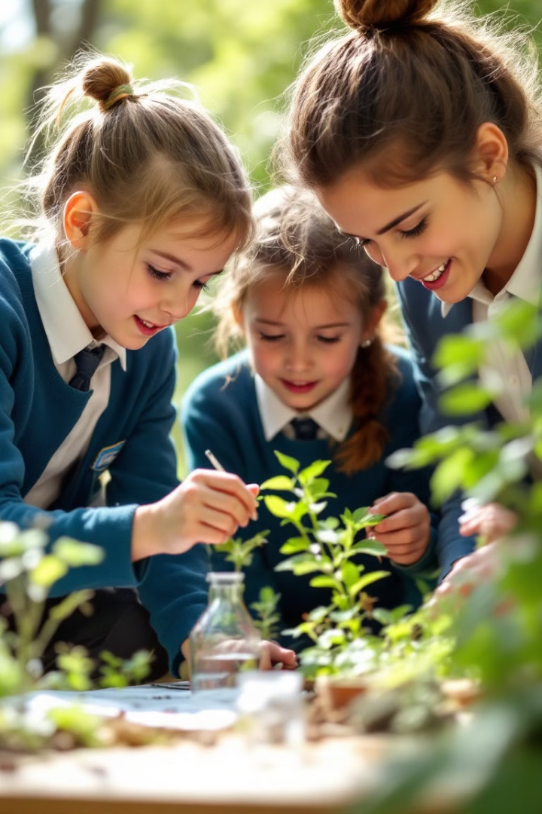


Primary School Science
Structured Experiments
Introduce more structured experiments that build on basic concepts. Guide students through the scientific method, encouraging them to make observations and draw conclusions. These experiments should be simple and safe, focusing on core scientific principles.
Real-World Connections
Connect science lessons to real-world examples and applications. Discuss how science impacts their daily lives and the environment around them. Making these connections helps students see the relevance of what they are learning.

Slide 5




Secondary School Science
Interdisciplinary Projects
Laboratory Skills
Advanced Concepts
Develop advanced laboratory skills and techniques. Provide opportunities for students to conduct independent research projects. These hands-on experiences are crucial for preparing students for higher education and careers in science.
Encourage interdisciplinary projects that integrate science with other subjects like mathematics, technology, and engineering. This fosters a holistic understanding and promotes creativity.
Introduce advanced scientific concepts in physics, chemistry, and biology. Challenge students with complex problem-solving tasks and critical analysis. This level requires a deeper understanding of scientific principles.

Slide 6



Assessment Strategies
Summative Assessments
Employ summative assessments to evaluate overall learning outcomes and assess student mastery of the curriculum. These assessments should be comprehensive and aligned with the curriculum goals.
Formative Assessments
2
Use ongoing formative assessments to monitor student progress and provide timely feedback. This helps identify areas where students may need additional support.
1
Performance-Based Tasks
Incorporate performance-based tasks that require students to apply their knowledge and skills in real-world contexts. These tasks assess practical skills and critical thinking abilities.
3

Slide 7

Cultural Relevance and Inclusivity
1
Diverse Perspectives
Incorporate diverse perspectives and examples from different cultures to make the curriculum more inclusive and relevant. This broadens students' understanding of science in a global context.
2
Local Adaptations
Allow for local adaptations to ensure the curriculum meets the specific needs and interests of students in different regions. This makes the content more relatable and engaging.
3
Equitable Access
Ensure equitable access to resources and opportunities for all students, regardless of their background or location. This promotes fairness and inclusivity in science education.

Slide 8
Key Takeaways and Next Steps
Curriculum Design
1
Focus on inquiry-based learning, real-world connections, and adaptable content.
Assessment Strategies
2
Use a mix of formative, summative, and performance-based assessments.
Cultural relevance
3
Ensure inclusivity and adaptability to meet diverse needs.
By integrating these strategies, we can create an international science curriculum that empowers students worldwide. To implement these insights effectively, educators and curriculum developers should collaborate to adapt the curriculum to their specific contexts. Ongoing evaluation and refinement are essential to ensure the curriculum remains relevant and effective. Thank you for joining this presentation, and let's work together to inspire the next generation of scientists!

