Slide 1
Week 2 The Importance of Listening and Speaking
24/7/2025
Thursday

Slide 2
Speaking and listening are fundamental human communicative tools since the beginning of humankind
Kline (1996) states that knowing the difference between hearing and listening is an important feature
“Hearing is the reception of sound; Listening is the attachment of meaning to the sound. Hearing is passive, listening is active.”

Slide 3
The skill of listening is important in learning any language
can barely talk at that age but that does not mean communication is not taking place.
The most powerful indicator that the skill of listening influence on learning a language
although children cannot necessarily speak at a young age, they understand many things asked of them
can be observed in little babies
in their development over the years
an important pattern was discovered;
spent their entire first 1.5 to 2 years of their lives listening to their parents, listening to others, and trying to make sense of their surroundings.

Slide 4
The HEAR strategy is important in learning any language
(Halt-Engage –Anticipate –Replay)
the idea that listening actually takes active work and it is not just a passive skill
Halt
[to] free your mind to pay attention to the person speaking”
Engage
“Focus on the speaker” by some sort of physical movement towards his/her direction
Anticipate
Actively think about what the speaker might share next
Replay–Review what the speaker is saying and try to make sense of commonalities, either independently or with peers
Replay

Slide 5
developing their ability to listen well can develop students' ability to become more independent learners,
hearing accurately
able to reproduce accurately
refine their understanding of grammar and develop their own vocabulary.

Slide 6
Listening is an activity absorbing of the meanings of words and sentences by the brain.
leads to the understanding of facts and ideas, but listening takes attention, or sticking to the task at hand in spite of distractions.
requires concentration, which is the focusing of our thoughts upon one particular problem
listening with concentration is actively listening
Active listening is a method of responding to another that encourages communication.

Slide 7
The importance of listening
• Communication is not complete without effective listening.
• An attentive listener stimulates better speaking by the speaker.
• A good listener learns more than an indifferent listener.
• A good listener can restructure vague speaking in a way that produces clearer meaning.
• Listening is the most important communication skill.
• We probably spend more time using our Listening Skills than any other kind of skill.
• Like other skills, Listening takes practice.
• Real Listening is an active process.
• Listening requires attention.
• A good listener learns to detect prejudices, assumptions and attitudes.

Slide 8
Communication plays a vital role in getting success in all fields.
Language is used as a tool for communication
.
Perfect communication is not possible for people without using a language.
.
Moreover, people cannot achieve their aims, objectives, and goals without using proper language to communicate.
Therefore, there is a need for a language to communicate with others those who live all around the globe.

Slide 9
* How can we define speaking?
an interactive process of constructing meaning
involves producing and receiving and processing information.
Its form and meaning are dependent on the context in which it occurs, including the participants themselves, their collective experiences, the physical environment, and the purposes for speaking.

Slide 10
The Importance of Speaking Skill
•The way we speak differs according to the situation we are in. We do not speak to our professors the same way we speak to our friends.
•Context is important, then. It defines the way we use language to communicate certain ideas to certain people.
•The purpose of talking also plays a role in the way we speak. If we are chatting to spend time it is different than lecturing to transfer information.

Slide 11
Speaking skills are useful for learners when they have to settle down well in their professions.
*The professionals have to give oral presentations as they have to promote the products or their companies or give training to the other colleagues.
an effective speaker can inspire the audience a lot and gain the complete attention of the audience and maintain the same tempo until the end of his/her speech.
the audience involves completely in the speaker’s speech and they sometimes forget the real world and put their complete concentration on the speech.

Slide 12
The main advantages of speaking skills are:
To participate actively in pair or group activities in the classrooms.
To give an impressive speech on different occasions.
To participate actively in debates and group discussions.
To pursue higher studies in foreign countries.
To interact with people all around the globe.
To promote the sale of products in the business.
To make living abroad simpler and easier.
To get better employment opportunities.
To perform well in job interviews.
To acquire more knowledge.
To give presentations for all purposes.
To communicate effectively with others.
To boost up the speakers’ self-confidence.
To know the different cultures of the world.

Slide 13
Strategies for listening with purpose
The study of listening is a specialist field and, like all specialist fields, there is some common terminology which might be unfamiliar or confusing.
Learning to recognize these terms will help you to understand and develop your learners’ listening skills.

Slide 17
When we achieve a very good level of listening in a particular language, we often forget how sophisticated this skill really is!
The terms we use to describe the processes of listening are called sub-skills and they include:

Slide 18
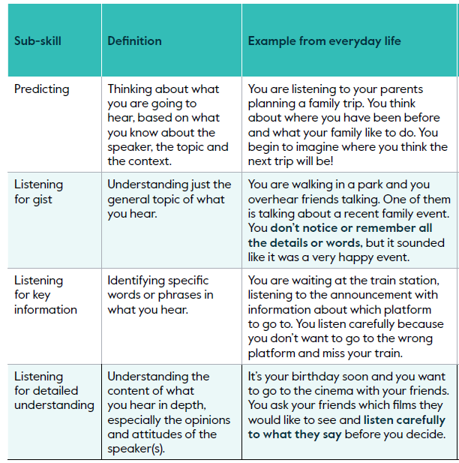

Slide 19
STRATEGIES OF LISTENING
What does effective listening involve?

Slide 20
Our ability to match the sounds to the word is called bottom-up processing.
To understand what the speaker means when they use the word, we need to listen for more information, we need to know the context and co-text. This is called top-down processing.

Slide 21
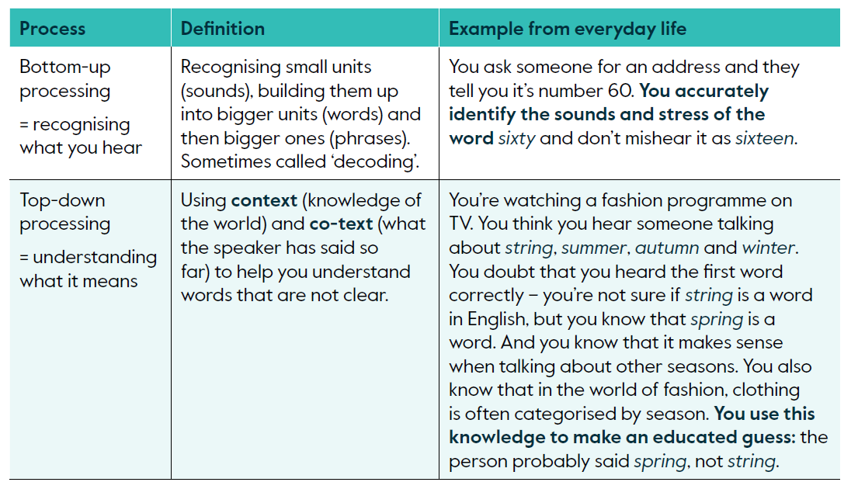

Slide 22
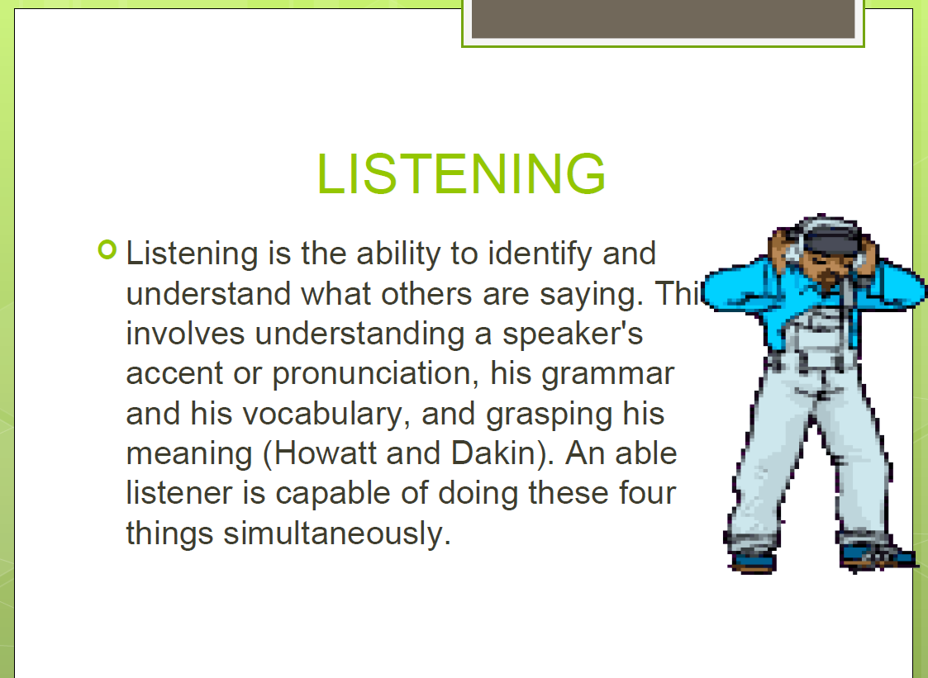

Slide 25
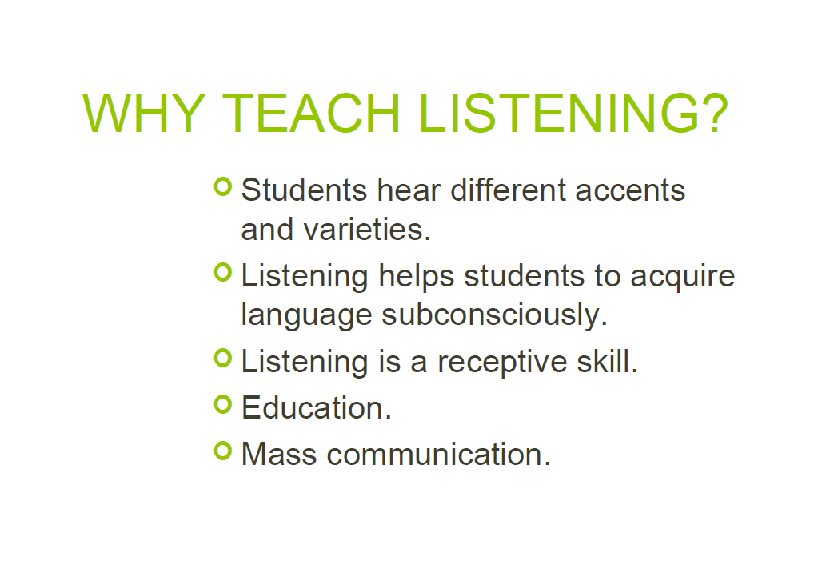

Slide 34
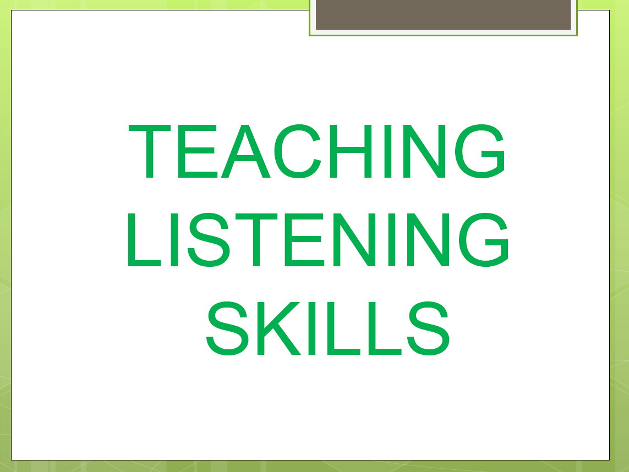

Slide 35
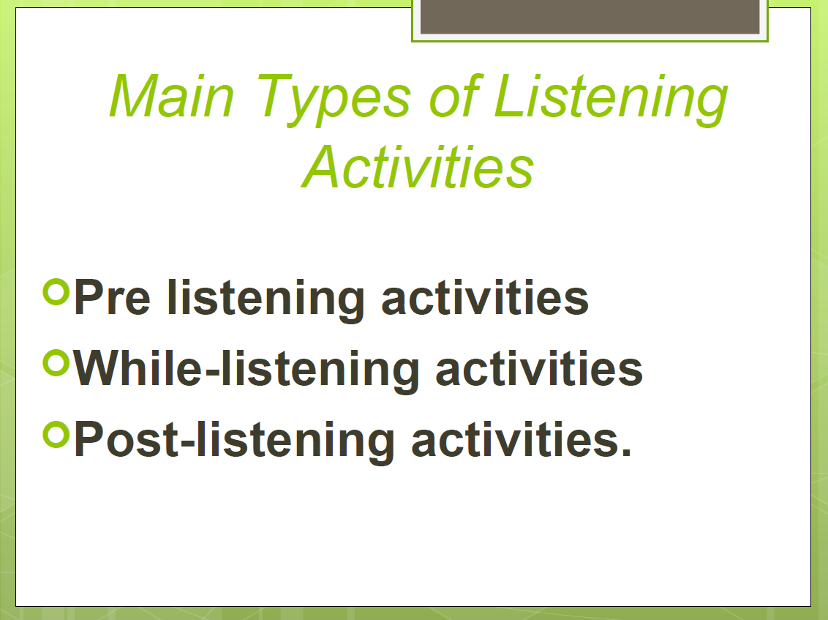

Slide 41
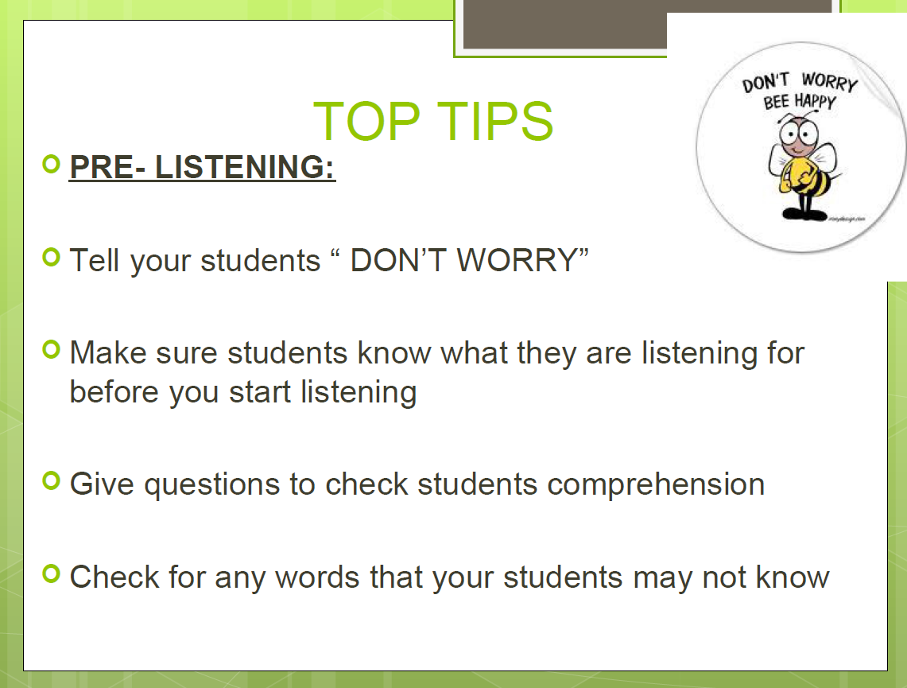

Slide 42
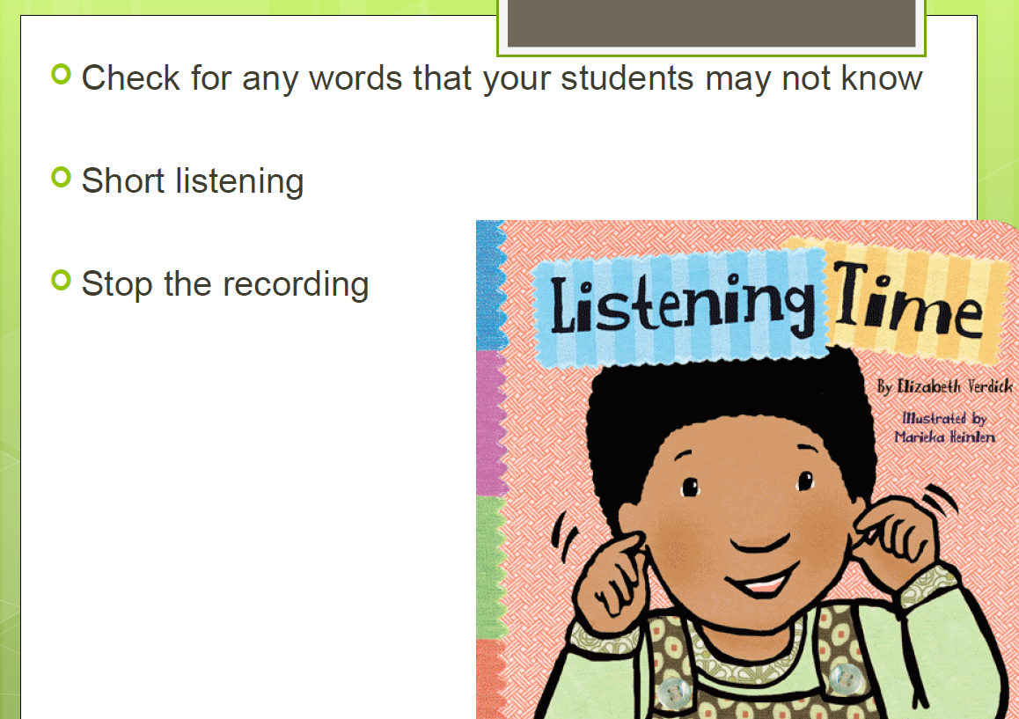

Slide 44
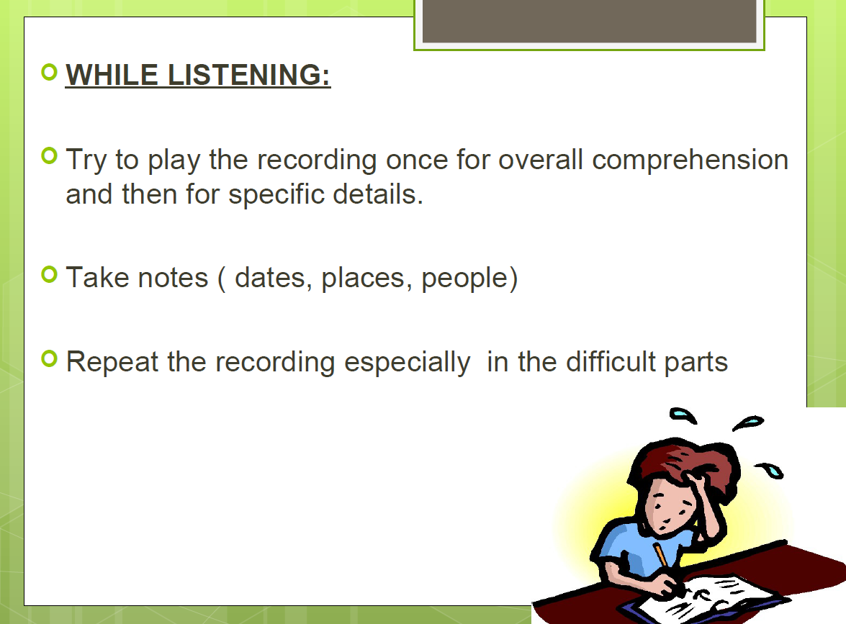

Slide 46
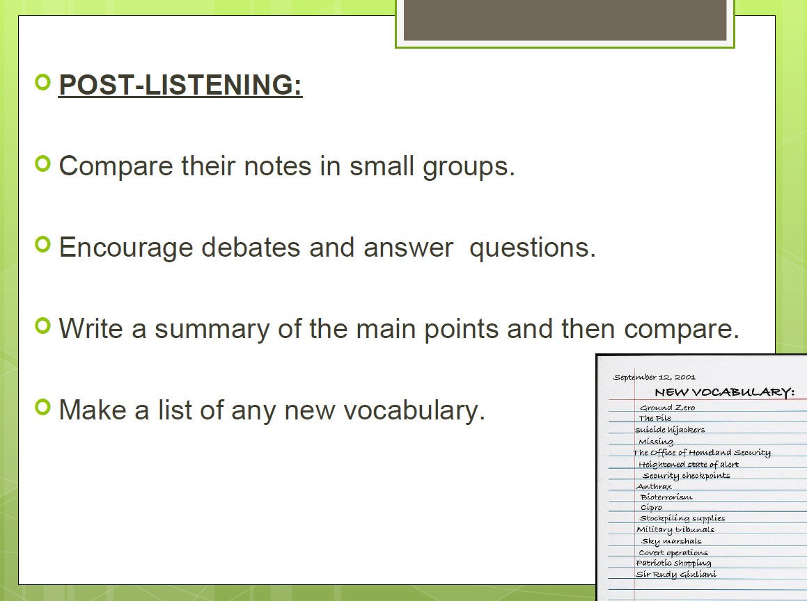

Slide 48
JIGSAW
It is a teaching technique invented by social Psychologist
ELLIOT ARONSON in 1971. A cooperative learning method where students become experts on a specific part of a topic and then teach that information to their group members. It is a co-operative learning technique appropriate for students from 3rd to 12th grade. It is also used extensively in adult English
second language ESL classes.
Listening
Engagement
Interaction
Peer teaching
Co-operation by giving each member of the group as essential
part to play in the academic activity.

Slide 49
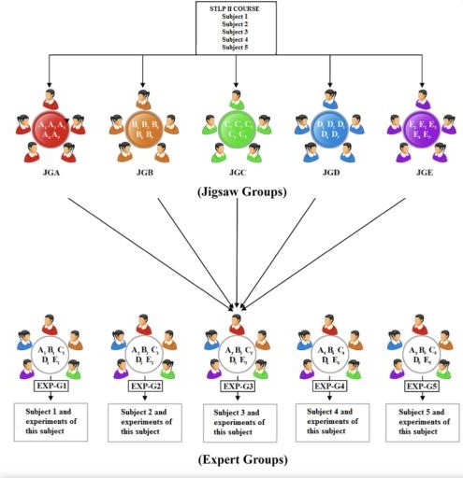

Slide 50
REMEMBER!!!
Try to use as many different sources of listening material as you can:
Advertisements, news programs, poetry, songs, extracts from plays, speeches, lectures, telephone conversations, informal dialogues.

