Slide 1
Marketing Systems and the Marketing Environment

Slide 2
Marketing Systems and the Marketing Environment
Marketing systems and the marketing environment
Macro-environment (external to the business)
Micro-environment (external to the business)
Internal environment (internal to the organization)

Slide 3
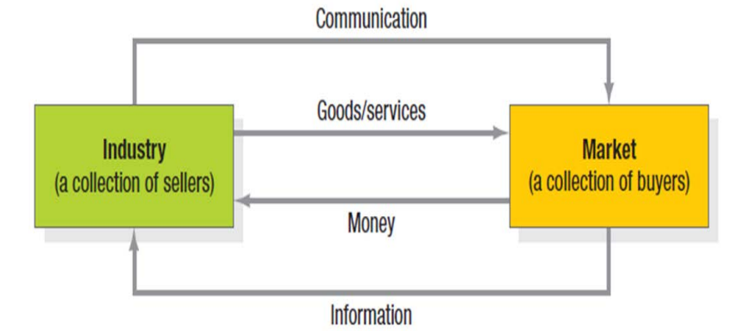
Marketing systems and the marketing environment.

Slide 4
Marketing systems and the marketing environment.
The Marketing System
The exchange that occurs between two groups of individuals in a larger structure is the marketing system. Therefore, the marketing effectiveness of salespeople and buyers depends on understanding the key components, functions, and relationships that make up the marketing system.
A marketing system is a group of important institutions and functions that link an organization with a market. Suppose a company produces a single product for a specific market. The key components in the market system are the company and the market. These two components are connected by the movement of four important things:
1. Products and services
2. Communication to the market
3. Amount of money received by the company
4. Information received by the company

Slide 5
Marketing systems and the marketing environment.
Individuals or driving forces that impact marketing management capabilities are either uncontrollable or only partially controllable. Therefore, companies aiming for competitive success must constantly monitor changes in the environment and adapt their strategies accordingly. The marketing environment is broadly categorized into two types:
External Environment
Internal Environment

Slide 6

The macroeconomic environment outside the business.
The external environment, or the factors beyond a business's control, refers to external constraints that influence the marketing system. These are uncontrollable factors that create opportunities or obstacles for the business and comprise the micro and macro environments. Broad factors within a country or international society include demographics, economics, politics and law, society and culture, technology, natural resources, and the physical environment.

Slide 7
The macroeconomic environment outside the business.
Competitors
According to the marketing concept, a company can only succeed if it can satisfy the needs and create satisfaction better than its competitors. Therefore, marketers must do more than just satisfy the needs of target consumers; they must be able to position their product in the minds of customers better than their competitors. Types of competitors: Competition is divided into three types:
5.1 Direct competitors: Companies that produce perfectly substituteable products. For example, Nescafé's direct competitors are Moccona and Khao Chong.
5.2 Indirect competitors: Companies that produce products that are somewhat substituteable but not perfectly. For example, Nescafé's indirect competitors are other beverages such as tea, fruit juice, and soft drinks.
5.3 All companies are competitors because they are considered to be vying for the limited purchasing power of consumers.

Slide 8
The macroeconomic environment outside the business.
Competitors
Structure of Competitive Marketing
Perfect Competition
There is a large number of buyers and sellers in the market.
The products in the market are identical in every respect, so buyers accept the price set by the market (price takers).
Producers and sellers can freely enter and exit the market without profit as an incentive.
There is free movement of resources for the production of goods and services.
Buyers and sellers are knowledgeable and well-informed, especially regarding prices.
Examples: Agricultural commodity markets; Stock and foreign exchange markets.

Slide 9
The macroeconomic environment outside the business.
Competitors
Structure of Competitive Marketing
Monopolistic Competition
A market with a large number of sellers or producers, but not as many as in perfect competition.
The goods or services are of similar quality and are substituted for each other.
Producers or sellers can freely enter and exit the market.
Competition often focuses on sales promotion, advertising, and price competition.
Each producer has a small market share and therefore lacks the power to set prices.
Examples: soap, shampoo, sugar, MSG, candy

Slide 10
The macroeconomic environment outside the business.
Competitors
Structure of Competitive Marketing
Oligopoly
A market with only a few sellers or producers.
Products or services are often similar but have unique characteristics.
There are considerable barriers to market entry.
Competition often focuses on sales promotion and advertising.
Producers or sellers have considerable price-setting power.
Examples: Oil, automobiles, mobile phones, steel, cement.

Slide 11
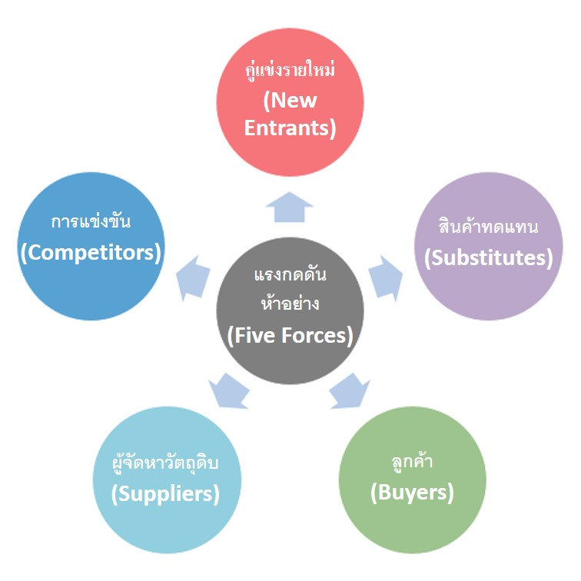
ทฤษฎีแรงกดดัน 5 ประการ ( Five Forces Model )
Porter’s Five Forces Model
The tool analyzes five key competitive factors and business environments, including new competitors, customers, substitute products, suppliers, and intra-industry competition. Businesses can use this tool to analyze their business and industry structures to identify the most appropriate strategies for coping.

Slide 12
Five Forces Model
The Threat of New Entrants
The entry of new businesses into a market means increased competition, leading to a decrease in market share. Large businesses may not be too concerned due to their large production capacity and low-cost raw materials, but smaller businesses must cope effectively. One way to mitigate this is by building strong relationships with existing customers, fostering customer satisfaction and creating a loyal customer base. Ways to counter the increase in competitors include differentiating products and creating unique features that are difficult to imitate.
A possible solution, as exemplified by 7-Eleven, is to improve and launch innovative products that differ from competitors, thereby reducing competitive pressure.

Slide 13
Five Forces Model
Bargaining Power of Suppliers
Pressure from suppliers, who are responsible for providing raw materials for production, worsens the situation if there are few suppliers producing that particular raw material. Purchasing raw materials at high prices increases our production costs, and if selling prices cannot be raised, the business faces greater risk. Therefore, businesses producing the same product should form groups to negotiate with suppliers, or pool resources to purchase goods in bulk to lower raw material prices.
This impacts the business by increasing prices, reducing quality, or decreasing production availability.

Slide 14
Five Forces Model
Barriers to purchase arise from the substitutability of products or services.
This pressure is considered the most impactful. While the products may not be of the same type, similar or identical purposes increase customer choices for substitutes. Examples include smartphones replacing watches or digital cameras, Airbnb replacing hotels, and airplanes replacing buses. Although some functions may be interchangeable, not all are. Therefore, businesses should focus on improving quality, enhancing appearance, and building brand loyalty to create unique products that are more appealing than substitutes.

Slide 15
Five Forces Model
Industry Rivalry:
A high level of competition in the market reduces a company's sales opportunities. Therefore, we should consider factors such as the number of competitors within the industry and the industry's growth rate. Furthermore, we should be well-prepared and have a robust strategic plan if we wish to enter a particular market to mitigate risks and strengthen the organization.

Slide 16
Culture and society
Business operations must adhere to social and cultural constraints because social and cultural characteristics significantly influence consumer purchasing behavior. Changes in consumer purchasing behavior resulting from cultural and social shifts affect marketing policies, including:
younger generations;
increased education for women;
greater acceptance of Western values ​​as a way of life;
increased brand loyalty; and
consumer influence through various media.

Slide 17
Politics and law
Changes in the political and legal environment will impact marketing decisions. The following are key political environmental factors involved in marketing management:
National monetary and fiscal policy
Business laws related to social responsibility
The relationship between government and various industries
Laws directly related to marketing

Slide 18
technology
Wearable Device
Payment
Mobile Marketing
Digital Marketing
Web trend

Slide 19
natural environment
The physical environment comprises soil, water, air, raw materials, and natural resources. Marketers deal with four aspects of the physical environment:
Increased levels of pollution
Shortage of certain raw materials
Increased cost of energy
The role of government in controlling and preventing environmental pollution in marketing.

Slide 20
The external microenvironment that affects the marketing mix.
market
Need or want
Money to Spend
Willing to Buy
Authority to buy

