Slide 1
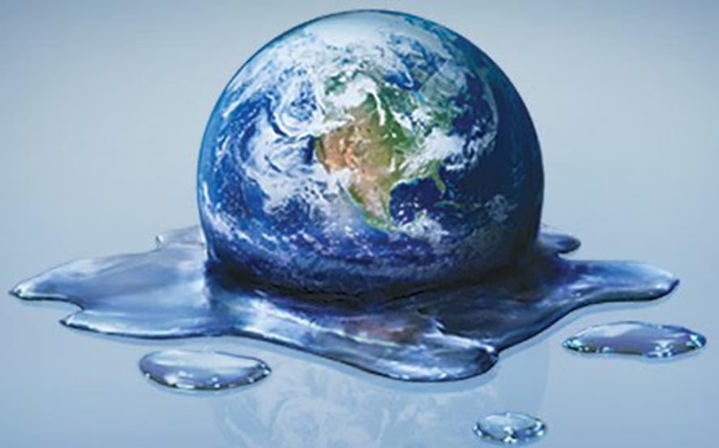
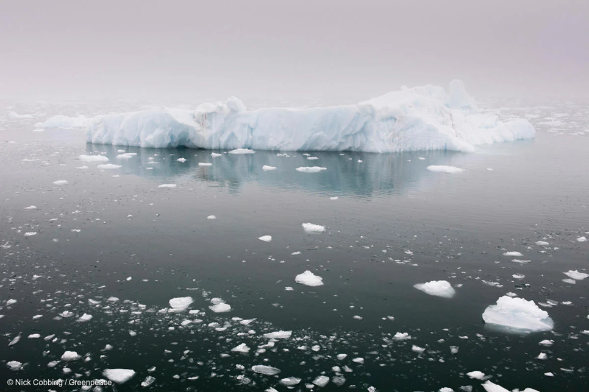
SMA 3201 Disaster and emergency management Dr. Nimit ponyiam

Slide 2
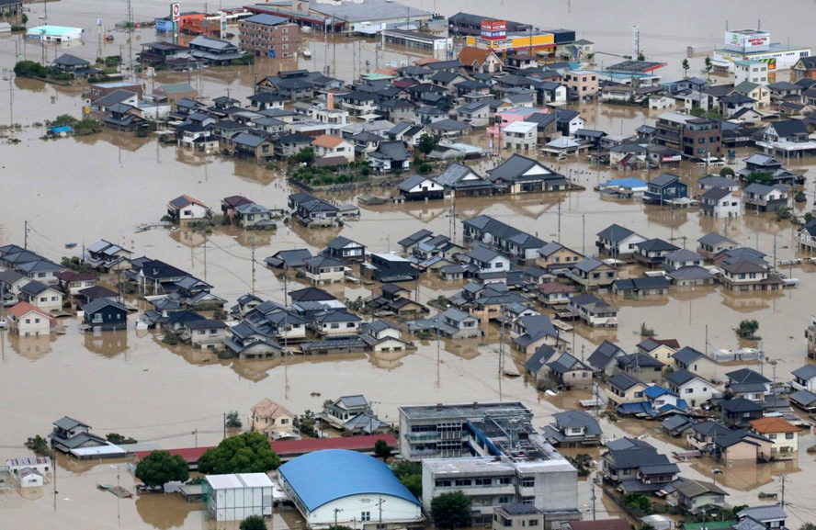
The Disaster
Disaster
A disaster refers to an event that
occurs suddenly and causes
severe impacts on a community
or society, resulting in widespread
losses to individuals, property,
the economy, and the environment.

Slide 3
The emergency situation
An emergency situation means a situation that affects or may affect public order, or poses a threat to national security, or may cause harm to the country Being in a critical situation or committing acts related to terrorism.

Slide 4
The New threats
Violence resulting from sabotage and terrorism
Cyber ​​attacks
Human trafficking
Issues related to migrant workers
Drug trafficking and money laundering
Emerging infectious diseases
Political dissent

Slide 5
The Emergency Management
Disaster refers to fire, windstorm, flood, drought, human epidemics, animal epidemics, aquatic animal epidemics, and pest outbreaks.
Disaster refers to fire, windstorm, flood, drought, human epidemics, animal epidemics, aquatic animal epidemics, and pest outbreaks.

Slide 6
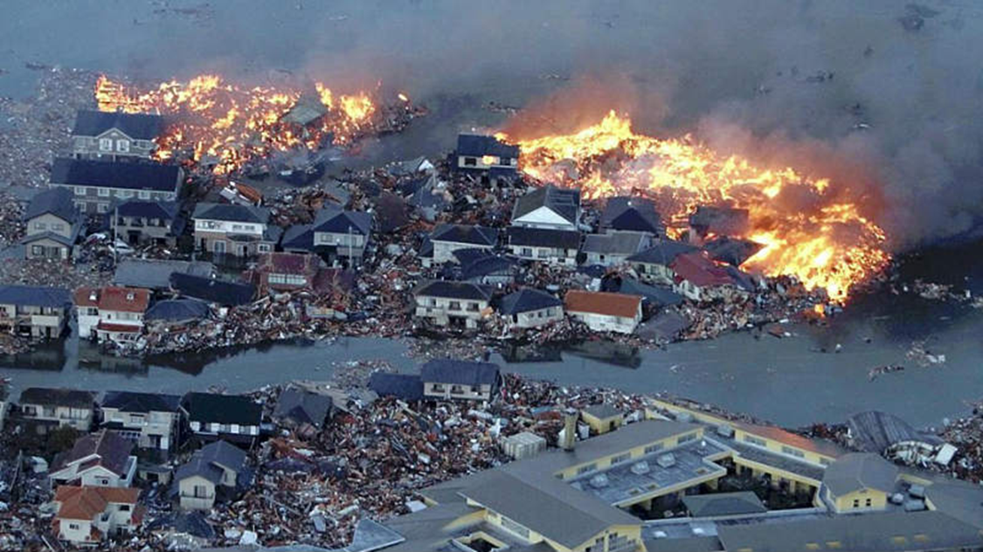
Guidelines for disaster and emergency management.
1. Mitigation
2. Preparedness
3. Response
4. Response

Slide 7
THE global warming It is the increase in the Earth's average temperature due to the greenhouse effect This is caused by humans increasing the amount of carbon dioxide from burning various fuels.
This reduces the efficiency of the mechanism that removes carbon dioxide from the atmosphere, leading to global warming. This allows more sunlight to penetrate the atmosphere and reach the Earth's surface, a phenomenon known as the "greenhouse effect.

Slide 8
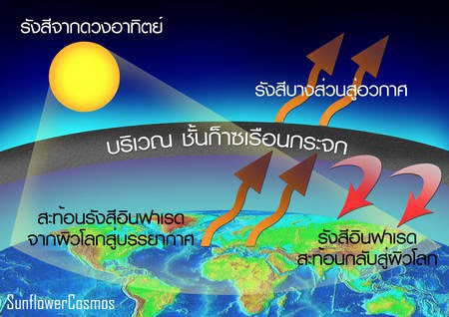
The greenhouse effect is the process by which thermal radiation from the Earth's surface is absorbed by greenhouse gases in the atmosphere and then reradiated in all directions. Because the radiation is emitted again and returned to the Earth's surface and the atmosphere below, the average surface temperature of the Earth would rise if these gases were absent.

Slide 9
Climate Crisis..
"Extreme weather events" are used to illustrate natural disasters that are becoming more severe and frequent as a result of climate change, such as heatwaves, droughts, and heavy rainstorms.

Slide 10
Rising temperatures are making droughts more severe. Data from the Center for Climate and Energy Solutions (CCES) indicates that increased evaporation causes soil depletion and leads to drought conditionsFurthermore, rising temperatures are linked to more frequent wildfires, and while wildfires can be caused by many factors, we cannot deny that this phenomenon is one of the contributing factors to many disastersThe region is experiencing drought, increasing the risk of wildfires which affect wildlife and humans.

Slide 11
The initial impact is from a slight to moderate increase in temperature.
1. Sea levels are rising due to melting glaciers.
2. The massive release of greenhouse gases from permafrost. 3. There is an increased risk of severe weather events.
4. Severe regional impacts. For example, in Europe, increased river flooding would occur in large areas of the continent.
5. Natural systems will be severely threatened

Slide 12
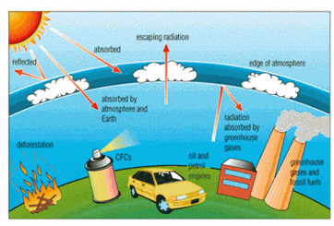
All the disasters mentioned are natural disasters, but there are also some types of disasters that are caused by human activity, such as droughts and floods.

Slide 13
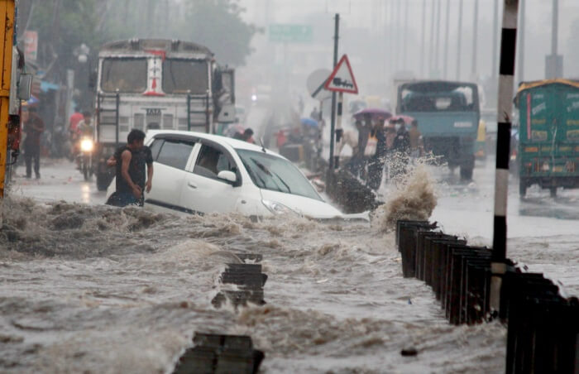
1. Flooding: Large-scale agricultural practices severely degrade topsoil, reducing nutrients and improving soil quality.

Slide 14
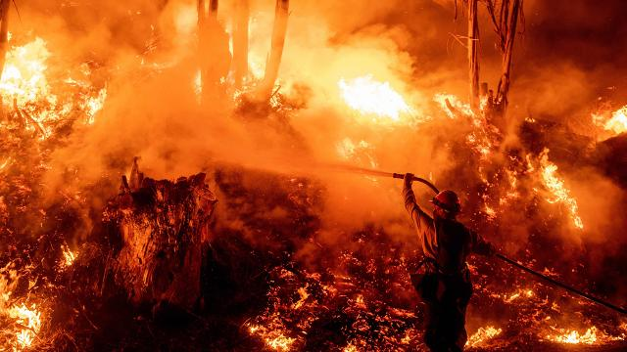
2. Wildfires caused by human activities such as burning weeds, burning trash, discarding glass bottles on roads (which can ignite when sunlight concentrates on them), discarding cigarette butts, and leaving campfires unextinguished after camping.

Slide 15
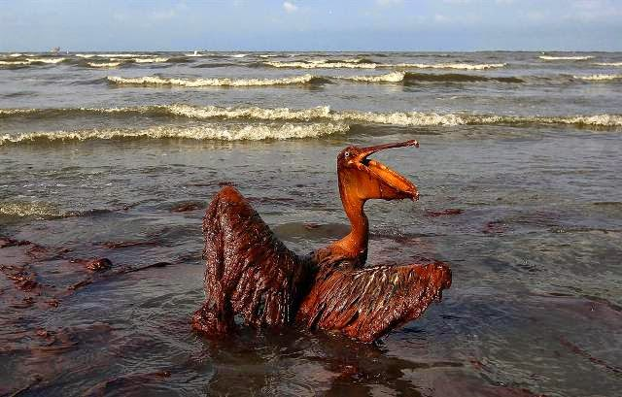
3. Oil or chemical spills, or accidents involving ships, such as collisions, shipwrecks, and other maritime activities.

Slide 16
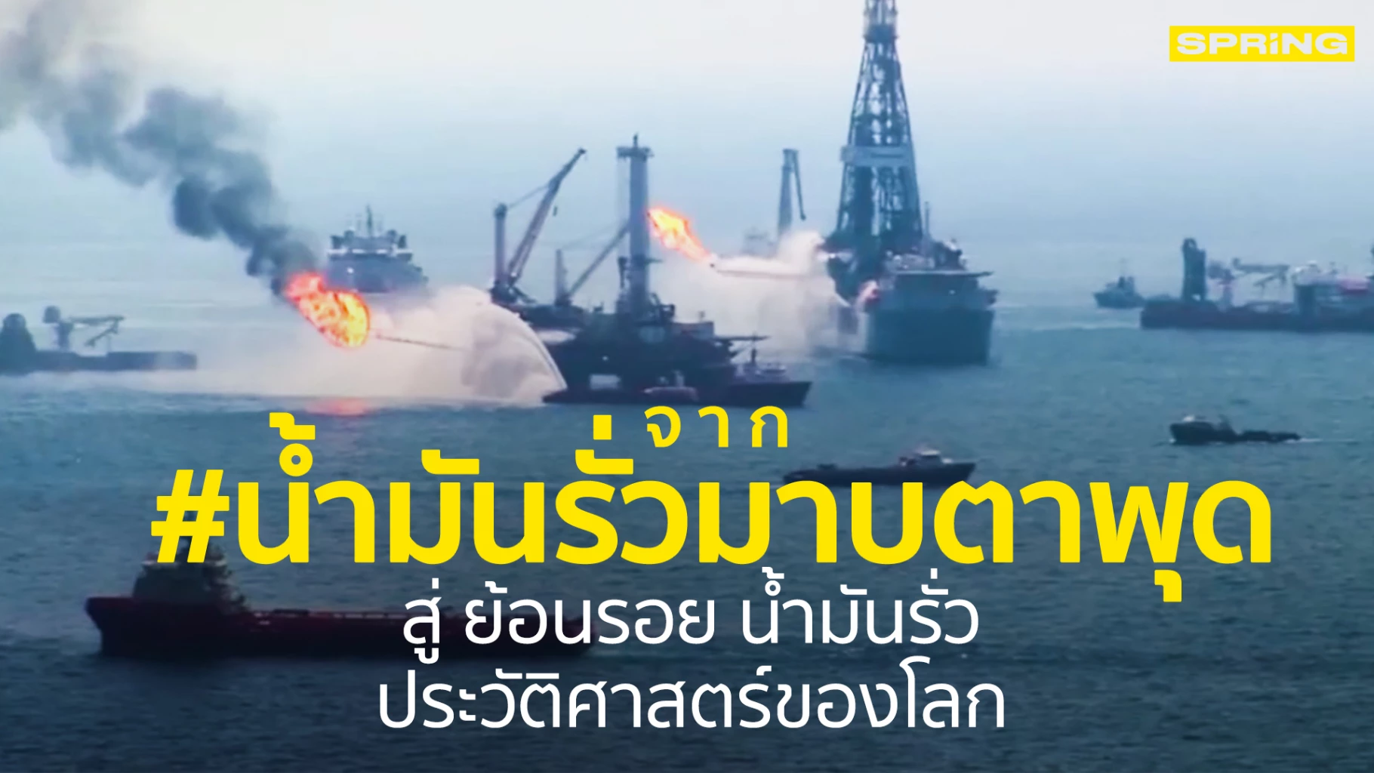
4. Natural gas drilling. Natural gas and the slag produced during the natural gas production process contain mercuryEven wastewater that has undergone preliminary treatment is found to contain 4% mercury, which, if not properly managed, will leach into the sea.

Slide 17
5. Offshore mining: Pollutants from mining operations, such as sediments generated during mining and mineral washing, are dispersed and carried to nearby areas.

Slide 18
The Disaster effects
1. Loss of life
2. Loss of home
3. Loss of property
4. Loss of natural resources
5. Loss of morale, spirits, and mental health
6. Loss of livelihood

Slide 19
