Slide 1
Welcome Section
4/12/2024

Slide 2
Course Orientation
Introduction to the course
Ethics, Morality and discipline
Importance of using English
Setting up the rules together
Pre-test

Slide 3
Introduction to the course
Ethics and morals and discipline 10%
Attitude towards learning, Attendance, class participation
Knowledge and Cognitive Skills 30%
Assignment, Presentation, Discussion, Exam

Slide 4
Introduction to the course
Ethics and morals and discipline 10%
Attitude towards learning, Attendance, class participation
Knowledge and Cognitive Skills 30%
Assignment, Presentation, Discussion, Exam

Slide 5
Introduction to the course
Interpersonal Skills 30%
Participation, Group work discussion, group and pair presentation,
Numeral Analysis 10%
Assignment (Research Paper)

Slide 6
Introduction to the course
Learning Management Skill 20%
Assessed from completed tasks at home
Meet the deadline, End of the exam (mark)

Slide 7
Ethics, Morality and discipline
Ethics จริยธรรม
the discipline concerned with what is morally good and bad and
morally right and wrong.
is also applied to any system or theory of moral values or principles.
it refers to community values, they're much more practical
An ethical code is a set of rules that defines allowable actions or correct behavior.

Slide 8
Morality ศีลธรรม
morality focuses on what moral obligations people have
Examples of morals can include things such as not lying, being generous, being patient, and being loyal.
More personal

Slide 9
Discipline การลงโทษ
the practice of training people to obey rules or a code of behavior, using punishment to correct disobedience.
control gained by enforcing obedience or order

Slide 10
Must and have to
They are both used to indicate that something is required or necessary to be done.
'Must' can imply that the obligation comes from internal motivations, while 'have to' is often used to express external requirements or obligations, such as rules and laws

Slide 11
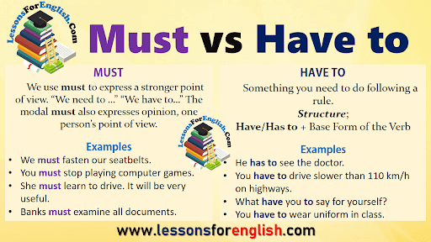

Slide 12
Go to mentimeter.com
Use code 66867561

Slide 13
Importance of using English
Communication /language of international communication
(widely spoken in the world, language of business, technology, science, language of internet)
Career advancement/ job opportunities
Education
Travel
gives access to more entertainment and more access to the Internet
English can make you ‘smarter’

Slide 14
Setting up the rules together
Group Work
Wordwall (make a group)
001 https://wordwall.net/resource/77124232/section-1-students-number
002 https://wordwall.net/resource/77124044/section-2-students-number

Slide 15
Classroom Rules and Expectation
Cooperation
(work together, take turns, be patient with one another, show good sportsmanship, help each other, solve disagreement smartly)
Responsibility
(follow directions, work hard, meet the deadline for every assignment, independent, complete all the tasks, use time wisely)

Slide 16
Classroom Rules and Expectation
Empathy
(kind, no bullying, no discrimination, don’t talk about others in a negative way)
Self-Control
(control your emotion and behavior, be a good listener, share ideas)

Slide 17
Classroom Rules
Be on time
Listen ( do not interrupt others)
Speak up (Participate in all activities-group discussion, presentation, share your ideas)
Clean up, switch all the electrical appliances after class)
Be Honest (no cheating, no copying from your friends)
Silence your cell phone
Work hard and be responsible

Slide 18
Pre-test
https://docs.google.com/forms/d/1HNTwz3e-skzRXye4gTSawH94VBeXiwG-p_qmVqong1k/edit

