Slide 1
Welcome Section
6/12/2024

Slide 2
Course Orientation
Introduction to the course
Ethics, Morality and discipline
Important Key terms (ESL,EFL)
Setting up the rules together
Pre-test

Slide 3
Introduction to the course
Important Key term
Bilingual Education , Types of Bilingual programs
Bilingualism, Presentation Techniques
Planning for a course, Planning for teaching and learning materials
Choosing the right course book
Designing your own materials
Learning styles and Learning needs
Revision Week
Midterm

Slide 4
Introduction to the course
Classroom Management in Bilingual Schools
Using Pair Work and Group work
Working with large class
How to keep your class in good order and lesson Planning
Language work in the classroom & Teaching Vocabulary
Teaching Grammar
Revision Week
Final Test

Slide 5
Introduction to the course
Ethics and morals and discipline 10%
Attitude towards learning, Attendance, class participation
Knowledge and Cognitive Skills 30%
Assignment, Presentation, Discussion, Exam

Slide 6
Introduction to the course
Ethics and morals and discipline 10%
Attitude towards learning, Attendance, class participation
Knowledge and Cognitive Skills 30%
Assignment, Presentation, Discussion, Exam

Slide 7
Introduction to the course
Interpersonal Skills 30%
Participation, Group work discussion, group and pair presentation,
Numeral Analysis 10%
Assignment (Research Paper)

Slide 8
Introduction to the course
Learning Management Skill 20%
Assessed from completed tasks at home
Meet the deadline, End of the exam (mark)

Slide 9
Ethics, Morality and discipline
Ethics จริยธรรม
the discipline concerned with what is morally good and bad and
morally right and wrong.
is also applied to any system or theory of moral values or principles.
it refers to community values, they're much more practical
An ethical code is a set of rules that defines allowable actions or correct behavior.

Slide 10
Morality ศีลธรรม
morality focuses on what moral obligations people have
Examples of morals can include things such as not lying, being generous, being patient, and being loyal.
More personal

Slide 11
Discipline การลงโทษ
the practice of training people to obey rules or a code of behavior, using punishment to correct disobedience.
control gained by enforcing obedience or order

Slide 12
Must and have to
They are both used to indicate that something is required or necessary to be done.
'Must' can imply that the obligation comes from internal motivations, while 'have to' is often used to express external requirements or obligations, such as rules and laws

Slide 13
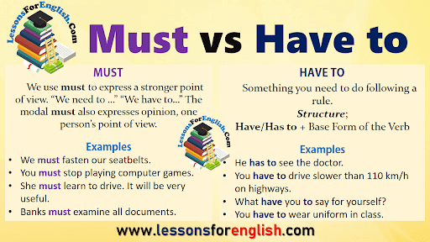

Slide 14
Go to mentimeter.com
Use code 2286 4456

Slide 15
Importance of using English
Communication /language of international communication
(widely spoken in the world, language of business, technology, science, language of internet)
Career advancement/ job opportunities
Education
Travel
gives access to more entertainment and more access to the Internet
English can make you ‘smarter’

Slide 16
Important key terms in English language teaching and learning
English as Second Language
ESL
EFL
TESOL
TEFL
TESL
ELT
English as Foreign Language
Teaching of English to speaker of other languages
Teaching English as a Foreign Language
Teaching English as a Second Language
English Language Teaching

Slide 17
Important key terms in English language teaching and learning
English for Specific Purpose
ESP
EAP
IELTS
TOEFL
TOEIC
English for Academic Purpose
International English Language Testing System
Test of English as Foreign Language
Test of English for International Communication
South Korean based test of English for higher education and employment

Slide 18
Setting up the rules together
Group Work
Wordwall (make a group)
001 https://wordwall.net/resource/77124232/section-1-students-number
002 https://wordwall.net/resource/77124044/section-2-students-number

Slide 19
Classroom Rules and Expectation
Cooperation
(work together, take turns, be patient with one another, show good sportsmanship, help each other, solve disagreement smartly)
Responsibility
(follow directions, work hard, meet the deadline for every assignment, independent, complete all the tasks, use time wisely)

Slide 20
Classroom Rules and Expectation
Empathy
(kind, no bullying, no discrimination, don’t talk about others in a negative way)
Self-Control
(control your emotion and behavior, be a good listener, share ideas)

Slide 21
Classroom Rules
Be on time
Listen ( do not interrupt others)
Speak up (Participate in all activities-group discussion, presentation, share your ideas)
Clean up, switch off all the electrical appliances after class)
Be Honest (no cheating, no copying from your friends)
Silence your cell phone
Work hard and be responsible

Slide 22
Pre-test
https://docs.google.com/forms/d/1HNTwz3e-skzRXye4gTSawH94VBeXiwG-p_qmVqong1k/edit

