Slide 1
outside television production
lectures and practice
Credit : https://en.wikipedia.org/wiki/Outside_broadcasting

Slide 2
outside television production
Outside broadcasting (OB) is the electronic field production (EFP) of television or radio programmes (typically to cover television news and sports television events) from a mobile remote broadcast television studio. Professional video camera and microphone signals come into the production truck for processing, recording and possibly transmission.
Some outside broadcasts use a mobile production control room (PCR) inside a production truck.

Slide 3
outside television production
Modern outside broadcasts now use specially designed OB vehicles, many of which are now built based around IP technology rather than relying on coaxial cable.^{[21]}
There has been an increasing rise in the use of flyaway or flypack Portable Production Units, which allow for an increased level of customisation and can be rigged in a larger variety of venues.

Slide 4
outside television production
In the past many outside broadcasting applications have relied on using satellite uplinks to broadcast live audio and video back to the studio. While this has its advantages such as the ability to set up anywhere covered by the respective geostationary satellite, satellite uplinking is relatively expensive and the round trip latency is in the range of 240 to 280 milliseconds.

Slide 5
outside television production
As more venues install fiber optic cable, this is increasingly used.^{[24]} For news gathering, contribution over public internet is also now used. Modern applications such as hardware and software IP codecs have allowed the use of public 3G/4G networks to broadcast video and audio. The latency of 3G is around 100–500 ms, while 4G is less than 100 ms.

Slide 6
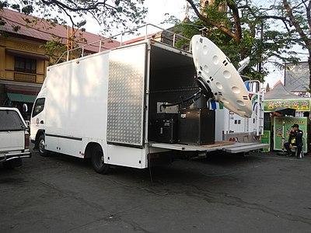
outside television production
An ABS-CBN OB van transmitting a satellite feed

Slide 7
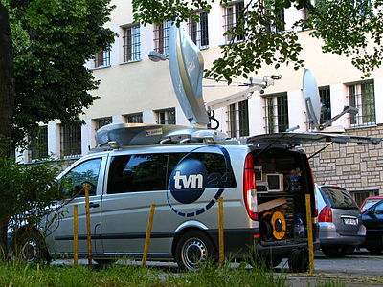
outside television production
A TVN24 outside broadcasting van in Poznań, Poland

Slide 8
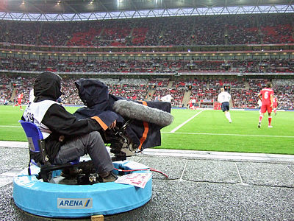
outside television production
Camera operator working on an outside broadcast of a football match at Wembley Stadium

Slide 9
outside television production

Slide 10
outside television production

