Slide 1
Module 2 : Political, Governance, and Economic Systems in the Knowledge-Based Society and BANI World
Ph.D. Management Innovation
College of Innovation and Management
SSRU

Slide 2

Learning outcomes
After completing this module, students will be able to:
1.Explain the impact of the BANI (Brittle, Anxious, Nonlinear, Incomprehensible) context on societal transformation and economic systems.
2.Formulate personal development strategies that reflect adaptive leadership and effective management practices in uncertain and complex environments.
3.Demonstrate an understanding of ethical principles in the governance and development of a knowledge-based economy, including transparency, equity, social responsibility, and respect for individual rights
4.Critically evaluate the evolution, structure, and effectiveness of political, governance, and economic systems in addressing global and local challenges within a knowledge-based economy.

Slide 3

Understanding the BANI World
https://www.istockphoto.com/

Slide 4
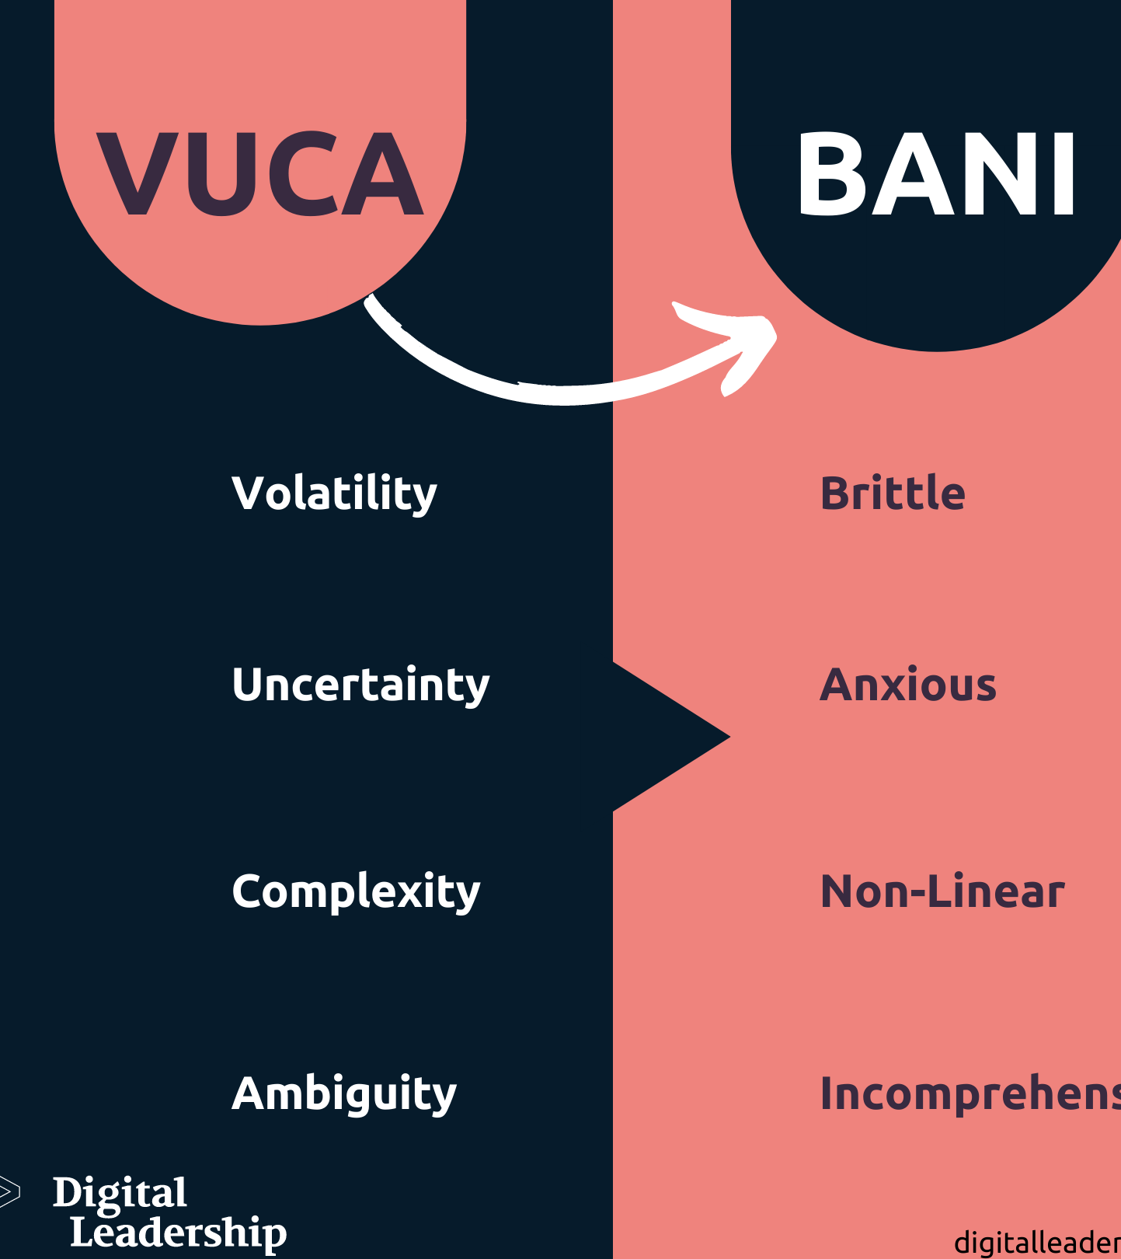
VUCA To BANI
https://digitalleadership.com/

Slide 5
Management Principles in BANI World
Three Phases of Management:
1. Execute – Adopt innovation
2. Transform – Redesign experience & culture
3. Innovate – Drive strategic change with IT
Emphasis on adaptability and proactive transformation

Slide 6
Exercise 1: BANI and Management innovator (10 minutes)
Given the "Brittle," "Anxious," "Non-linear," and "Incomprehensible" nature of the BANI world, how can organizations best foster and manage innovation when traditional approaches to planning and predictability are increasingly ineffective?

Slide 7
Answer:
To foster and manage innovation in the BANI world, organizations must pivot from traditional methods to adaptive, resilient, and human-centric approaches:
Embrace Agility and Experimentation: Focus on rapid prototyping, learning from quick failures, and empowering small, agile teams to respond to non-linear changes and brittle systems.
Cultivate Psychological Safety and Resilience: Directly address employee anxiety, build redundancy for brittle systems, and use a strong sense of purpose to guide decisions in incomprehensible situations.
Leverage Data (with Intuition): Shift from predicting to "sense-making" using continuous environmental scanning. Combine data insights with diverse perspectives and human intuition to navigate non-linear complexities.
Form Strategic Partnerships: Engage in co-creation and open innovation with external partners to share risks and resources, recognizing that ecosystem resilience strengthens individual organizations.
Ultimately, innovation in the BANI world thrives on flexibility, adaptability, and collaboration, moving away from rigid plans toward dynamic, responsive strategies.

Slide 8
Preparing for a Knowledge-Based Society & Economy
Policy, Tech Trends
Knowledge
Skills
Ethics
Attributes
Vision, Learning, Decisiveness,
Data, Collaboration,
Change Management
Transparency, Sustainability,
Intellectual Property: IP Respect

Slide 9
The Crucial Role of Political Regimes, Governance, and Economic Systems in a Knowledge-Based Society and Economy
KBE
Political
Regimes
Governance
Economic Systems

Slide 10

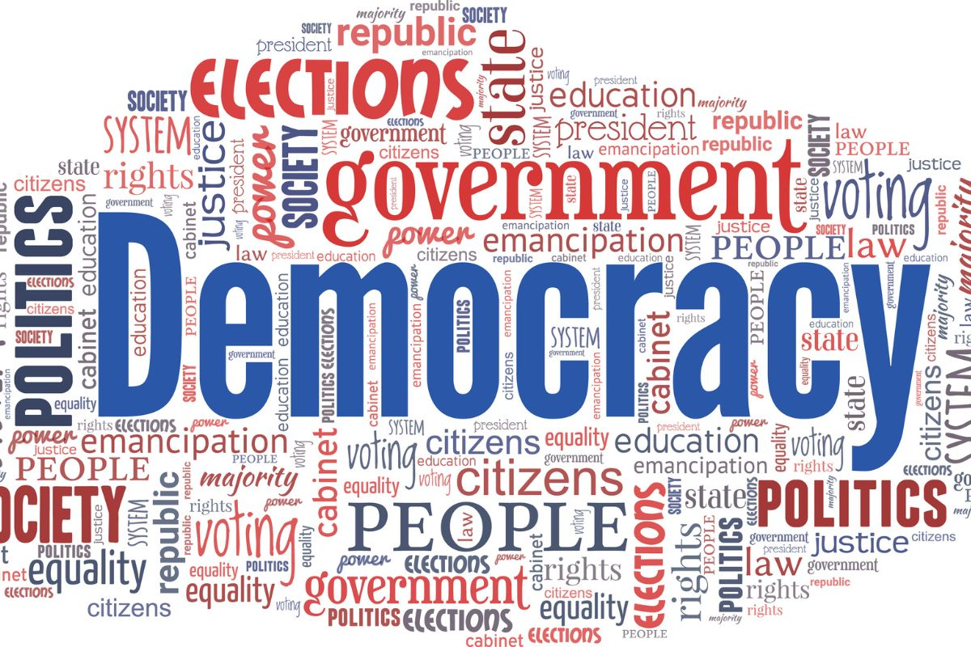


Types of Political Regimes
Dictatorship
Monarch holds supreme power over both politics and the law.
The monarch serves as the head of state but does not hold executive power.
Dictatorship
The ultimate authority belongs State power is concentrated in the
to the people hands of one person or a small group

Slide 11
Key Traits of a Political Regime in a Knowledge-Based Economy
Rule of Law and Governance
Decentralized and Effective Administration
Participatory Democracy
Investment in Education

Slide 12
Effective governance in a BANI world : Example countries Finland, S. Korea, and Singapore
Transparency and Anti-Corruption Efforts
Public Participation
Rule of Law and Equality
Political Stability
Efficient Public Services

Slide 13
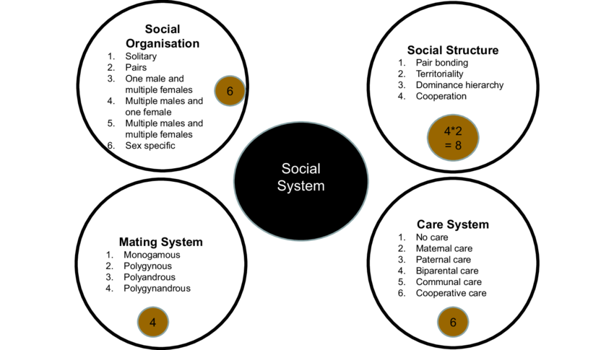
Social Systems in a Knowledge-Based Society
https://www.researchgate.net/

Slide 14
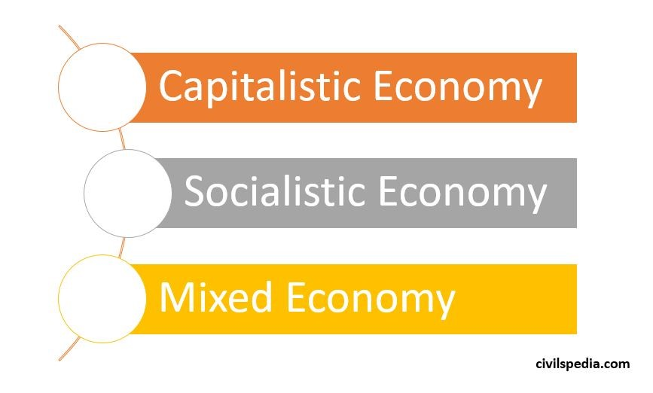
Economic Systems: Capitalism, Socialism, Mixed
Private individuals or businesses own
and control the means of production
Emphasizes government or collective control
over economic activities to achieve social
equality and reduce economic disparity
Combines principles from both
capitalism and socialism.
Its aim is to leverage the advantages
of both systems while minimizing their
drawbacks.

Slide 15
Example of Strategic Response in BANI Era
Old Approach: Optimize for low cost + high volume.
BANI Strategy:
Brittle? → Localize suppliers (avoid global disruption).
Anxious? → Crowdsource product ideas from communities (build trust).
Nonlinear? → Test pop-up stores in 3 markets before scaling.
Incomprehensible? → Use AI to predict regional demand spikes.

Slide 16
Exercise 2: Considering the economic model in your country, how do you define your role as a leader in management innovation? Respond to these three pivotal questions to highlight your dedication and expertise in this area. (15 minutes)
Questions | BANI-Era Innovation
What to produce?
How to produce?
For whom to produce?

Slide 17
The Relationship Between Politics, Governance, and Economy in a Knowledge-Based Society
Creating Policies Conducive to Innovation
Building Digital Infrastructure
Politics and Governance Determine Economic Direction
Investing in Human Capital

Slide 18
The Knowledge-Based Economy Impacts Politics and Governance
Changing Role of the State
Politics Must Adapt to Technology
Demanding Transparency and Efficiency

Slide 19
A Mutually Dependent Relationship
Effective governance
A growing knowledge-based economy
Stable and transparent politics

Slide 20
EX3: From Figure 17-19, if we were to conduct research, what should be the dependent variable and what should be the independent variable, and why?
Inde. Var.
De. Var.

Slide 21
Please present the assigned reading articles as prepared..

Slide 22
Assignment Module 2: Choose one question each, without repeating it, and write a short, concise, and to-the-point comment no longer than 10 lines.
1. How can we ensure that technological innovation benefits all segments of society, not just the privileged few?
2. What ethical responsibilities do governments and tech companies have in regulating emerging digital technologies?
3. In what ways might rapid innovation challenge or conflict with principles of equity and justice?
4. How can we balance the need for data-driven innovation with the protection of individual privacy rights?
5.How should policymakers respond to the unintended social consequences of digital innovation, such as job displacement?
Please send all your assignments to kuncharee.ka3556@gmail.com on 25 July 2025

