Slide 1
Basic English for Social Studies Teachers
Week 1
4th December 2025

Slide 2
  Course Objectives: After the course, students will have English language skills in listening, speaking, reading, and writing, focusing on social studies terms and the structure of English commonly used in social studies from related print materials and others, and social studies terms and structure of English commonly used in instruction; applying knowledge in social studies instruction.

Slide 3
Method of Teaching
Active Participation & Discipline: Students should participate actively in learning activities and inspections, maintaining discipline. * Responsibility & Collaboration: Encourage responsibility in individual work and group projects (collaborative learning).
Honest Work: Ensure all assignments are completed with honesty and integrity, without copying from others.
Active & Problem-Based Learning (PBL): Focus on methods that require students to be actively engaged and to solve real-world problems.
Research & Investigation: Students should review, investigate, and discuss relevant research articles (e.g., social studies research).
Independent Study: Assign students to study important knowledge on their own (self-directed learning).

Slide 4
Method of Evaluation
1. 🔍 Observational & Behavioral Assessment
Learning Behavior: Observation of students' overall learning behavior and conduct.
Activity Engagement: Observing engagement in teaching and learning activities, including their participation in discussions.
2. 📝 Performance & Participation
Assignments: Evaluation of assignments that demonstrate honesty and integrity (not copied from others).
Responsibility: Assessing the practice of responsibility in both learning activities and group work.
Class Participation: Evaluating participation in learning activities, answering questions, and contributing to discussions.
Group Work: Assessment based on the quality of group work and the presentation of discussion results.
3. ✅ Formal Testing
Academic Tests: Results from the mid-term and final-term academic achievement tests.

Slide 5
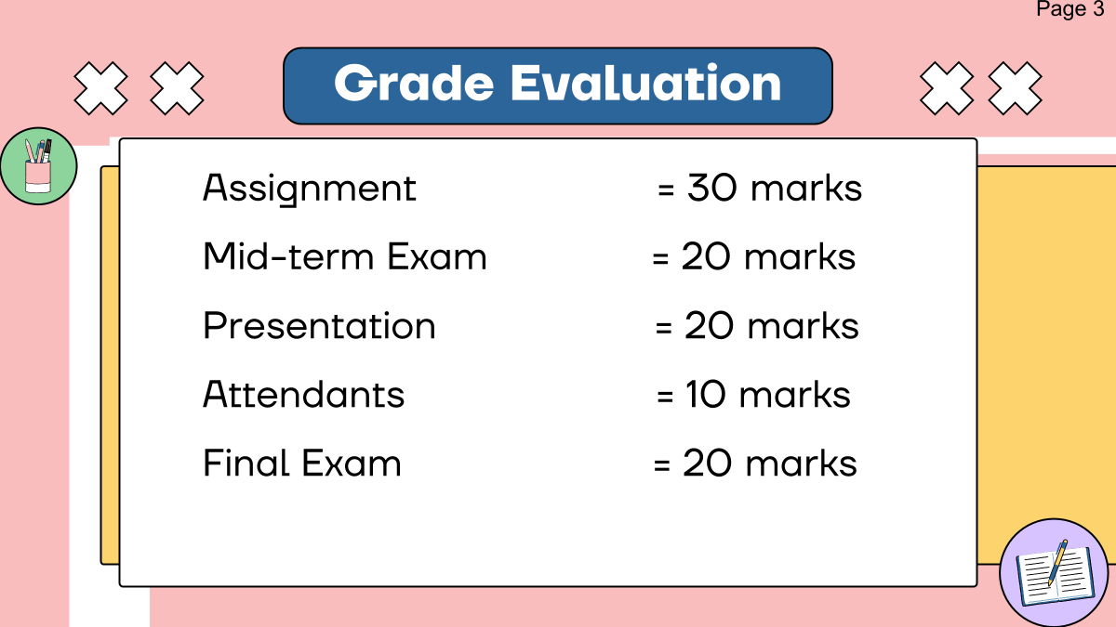
Grade Evaluation
Participation in Class/ Attention

Slide 6

Setting up the rules together
Group Work

Slide 7
Setting up the rules together
Set 5 Classroom rules in your groups.

Slide 8
Classroom Rules (Section 1)
Don’t be late more than 15 minutes
Food is not allowed in the class (Only drink)
When you want to ask question, raise your hand(Participate in all activities-group discussion, presentation, share your ideas)
Don’t be absent more than 3 times (absence more than 3 times= No exam)
Be Honest, Submit the assignment on time (no cheating, no copying from your friends)
10 minutes break

Slide 9
Classroom Rules (Section 2)
Don’t be late more than 15 minutes
Food is not allowed in the class (Only drink)
Speak up (Participate in all activities-group discussion, presentation, share your ideas)
Don’t be absent more than 2 times (absence more than 3 times= No exam)
Be Honest (no cheating, no copying from your friends)
Silence your cell phone, off the notification

Slide 10
Classroom Rules and Expectation
Cooperation
(work together, take turns, be patient with one another, show good sportsmanship, help each other, solve disagreement smartly)
Responsibility
(follow directions, work hard, meet the deadline for every assignment, independent, complete all the tasks, use time wisely)

Slide 11
Classroom Rules and Expectation
Empathy
(kind, no bullying, no discrimination, don’t talk about others in a negative way)
Self-Control
(control your emotion and behavior, be a good listener, share ideas)

Slide 12
Classroom Rules
Be on time
Listen ( do not interrupt others)
Speak up (Participate in all activities-group discussion, presentation, share your ideas)
Clean up, switch all the electrical appliances after class)
Be Honest (no cheating, no copying from your friends)
Silence your cell phone
Work hard and be responsible

