Slide 1
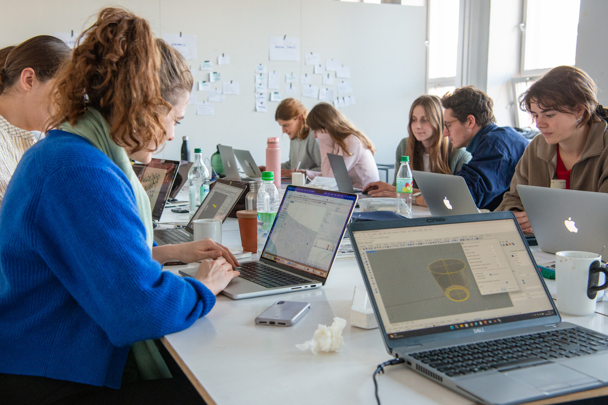
English for Design
and Digital Innovation
Topic: Introduction to Design Vocabulary
ACTIVE LEARNING
VOCABULARY
Course objectives
•
Learn essential English vocabulary for design.
•
Communicate design ideas in English.
•
Use digital tools for learning and presentation.
Class activity: Match the words with their meanings.
English for Design and Digital Innovation • 1/5

Slide 2

Design Vocabulary
Key words used in digital design conversations
Design
The process of creating something.
Innovation
A new idea or method.
Prototype
The first model of a product.
UX
How people feel when using a product.
Practice: Fill in the blanks
Interface
The way users interact with a system.
•
A ______ is the first version of a product.
•
Good ______ improves user satisfaction.
Creativity
The ability to create new ideas.
•
______ means creating something new.
English for Design and Digital Innovation • 2/5

Slide 3

Reading Practice
Read for main ideas and design-related vocabulary
Digital innovation changes the way people communicate, work, and create products. Designers use creativity, technology, and problem-solving skills to develop products that meet users' needs.
Comprehension questions
Discussion
•
What does digital innovation change?
What digital products do you use every day?
•
What skills do designers use?
•
Why do designers create products?
English for Design and Digital Innovation • 3/5

Slide 4
Speaking Activity
Pair work: talk about a favorite design
Student A asks
Useful expressions
•
What is your favorite design?
•
I think...
•
Why do you like it?
•
In my opinion...
•
Who designed it?
•
It is useful because...
•
I prefer...
Student B answers using complete sentences.
Example: My favorite design is the iPhone. I like it because it is simple and easy to use.
English for Design and Digital Innovation • 4/5

Slide 5
Mini Project: Design Presentation
Prepare a 2-minute presentation in English
Choose one digital product
Presentation template
•
Mobile App
Hello everyone.
Today I would like to present my design.
The product is called ________.
It is designed for ________.
The main features are ________.
Thank you for listening.
•
Website
•
Logo
•
Poster
•
Smart Device
Learning outcomes: vocabulary, reading, communication, presentation.
English for Design and Digital Innovation • 5/5

