Slide 1
use of studio equipment
Lecture, Q&A Practice using the equipment in the studio.
Credit : https://www.tekobroadcast.com/en/video-studio-equipment

Slide 2
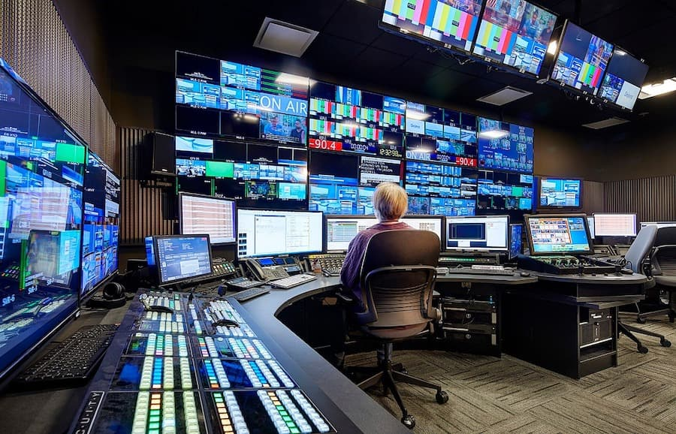
use of studio equipment

Slide 3
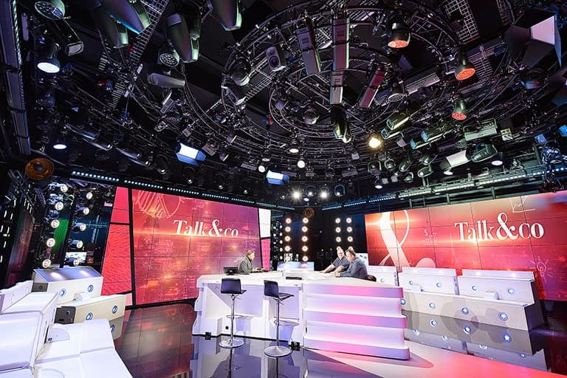
use of studio equipment
Lighting
In a professional studio, it is essential to have proper lighting, especially when using virtual sets with a chroma key - in these cases, the lighting will have to be strong and evenly spread throughout the scene

Slide 4
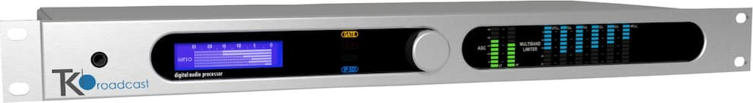
use of studio equipment
TV Audio Processor
Identically to what happens for the video, the audio of a station is first embedded into the SDI signal, to then be processed and re-embedded into the now-ready-to-be-broadcast SDI signal.

Slide 5
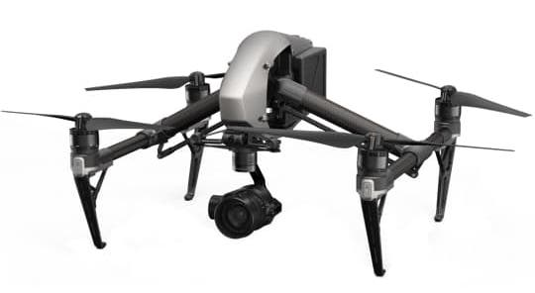
use of studio equipment
Drones
Unmanned aerial vehicles (UAV), commonly known as "drones", have become wildly popular over the last 10 years. This is largely due to the fact that they make it incredibly easier and quicker to solve multiple problems for which rare and very expensive equipment once was necessary.

Slide 6
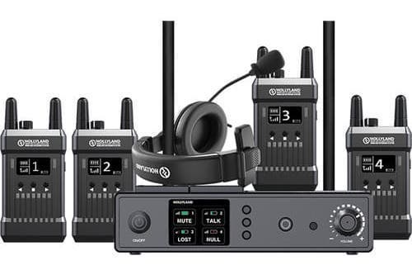
use of studio equipment
Intercom System
An intercom - or wireless transmitters - system, serves the purpose of connecting multiple people across several rooms or spaces.
It is an essential piece of equipment, guaranteeing rapid and efficient communication between directors, cameramen and all the members of staff of a television program.

Slide 7
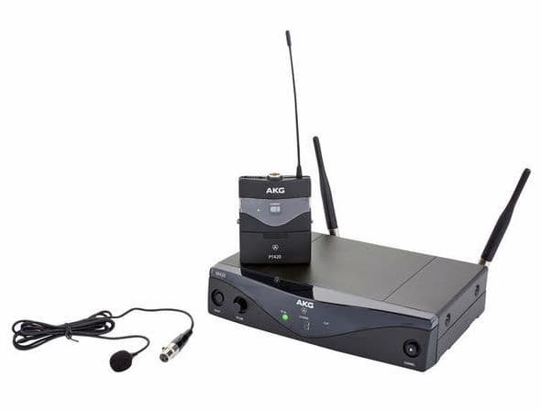
use of studio equipment
Audio Equipment
We include in this category all the equipment that is used to manage the audio of a television station.
All the signals go through the mixer, are there processed and sent, via auxiliary channels, to the speakers to be monitored, to the telephone hybrids, and to the host's in-ear monitors.

Slide 8
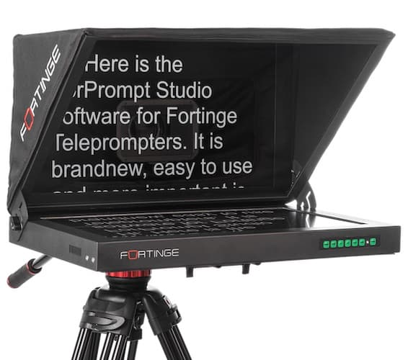
use of studio equipment
Studio Prompter/Teleprompter
Studio prompters - or teleprompters - are fundamental during news, sports and weather programs.
They allow the host or journalist to easily read the prompts without looking away from the camera.

Slide 9
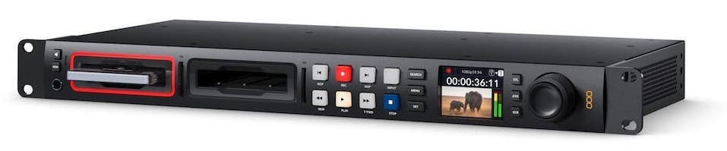
use of studio equipment
Video Recorder
Video Recorders allow you to record a video signal directly onto SD cards or SSD hard disks to then be edited by the production studio, or to simply play a pre-recorded signal.

Slide 10
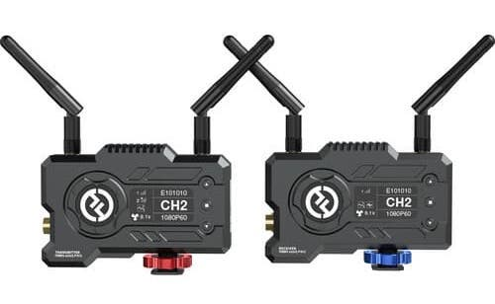
use of studio equipment
Video Transmitter
Video transmitters are designed to carry video and audio signals from one place to another.
They normally come in pairs: a transmitter, or "sender", which is connected to an input signal - for example, a CCTV camera or a television set -; and a receiver, which picks up the signal and sends it to a screen.

Slide 11
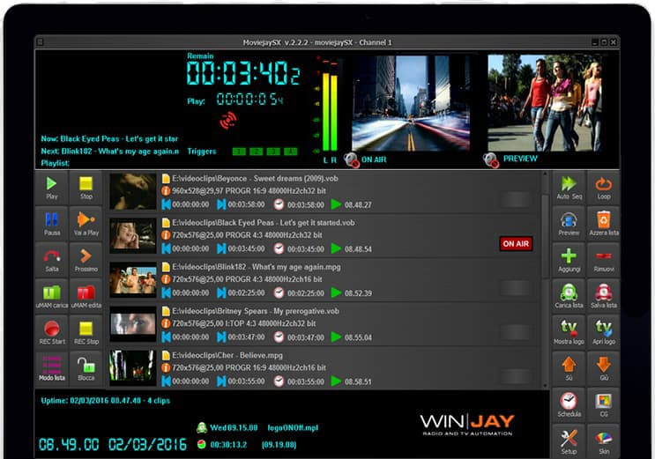
use of studio equipment
TV Automation Software
To properly manage the scheduling and the video stream of a television station, a software is necessary.
This type of software, interfaced with acquisition and playback cards, can receive and send signals from and to the direction.

Slide 12
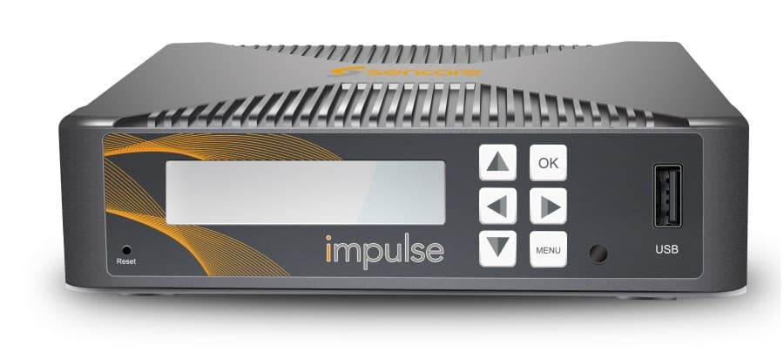
use of studio equipment
Encoders and Decoders
Encoders and Decoders are necessary pieces of equipment used to transport the audio and video signal from one point to another via the internet, via fiber or via wi-max point to point.

Slide 13
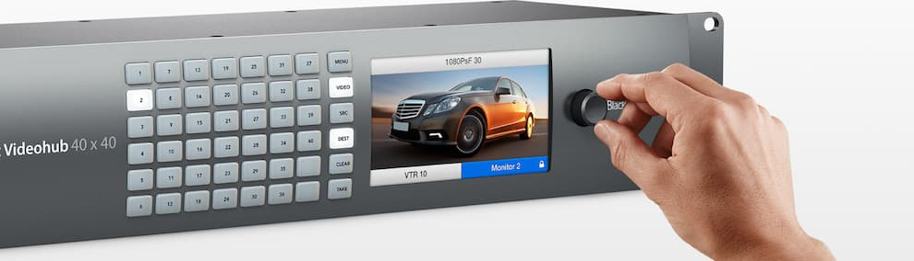
use of studio equipment
Video Router
The video router - or matrix - is the sorting center for the signals of one or more studios.

Slide 14
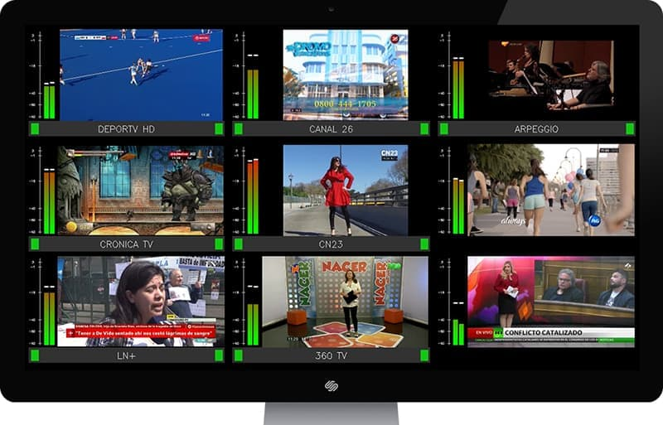
use of studio equipment
Audio and Video Monitoring
Monitors make it possible for studio operators to check audio and video signals travelling between one direction and the other, internally as well as externally.

Slide 15
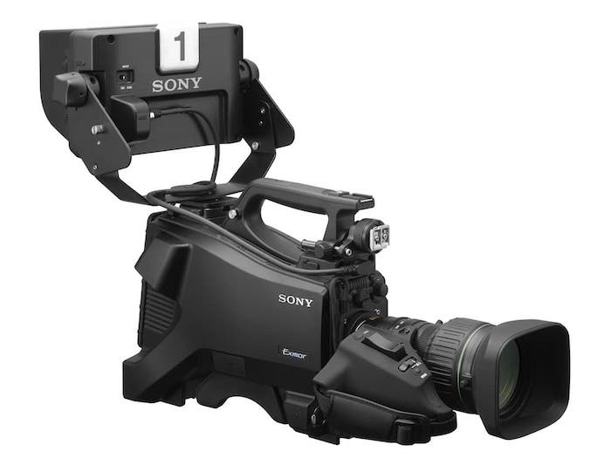
use of studio equipment
Studio Cameras
Originally designed specifically for video studios, these cameras have greatly evolved and become very popular, extending their potential to many other applications: music videos, news, sports, events, etc.

Slide 16
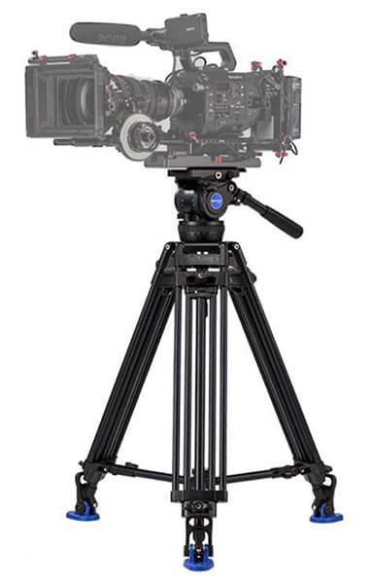
use of studio equipment
Tripod
Included among camera accessories, tripods are definitely one of the most indispensable ones.

Slide 17
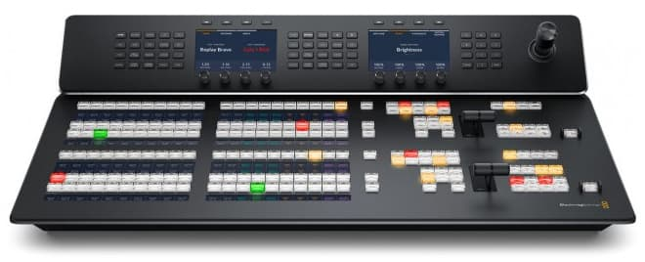
use of studio equipment
Video Mixer/Switcher
The video mixer is arguably the core element of a television studio.
It allows you to air the desired source via simple or complex transitions; create and manage virtual sets; superimpose graphics or texts.

Slide 18
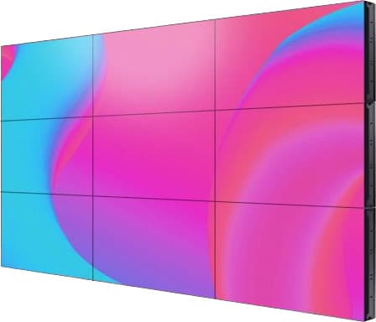
use of studio equipment
Video Wall
A video wall is a maxi screen composed of a variable number of modules.
These can be combined to reach the desired dimensions of the screen.

Slide 19
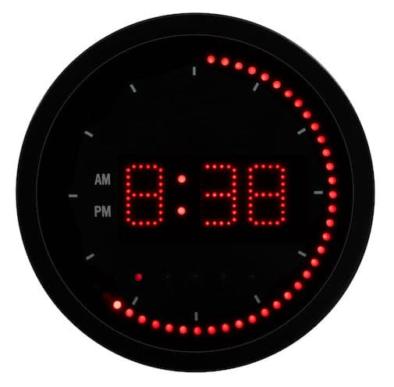
use of studio equipment
Studio Clock
As much as it may seem a trivial accessory, studio clocks are essential when it comes to timing the program's schedule, and they are a point of reference for all the members of the crew.

Slide 20
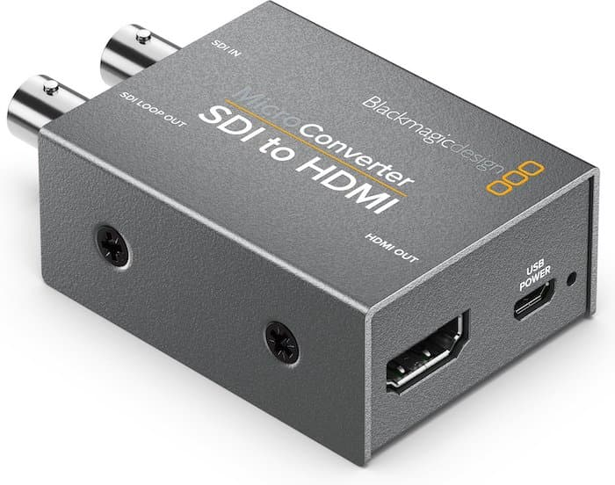
use of studio equipment
Converters
There are many different types of converters that can be used differently within a television studio.
SDI-to-HDMI converters, for example, are necessary if you wish to send any SDI signal to the studio or direction monitors.

Slide 21
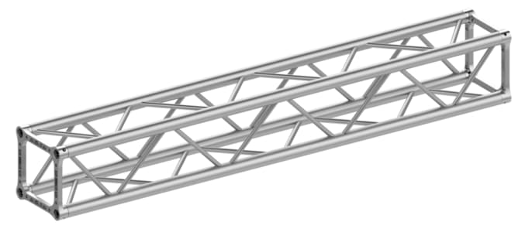
use of studio equipment
Truss
Trusses allow you to install all the lights that you will use for the scene.
They are generally installed on the ceiling, or, sometimes, on mobile lattices for ease of maintenance.

