Slide 1
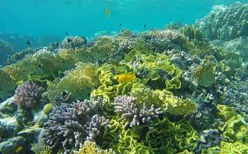
Climate Change and
Introduction to Aquatic Ecology
15th January 2025

Slide 2
Climate Change
Reading Comprehension
COP29 UN Climate Change Conference

Slide 3
Climate Change
Listening
https://youtu.be/-Q0xUXo2zEY
https://learnenglish.britishcouncil.org/general-english/video-zone/greta-thunberg-george-monbiot-climate-crisis
In this video, climate activists Greta Thunberg (Gre-ta Thung-berg) and George Monbiot (jorj maan·byuht) tell us how we should use nature to tackle the climate crisis.
Before you watch and listen the video, do the pre-task matching the words and their meaning.

Slide 4
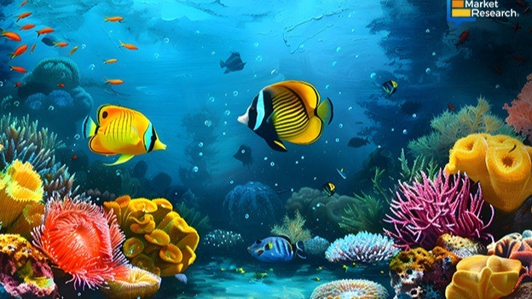

Slide 5
The Building Blocks of Life
The resources that organisms need to survive, grow, and reproduce in bodies of water.
Biomass: renewable organic material that comes from plants and animals.
Production : Production is the rate of increase in the total biomass

Slide 6
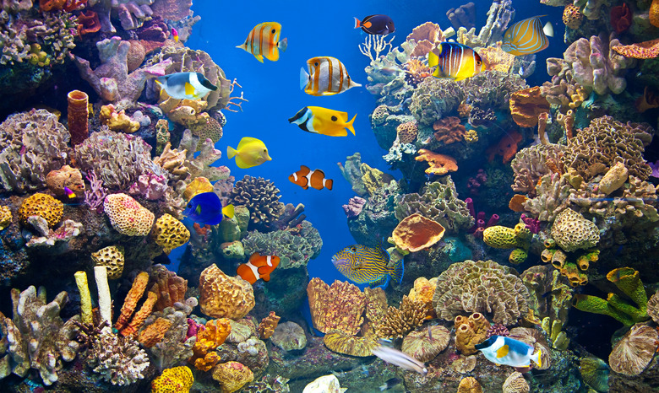
Ecology and Ecosystem
the scientific study of how organisms interact with each other with their environment
relationships between individuals of the same species, between different species, and
between organisms and their physical and chemical environments
Aquatic ecology includes the study of these relationships in all aquatic environments
oceans, estuaries, lakes, ponds, wetlands, rivers, and streams

Slide 7
An ecosystem(Group 1)
An ecosystem is a community of living organisms and their physical and chemical environment,…………………..
Read from pdf file

Slide 8
The physical characteristics of aquatic habitats(G2)
affect the types of organisms found there. Living organisms in a particular environment are directly affected by environmental characteristics…………………………………….
Read from pdf file

Slide 9
Life in Aquatic Ecosystems (Group 3)
Organisms living in aquatic ecosystems are dependent on the resources ……………………
Read from pdf file

Slide 10
The Building Blocks of Life (Group 4)
All living organisms need water, energy, carbon, nutrients and oxygen to stay alive,…………….
Read from pdf file

Slide 11
Energy (Group 5)
Almost all energy used by organisms is derived, directly or indirectly, from the sun;
Read from pdf file

Slide 12
Carbon (Volunteer Students )
Carbon is a building block in the sugars, proteins, and fats that make up the tissues of all organisms.
Read from pdf file

Slide 13
Nutrients (volunteer student)
Nitrogen and phosphorus are the most important nutrients for the growth of algae
Read from pdf file

Slide 14
Homework
Do the exercises.

