Slide 1
Week 2
11th December 2025
Basic English for Social Studies Teachers

Slide 2
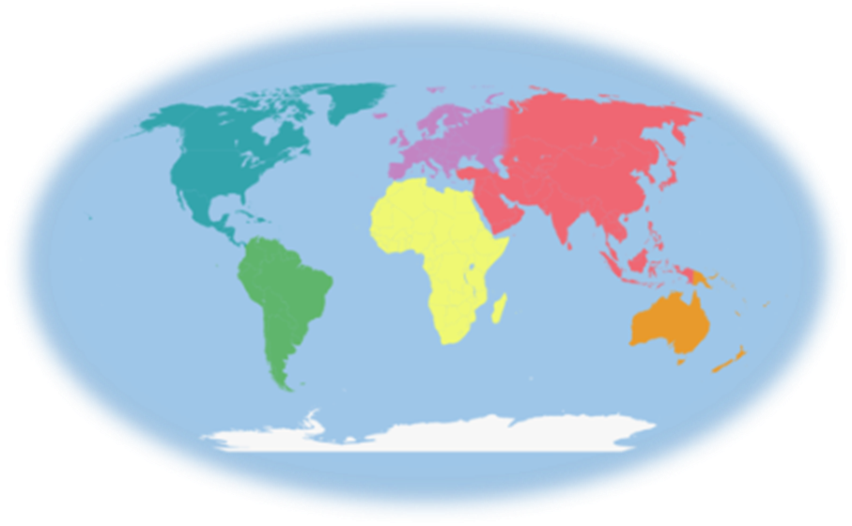
North
America
Europe
Asia
Africa
South America
Australia
Antarctica

Slide 3
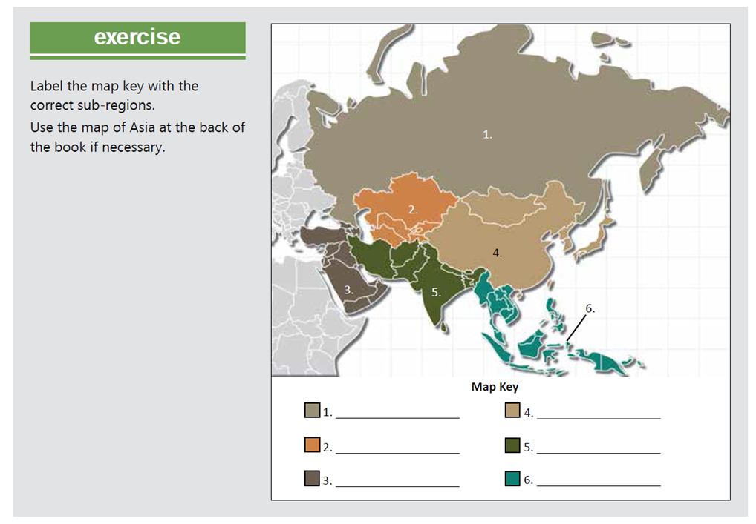
Northern Asia
East Asia
South Asia
Central Asia
Western Asia
Southeast Asia

Slide 4
Preview
What is migration?
Migration is when people move from one area to another. Migration can be from one country to another or one town to another. It can be permanent or temporary. In ancient times, entire groups of people migrated permanently to parts of
Southeast Asia.
2. Why do people migrate?
There are many reasons why people migrate. Sometimes people migrate for work; to escape violence; to be with family and friends; or because of a natural disaster like a flood or an earthquake.

Slide 5
2. Why Do People Migrate?
The reasons for migration are often complex and intertwined, but they are generally grouped into "Push Factors" and "Pull Factors."
A. Push Factors (Reasons to Leave)
These are the unfavorable conditions and events that push or compel a person to leave their place of origin:
Economic:
Lack of job opportunities or very low wages.
High cost of living and deep poverty.
Poor economic conditions or recession.
Social/Political:
War, civil conflict, or political instability.
Persecution based on ethnicity, religion, or political beliefs.
Lack of basic human rights or political freedom.
Lack of access to essential services like quality education and healthcare.
Environmental:
Natural disasters (e.g., earthquakes, hurricanes, floods).
The adverse effects of climate change (e.g., severe drought leading to crop failure and hunger).
High pollution levels.

Slide 6
B. Pull Factors (Reasons to Come)
These are the attractive conditions and opportunities that pull a person toward a new destination:
Economic:
Higher wages and better job opportunities.
A higher overall standard of living.
Social/Political:
Greater safety, political stability, and peace.
Religious and political freedom.
Better access to high-quality education and advanced healthcare.
The presence of family or community networks (chain migration).
Environmental:
A more appealing, safe, or comfortable climate and living environment.
In summary, most people migrate in the hope of achieving a better life—whether that means financial stability, personal safety, or freedom from persecution.

Slide 7
Preview
Is your country a member of ASEAN?
Yes
2. What other countries are members of ASEAN?
Brunei, Cambodia, Indonesia, Laos, Malaysia, Myanmar, the Philippines, Singapore, Thailand, Vietnam, Timor-Leste

Slide 8
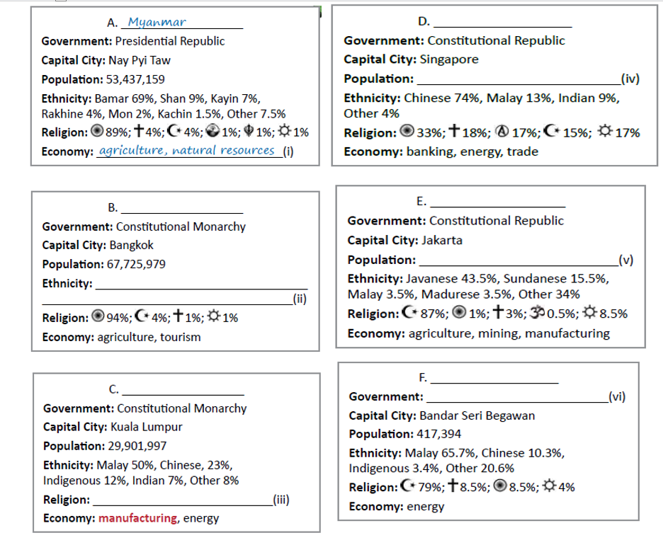
Singapore
f. 5,469,700
Thailand
Indonesia
c. 254,454,778
Thai 90%, Mon/Khmer 6%,
Malay 3%, Other 1%
Malaysia
Brunei
d. Monarchy

Slide 9
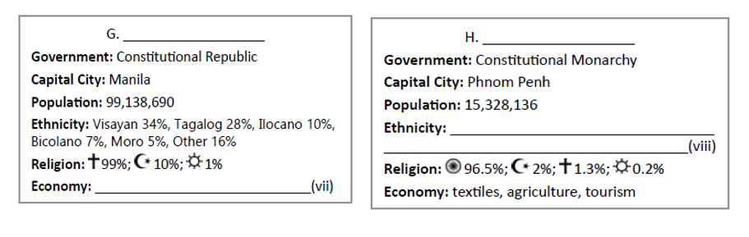
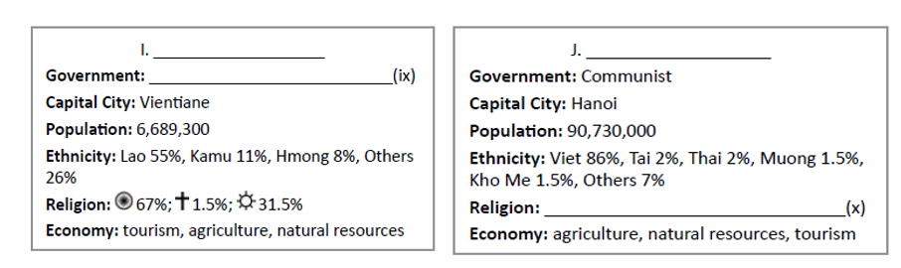
The Philippines
Cambodia
g. Khmer 90%, Vietnamese 5%, Chinese 1%, Other 4%
e. Agriculture, shipbuilding, manufacturing
Laos
Vietnam
h. Communist

Slide 10
Exercise
Which current ASEAN members did not join ASEAN in 1967?
Brunei, Cambodia, Laos, Myanmar, Vietnam.
2. What is the purpose of regional organizations?
To help the countries of a region cooperate on important issues.
3. What other regions have organizations like ASEAN?
Europe, Africa, the Americas (other examples not mentioned in the text: The Arab League, the Commonwealth of Independent States, Union of South American Nations...)

Slide 11
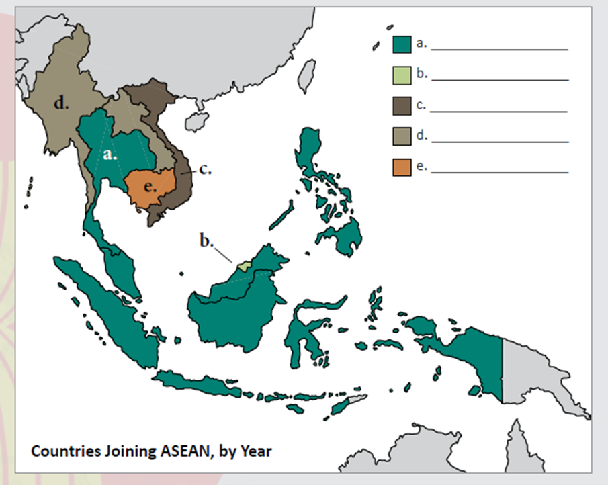
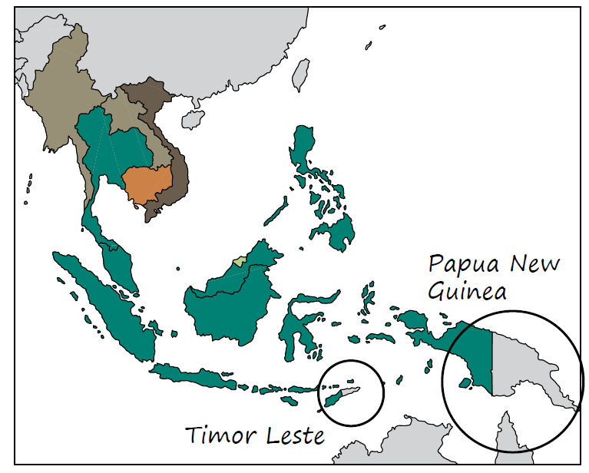
1967
1984
1995
1997
1999
Timor-Leste (2025)

Slide 12
Preview
What is a charter?
A document that sets out the basic rules and structure of an organization.
2. What is the purpose of a charter?
To describe the aims, purposes and activities of an organization. It helps to guide what an organization does and how it does it.

Slide 13
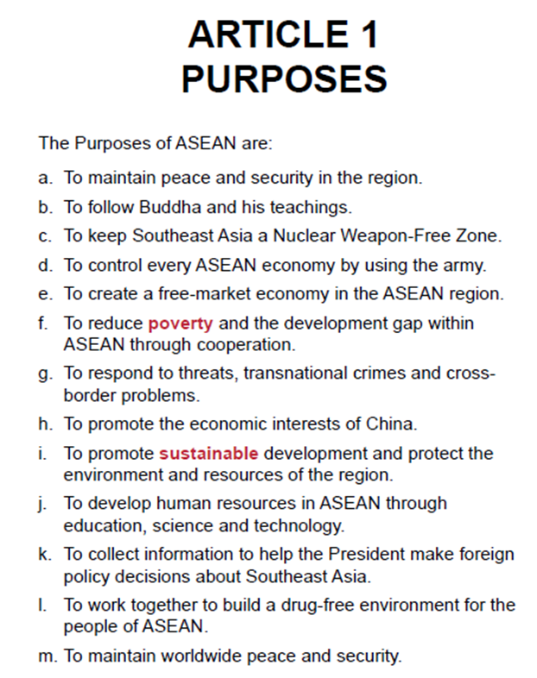
a. Yes
b. No. ASEAN does not promote a specific religion.
c. Yes
d. No. ASEAN does not try to control economies or to use armed force.
e. Yes (but it is described as “creating a single production base”)
f. Yes
g. Yes
h. No. ASEAN works for countries in Southeast Asia.
i. Yes
j. Yes
k. No. There is no president in ASEAN.
l. Yes
m. No. ASEAN focuses only on regional security.

Slide 14
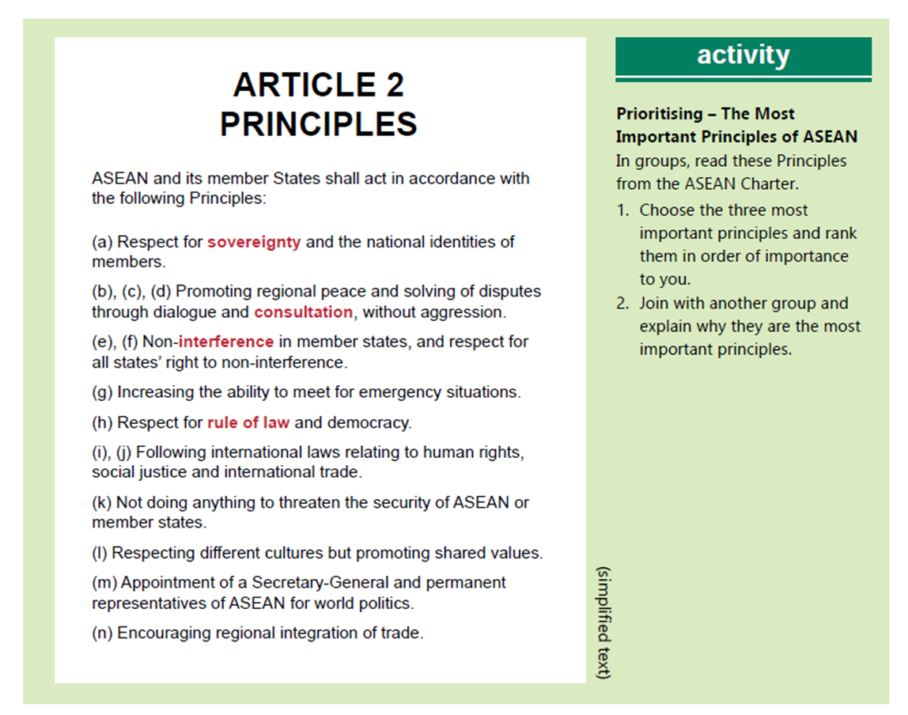

Slide 15
Discussion
Is it important to have a charter for an organization like ASEAN? Why or why not?
Yes. It’s important so everyone has the same idea about what the rules are and what the values of
the organization are. It also helps organizations to work together effectively and efficiently.
2. How should ASEAN and other organizations decide what their Purposes and Principles are?
Leaders decide by themselves, or; Leaders decide with input from the public, or; People from all member countries vote for them.

Slide 16


