Slide 1
SOCIAL MEDIA
MARKETING
การตลาดบนโซเชียลมีเดียยุค TikTok-First (Social Media Marketing)

Slide 2


SOCIAL MEDIA MARKETING
Gartner, a global research and consulting firm, defines "social media marketing" as the use of various social media platforms to connect with audiences, build brand awareness, increase sales, and drive website traffic. This involves paid media efforts, ownership and acquisition, including publishing high-quality content on social media profiles, listening to and engaging with followers, analyzing results, and displaying advertisements across various social media platforms.

Slide 3
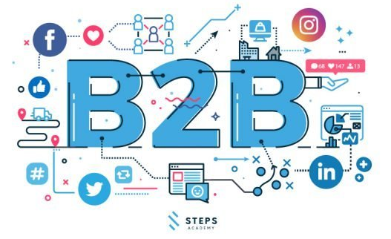
Effective B2B Business Techniques Using Social Media Strategy
1. Use social media to build brand awareness for B2B businesses.
3. Build trust with consumers.
4. Create a positive impression of the business through brand voice.
2. Provide useful knowledge to consumers.
5. Choose the appropriate platform for your social media strategy.

Slide 4
Effective B2B Business Techniques Using Social Media Strategy
1. Use social media to build brand awareness for your B2B business.
Building awareness here isn't just about letting consumers know what your business does or its name. The most effective way to build awareness is to make consumers understand how your business is important, how it can help them, and how it differs from competitors. Marketers are familiar with this term: Brand Awareness.
2. Provide useful knowledge to consumers. Many B2B businesses focus on building brand awareness by paying for advertising, neglecting the crucial aspect of providing useful information to consumers. Many B2B businesses using social media prioritize likes or views. Consumers take a considerable amount of time to decide on a purchase from a B2B business, as each purchase is costly. Failing to build awareness that meets the target audience's needs will result in disappointing outcomes.
3. Build trust with consumers.
One of the advantages of doing business on social media platforms is that if you conduct your business with honesty, transparency, and verifiability, you will build trust. This will impress consumers and create a positive brand experience (Customer Experience), leading to positive reviews and word-of-mouth. If we can build trust with consumers, the results will be well worth it, and the business will be able to drive and grow in a much better direction.
4. Create a lasting impression with Brand Voice. Brand Voice
is another crucial aspect of doing business. It acts as a representative that conveys the feelings, emotions, and personality of the brand to consumers. One problem that many B2B businesses face is that consumers often perceive their image as too formal, resulting in low engagement and a failure to attract consumer attention. Even small changes in communication can significantly alter people's perceptions of a B2B business. And this method can be applied not only to B2B businesses but to all businesses.
5. Choose the right platform for your social media strategy.
One of the key factors that many businesses are unsure about when planning for social media business is choosing the right platform. Many businesses may have good content, attractive images, or videos, but make the mistake of choosing a social media platform that is unsuitable for their business or marketing style. Currently, many businesses understand that to conduct business effectively... It is interesting to consider marketing across all platforms, as each platform actually serves a different purpose.

Slide 5
Create a social media strategy.
1. Identify Your Social Media Marketing Goals
It's undeniable that having a clear, solid plan, objectives, and goals is crucial before starting any social media or marketing strategy. Without knowing what you want or your goals from the start, success is impossible. You won't be able to measure or develop your strategy without a clear objective beforehand.
Therefore, the goals of your social media strategy should align with your overall marketing efforts. Writing down your goals is essential if you want to achieve them. Research shows that businesses tend to be 30% more successful if they have clear and measurable goals. Key elements in setting goals are: they must be specific, achievable, and measurable at every stage.

Slide 6
Create a social media strategy.
2. Research and Learn About Your Target Audience
Connecting with and engaging with your audience is crucial to today's marketing if you want to generate profits. But to do so, you need to understand your audience, both internally and externally. You should be able to identify their needs, wants, and desires. If you hope to build a successful social media strategy, here are some practices to help you better understand your audience:
Explore your audience to better understand their pain points or needs.
Examine demographics thoroughly.
Join discussions in communities filled with your target audience.
Respond to comments on your blog and comment on other blogs with the same target audience.
Respond to all comments or questions on your social media. Gather feedback.

Slide 7
Create a social media strategy.
3. Create a Contest to Boost Your Social Media Marketing Power
Creating contests or interactive events with prizes on social media channels is one of the most enticing strategies. It helps increase visibility, followers, and engagement. The key to running a successful contest is offering something of immense value, which might mean something your audience can't resist.

Slide 8
Create a social media strategy.
4. Create Concise Social Media Marketing Content
Every piece of content you post on social media should be carefully considered. If you're just posting for the sake of updates, you're doing it wrong. You need to learn the different purposes of each network, depending on the social media network you're posting to. Here are some examples:

Slide 9
Create a social media strategy.
5. Minimize Sales Strategies.
Traditional marketing that excessively intrudes on people's privacy has long been outdated. Consumers feel uncomfortable when brands and businesses post excessive promotions or sales pitches. The simple reason is: people don't want to be constantly pressured into buying something. They want to build genuine relationships with you. Alternatively, you can create useful content that people actually want to consume—content that leads buyers to your product or service without rushing into a sale. That's the key to building trust with your audience or customers. And if they trust you, they will buy from you without you having to push them at all.

Slide 10
Create a social media strategy.
6. Leverage Video Content in Your Strategy
Unless you're out of this world, you don't know the potential of video content, especially in social media marketing. So, if you haven't already created any video content, it's time to jump in and start! There are many ways to use video content in your social media strategy, but live videos, such as Facebook Live, seem to be incredibly popular right now.
Facebook Live allows you to truly connect with your audience, which isn't possible with other content formats. Plus, you can reuse your live videos for those who missed out! People engage by asking questions, so you can show them you're not just a brand. By interacting with them during and after your live video, they see you as a caring business owner, and this will yield results more than anything. According to Facebook, you'll see six times more interaction and engagement with live videos. However, a mix of live and regularly recorded videos is best. You'll have a constant stream of people watching.

Slide 11

How to promote your store through social media.
Facebook
A 2019 survey of internet user behavior by ETDA found that 64% of Thais prefer selling goods on social media platforms, particularly Facebook. Since Facebook is primarily text-based, businesses should establish an online presence to build customer trust. Regularly posting product details and engaging with comments on your page is crucial for maintaining customer confidence.
Because Facebook communication is largely text-based, businesses should prioritize engaging content. Content should explain how products solve problems or offer new experiences. Use clear, concise language, a friendly approach, or create engaging captions to make posts more appealing.
Product images are equally important for social media sales. Attractive images capture the customer's attention and should closely resemble the actual product to prevent potential complaints and brand damage. Don't forget to include your brand logo. Or you can add a watermark to the images to create awareness that it's a product from your brand.
Currently, Facebook facilitates more business, especially Facebook Marketplace, which is a space where entrepreneurs can promote their shops through social media for free. Alternatively, creating a group so that members can learn about the products they sell directly is another interesting channel.
Entrepreneurs shouldn't forget to run promotions, which are essential for sales. This could include offering discounts to new customers, discounts on purchases exceeding a certain price, or offering special discounts for sharing promotional posts. This helps promote your products to others who don't yet know your brand at the same time.

Slide 12

How to promote your store through social media.
YouTube
YouTube is a video-based platform that serves as a crucial tool for selling products online.
With the increasing popularity of online shopping, video content is extremely important in influencing customer purchasing decisions. Businesses can use creative ideas to create high-quality video content that aligns with their products, such as:
Product review videos, which serve as another form of advertising to potential customers, increasing the chance of converting them into future customers.
For products with complex usage procedures, such as technology tools, promoting a store through social media with instructional content will help customers easily understand the process.
Create Q&A videos about the product, where businesses can gather frequently asked questions to answer customer inquiries.

Slide 13
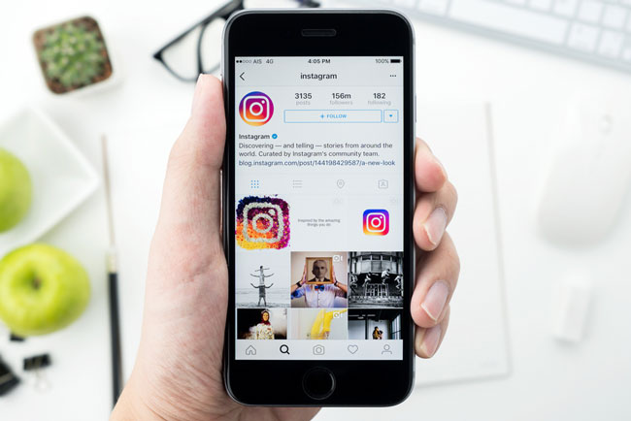
How to promote your store through social media.
nstagram
Instagram is a platform known for its beautiful images and short videos, making it a great channel for businesses looking to promote and sell products on social media, especially fashion and jewelry, which emphasize product aesthetics. Businesses selling on Instagram should consider using a business account, specifically designed for sales. Furthermore, Instagram offers analytics such as follower count, content reach, and post frequency, allowing businesses to improve their sales strategies.
Since Instagram is designed for viewing images, businesses promoting their stores through this type of social media should prioritize the visual appeal of their photos. Product placement should be prominent to align with Instagram users' preferences, who tend to be drawn to visually appealing images. Another technique to increase product visibility is engaging with customers. For example, after a purchase, encourage customers to take photos and tag the brand, creating product reviews and raising awareness. If they like the product, they'll click on the tag to see what other products the business offers. This is a common technique used by many brands to promote their businesses on Instagram.

