Slide 1
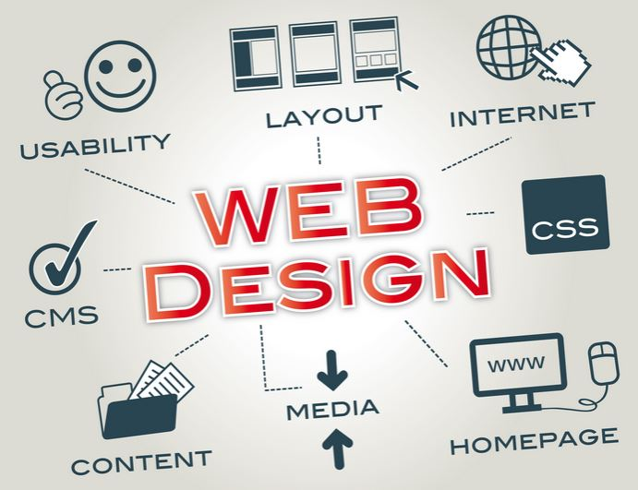
Principles of Website Design & SEO (Website + Search Optimization)

Slide 2
Web page development
Web page design and development is a field of study that computer scientists and those interested in creating works and projects through the internet. This can be done using various systems, depending on the nature of the data, the developer's preferences, and the target audience. Therefore, studying the principles of web page development is essential and crucial.

Slide 3
Website design styles
Modern websites don't differ much in design. Most website designs focus on organizational elements, the organization, or the content being presented. There are three main website design styles:
1. Content-Focused Website Design:
This design prioritizes content over images. The structure primarily uses tables, and the layout is simple, featuring a table of contents and content menus.
2. Graphic-Focused Website Design:
This design emphasizes visually appealing graphics, often using programs like Photoshop for image editing. Advantages: Visually appealing and engaging. Disadvantages: May result in longer loading times.
3. Image and Text-Based Website Design:
This is a popular current design style that combines text and images, strategically arranged to create an attractive website.

Slide 4
Website structure design
The principles of website structure design should consider the following:
  Define the objective, considering what the goal of creating this website is.
  Study the characteristics of the users, identifying the target audience and the information they need. This step should be done concurrently with the first step.
  Plan the content structure. Website design requires a clear structure or organization of information.
  Define the details of the structure, considering the established objectives. Set criteria for use, such as what users should be able to do, the number of pages, and the amount of linking.
  After that, create the website and test it to find errors and make corrections and improvements. Finally, launch it online.

Slide 5
The elements of good website design.
1. Clear structure
2. Easy to use
3. Good connectivity
4. Suitable screen size
5. Speed

Slide 6
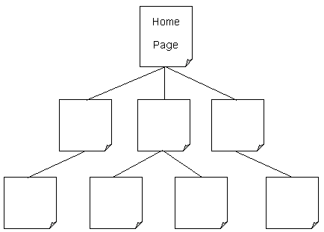
The elements of good website design.
It can be divided into 3 types:
1. Hierarchical style: This is how web pages are arranged, branching out in a continuous sequence like an inverted tree.

Slide 7

The elements of good website design.
2. Linear layout: This displays web pages in a continuous sequence in a single direction.

Slide 8
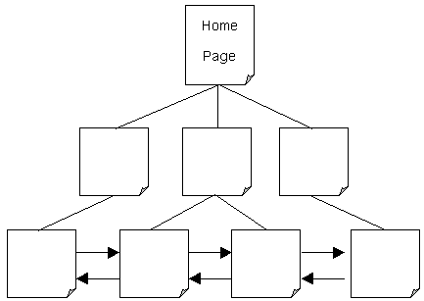
The elements of good website design.
3. Combination: This is a web page layout that combines hierarchical and linear styles.

Slide 9
Elements of a good website
A website is a crucial tool for online business. Besides aesthetics, there are several elements of a good website that website owners should be aware of. These can be used to develop and improve your website in many ways. However, webmasters should consider these five key elements of a good website:
1. Accessibility: The ability to easily access information.
2. Speed: The speed at which information is displayed on the website.
3. Attractiveness: The website must be visually appealing and attractive.
4. Simplicity: Ease of use.
5. Credibility: The website's credibility.

Slide 10
Steps in creating a website
Website Planning
This is the first step in web design, as it involves defining the title, content, and details of the website to create a rough overview before construction begins. Additionally, we need to categorize content in a logical order to facilitate the website's structure.

