Slide 1
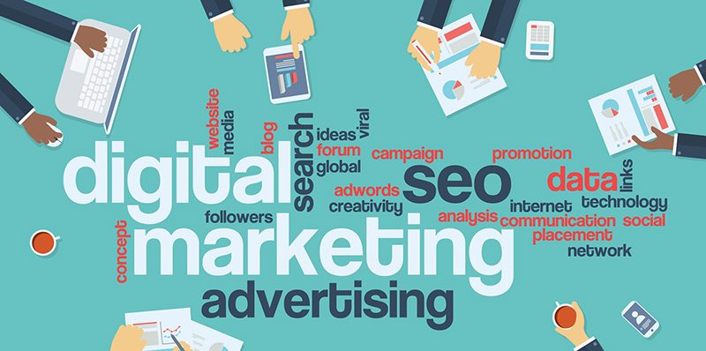
Online Consumer Behavior

Slide 2
SEO + Search Behavior
Content
Customer Journey in the Digital World
Gen Z Behavior:
Trusts Creator Reviews More Than Brand Reviews
Purchase Decision Made Within 10-20 Seconds
Insights from Social Listening
Case Study
Customers Buying Cosmetics: Watch TikTok Reviews → Search Google → Purchase via IG DM
Student Cafe: IG Story = The Fastest Channel for Closing Sales

Slide 3

Consumer Behavior In Digital Marketing.
This refers to the actions of individuals directly related to obtaining and using economic goods or services, including the decision-making process that occurs beforehand and the determinants of various actions. This is expressed in two ways:
Internal behavior (Convert Behavior), such as feeling satisfied with the form of a product.
External behavior (Overt Behavior), such as standing and considering a product, or browsing and selecting a product.

Slide 4

Consumer behavior in digital marketing.
Increased online shopping behavior
Increased use of digital currency for payments
Increased tendency to provide feedback or complaints via social media
Increased interest in following social trends
Decreased brand loyalty.

Slide 5
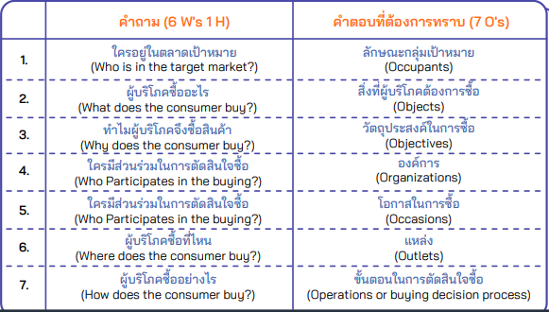
Analyzing Consumer Behavior

Slide 6

Digital marketing consumer behavior analysis
Online Behavior of Thai People
When considering which online channels are most popular among buyers and sellers, it was found that the channel most used by buyers to purchase goods is e-Marketplace, namely Shopee at 75.6%, followed by Lazada at 65.5%, and Social Media, including Facebook Fanpage at 47.5% and Line at 38.9%. In contrast, the channel most popular among sellers for online sales is Facebook Fanpage at 64.0%, followed by Shopee at 43.1%, and LINE at 39.5%. It was also found that Thai people prefer using LINE for communication (98.5%), followed by Facebook Messenger, FaceTime, and WhatsApp.

Slide 7
Digital marketing consumer behavior analysis
1. Consumer behavior helps us understand the factors that influence purchasing decisions, leading to the entire process of buying and consuming goods and services.
2. Consumer purchasing behavior helps in planning strategies to modify or respond to purchasing decisions in alignment with the goals and capabilities of the business.
3. Studying and understanding consumers directly stimulates the development of better products, as well as the continuous development of the business organization and operational strategies.
4. Studying or summarizing consumer behavior helps increase market share, resulting in higher sales, because it allows for the fulfillment of the needs of a large number of consumers by understanding and studying their consumption patterns.
5. Developing and improving various strategies, including setting objectives for studying consumer behavior, will increase the ability to meet consumer needs and gain a competitive advantage over other competitors.

Slide 8
The Business Success Tool for Digital Marketers
Techniques for Creating Content Based on Consumer Behavior in Digital Marketing
Buyer Persona: To attract customers, you must know your customers.
Personalization: Predict and offer the products customers want most.
Visual Content: Content that is more than just text.
Mobile Friendly: Mobile phones are important.

Slide 9
เทคนิคสร้าง Content สำหรับพฤติกรรมผู้บริโภคการตลาดยุคดิจิทัล
Buyer Persona: To attract customers, you must know your customers.
Buyer Persona is a content marketing strategy that targets marketing trends by studying the behavior of consumers who are likely to become your customers. This helps brands create articles or advertisements to present services, products, and the brand more effectively and comprehensively to their target audience. Key points to consider when studying your customers include:
Who are your customers? Customers are not limited to a single group, so you need to study them to find your brand's clear customer base, such as gender, age range, location, and geographical location.
What do your customers want? Diverse customers will have different interests in products. For example, fast service, healthy food, beauty products, etc.
Why are your customers interested? Each customer's interests have different reasons. For example, they might be interested in healthy food because they want to lose weight, or in a brand that provides fast service because they need the product quickly.
How can we reach these customers? This involves analyzing how customers most likely can access your brand, such as through social media, TV advertising, radio, etc. Once you find the answers to these questions, you can develop a content marketing strategy that reaches your target audience more effectively.

Slide 10
Techniques for creating content based on consumer behavior in digital marketing.
Personalization: Predict and offer the products customers want most.
The technique of penetrating consumer trends through personalization involves creating content that provides the best user experience for different customer groups. This strategy comes from brands analyzing consumer purchase history, services, and usage data to create content that quickly and effectively targets a wide range of audiences.
Gather data to understand your customers: To communicate effectively with customers, you need to understand their characteristics, such as gender, location, age, name, and email address. This is crucial data for creating the most effective content.
Browsing behavior: Create interaction with users. Consumers who search for products and visit your brand will have different experiences. Some are first-time visitors, while others are repeat customers. Offer products and services tailored to each customer type to guide them to what they need and ultimately close the sale.
Offer multiple content formats: Each customer has a different experience with a brand. Create content to present in two formats: A and B, or separate content for existing and new customers. For new customers, format A might present a webpage explaining who your brand is or what it does, followed by a tutorial on how to use the product.
And to close the sale, for existing customers (Type B), the website will automatically present the products and services the customer is looking for, without the customer having to search for products manually, similar to e-commerce websites like Shopee and Lazada which display the same types of products the customer has previously purchased on the first page.

Slide 11
Techniques for creating content based on consumer behavior in digital marketing.
Visual Content: Content That's More Than Just Text
The strategy of creating visual content using beautiful images, also known as infographics, aims to attract attention and provide easy-to-understand information in a short time. This suits consumer behavior that emphasizes fast-paced media consumption. This type of content helps attract customers to stop scrolling past product images and encourages responses in the form of comments, likes, and shares.
91.2% of Thais use the internet for social media such as Facebook, Instagram, and Twitter, followed by watching movies and listening to music at 71.2%. This shows the trend of consumers increasingly favoring video consumption. In current content marketing, besides infographics, creating video content to advertise brands is also a key strategy to attract the target audience. The video content must be edited to capture the consumer's attention within the first 3 seconds before viewers are willing to watch the rest of the content.

Slide 12
Techniques for creating content based on consumer behavior in digital marketing.
Mobile Friendly: Mobile phones are important.
Currently, 50% of Thais use the internet via mobile phones, and they are increasingly prioritizing speed. When they need information, they immediately pick up their phone to search for it. Brands should design their social media channels to be compatible with all devices, including tablets and computers, especially on mobile phones (Mobile Friendly). This will best align with consumer internet usage behavior when searching for information; your brand should appear on the screen whenever they search.

