Slide 1



TODAY’S AGENDA
11/12/24
9:00 AM
10:00 AM
11:00 AM
12:00 PM
Attendance & Warm up activities
Eng Communication (Group Work)
Break
English skills for Science
Science Vocabulary
Reading hour
TO-DOS
Take notes
Discuss and participate

Slide 2
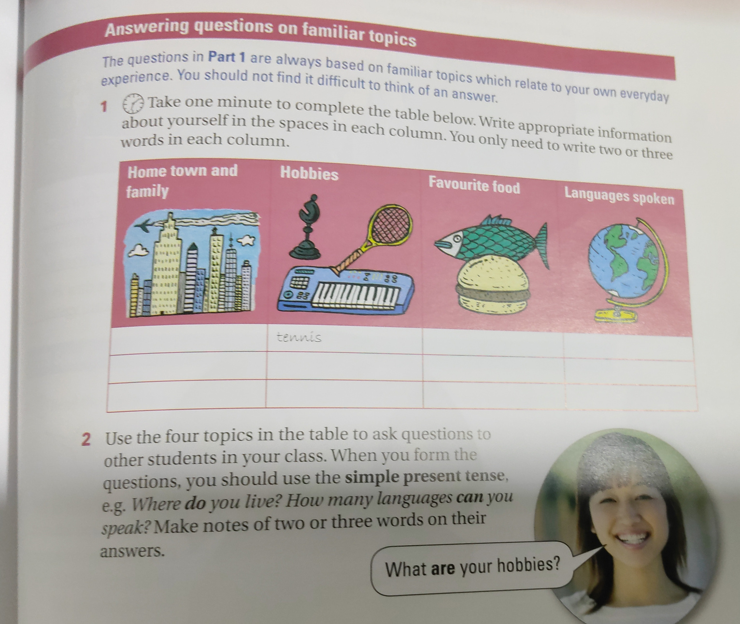

Slide 3
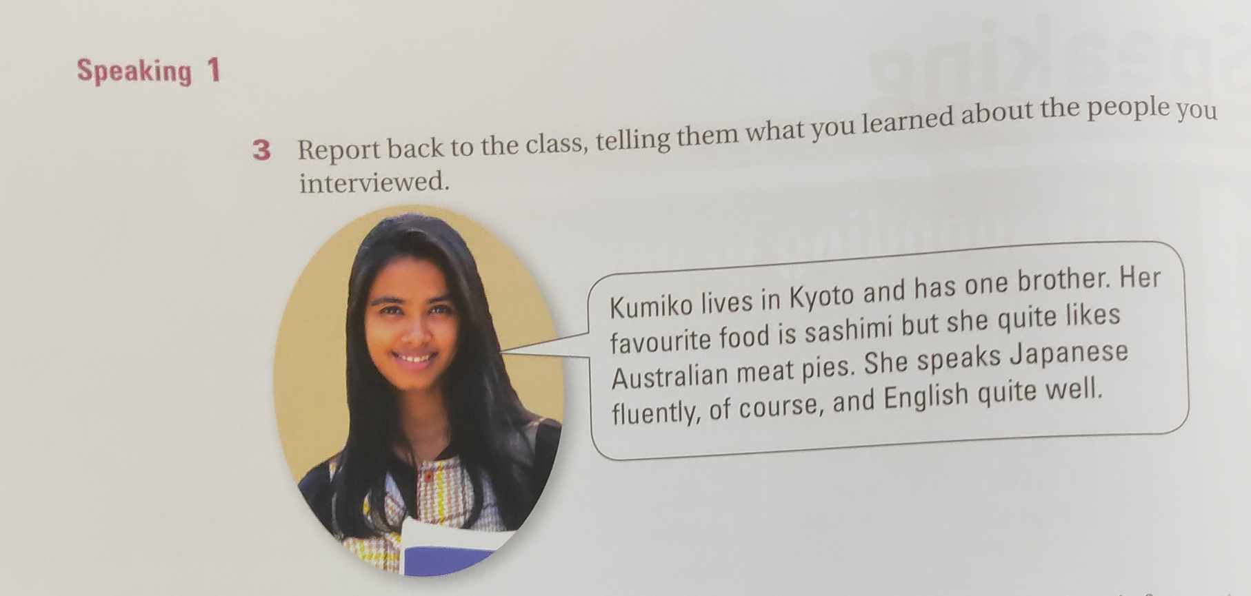

Slide 4
Talk about your friends in front of the class

Slide 5
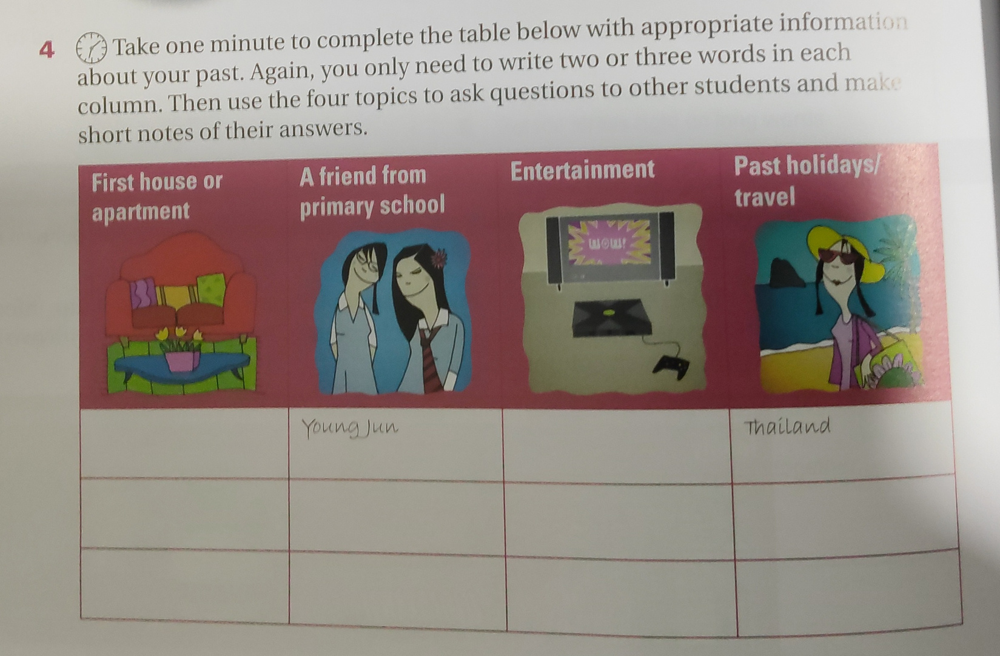

Slide 6
Think about some of the past tense
lived
ate
was
saw
had
went
got
took
used
watched
gave

Slide 7
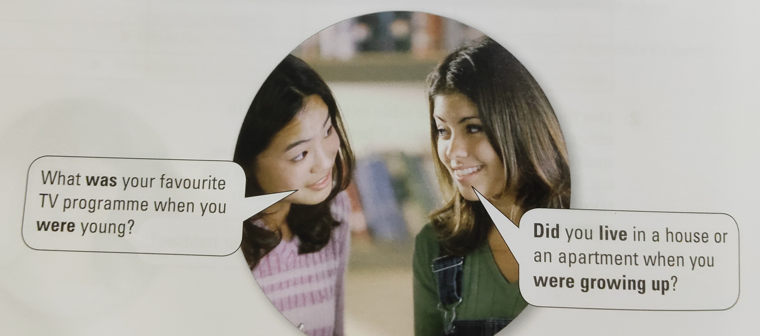
Use past tense

Slide 8
English Skills for Science
Give some of the science words that you are familiar

Slide 9
English Skills for Science
Group work discussion
Work in your group. Read the vocabulary and put the into the correct category Chemistry,
Physics,Biology and earth-space

Slide 10
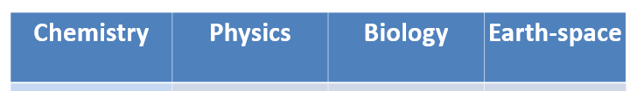
Speed
Average
force
Velocity
motion
gravity
compound
Electron
Neutron
Nucleus
abdomen
blood
Brain
Sphere
Eclipse

