Slide 1
Teaching Reading
By
Wipada Prasansaph (D.Ed. – TESOL)
Faculty of Education
Suan Sunandha Rajabhat University

Slide 2
Principles of Teaching English Reading (By Burns, Roe, Ross)
Principle 1: Reading is a complex act with many factors
that must be considered.
● sensory
● thinking
● perceptual
● learning
● sequential
● affective
● experiential

Slide 3
Principles of Teaching English Reading (By Burns, Roe, Ross)
Principle 2: Reading is the interpretation of meaning of
printed symbols.
● If a person does not derive meaning from a passage, he or she has not been reading.
Is a student considered a “reader” if he or she is able to read all the words of a text?
No, a student is not considered a reader if he or she can read all the words of a text. He or she must also comprehend or make meaning of the text.

Slide 4
Principles of Teaching English Reading (By Burns, Roe, Ross)
Principle 3: There is no one correct way to teach reading.
● Each child is an individual.
♣ Some are visual learners.
♣ Some are auditory learners.
♣ Some are kinesthetic learners.
♣ Some need to be taught through a combination of perception.

Slide 5
Principles of Teaching English Reading (By Burns, Roe, Ross)
Principle 4: Learning to read is a continuing process.
♣ Children learn to read over a long period of time
and refinement continues.

Slide 6
Principles of Teaching English Reading (By Burns, Roe, Ross)
Principle 5: Students should be taught word recognition skills
that will allow them to unlock the pronunciations
and meanings of unfamiliar words independently.
♣ Children need to learn techniques of figuring out
unfamiliar words.

Slide 7
Principles of Teaching English Reading (By Burns, Roe, Ross)
Principle 6: The teacher should diagnose each student’s
reading ability and use the diagnosis as a basis for
planning instruction.
♣ The teacher should pinpoint the strengths and
weaknesses of each individual.

Slide 8
Principles of Teaching English Reading (By Burns, Roe, Ross)
Principle 7: Reading and the other language arts are closely
interrelated.
♣ Mastering listening skills is important in learning to read.
♣ People learn to speak before they learn to read and write.
♣ Reading involves decoding skills, whereas writing involves
encoding skills.

Slide 9
Principles of Teaching English Reading (By Burns, Roe, Ross)
Principle 8: Reading is an integral part of all content area
instruction within the educational program.
♣ The relationship of reading to other subjects within
the curriculum.

Slide 10
Principles of Teaching English Reading (By Burns, Roe, Ross)
Principle 9: The students needs to see why reading is
important.
♣ Teachers should attempt to show the children immediate,
personal values of reading.

Slide 11
Principles of Teaching English Reading (By Burns, Roe, Ross)
Principle 10: Enjoyment of reading should be considered of
prime importance.
♣ Teachers can help children to realize this by reading
interesting materials and by making good books of
appropriate difficulty for them.

Slide 12
Principles of Teaching English Reading (By Burns, Roe, Ross)
Principle 11: Readiness for reading should be considered at all
levels of instruction.
♣ Teachers should consider the readiness of the child for
instructional activities.

Slide 13
Principles of Teaching English Reading (By Burns, Roe, Ross)
Principle 12: Reading should be taught in a way that allows
each child to experience success..
♣ The child should read materials which are not too difficult
for them.
♣ Give the children instruction at their own level of achievement.
♣ Help them gain the confidence to learn to read.

Slide 14
Key Other Principles of Teaching English Reading
Principle: Reading development is strongly correlated with the number of words children read. (Allington, 2001/2011).
The quantity of words children read has a significant relationship with their reading development. Therefore, all readers must be immersed in a rich program of reading a wide range of accessible texts written for a range of purposes and audiences (i.e., genres) with frequent opportunities to read connected texts.

Slide 15
Key Other Principles of Teaching English Reading
Principle: Accessible texts utilize predictable linguistic structures and familiar content that enable readers to draw on their linguistic and cultural knowledge, experiences, and interests in the process of making sense of texts. (Rhodes & Dudley-Marling, 1996).
Readers can interpret the texts based on their:
linguistic knowledge
cultural knowledge,
experiences, and
interests.

Slide 16
Models of Reading Processes

Slide 17
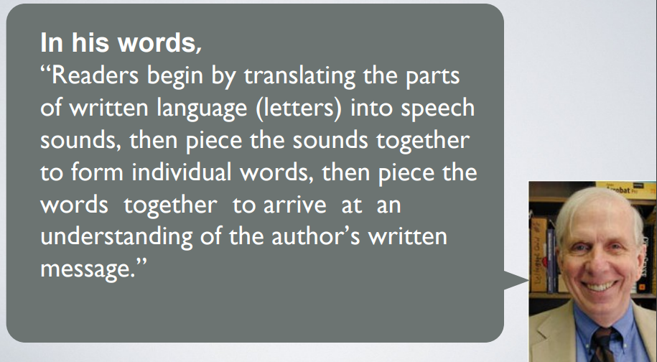
Bottom-Up Reading Model and Process
Underlying concepts

Slide 18

Bottom-Up Reading Model and Process
Underlying concepts
Many theorists promoted this in reading instruction in the 1970s. Philip Gough, in his book One Second of Reading, was one of them. He proposed that reading is a sequential process in which the reader takes letters, gathers them into sounds, and those sounds make words and phrases.

Slide 19
Bottom-Up Reading Model and Process
Underlying concepts
❖ The Bottom-Up Approach “refers to a kind of processing in which meaning is derived from the accurate, sequential processing of words. The emphasis is on the text rather than the reader’s background knowledge or language ability.” Students begin by “learning the parts of language (letters) to understanding whole text (meaning).”
❖ This model views comprehension process as text-driven/ is data-driven

Slide 20
Bottom-Up Reading Model and Process
Underlying concepts
❖ View comprehension process as text-driven/ is data-driven
❖ Emphasize on the decisive role of the lower-level recognition skills
❖ The role of the lower level recognition skills, including orthographic, semantic, syntactic and phonological processing are crucial.

Slide 21
Bottom-Up Reading Model and Process
Underlying concepts
❖ A great portion of reading is the outcome of unconscious processes emerging from the text, not the strategic and conscious processing on the part of the reader.
❖ Reading is a hierarchical and step by step process, starting from the perception of single phonemes to words, clauses, sentences and then the whole piece of discourse.

Slide 22

Bottom-Up Reading Model and Process
Reading process
❖ A reader constructs meaning from letters, words, phrases, clauses and sentences.
❖ A reader builds meaning in a linear manner.
Decoding letters
Phrases
Clauses
Sentences
Words
❖ The bottom-up model treats developing reading skills as a sequential process.

Slide 23
Bottom-Up Reading Model and Process
Reading process
❖ This process becomes more automatic over multiple experiences.
❖ Emphasis is placed on the reader’s ability to recognize words.
❖ Word recognition takes place prior to comprehension.

Slide 24
Bottom-Up Reading Model and Process
Reading process
This model is declared as a decoding process of constructing meaning at the “bottom”, e.g. letters or words to the larger units at “the top”, e.g. phrases, clauses, and intersentential linkages (Carrell & Eistenhold, 1983). Readers begin with decoding letters, words, and syntactic features of a text, then they build textual meaning. This model works mainly from the text but ignore reader’s prior or background knowledge.

Slide 25
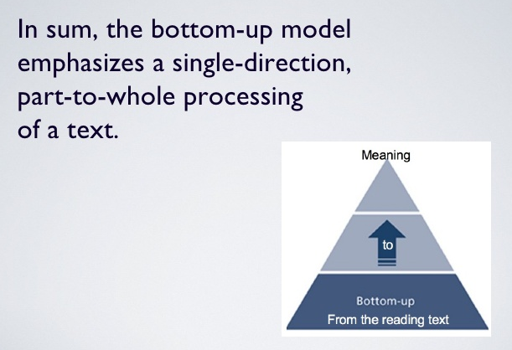
Bottom-Up Reading Model and Process
Reading process

Slide 26
Advantages of Bottom-Up Model
Better pronunciation and word recognition
Improve spelling
Auditory learners tend to benefit from phonics approach

Slide 27

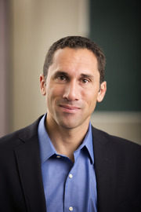

Top-Down Reading Model and Process
Proponents of top-down model
Kenneth Goodman (1967)
Frank Smith (1971)
Garnham, (1985)
Rieben & Perfitti (1991)
(Clarke & Silberstein (1977)
Kenneth Goodman
Frank Smith

Slide 28
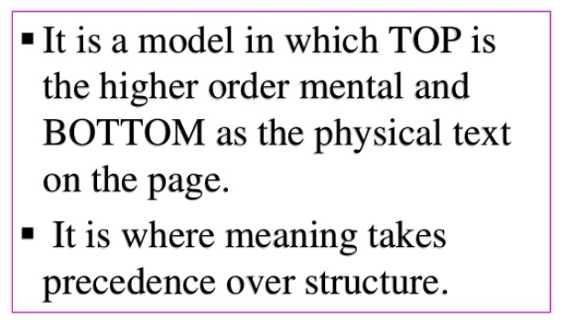
Top-Down Reading Model and Process
Introduction

Slide 29
Top-Down Reading Model and Process
Concepts of reading process
■ According to the model, the comprehension process is reader-driven/concept-driven.
■ Reading is a psycholinguistic guessing game because readers' preconceptions and background knowledge influence lower-level processes such as orthographic and phonological processing, as well as word recognition skills.

Slide 30
Top-Down Reading Model and Process
Concepts of reading process
■ Readers are not merely the neutral and passive receivers of the information from the text.
■ Their background knowledge and other interpretative skills, together with cognitive and metacognitive strategies, boost lower level processing during the comprehension stage.

Slide 31
Top-Down Reading Model and Process
Concepts of reading process
■ The printed information is just a preliminary step of reading process.
■ There is still a more central component of reading skill which is called background information, which is formed as the propositional, meta-textual and conceptual representations in the learners’ long-term memory.

Slide 32
Top-Down Reading Model and Process
Concepts of reading process
■ Top-down processing occurs when readers obtain information from the text and then contrast it with their prior knowledge to make sense of what is written.
This model proposes that readers add meaning to the text based on their prior experiential and interpretive understanding.

Slide 33
Top-Down Reading Model and Process
Concepts of reading process
■ The comprehension process is neither mechanical nor linear, but actively controlled by the reader.
■ The main mechanisms for the processing of the text are in the mind of readers.

Slide 34
Top-Down Reading Model and Process
Concepts of reading process
■ Readers can comprehend a selection even though they do not recognize each word.
■ Readers recognize letters and words only to confirm their preconceptions with reference to the meaning of the text. Accordingly, they can successfully decode a passage even if they do not know the meaning of the new words within the text.

Slide 35
Top-Down Reading Model and Process
Concepts of reading process
■ Readers should use meaning and grammatical cues to identify unrecognized words.

Slide 36
Top-Down Reading Model and Process
Reading process
P
S
C
C
☼ Predicting the content,
☼ Sampling the printed information,
Active Process Reading
☼ Confirming the true predictions,
☼ Correcting the false predictions

Slide 37
Top-Down Reading Model and Process
Summary
The concept behind this model is to guess the meaning of the target reading text. Goodman (1971) firstly comment on top-down model as “a psycholinguistic guessing game’, by showing that the readers predict text’s meaning primarily based on their existing or background knowledge. this model is used when readers need to interpret assumptions and draw inferences, or when they need to determine the overall purpose of the text or the main ideas of the text(Nuttall, 1996).

Slide 38
Top-Down Reading Model and Process
Summary
In addition, this model is still considered as concept-driven and dependent upon what the reader brings to the text which could be their own intelligence and experience to understand a text.

Slide 39
Drawbacks of Top-down Model
Top-down processing is most appropriate used for readers who possess a fluent skill of reading with automatic perception and decoding.
This would mean that the model of top-down can hardly be used at elementary levels of language instruction.
The top-down reading model is essentially a model of the fluent reader and does not account for all of the needs of pupils learning to read.”

Slide 40
Drawbacks of Top-down Model
When reading topics which are completely new and foreign, it is inefficient, impractical and perhaps impossible to make predictions about the reading.
Imagine:
A boy from a rural area in Thailand is assigned to read about Halloween.
Would he be able to understand “Trick or Treat”?

Slide 41
Schema Theory
♣ Smith (1971,1994) places extreme importance on background knowledge (Schema) in a person’s construction of meaning during the process of virtually any type of information.
♣ Smith states knowledge of relevant schemes is obviously essential if we are to read any kind of text with comprehension.

Slide 42
Schema Theory
♣ British Gestalt psychologist, Sir Frederic Bartlett is regarded as the first person who used the term schema. He thinks that the term “schema” means an active organization of past reaction, or of past experience, which must always be supposed to be operating in any well-adopted organic response (Bartlett, 1932).
♣ Schema is a term used in psychology and cognitive science, which describes a systematic pattern of thought and behavior.

Slide 43
Schema Theory
♣ People use schemata to organize prior knowledge and provide a framework for future understanding.
♣ Schemata affect attention and the absorption of new information.
♣ Schemata affect attention and the absorption of new information.

Slide 44
Schema Theory
Types of Schema
♣ Schema can be classified into three types: linguistic schema, content schema and formal schema (Carrell, 1984).
♣ Linguistic schema refers to readers' prior linguistic knowledge, including the knowledge about phonetics,
grammar and vocabulary as traditionally recognized.

Slide 45
Schema Theory
Types of Schema
♣ Content schema is the background knowledge an assay or the topic it relates to (Carrell, 1988). It involves many things, such as topic familiarity, cultural knowledge, conventions and previous experience of the domain.

Slide 46
Schema Theory
Types of Schema
♣ Formal schema is “abstract, encoded, internalized, coherent patterns of meta-linguistic, discoursed, and textual organization that guide expectations in our attempts to understand a meaningful piece of language” (Carrell, 1983).

Slide 47
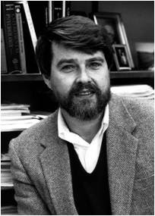
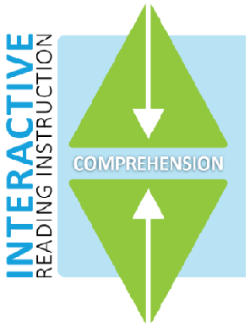
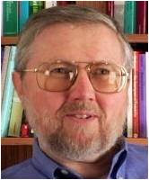
Interactive Reading Model and Process
Proponents of interactive model
David Rumelhard (1977),
Stanovich (1980)
Ruddell and Speaker (1985)
Rumelhard
Stanovich

Slide 48
Interactive Reading Model and Process
Introduction
☻ Rumelhurt (1977) withholds that in the interactive model of reading comprehension, meaning is not bound to the text alone; rather, it is the outcome of co-construction of the information within the text and the readers’ interpretation.

Slide 49
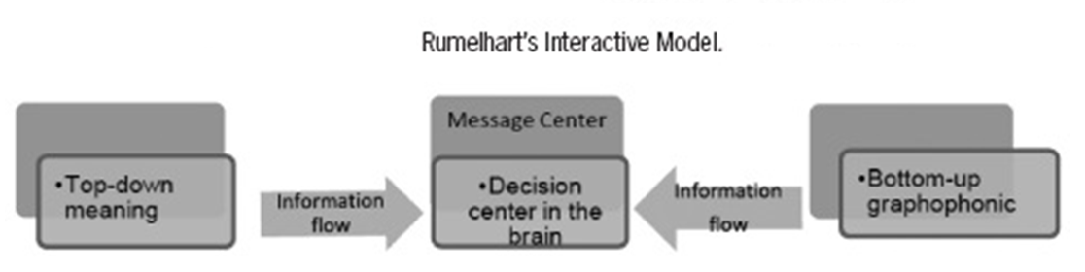
Interactive Reading Model and Process
Introduction

Slide 50
Interactive Reading Model and Process
Introduction
☻ The approach (to teaching reading) that is accepted as the most comprehensive description of the reading process is an interactive approach.
☻ This model combines elements of both bottom-up and top-down approaches.

Slide 51
Can you complete the story?
Once upon a ______ there lived an unhappy young girl. Her ______ was dead and her father had married a ______ with two daughters. Her stepmother didn't like ______. All her kind thoughts and loving touches ______ for her own daughters. Nothing was ______ good for them - dresses, shoes, delicious ______, soft beds, and every home comfort. But, ______ the poor unhappy girl, there was ______ at all.

Slide 52
You are a good reader!

