Slide 1
Chapter 1
Fundamentals of Global Marketing

Slide 2
Why Go Global?
Domestic markets are becoming saturated.
Customers are located worldwide.
The Internet makes global access easier.
Products can be exported quickly.
Communication costs have decreased.

Slide 3
Definition of Global Marketing
Global marketing is the process of planning products, pricing, distribution channels, and marketing communications across multiple countries.
  Apply global marketing principles.
  Adapt strategies to the environment of each country, such as culture, economy, legal systems, consumer behavior, and local competitive structures.
  Think global, Act local

Slide 4
Key Elements of Global Marketing That Differ from Domestic Marketing
Product Adaptation – Adjusting elements such as taste, size, packaging, ingredients, and design to suit each market.
Price Setting – Considering purchasing power, exchange rates, import tariffs, and local pricing policies.
Place (Distribution) – Choosing appropriate channels such as e-commerce platforms, physical stores, local distributors, and managing international logistics.
Promotion – Adapting messages, tone, colors, visuals, using suitable influencers, and designing campaigns that align with local culture.

Slide 5
Drivers of Globalization
Communication Technology enables instant global connectivity.
Modern Logistics & Transportation have become significantly faster and more cost-efficient than in the past.
Cross-border E-commerce allows even small businesses to access global markets without having physical stores.
Economic Integration – Countries form larger economic blocs to facilitate trade and create bigger markets.
Trade Liberalization – The reduction of tariffs and trade barriers between countries.

Slide 6
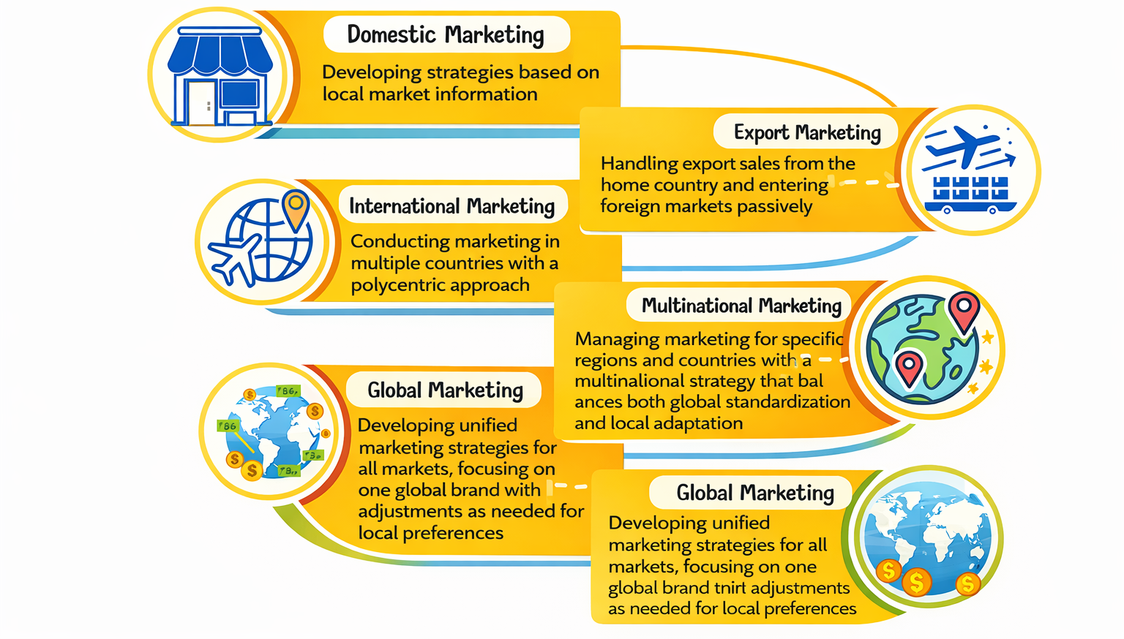
Stages of Developing Marketing to the Global Level

Slide 7
Objectives of Global Marketing
Increase global sales.
Build global brand equity.
Expand the customer base.
Reduce dependence on a single market.
Leverage global supply chain efficiency.)

Slide 8
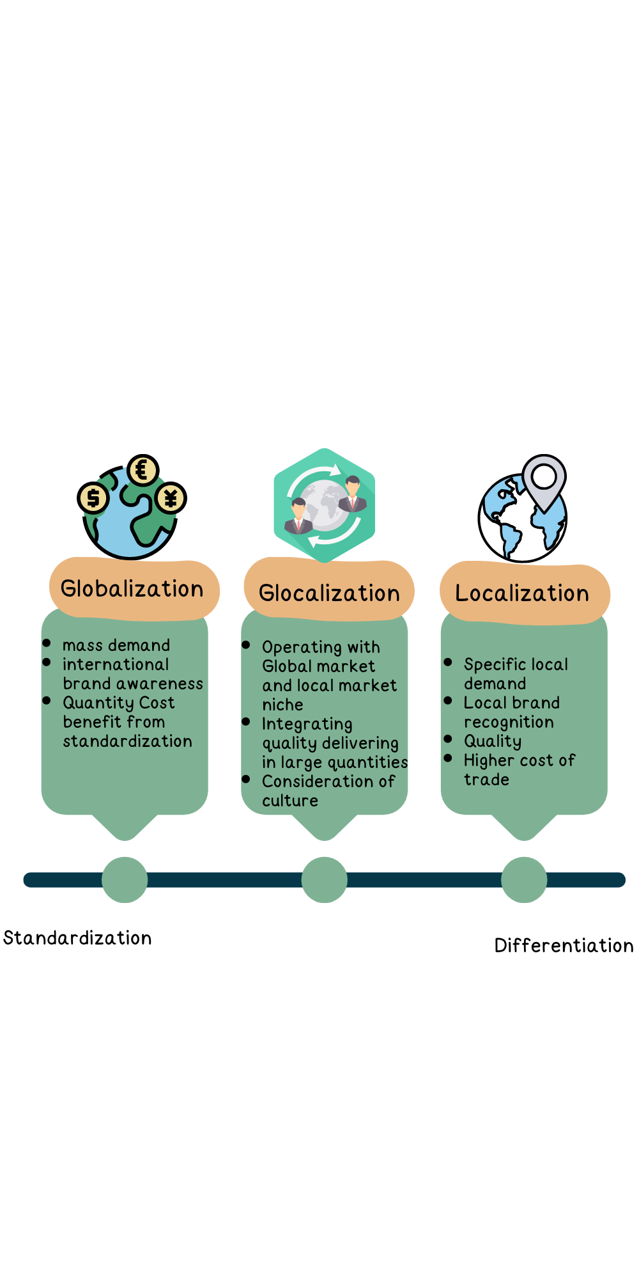
Global Marketing Concepts

Slide 9
Standardization vs Adaptation
Standardization
Using the same products, branding, and advertising worldwide
Objective: Build a global brand, reduce costs, and maintain a consistent image across all countries
Adaptation
Adjusting products, pricing, distribution channels, and promotion to fit each country
Objective: Connect with local consumers and respect cultural differences

Slide 10

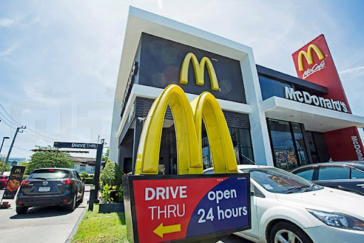

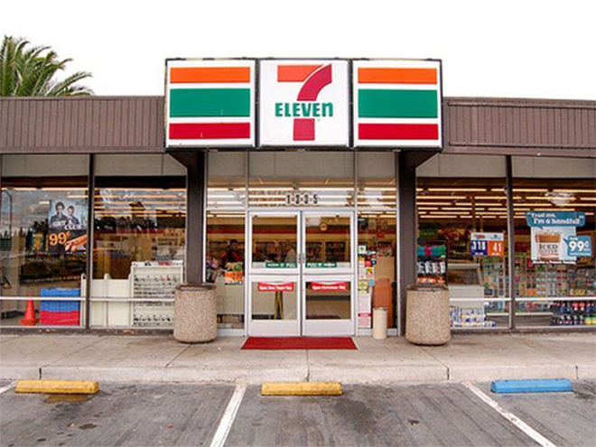
Examples of Global Marketing Brands

Slide 11
The EPRG Model: Four Strategic Orientations in International Business
1. Ethnocentric Orientation
The company views the home country as superior and assumes foreign markets are similar to the domestic market. It applies the same products and strategies internationally with little or no adaptation.
2. Polycentric Orientation
The company believes each country is unique and requires tailored strategies. Products, advertising, pricing, and packaging are adapted to fit local market conditions.
3. Regiocentric Orientation
The company organizes its strategy by geographic regions rather than individual countries. It standardizes strategies within a region (e.g., Asia or Europe) but differentiates between regions.
4. Geocentric Orientation
The company views the world as a single, integrated market. It develops a global identity and unified strategy while making necessary adjustments to local markets when required.

