Slide 1

Course Code: PIM9104
Knowledge-based Economy Social Management
Instructor: Assoc. Prof. Dr. Kuncharee Kakhai
Management Innovation Program, College of Innovation and Management,
Suan Sunandha Rajabhat University Semester 1, Academic Year 2025

Slide 2
Course Description
Theories and principles of knowledge-based economic society and development directions of the country; Principal pillars of knowledge-based economic society; Knowledge management; Educational Management and Training; Creativity and critical thinking and open innovation; Assessment of the state of knowledge-based economic society; Case studies from foreign countries and in the country.

Slide 3
Course Objectives: After studying students can
1.Design a model for the development of a knowledge-based economy
by integrating theories, principles of knowledge management, education, innovation, creativity, and case studies to be consistent with the current and future contexts of the country.
2. Develop strategic practices to promote a knowledge-based economy at the organizational or national level by using creative work skills, integrating knowledge, technology, knowledge management, and stakeholder participation.
3. Demonstrate values ​​and ethics in the process of developing a knowledge-based economy, focusing on public benefits, sustainability, transparency, and social responsibility, and convey such concepts into real-life practice or professional roles.
4. Develop characteristics of citizens in the 21st century by adhering to the principles of morality, ethics, systematic thinking, creativity, working with others, and social responsibility to lead to creative participation in the sustainable development of the country’s knowledge-based economy.

Slide 4
Evaluation: 1.Academic writing
Students are required to choose one topic within the scope of the course and write an academic article that is approximately 10 pages long (excluding references). The article must include the following elements:
1.Title of article
2. Abstract and Key words
3. Introduction (1 paragraph)
4. Content (must have internal reference at least 10 research papers published within the last 5 years, as well as at least 10 textbooks or articles, following APA citation style)
5. Conclusion (1 paragraph)
6. Bibliography (APA style)
7. Additionally, the paper must undergo a plagiarism check using Turnitin, with a similarity rate of no more than 12%.
The deadline for submissions is October 15, 2025. Please send your entries via Ms. Belle for checking plagiarism.

Slide 5
Example of Academic writing
Moruzzi, C. (2025) Artificial Intelligence and Creativity
Philosophy Compass http://doi.org.10.111/phc3.70030
pp1-8
Obrom Aranyapruk (2022) Strategies for Building a Knowledge-Based Economy for Community Enterprises in the Eastern Economic Development Zone https://doi.org/10.57260/rcmrj.2022.261618

Slide 6
2. Paper exam
The assessment consists of three questions and must be completed within a specified time limit of three hours.

Slide 7

Background of work
and study
Research interests
related to your thesis
Level of English communication skills.

Slide 8
Module 1: Theories and principles of a knowledge-based economy and the direction of national development.
Learning Outcomes: Upon completion of this subject, learners will be able to:
Systematically identify the significance, key concepts, meanings, and components of a knowledge-based economy.
Examine the theories and principles associated with the development of a knowledge-based economy.
Compare case studies of countries that have successfully established a knowledge-based economy.
Analyze the development trajectory of Thailand's knowledge-based economy.
Recommend strategies for the sustainable growth of the Thai economy through the application of knowledge and innovation.

Slide 9
A framework for understanding and applying knowledge
Know What
Know why
Know How
Care Why

Slide 10
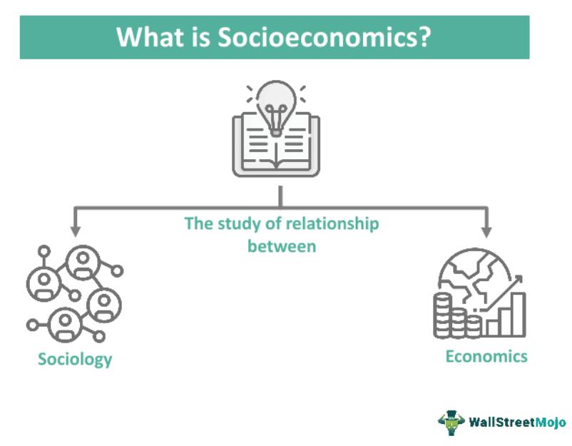
What is social economy
Social is made up of people
who share values, norms, culture,
and family, school, and religion.
Resource production, consumption,
exchange, and distribution comprise
a nation's economy.
Social
Economy
Social economy is the relationship between people's way of life (society) and their livelihood through production and consumption (economy).

Slide 11
Important components of social economy
Natural resources
Labor
Economic systems
Social structures
Technology and innovation

Slide 12
Synopsis of Social Economy
Aspects | Points
Focus | Social objectives, sustainable development, and inclusive growth
Values | Solidarity, community, and social impact
Examples | Cooperatives, mutual societies, social enterprises, and non-profit organizations.
Key Characteristics | Social mission, Democratic governance, Reinvestment of profits
Goal | To create a more equitable and sustainable society through social and economic initiatives.

Slide 13
What is A Knowledge-based Economy?
A knowledge economy is one in which knowledge is created, acquired, transmitted, and used effectively by enterprises, organizations, individuals, and communities.
World Bank. (2007). Building knowledge economies: Advanced strategies for development. Washington, DC: The World Bank.
The knowledge-based economy is an expression coined to describe trends in advanced economies towards greater dependence on knowledge, information and high skill levels, and the increasing need for ready access to all of these by the business and public sectors. (https://ec.europa.eu/)
A knowledge-based economy (KBE) is an economic system where knowledge, rather than traditional factors like land or labor, is the primary driver of growth, wealth creation, and employment. It focuses on the creation, distribution, and application of knowledge, emphasizing innovation, research, and a skilled workforce. (https://www.adb.org/)

Slide 14
Group Activity 1: Create a theoretical definition of Knowledge-Based Economy (KBE) from three sources using different artificial intelligence programs.

Slide 15
Theoretical Definition: A knowledge-based economy
A knowledge-based economy is one where growth and innovation are driven primarily by knowledge, skills, and information rather than physical resources (World Bank, 2007; https://ec.europa.eu/; https://www.adb.org/).

Slide 16
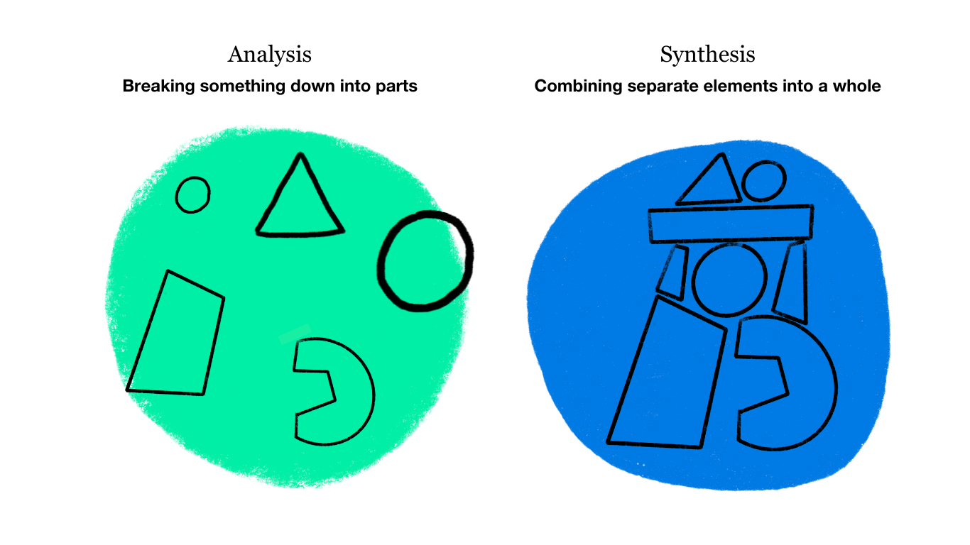
Create one theoretical definition
How to create a definition

Slide 17
Why a Knowledge-Based Economy Matters
The ability to manage knowledge, engage in continuous learning, and foster innovation are crucial for economic development.
For Developing countries, adapting to a KBE is urgent and essential.
This transition is vital to escape the middle-income trap and achieve sustainable economic and social development.

Slide 18
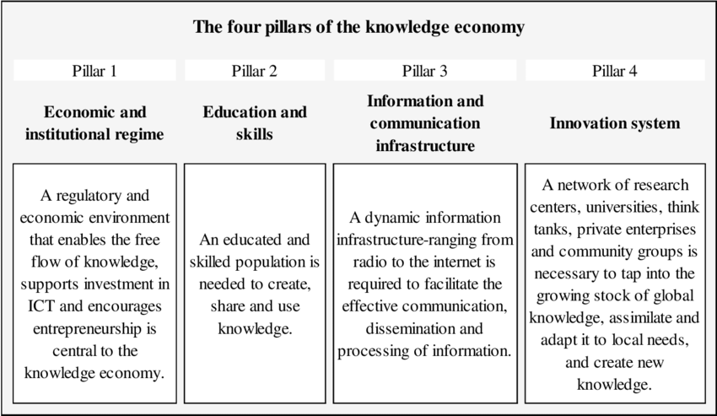
How to drive KBE: The World Bank Four Pillars of the KBE
(World Bank. 2018, Retrieved 18/03/2019 from http://web.worldbank.org/

Slide 19
Care why to develop knowledge-based economy
Drives sustainable economic growth
Enhances global competitiveness
Improves quality of life
Creates better jobs
Increases resilience

Slide 20
From Industrial to Knowledge-Based Economy
- The 21st-century economy has rapidly transitioned from industrial to Knowledge-Based Economy (KBE).
- Knowledge, technology, and innovation are now the primary drivers of value and competitiveness.
- These new drivers replace traditional resources like labor and raw materials.

Slide 21
Key Characteristics of the KBE Shift
Knowledge and skills become outdated more rapidly
Lifelong learning is critical for adaptability.
Countries now compete more on knowledge and innovation
Less reliance on traditional resources or cheap labor
Digital technology, AI, and Big Data are transforming production, consumption, and communication
Future jobs demand higher-level skills
Emphasis on analytical skills, creativity, and technological proficiency

Slide 22
Synopsis of Knowledge-Based Economy
Aspects | Points
Focus | Intellectual capital, innovation, and knowledge-intensive activities
Values | Economic growth, technological advancements, and high-skilled workforce.
Examples | Technology companies, research institutions, and universities
Key Characteristics | Intellectual property, Skilled workforce, Information technology
Goal | To increase the value of goods and services through innovation and knowledge application

Slide 23
If poor countries want to develop towards KBE, what challenges must they face?
Lack of infrastructure
Lack of investment in R&D/innovation
Shortage of highly skilled personnel
Poor quality of education
Lack of good governance

Slide 24
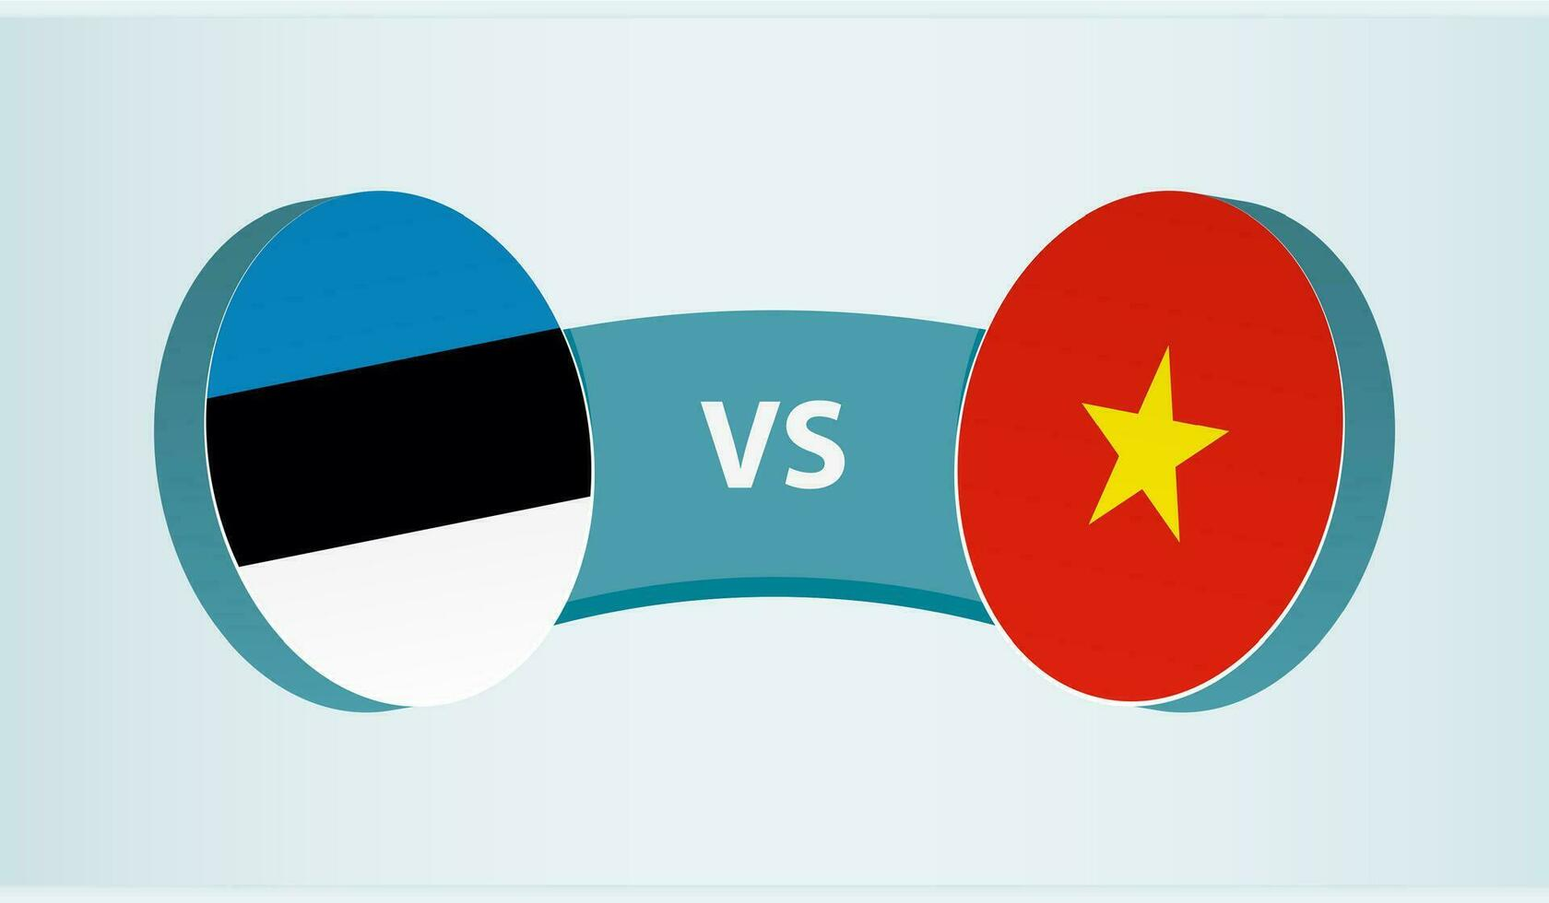

Examples of success practices and not yet
Success Practices | Not Yet
Estonia | Central African Republic – CAR
Vietnam | Niger

Slide 25
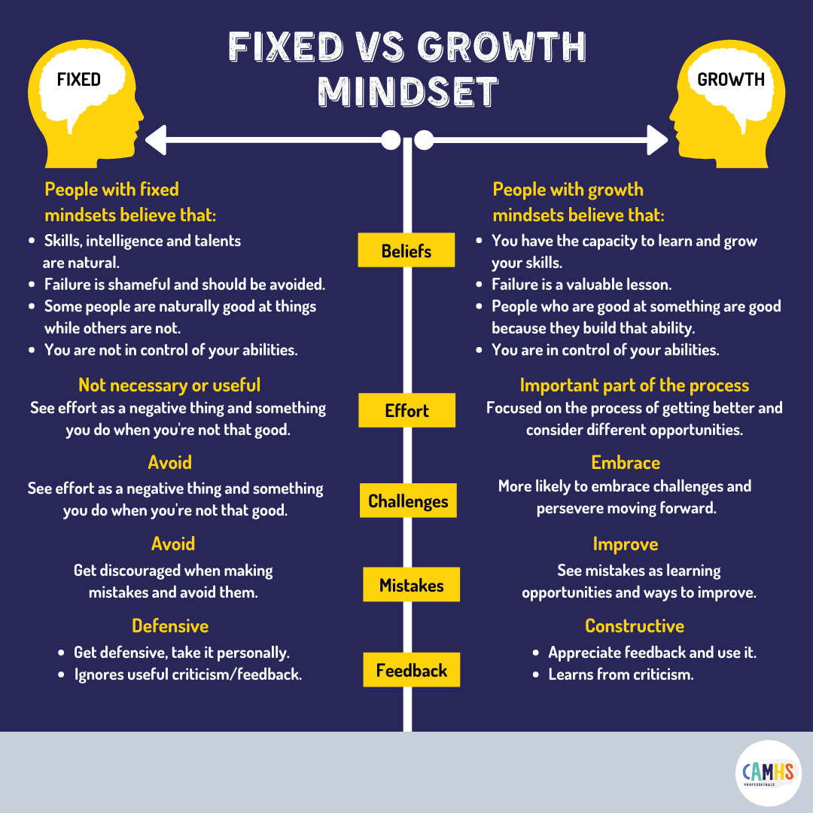
“Not Yet” — The Most Important Mindset for Growth
Developing a Growth Mindset with Carol Dweck- https://lnkd.in/eTQdvki

Slide 26
Estonia and Vietnam
Dimension | Estonia | Vietnam (Transforming)
Economic Drivers | Tech exports, e-governance, flat tax | State-led industrialization, FDI (Foreign Direct Investment) in manufacturing
Education Focus | Teacher autonomy, STEM, lifelong learning | Curriculum reform, Industry 4.0 integration
Innovation Ecosystem | Startup-friendly policies, Nordic investment | Government incubators, weak R&D spending
Key Challenges | Brain drain, energy security | Skills gap, infrastructure deficits
S – Science T – Technology E – Engineering M – Mathematics
STEM:An educational and skills development approach emphasizing the integration of knowledge across four fields to prepare individuals
for a modern world driven by innovation, technology, and systemic problem-solving

Slide 27
Success-Practice refers to a standard or set of guidelines known to yield positive outcomes when followed.
Key aspects of success practices Hierarchy of Practices
Best Practice
World Class
Individual
Best in Class
Best in Group
Proven effectiveness
Efficiency
Adaptability
Continuous improvement

Slide 28
Current State of Social and Economic Conditions in Thailand
Highlights of KBE development in Thailand Major challenges
1. Continuous policy push
2. Investing in digital infrastructure.
3. Enhancing Research and Innovation Capabilities
4. The Growth of Startups and the Digital Economy
1. The quality of education and inequality in access to it.
2.Investment in R&D remains low.
3.Policy management and integration lack flexibility.
5.The culture of learning and innovation is still developing.
4. Shortage of skilled personnel in advanced technology

Slide 29
A broader idea behind KBE Theory
Intangible assets that contribute
to its value and competitive advantage.
Results
Intellectual Capital
The value derived from an individual's or group's social networks, relationships,
and connections.
The collective knowledge, skills,
abilities, experience, creativity,
and health embodied in individuals
within an organization or society.
Human Capital
Social Capital
Amplifies

Slide 30

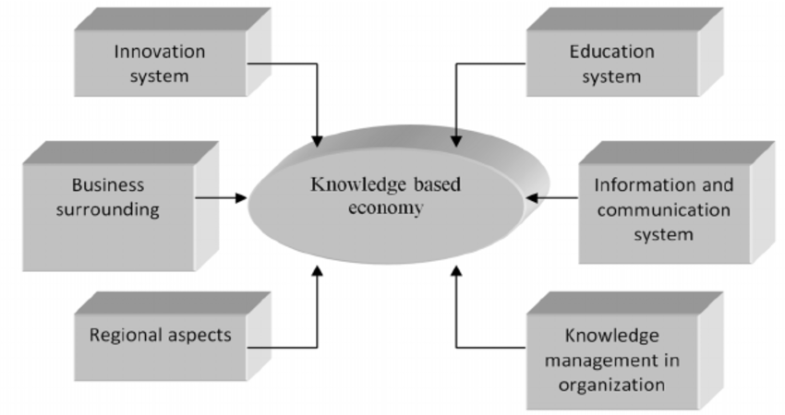
The Knowledge-Based Economy (KBE) Theories
Knowledge is the key to creating economic value, especially in an age of information technology and innovation.
Zwiefka, A.& Nycz, M (2013)

Slide 31
Knowledge economy theorices
Knowledge as a Capital
Networked Economy
Learning Economy
Innovation-Driven Growth

Slide 32
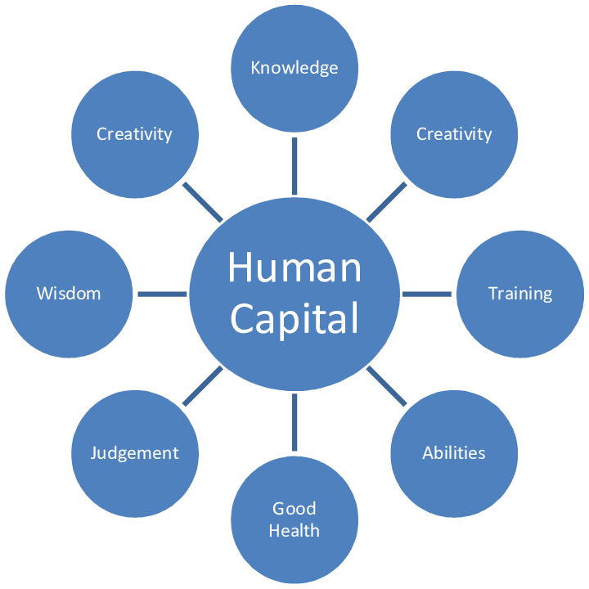
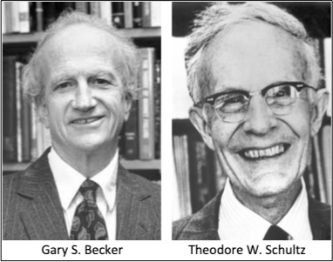
1.Knowledge as a Capital
Modern economies depend
heavily on human capital
Zaric &Babi (2020) CREATING HUMAN CAPITAL RESPONSIVE TO REQUESTS OF
SUSTAINABLE DEVELOPMENT GOALS: SOME EVIDENCE FROM SERBIA

Slide 33
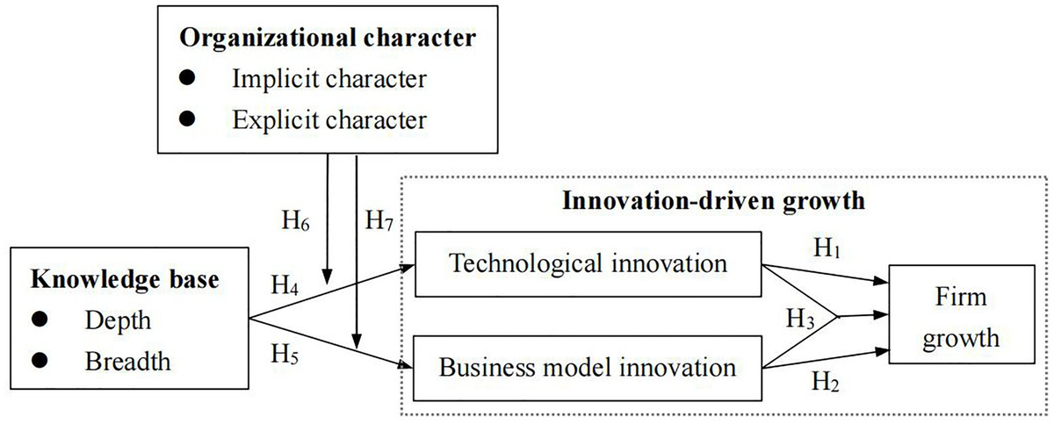
2.Innovation-Driven Growth
Innovation and economic growth
Produce higher value products and services
Innovation Ecosystem
Educational and research sector
Business sector
Increase labor productivity
Heart of economic that must compete globally
Government support
ICT infrastructure
Yu D and Yan H (2021) Relationship Between Knowledge Base
and Innovation-Driven Growth: Moderated by Organizational Character.
Front. Psychol. 12:663317. doi: 10.3389/fpsyg.2021.663317

Slide 34
3.Learning Economy
An economic system where learning serves as the primary mechanism for boosting productivity, fostering innovation, and competing in the global market.
Learn through childhood, work,
and retirement.
Reskilling / Upskilling
Future Skills
R&D
Lifelong Learning
Critical Thinking, Creativity,
Digital Literacy, AI & Data Skills,
Entrepreneurship
Linking universities – research centers – business sector

Slide 35
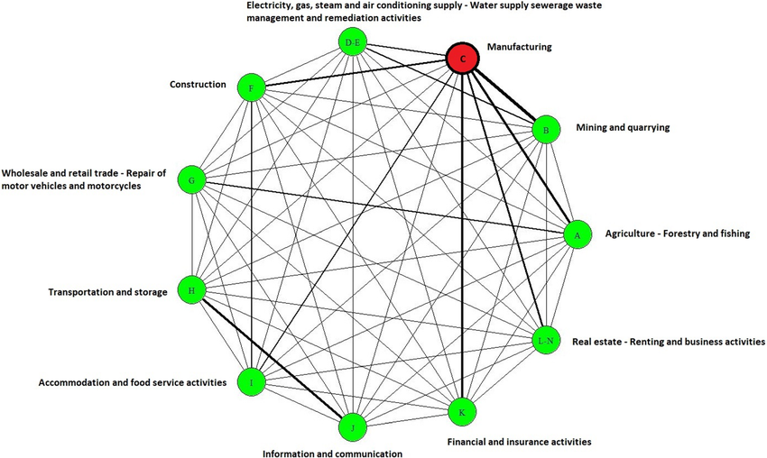
4.Networked Economy: An economic system that is driven by networks of information, knowledge, and participants through digital technology.
Daglis, et al, (2023)

Slide 36
Proposals for driving the developing country economy towards sustainable growth based on knowledge and innovation
Strong innovation ecosystem and R&D investment
Human capital development with future talent
Promoting AI and digital technology in numerous sectors
Target and high-potential industries are promoted.
Fostering sustainable growth

Slide 37
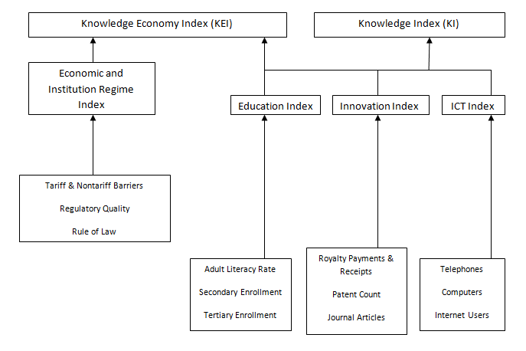
How to assess knowledge-based Economy
The latest version of the World Bank framework was released in 2015.

Slide 38
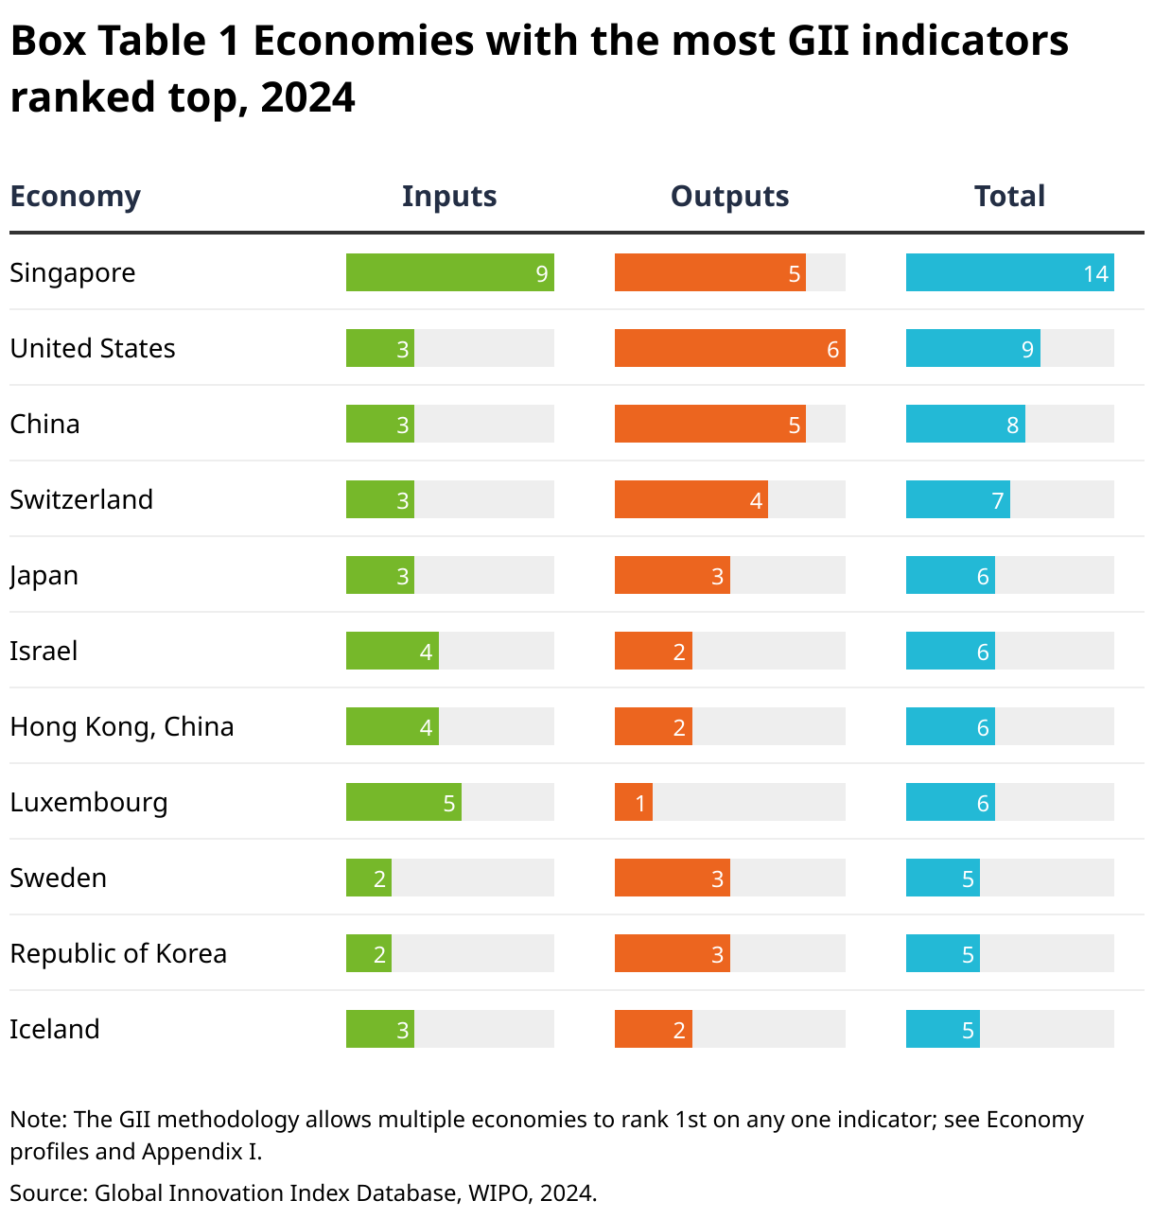
The Global Innovation Index (GII)

Slide 39
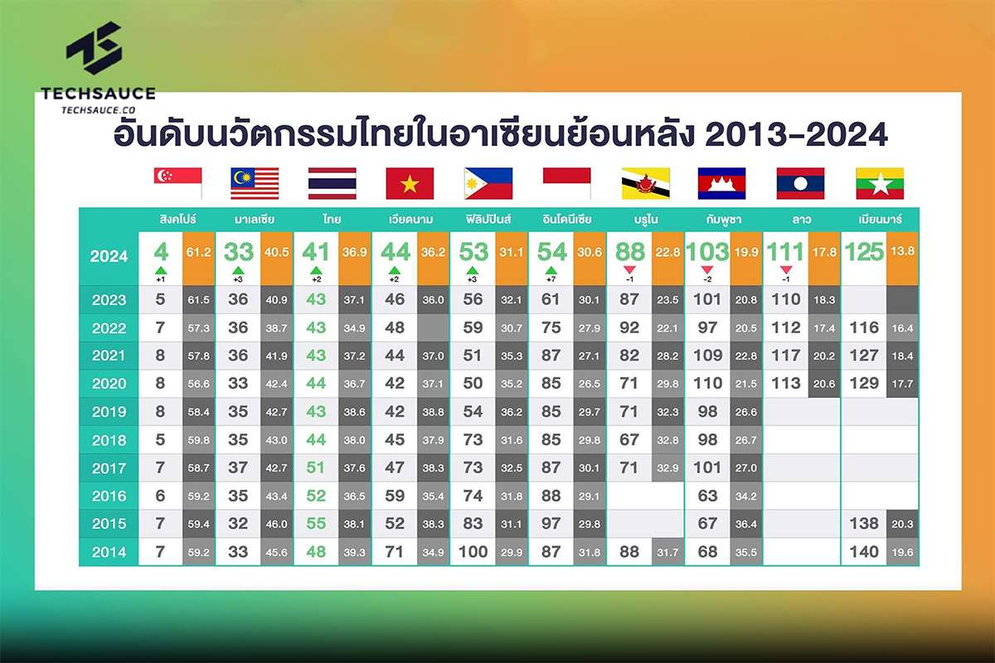

Slide 40
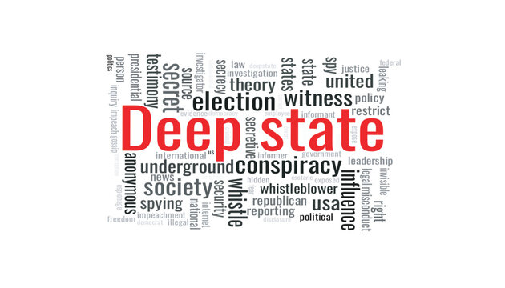
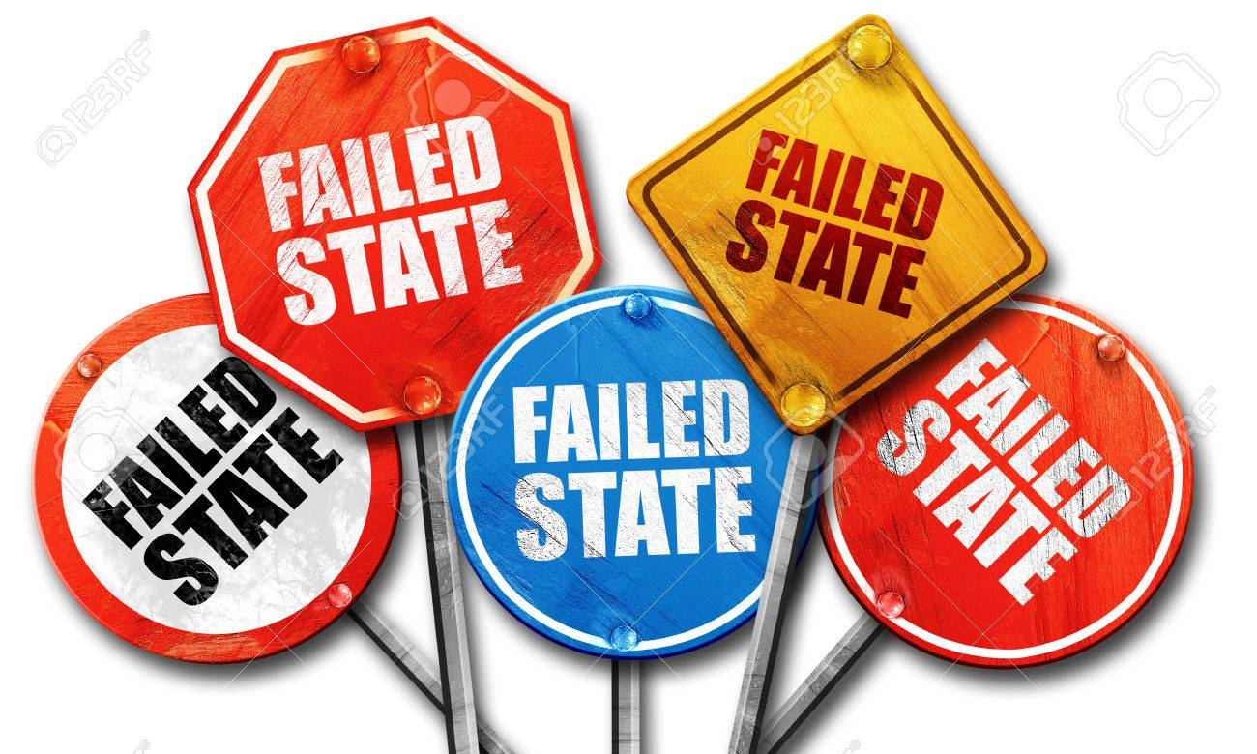
What are your views on the current situation in Thailand?
(30 minutes)
The "deep state" refers to a concealed, influential,
and unelected faction within the government that
allegedly seeks to control or subvert official policy.
A failed state is one that cannot ensure safety for its citizens,
lacks effective governance, and fails to provide essential services
that the government should offer.

Slide 41
Articles for Module 1: (Retrieved from google.co.th)
Obrom Aranyapruk (2022) Strategies for Building a Knowledge-Based
Economy for Community Enterprises in the Eastern Economic
Development Zone https://doi.org/10.57260/rcmrj.2022.261618
2. Bermeo Giraldo, M.C., Patiño Toro, O.N., Valencia Arias, A., Benjumea Arias,
M.L., & Bran Piedrahita, L. (2022). Research trends of the knowledge
-based economy: A bibliometric study. Intangible Capital, 18(2), 290-313.
https://doi.org/10.3926/ic.2048
3. HADAD, S. (2017) Knowledge Economy: Characteristics and Dimensions
Management Dynamics in the Knowledge Economy Vol.5 (2017) no.2, pp.203-225;
DOI 10.25019/MDKE/5.2.03 https://core.ac.uk/
4. Tshetshe, Z. (2025) Recognizing ‘Being’ in the BANI world
International Journal for Multidisciplinary Research (IJFMR)

Slide 42
Assignment 2: At the end of Lesson 1, you are required to write a brief
reflection note in one page divided into four sections
Section 1: Summary of insights gained today.
Section 2: Issues of particular importance to Thailand. Section 3: Select a benchmark country.
Section 4: Strategies for addressing areas of concern from the benchmark country.
Please send all your assignments to kuncharee.ka3556@gmail.com on 31 July 2025

Slide 43
Assignment 2: At the end of Lesson 1, you are required to write a brief
reflection note in one page divided into four sections
Section 1: Issues of particular importance to Thailand. Section 2: Select a benchmark country.
Section 3: Strategies for addressing areas of concern from the benchmark country.
Please send all your assignments to kuncharee.ka3556@gmail.com

