Slide 1

Planning a course
3rd January 2025

Slide 2

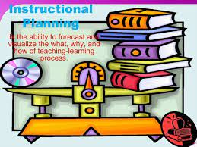
Outline
Suggestions and tips in planning a course
Planning for teaching and learning
Choosing the right course book

Slide 3


Suggestions in planning a course
Teachers are asked to work with a plan that already exists.
Can be explicit documents generated within the institution.
Can be more implicit statement such as prescribed coursebook
Individual teacher or group of teachers need to plan a course themselves.
Explicit –stated clearly and in details, no confusing or doubt.
Implicit-secret or hidden; not openly practiced or engaged in or shown or avowed.

Slide 4
Begin the process early, giving yourself as much time as you can to plan a new course
require careful planning and continual revision
Consult with colleagues who have taught the same or similar courses
learn from their strategies and their general impressions of the students who typically take the course.

Slide 5
If you are team-teaching, you and your teaching partner(s)
should begin meeting well in advance to discuss
course goals,
teaching philosophies,
course content,
teaching methods, and
course policies,
specific responsibilities for each instructor

Slide 6
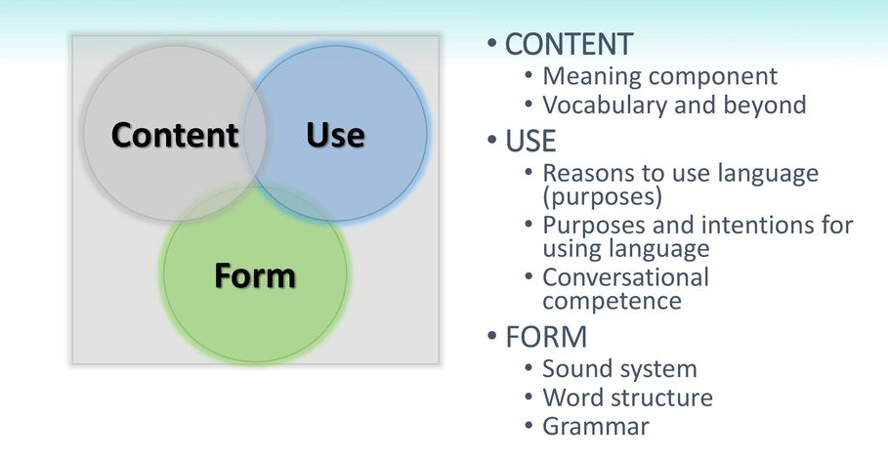
Know your learners
Analysis of learners needs, both language content and skills and learning process
planning includes “ considering the students, thinking of the content, materials and activities

Slide 7
learn about the students who typically take the course
(their level of preparation, their majors or academic interests, etc.)
think about how your course will help this group of students build their knowledge and understanding of the topic.

Slide 8


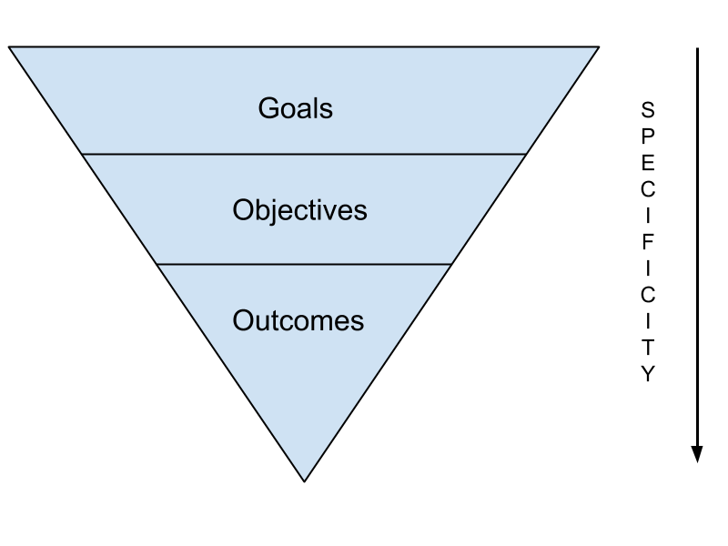
2. Formulate aims and objectives
What do you want the learners to be able to do by the end of the course?
What do you want them to have read and listened to?
How can these objectives to be broken down into manageable steps?

Slide 9
Define course goals
Determining the goals for the course will clarify what you want the students to learn and accomplish.
Having these course goals in mind will help you make decisions about
which content to include,
which teaching methods to use, and
what kinds of assignments and exams are appropriate

Slide 10
When you define the course goals, focus on student learning
One way to formulate these goals is
determine what students should be learning
in terms of content,
cognitive development, and
personal development
Be as specific as you can and
make sure that the goals define learning can be measured

Slide 11
Consider the following questions:
What do you want your students to remember from your course in 5-10 years?
How should taking your course change students?
What skills should students gain in this course?
How does this course relate to other courses in the discipline?
then, you might define the course goals accordingly (e.g., for an introductory, fundamental, or advanced course in the discipline)?

Slide 12
3. Name the aspects of the learning experience
To reach the objectives
Should Consider
Processes(The task learners might do)
Topics
Text types
Language content
Consider each one in details-------

Slide 13
Determine course content
Select the major topics and determine the order in which you will teach them
Select the main topics to be covered
To obtain an initial list of course topics, look in current textbooks or the current literature (for a special-topics course)
Determine whether there is concerning the necessary topics by obtaining previous course syllabi and discussing potential topics with colleagues.

Slide 14
Refine your list by considering
your course goals and
the characteristics of your students.
At the same time, use the desired content to refine the course goals.
Pare down and refine your initial list of topics.
Instructors often plan initially to teach more material than they can cover in the allotted time.

Slide 15

4. Consider the language content
required To specify
the main structures, lexis and language functions
(that learners will experience and work with during the course)
link these features with the overall aims and objectives of your course
Main Structure
Languages differ from each other in various respects,
e.g., in their sentence structure (syntax), word structure (morphology), sound structure (phonology) and vocabulary (lexicon).

Slide 16
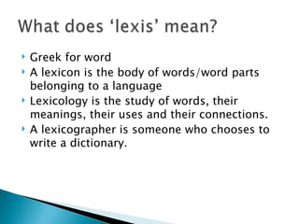

Slide 17
Language functions
Language functions are the reasons for using language, or the purpose of expressing oneself. Some examples of language functions include:
Expressing opinions: Sharing thoughts and responding to others' ideas
Asking and answering questions: Facilitating the exchange of information
Making requests: Playing a role in coordinating actions and activities
Apologizing: Expressing emotions and maintaining social harmony
Greeting and introducing oneself: Establishing an interaction and managing social situations

Slide 18
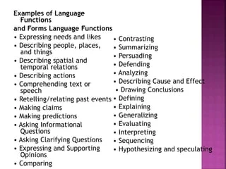

Slide 19

Besides the experience of these explicitly stated language features
Learners need a general verity of exposure
give them opportunities to acquire features which are not being explicitly taught
FUNKY TUNES
BOFFIN
Launch
Launch

Slide 20

5.Think about topics and text types
Do the course objectives imply/mean/indicate a particular topics and written or spoken text types?
Are some topics particularly relevant and interesting for the learners?
Which text types might most easily support the language and content objectives, as well as to a wide exposure?
Text types-refers to the broad categories of writing that present information, ideas, or stories in different ways.

Slide 21
Determine the structure of the course;
arrange the topics in a logical order
Develop a rationale that guides the structure of the course
to explain the material more clearly to the students
discuss how and why you have organized the material in a particular way
how one topic builds on, illustrates, or offers a different perspective on another.
increases and maintains the students’ interest in the course content
Determining the course structure can help you decide which texts are most appropriate.

Slide 22
Develop teaching methods and tools
Once you have determined the course goals and content, think about how you will present the content
Select and develop teaching methods and tools that are
1) appropriate for the size of the class and
2) consistent with the course goals.

Slide 23
Consider the following questions and suggestions:
What is your teaching style? How will you apply or adapt your style to suit the course goals, the size of the class, and the types of students who are likely to enroll?
Which types of teaching methods will best fulfill your course goals?
When deciding whether or not you will use technology in your teaching, identify specific goals that technology will help you reach. Plan carefully to determine how you will integrate technology with more traditional teaching tools, such as the chalkboard.
Whenever possible, use a variety of approaches, taking into account that students use a diverse range of learning preferences.
Plan to use teaching methods that will require and measure active student learning.

Slide 24

6. Thinking about the process
Negotiating in a group
Writing a summary from various source texts-
Learners can already identify some of the activities they need to perform
Which process will best support your language content objectives?
Which will best support the student’s general language learning?

Slide 25
7. Decide on a sequence for the course elements
Require a rational to help
Determine which chapters will come first, which later
how phases will be recycled
Think of
Immediate need, relevance, or
Difficulty (a complex one, requested questions about what can be meant by “mastery” of a course element

Slide 26
Organize the topics in a variety of ways
whether chronological, topical, conceptual, survey-oriented, or process-oriented
Think about how the structure of the course will contribute to student learning.
Ask questions such as the following:
Can I organize the topics according to a theme or storyline?
Do I need to teach certain skills initially and then discuss applications?
Do I want to introduce a particular theory before illustrating it with specific examples or problems?

Slide 27
8.Get feedback on your draft course
Before the course plan is finalized,
It is essential to get feedback from others
Colleagues can spot the problems
From gaps in course coverage to ambiguous (unclear or confusing, it can be understood in more than one way
or difficult formulations

Slide 28
9. Develop a formal, public document
The ‘finished’ course documents or course description
Should be available
to teachers using it
to other colleagues, learners, sponsors and parents
Writing for many different audiences is challenge but
A documents that successfully addresses all stakeholders
Can be powerful unifying force

Slide 29
10. Remain open to change
As the course is taught
With no doubt, teachers and learners will experience and
reveal the ways it could be improved
Need to set up a system to channel these developing insights back to you
Completely change the course plan every year is
Impractical
Inappropriate
But do remain open to feedback and modifications.

Slide 30
Planning for teaching and learning
The more you can find out about
Why your learners are learning English
Why they intend to do with their new language,
The better you can plan your program for them.

Slide 31
When designing your own materials,
Even when making extensive use of published materials,
It is necessary to make materials of our own to cover particular issues

Slide 32
If you intend your students’ learning to be supported
by a particular coursebook,
Select the most appropriate book,
Your learners’ need will be met well
You will find it a resource with which is comfortable to work

