Slide 1








Language Functions
LISTENING AND SPEAKING FOR TEACHERS OF ENGLISH

Slide 2

Lesson Objectives
Understand the functions of Language
Identify and categorize sentences by their function
Use different sentence functions in speaking

Slide 3
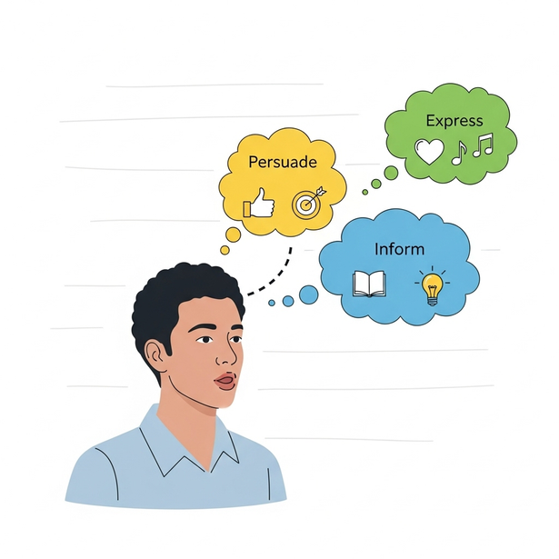
An Introduction to Language Functions
ESSENTIAL GUIDE TO MASTERING COMMUNICATION IN ENGLISH

Slide 4





What Are Language Functions?

Slide 5

Defining the concept
A language function refers to its purpose for which we use a sentence or phrase and depends on what you want to communicate.
It's the "job" a sentence does (e.g., apologizing, greeting, requesting).
Understanding these functions is key for effective communication, especially in formal situations like interviews or exams

Slide 6
Example
“I’m sorry”
represents the function of apologizing
“Good Morning!”
represents the function of greeting.

Slide 7









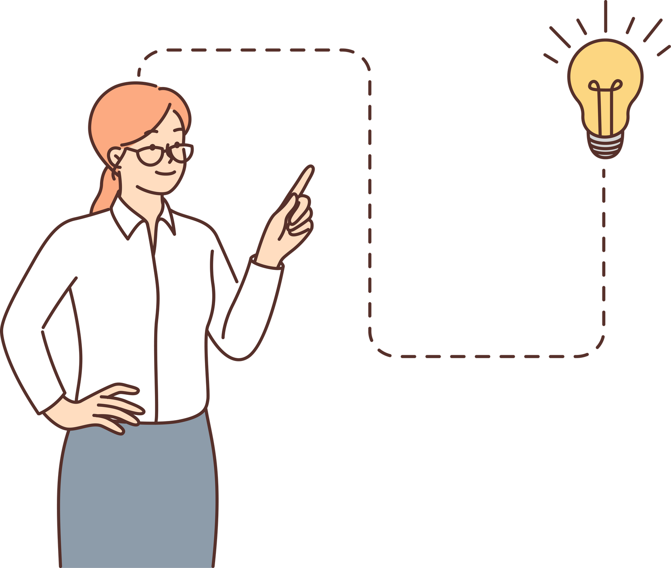
Functions
Everyday Functions: Introducing, Greetings & Farewells
Expressing Feelings & Opinions (Like and Dislikes)
Asking, Requests, Offers, and Invitations
Navigating the World: Asking and Giving Directions & Descriptions (people, place, weather)
Offering and giving help, Accepting Help, Refusing Help
Making Suggestions

Slide 8






Functions
Apologies
Checking Information (Clarification)
Obligation, giving rules and Prohibition
Permission and warning and advice

Slide 9
Examples Sentences
Formal: Good morning, How do you do?.
Informal: Hello/Hi, Morning.
Introducing: Hello, I am (x), (x) This is (z).
Goodbyes: Good-bye, Have a nice day/evening.
Likes: I love it, I'm crazy about it, It's fantastic.
Dislikes: , I can't stand it, It's horrible.
Giving Opinions: I think/believe..., In my opinion....
Asking: Can/could I have...?, Would you mind...?.

Slide 10
Examples Sentences
Offering: Shall I take that for you?, Can I help you?.
Inviting: Would you like to...?
Asking for Directions: Excuse me, how do I get to...?
Giving Directions: Turn right into..., Go past the..., The... is on the right.
Describing People/Places: What's she like?, What's the weather like?

Slide 11
Lesson Checkpoint
Determine which sentence is which language function. How did you identify each function?
You can…... If you want to ….
Would it be a good idea to

Slide 12

How did you do?
Determine which sentence is which language function. How did you identify each function?
This sentence is giving permission. It has the model verb “can” “You can....”.
You can…... If you want to ….
This sentence is making suggestions. “Would” is used at the beginning of the sentence for
asking for agreement.
Would it be a good idea to

Slide 13
Lesson Checkpoint
Determine which sentence is refusing help and which is accepting help. How did you identify each function?
Thank you. That's very kind of you
It’s all right, thanks. I can manage

Slide 14
How did you do?
Determine which sentence is refusing help and which is accepting help. How did you identify each function?
This sentence is ......
It shows ....................
Thank you. That's very kind of you
This sentence is ............
It ..................
It’s all right, thanks. I can manage

Slide 15
Practice 1: True or False?
"Don't worry about it" is a phrase used for making an apology
Click and drag the circle to indicate your answer.
TRUE
FALSE

Slide 16
Practice 2: True or False?
2. "You can't miss it" suggests that the directions are difficult to follow.
Click and drag the circle to indicate your answer.
TRUE
FALSE

Slide 17
Practice 3: True or False?
3."Would you like to?" is a phrase used for extending an invitation.
Click and drag the circle to indicate your answer.
TRUE
FALSE

Slide 18
Practice 4: True or False?
4. A negative question like "Isn't / wasn't / didn't...?" is used for checking information.
Click and drag the circle to indicate your answer.
TRUE
FALSE

Slide 19

Practice 5: Find the Function
5. Which sentence is warning and advice? Click and drag the checkmark to the correct sentence.
You're allowed to ….
Make sure you….
You're supposed to ………..
I think we need to ……..

Slide 20

Practice 6: Find the Function
6. Which sentence is expressing preference? Click and drag the checkmark to the correct sentence.
Well, I've never thought about that before but ...
The main reason why ... is because / is that ...
If everything goes according to plan, I'll ..
If I had the choice, I'd rather ..................

Slide 21

Practice 7: Find the Function
7. Which sentence is Speculating ( = Guessing When You Don't Know)? Click and drag the checkmark to the correct sentence.
Well, I've never thought about that before but ..
What I'm trying to say is ..........
Typically,
Eek! That spider jumped out of nowhere!

Slide 22
Practice 8: Name the Function
8. Click and drag the correct function of the language below
to the language Function box.
Keep your voice down during the performance, please.
Language Function:
Warning and advice
Rules
Express a prohibition
All of the above

Slide 23
Practice 9: Name the Function
9. Click and drag the correct function of the sentence below
to the Sentence Function box.
What steps should we take to clean up the environment?
Sentence Function:
Giving Permission
Making Suggestions
Asking for Suggestions
Asking for agreement

Slide 24
Practice 10: Name the Function
10. Click and drag the correct function of the sentence below
to the Sentence Function box.
It seems to me that the lecture is quite interesting.
Sentence Function:
Expressing an opinion
Expressing a plan
Making Request
Explaining

Slide 25
Answer Key
1. False (Replying for apology)
2. False (the directions are easy to follow)
3. True
4. True
5. Make sure you….
6. If I had the choice, I'd rather ...................
7. Well, I've never thought about that before but ..
8. All of the above
9. Asking for Suggestions
10. Expressing an opinion

Slide 26
Resource Page
These elements and fonts were used in this presentation.
Loyola
set:nAE8-2m3L4Q
VAG Rounded Next

Slide 27
Press these keys while in present mode!
B for blur
C for confetti
D for drumroll
M for mic drop
O for bubbles
Q for quiet
U for unveil
Any number from 0-9 for timer

