Slide 1
Basic Grammar

Slide 2

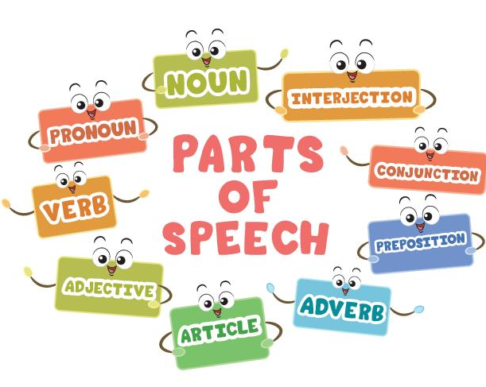
Source: https://dumbbear22.blogspot.com/2019/03/part-of-speech.html

Slide 3

Subject-verb agreement

Slide 4




Some nouns appear plural but are singular. Other nouns have irregular plurals that look singular. Be careful because the verb must agree with the subject.
Examples
A sum of money = a singular noun
Twenty dollars is a low price for a nice dress.
Nine cents is added to the price for sales tax.
A company name with a plural noun = a singular noun
GM Autos owns this factory.
United Gems employs most of the workers in this town.

Slide 5

Words beginning with “every” or “no” (everyone, nobody) = a singular noun
Everyone wants to have a break now.
Nobody is ready for the exam.
Irregular plural words may look singular.
Children are allowed to play games on weekends.
Few people work on Sundays.

Slide 7


Slide 10
The subject and verb of a sentence must agree. A prepositional phrase may come between the subject and verb of a sentence, and the phrase may contain a noun that is different in person or number from the subject. This does not change the need for subject-verb agreement.
Examples
The order for office supplies was on my desk.
The workers in the factory receive many benefits.
This group of business leaders meets with the mayor every month.

Slide 11
Subject-verb agreement with prepositional phrases
1. The officers of the company ______ today at 1:00.
a. is meeting
b. meets
c. has met
d. are meeting

Slide 12
Subject-verb agreement with prepositional phrases
2. The owner of these buildings ______ his tenants a very reasonable rent.
a. charges
b. charge
c. are charging
d. have charged

Slide 13
Subject-verb agreement with prepositional phrases
3. The supplies in that closet ______ there for any staff.
a. is
b. has
c. are
d. was

Slide 14

4. The documents in this folder ______ to be signed by both parties and returned to the attorney right away.
a. need
b. needs
C. needy
d. is needed

Slide 15
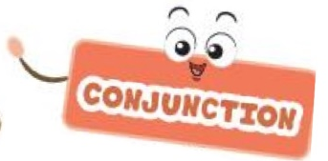



Slide 16
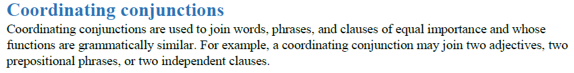
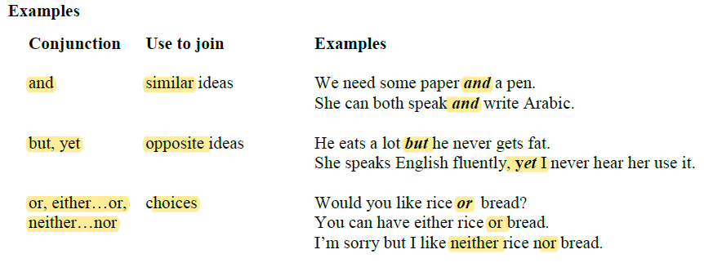

Slide 17
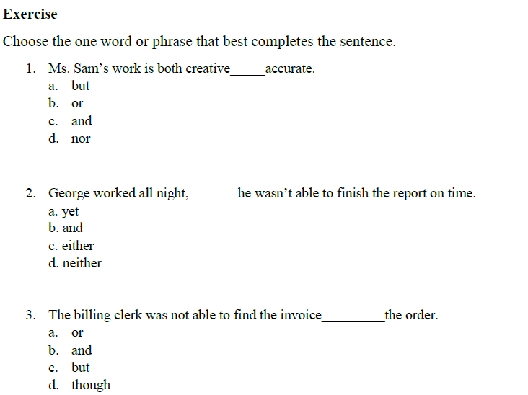

Slide 18
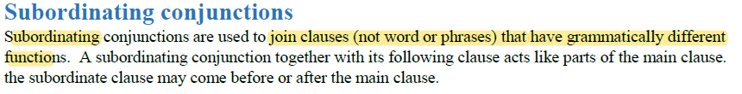
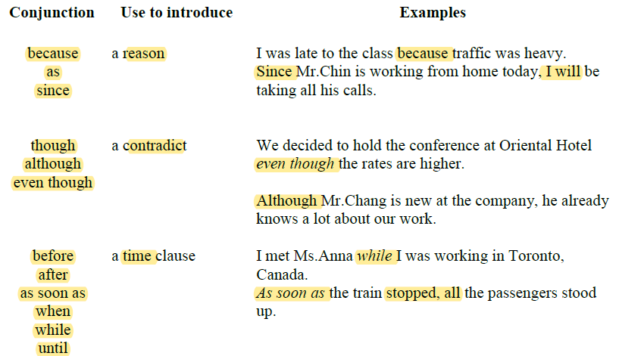

Slide 19
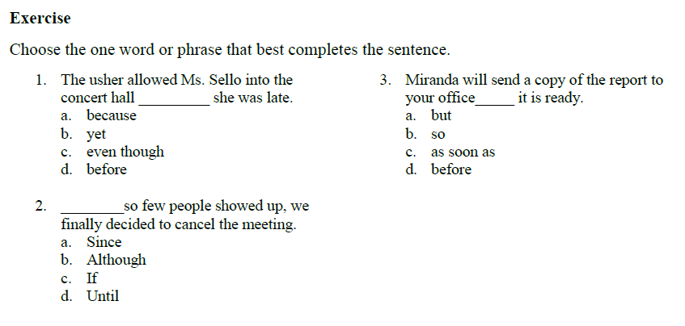

Slide 20
Auxiliary Verbs
Auxiliary, or helping verbs, are used before infinitives to add a different meaning. For example, you use auxiliary verbs to say:
The helping verbs are can, could, would, should, ought to, will, shall, may, might and must.

Slide 21
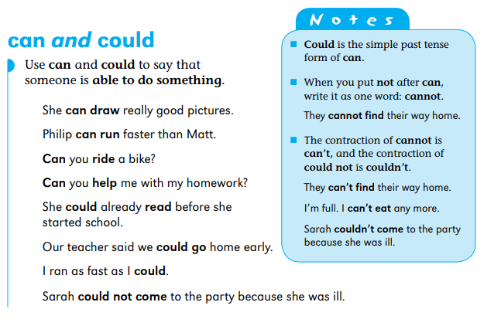
Auxiliary Verbs

Slide 22
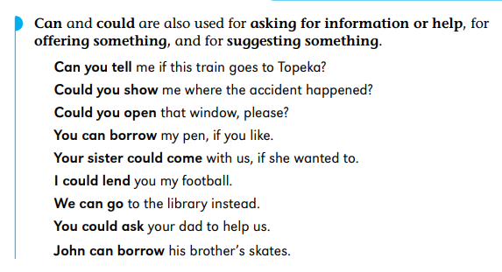
Auxiliary Verbs

Slide 23
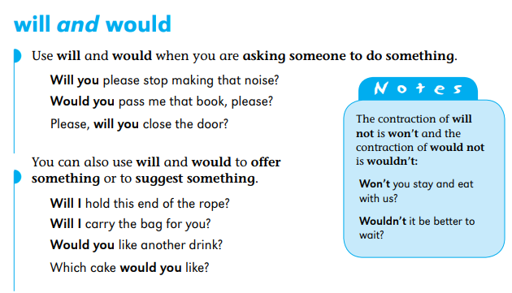
Auxiliary Verbs

Slide 24
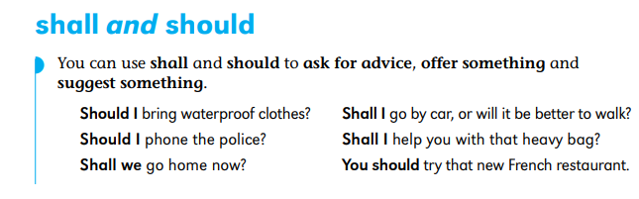
Auxiliary Verbs

Slide 25
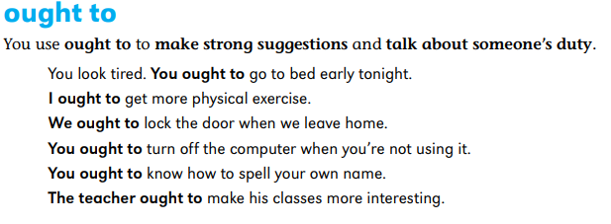
Auxiliary Verbs

Slide 26
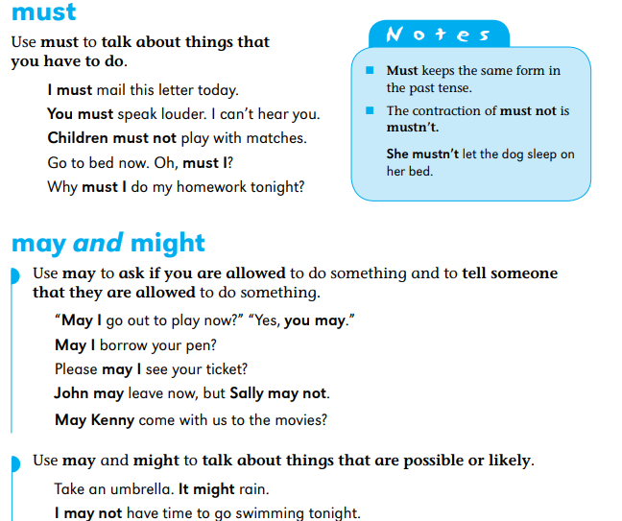
Auxiliary Verbs

Slide 27
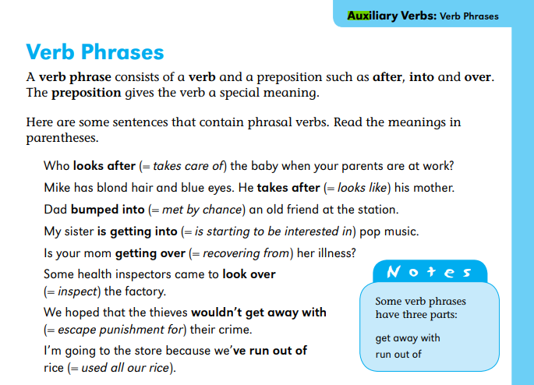
Auxiliary Verbs

Slide 28
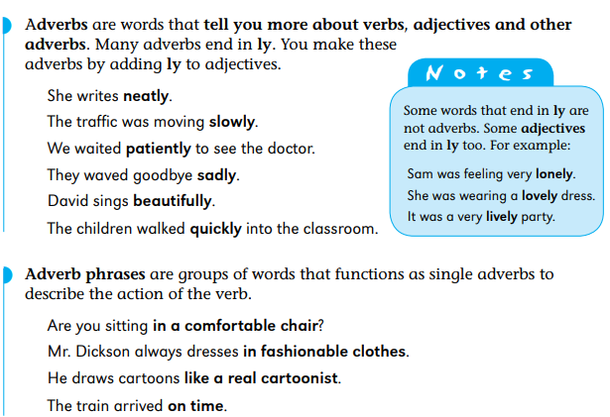
Adverbs and Adverb Phrases

Slide 29
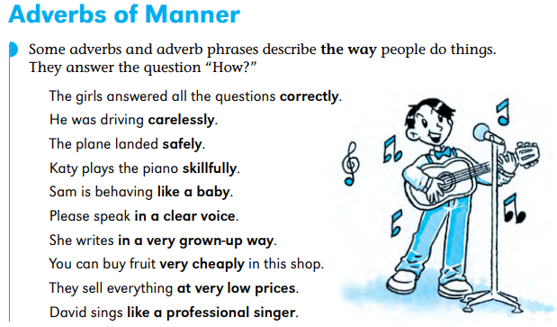
Adverbs and Adverb Phrases

Slide 30
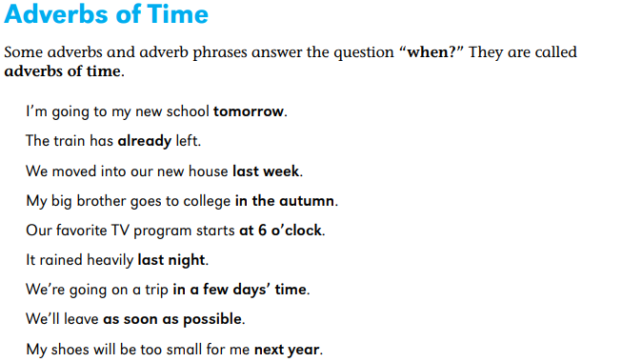
Adverbs and Adverb Phrases

Slide 31
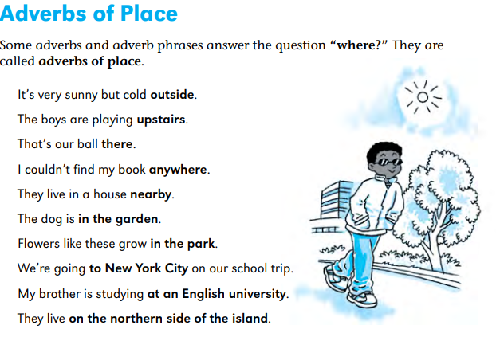
Adverbs and Adverb Phrases

Slide 32
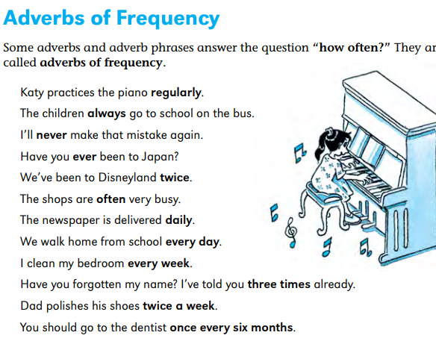
Adverbs and Adverb Phrases

Slide 33
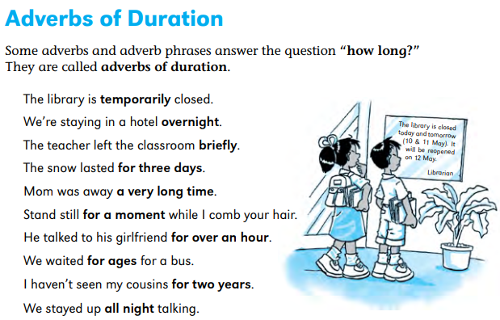
Adverbs and Adverb Phrases

Slide 34
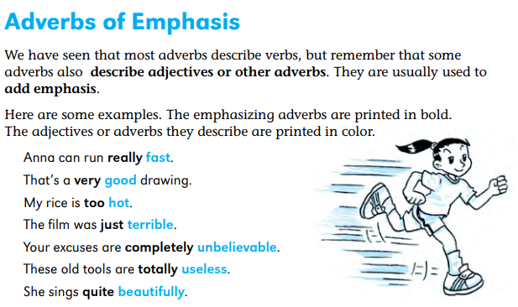
Adverbs and Adverb Phrases

