Slide 1
Financial Statement Analysis
Lesson 7

Slide 2
Objectives
Understand the purpose of basic financial statements and their contents.
Understand what is meant by “convergence” in accounting standards.
Explain why financial statement analysis is important to the firm and to outside suppliers of capital.
Define, calculate, and categorize (according to liquidity, financial leverage, coverage, activity, and profitability) the major financial ratios and understand what they can tell us about the firm.
Define, calculate, and discuss a firm’s operating cycle and cash cycle.
Use ratios to analyze a firm’s health and then recommend reasonable alternative courses of action to improve the health of the firm.
Analyze a firm’s return on investment (i.e., “earning power”) and return on equity using a Du Pont approach.
Understand the limitations of financial ratio analysis.
Use trend analysis, common-size analysis, and index analysis to gain additional insights into a firm’s performance.

Slide 3
Financial Statements
Financial (statement) analysis The art of transforming data from financial statements into information that is useful for informed decision making.
Balance sheet A summary of a firm’s financial position on a given date that shows total assets = total liabilities + owners’ equity
Income statement A summary of a firm’s revenues and expenses over a specified period, ending with net income or loss for the period.

Slide 4
Balance Sheet Information
The assets are listed in the upper panel according to their relative degree of liquidity Cash is the ultimate in liquidity, and appears first. The bottom panel of the table shows the liabilities and shareholders’ equity
Cash equivalents Highly liquid, shortterm marketable securities that are readily convertible to known amounts of cash and generally have remaining maturities of three months or less at the time of acquisition.
Shareholders’ equity Total assets minus total liabilities. Alternatively, the book value of a company’s common stock (at par) plus additional paid-in capital and retained earnings.

Slide 5
Aldine Manufacturing Company balance sheets

Slide 6
Income Statement Information
The income (earnings, or profit and loss)
Cost of goods sold Product costs (inventoriable costs) that become period expenses only when the products are sold; equals beginning inventory plus cost of goods purchased or manufactured minus ending inventory

Slide 7
Aldine Manufacturing Company statements of earnings (in thousands)

Slide 8
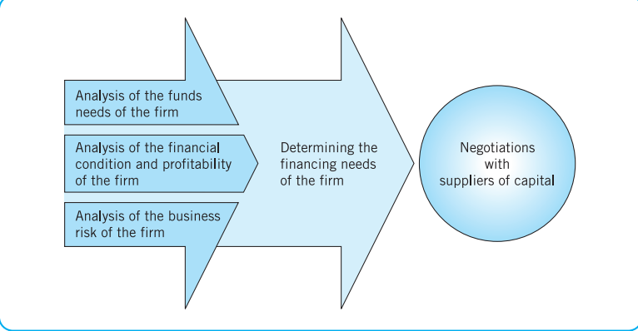
A Possible Framework for Analysis

Slide 9
Financial Ratios
An index that relates two accounting numbers and is obtained by dividing one number by the other.
the financial analyst needs to perform “checkups” on various aspects of a firm’s financial health. A tool frequently used during these checkups is a financial ratio, or index, which relates two pieces of financial data by dividing one quantity by the other

Slide 10
“checkups
Internal Comparisons
External Comparisons and Sources of Industry Ratios.

Slide 11
Types of Ratios

Slide 12
Aldine Manufacturing Company balance sheets

Slide 13
Balance Sheet Ratios
Liquidity ratios Ratios that measure a firm’s ability to meet shortterm obligations.
Current ratio Current assets divided by current liabilities. It shows a firm’s ability to cover its current liabilities with its current assets.

Slide 14
Aldine Manufacturing Company balance sheets

Slide 15

Acid-Test (or Quick) Ratio. A more conservative measure of liquidity is the acid-test,

Slide 16
Aldine Manufacturing Company balance sheets

Slide 17

Financial Leverage (Debt) Ratios
Debt ratios Ratios that show the extent to which the firm is financed by debt.
Debt-to-Equity =

Slide 18
Aldine Manufacturing Company balance sheets

Slide 19
Debt-to-Total-Assets Ratio. The debt-to-total-assets ratio is derived by dividing a firm’s total debt by its total assets
Debt-to-Total-Assets Ratio =

Slide 20
Coverage Ratios
Coverage ratios are designed to relate the financial charges of a firm to its ability to service, or cover, them. Bond rating services, such as Moody’s Investors Service and Standard & Poor’s, make extensive use of these ratios.

Slide 21
Aldine Manufacturing Company statements of earnings (in thousands)

Slide 22

interest coverage ratio =

Slide 23
Aldine Manufacturing Company statements of earnings (in thousands)

Slide 24
Aldine Manufacturing Company balance sheets

Slide 25
Activity Ratios
Activity ratios, also known as efficiency or turnover ratios, measure how effectively the firm is using its assets.
Receivables Activity =
Receivable turnover in days (RTD) =

Slide 26
Payables Activity There may be occasions when a firm wants to study its own promptness of payment to suppliers or that of a potential credit customer.
the payable turnover in days (PTD) or average payable period as

Slide 27
Inventory Activity To help determine how effectively the firm is managing inventory (and also to gain an indication of the liquidity of inventory
inventory turnover in days (ITD):

Slide 28
Aldine Manufacturing Company statements of earnings (in thousands)

Slide 29
Aldine Manufacturing Company balance sheets

Slide 30
Operating cycle The length of time from the commitment of cash for purchases until the collection of receivables resulting from the sale of goods or services.
Cash cycle The length of time from the actual outlay of cash for purchases until the collection of receivables resulting from the sale of goods or services; also called cash conversion cycle.

Slide 31
Case
Some firms have proven successful at aggressively managing their cash cycle. Dell, Inc. (DELL) – computer hardware manufacturer – is one of the few companies that have even been able to produce a negative cash cycle while still paying its bills on time

Slide 32
Aldine Manufacturing Company balance sheets

Slide 33
Aldine Manufacturing Company statements of earnings (in thousands)

Slide 34
Total Asset (or Capital) Turnover. The relationship of net sales to total assets is known as the total asset turnover, or capital turnover, ratio:

Slide 35
Profitability Ratios. Ratios that relate profits to sales and investment.
or

Slide 36
Aldine Manufacturing Company statements of earnings (in thousands)

Slide 37
Aldine Manufacturing Company balance sheets

Slide 38
Profitability in Relation to Investment. The second group of profitability ratios relates profits to investment. One of these measures is the rate of return on investment (ROI), or return on assets:

Slide 39
Return on Equity (ROE). Another summary measure of overall firm performance is return on equity. Return on equity (ROE) compares net profit after taxes (minus preferred stock dividends, if any) with the equity that shareholders have invested in the firm

Slide 40
Common-Size and Index Analysis
Common-size analysis An analysis of percentage financial statements where all balance sheet items are divided by total assets and all income statement items are divided by net sales or revenues.
Index analysis An analysis of percentage financial statements where all balance sheet or income statement figures for a base year equal 100.0 (percent) and subsequent financial statement items are expressed as percentages of their values in the base year

Slide 43
Questions
1. What is the purpose of a balance sheet? An income statement?
2. Why is the analysis of trends in financial ratios important?
3. Auxier Manufacturing Company has a current ratio of 4 to 1 but is unable to pay its bills. Why?
4. Can a firm generate a 25 percent return on assets and still be technically insolvent (unable to pay its bills)? Explain.
5. The traditional definitions of collection period and inventory turnover are criticized because in both cases balance sheet figures that are a result of approximately the last month of sales are related to annual sales (in the former case) or annual cost of goods sold (in the latter case). Why do these definitions present problems? Suggest a solution.
6. Explain why a long-term creditor should be interested in liquidity ratios.
7. Which financial ratios would you be most likely to consult if you were the following? Why?
a. A banker considering the financing of seasonal inventory
b. A wealthy equity investor
c. The manager of a pension fund considering the purchase of a firm’s bonds
d. The president of a consumer products firm

