Slide 1

FIN 3303
Financial Planning
and Controlling

Slide 2

Course Description
Use of financial planning techniques through financial statements, financial statement analysis, working capital management, sales forecasting and profit planning; Principles of budgeting as a tool for administrative teams in the business operation controlling and planning.

Slide 3

Financial Statements

Slide 4

Meaning of Financial Statement
Financial statements refer to the statement of financial position, the comprehensive income statement, the statement of changes in equity, the cash flow statement, and the notes to the financial statements

Slide 5

Elements of Financial Statements
Balance Sheet Income Statement
Assets
Liabilities
Equity
Revenues
Expenses

Slide 6
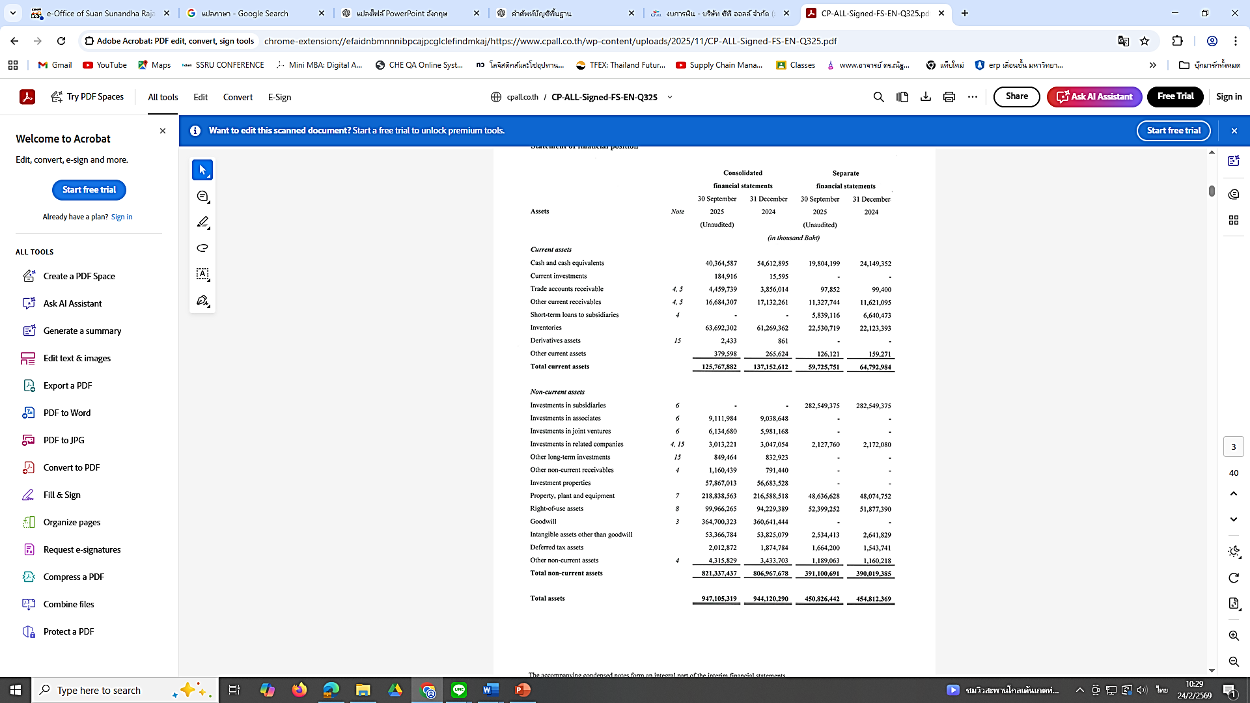

Slide 7
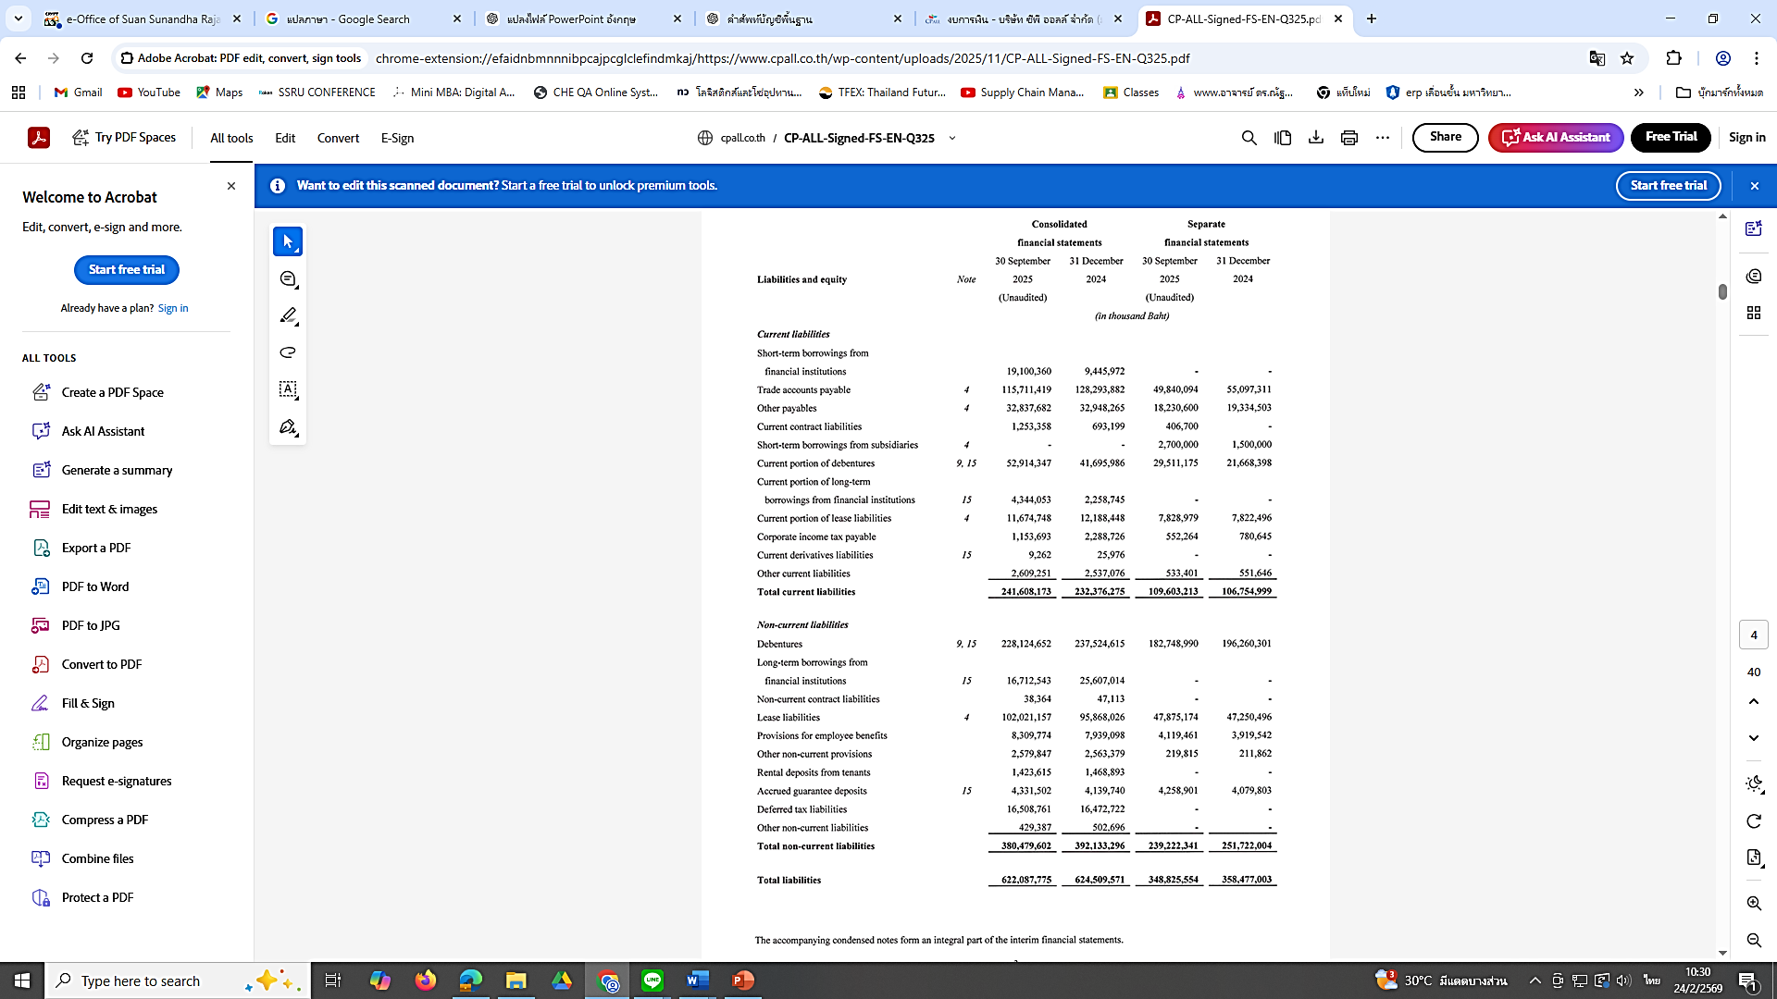

Slide 8
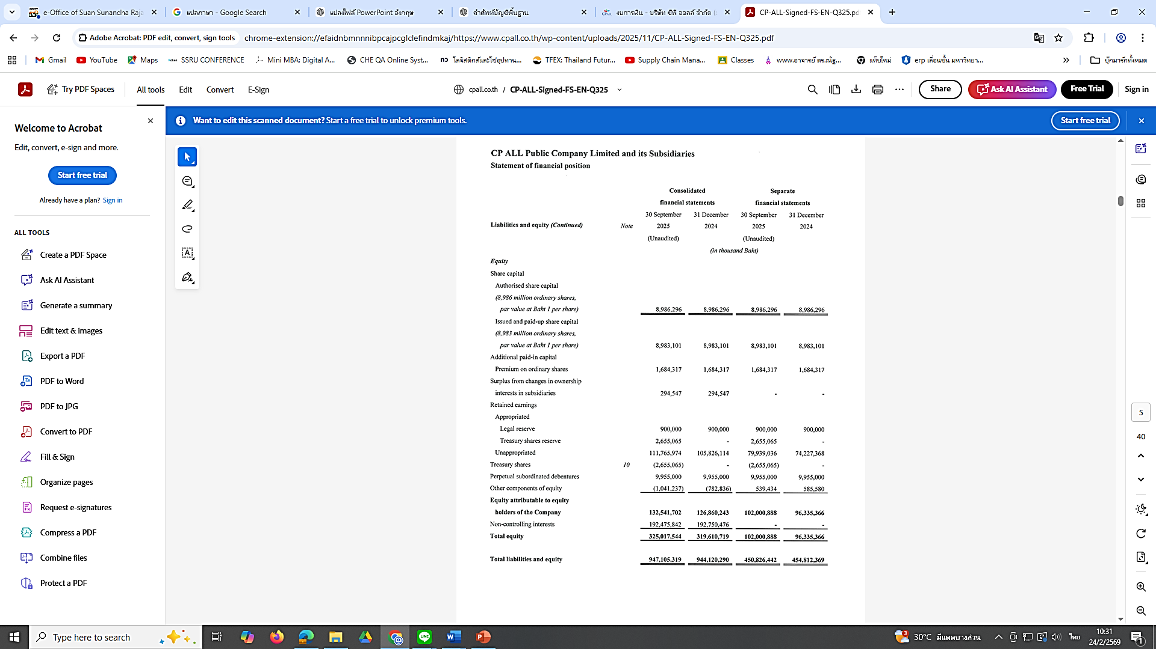

Slide 9
