Slide 1
Digital Marketing Strategy

Slide 2
Digital Marketing Planning And Strategies.
Content
Analyzing SMART Objectives
Creating a Content Calendar (Facebook–IG–TikTok)
Simple Advertising Planning
ROI = Calculating Sales vs. Media Cost
Case Study
Online Cake Shop: Posting 3 types of content → Analyzing the one with the highest reach → Performing A/B testing of the advertisement

Slide 3
Digital Marketing Planning And Strategies.
A Digital Marketing Strategy is simply a plan outlining how to proceed to achieve desired goals.
It's a form of marketing that promotes products or services through digital media and creates consumer engagement using various digital marketing strategies. This is widely popular today because it increases sales as consumers can easily access these media anytime, anywhere, 24/7.
Creating a marketing plan helps us understand what we have to sell/use, what we will do, how we will do it, who we are targeting (customers), and where we will do it (channels). In short, it's the What, Why, Where, When, How, and Whom of marketing.

Slide 4
Digital Marketing Planning And Strategies.
What does a Digital Marketing Strategy consist of? The following content will serve as a framework to help you plan fundamentally. It consists of 7 steps:
Know your business. What will you sell?
Know your customers or target audience.
Determine your marketing objectives and KPIs.
Design the customer journey.
Choose channels and media to reach your target audience.
Select a strategy, message, or promotion.
Design a plan by combining all of the above.

Slide 5
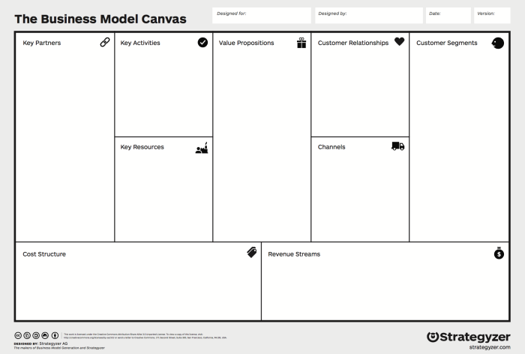
Digital Marketing Planning And Strategy; Analyzing The Environmental Factors That Affect Digital Marketing Planning.
The Business Model Canvas is a clever concept developed by Alex Osterwalder. It's a business tool that provides a clear view of your business and ensures that teams have a shared understanding of the business's model and problems. This leads to faster problem-solving and brainstorming, as you can see your strengths and weaknesses through this single, comprehensive model sheet. It's often used in a large format to allow for the attachment of Post-it notes, making it easy to edit and add/remove information.

Slide 6
Business Model Canvas
จากงานวิจัยของทาง Strategyzer พบว่า ได้มีการนำ Business Model Canvas ไปใช้มากกว่า 5 ล้านรายทั่วโลก มีการนำไปใช้ในการพัฒนาธุรกิจใหม่สูงถึง 36% และสถิตใน Google Trend ยังมีการเติบโตของ Business Model Canvas ขึ้นอย่างต่อเนื่อง ซึ่งจุดเด่นของ Business Model Canvas มีดังนี้
Business Model Canvas ทำให้เห็นภาพรวมของธุรกิจได้อย่างรวดเร็วและไม่มีข้อมูลที่ไม่จำเป็นในแผนภาพ เมื่อเทียบกับโมเดลธุรกิจแบบดั้งเดิม
สามารถแก้ไขได้ง่ายขึ้นและช่วยกัน brainstorm เพื่อให้เกิดชุดความคิดใหม่ๆ ในการร่วมกันวางแผนกลยุทธ์
Business Model Canvas สามารถใช้ได้ตั้งแต่ Startup ที่พึ่งก่อตั้งไปจนถึงบริษัทขนาดใหญ่ก็ใช้ BMC ตัวอย่างเช่น บริษัท 3M, Microsoft, Lego, Coca Cola ฯลฯ
Business Model Canvas ช่วยให้ทุกคนสามารถเข้าใจชัดเจนเกี่ยวกับแผนกลยุทธ์ของธุรกิจไปในแนวทางเดียวกัน

Slide 7
Business Model Canvas

Slide 8
Business Model Canvas
Customer Segments
Value Propositions
Channels
Customer Relationships
Revenue Streams
Key Resources
Key Activities
Key Partners
Cost Structure

Slide 9
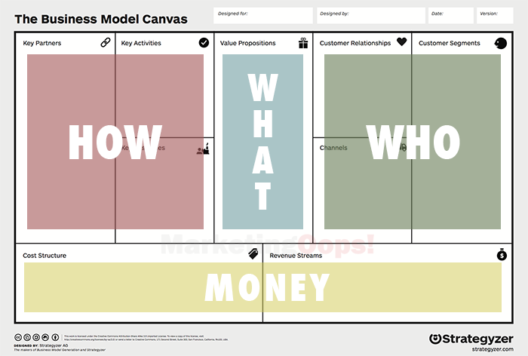
Business Model Canvas
The Business Model Canvas views the nine topics as four main groups, as shown in the image below. Each group has a different primary function:
The red group is HOW, comprising Key Partners, Key Activities, and Key Resources.
The blue group is WHAT, comprising Value Propositions.
The green group is WHO, comprising Customer Relationships, Customer Segments, and Channels.
The yellow group is MONEY, comprising Cost Structure and Revenue Structure.

Slide 10
Business Model Canvas

Slide 11
BMC: WHO
Customer Segments: Who are our customers? Is our customer group mass or niche? What are our customers' problems? It's important to differentiate between buyers and users, because for some products, the buyer doesn't use them, and the user doesn't buy them, such as baby products where parents are the buyers. The product must meet the needs of the users, but our communication will be with the buyers. It's also crucial to understand our customers' behavior and the media they use.
Customer Relationships: Building and maintaining customer relationships is often overlooked, but believe it or not, it's a key reason for word-of-mouth marketing, repeat purchases, and ultimately, brand loyalty. Customer relationships vary across businesses and can be categorized into four types: – Personalized support, such as call centers, mechanics at car service centers, and employees who call to inquire about customer satisfaction with products and services. – Self-service, such as ATMs, True's bill payment kiosks, and financial transaction applications. – Automated service, similar to self-service, where customers can interact with our business themselves through an automated system we've created. – Community-based service, such as a Facebook Fanpage.

Slide 12
BMC: WHO
Channels are the channels for buying and selling and for communicating with customers. What kind of customers do we have? What is the nature of our business? Which channel is most convenient for sales? Furthermore, choosing the right communication channels with customers is crucial. What types of media do our customers use? How can we effectively inform customers about products or promotions? This is an essential aspect for businesses to understand. These channels are involved throughout the pre-sales process, through to the post-sales process. The basic sales process consists of five stages:
> Awareness: How will customers become aware of our products and services?
> Evaluation: How will customers see the value in our products and services?
> Purchase: What channels will customers use to purchase our products and services?
> Delivery: What channels will we use to deliver our products and services to customers?
> After-sale: How will we provide after-sales service and support?

Slide 13
BMC: WHAT
What makes customers choose our products and services? This is a crucial question. We must ask ourselves what the value is in the products and services we offer. What value will customers gain from paying us? How does our product and service solve their problems, meet their needs, or enhance their well-being? For example, a coffee shop sells its products at a higher price than competitors in the area, but there are certain things that set it apart and make customers willing to pay more: ample parking, a relaxing and pleasant aroma throughout the shop, unique and hard-to-find specialty coffees, and a custom-made coffee machine unlike any other in Thailand. All of these represent the value customers receive when choosing this coffee shop. Find the value in your business.

Slide 14
BMC: HOW
Key Partners: Many aspects of a business process depend on others for smooth operation. Partners are groups of people involved in the business's operations; they might be called business associates. The advantages of having partners include increased efficiency in business processes, risk diversification, and reducing the need to handle everything yourself, saving time and allowing you to focus on more important tasks.
Key Activities: These are the core activities that drive the business. Simply put, what are the main functions you need to perform in your business? Each business will have different key functions. For example, in a laundry business, the main functions would be cleaning and ironing clothes, making them ready to wear.
Key Resources: These are the resources crucial to your business. Resources include people, machinery, capital, intellectual property, land, etc. This section should be divided into two parts: resources you already possess and resources you need to acquire. When identifying resources, you need to consider who your customers are, what value you offer, and whether your existing resources can create that value.

Slide 15
BMC: MONEY
Cost Structure
Costs come in many forms. Let's categorize them by purpose first. Costs categorized by purpose fall into two types: capital to drive the business, such as employee wages, utilities (water, electricity), fuel, machinery maintenance, office rent, etc., and capital to add value to the business, such as advertising budgets, budgets for renting exclusive space for customers in shopping malls, public relations budgets, etc. However, if we categorize costs by type, there are four types:
Fixed costs: These are fixed, recurring expenses, such as employee wages and rent.
Variable costs: These vary depending on the quantity used, such as water, electricity, and fuel.
Economies of scale: Costs where production volume results in a lower price per unit. For example, ordering 1,000 or more food jars results in a lower price per unit than usual.
Economies of scope: Costs where purchasing multiple items together results in a lower price and free delivery. For example, buying office supplies together and having them delivered as a single shipment provides a greater discount and free delivery.

Slide 16
BMC: MONEY
Revenue Streams
It's essential to understand the various ways revenue will come in. Generally, there are four main types: service fees, product sales, rentals, and licensing fees. It's crucial to delve deeper into how customers prefer to pay—credit or cash, through various channels like bank transfers, counter services, or cashiers. This must align with your products and services and connect with your customers.

Slide 17
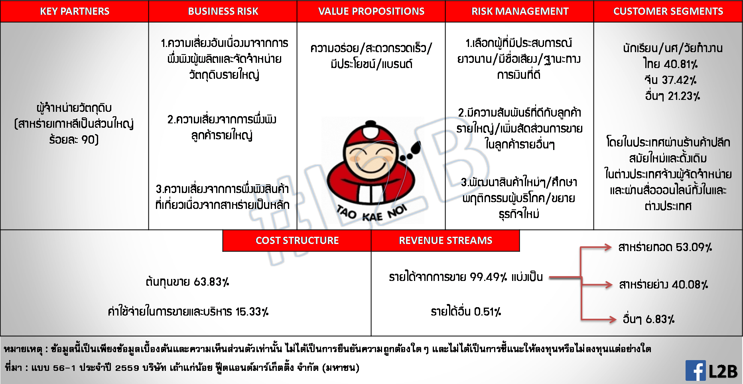
TKN: Taokaenoi Food and Marketing Public Company Limited

