Slide 1
lesson 9 Accounts Receivable and Inventory Management

Slide 2
Objectives
List the key factors that can be varied in a firm’s credit policy, and understand the trade-off between profitability and costs involved.
Explain how the level of investment in accounts receivable is affected by the firm’s credit policies.
Critically evaluate proposed changes in credit policy, including changes in credit standards, credit period, and cash discount.
Describe possible sources of information on credit applicants and how you might use the information to analyze a credit applicant.
Identify the various types of inventories and discuss the advantages and disadvantages to increasing/decreasing inventories.
Define, explain, and illustrate the key concepts and calculations necessary for effective inventory management and control, including classification, economic order quantity (EOQ), order point, safety stock, and just-in-time (JIT)

Slide 3
Credit and Collection Policies
Must to know
Credit standard The minimum quality of creditworthiness of a credit applicant that is acceptable to the firm.
Credit period The total length of time over which credit is extended to a customer to pay a bill.
Cash discount period The period of time during which a cash discount can be taken for early payment.
Cash discount A percent (%) reduction in sales or purchase price allowed for early payment of invoices. It is an incentive for credit customers to pay invoices in a timely fashion
Seasonal dating Credit terms that encourage the buyer of seasonal products to take delivery before the peak sales period and to defer payment until after the peak sales period.

Slide 4
Credit and Collection Policy Formulation – Done Right – Helps Break Down Barriers Between Marketing and Finance
Credit and collection policies share a relationship with marketing (sales and customer service) policies. For example, processing credit orders efficiently affects sales and customer satisfaction. In fact, it is useful to think of a company’s credit and collection policies as part of the product or service that a business is selling. Therefore the marketing manager and financial manager should actively cooperate in developing credit and collection policies

Slide 5
Default Risk
Our concern in this section is not only with the slowness of collection but also with the portion of the receivables in default. Different credit standard policies will involve both of these factors. The optimum credit standard policy, as we shall see, will not necessarily be the one that minimizes bad-debt losses

Slide 6
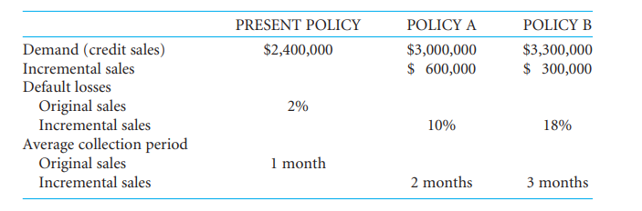
example
Suppose that we are considering the present credit standard policy (resulting in sales of $2.4 million) together with two, increasingly more liberal, new ones. These alternative policies are expected to produce the following results:

Slide 7
We assume that after six months an account is turned over to a collection agency, and, on average, 2 percent of the original sales of $2.4 million is never received by the firm, 10 percent is never received on the $600,000 in additional sales under Policy A, and 18 percent on the $300,000 in additional sales under Policy B is never received. Similarly, the one-month average collection period pertains to the original sales, two months to the $600,000 in additional sales under Policy A, and three months to the $300,000 in additional sales under Policy B. These numbers of months correspond to annual receivable turnovers of 12 times, 6 times, and 4 times, respectively.

Slide 8
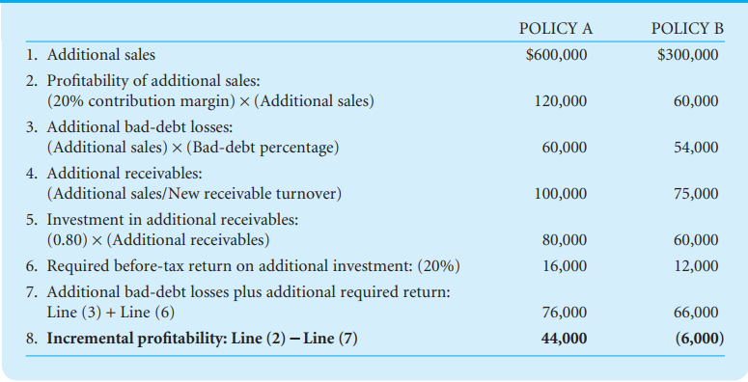
Profitability versus required return in evaluating credit policy changes

Slide 9
We would want to adopt Policy A but would not want to go as far as Policy B in relaxing our credit standards. The marginal benefit is positive in moving from the present policy to Policy A but negative in going from Policy A to Policy B. It is possible, of course, that a relaxation of credit standards that fell on one side or the other of Policy A would provide an even greater marginal benefit. The optimal policy is the one that provides the greatest incremental benefit.

Slide 10
Collection Policy and Procedures
The firm determines its overall collection policy by the combination of collection procedures it undertakes. These procedures include such things as letters, faxes, phone calls, personal visits, and legal action. One of the principal policy variables is the amount of money spent on collection procedures. Within a range, the greater the relative amount expended, the lower the proportion of bad-debt losses, and the shorter the average collection period, all other things being the same

Slide 11
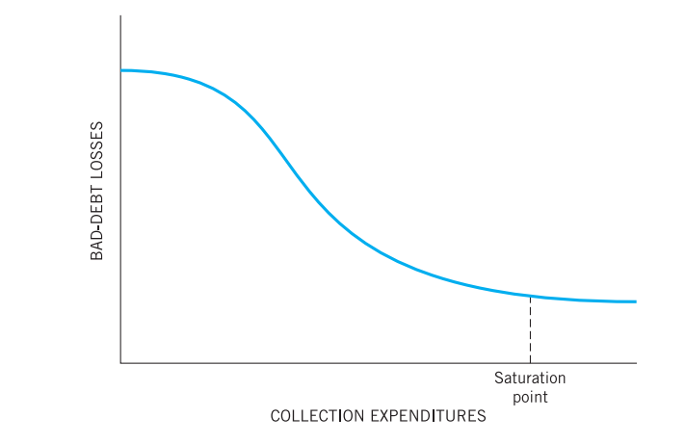
Relationship between amount of bad-debt losses and collection expenditures

Slide 12
Credit and Collection Policies
We see that the credit and collection policies of a firm involve several decisions: (1) the quality of the account accepted; (2) the length of the credit period; (3) the size of the cash discount given; (4) any special terms, such as seasonal datings; and (5) the level of collection expenditures. In each case, the decision should involve a comparison of possible gains from a change in policy with the cost of the change. Optimal credit and collection policies would be those that resulted in the marginal gains equaling the marginal costs.

Slide 13
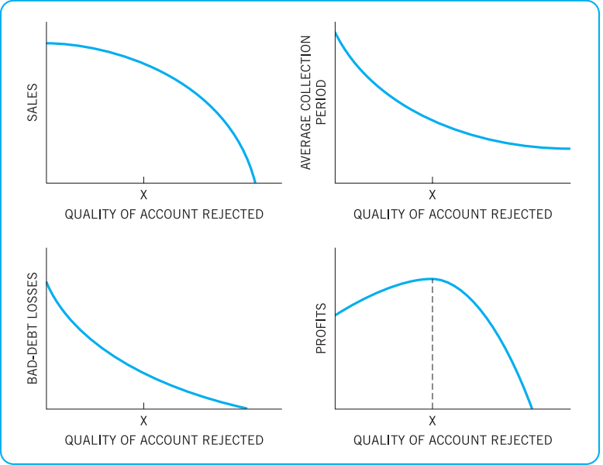
Relationship of sales, average collection period, bad-debt losses, and profits to the quality of account rejected

Slide 14
Analyzing the Credit Applicant
Financial Statements. At the time of the prospective sale, the seller may request financial statements, one of the most desirable sources of information for credit analysis. Frequently, there is a correlation between a company’s refusal to provide statements and a weak financial position.
Credit Ratings and Reports. In addition to financial statements, credit ratings are available from various credit reporting agencies
Bank Checking. Another source of credit information for the credit analyst checking on a particular firm is the firm’s bank.
Trade Checking. Credit information is frequently exchanged among companies selling to the same customer.
The Company’s Own Experience.

Slide 15
Credit Analysis
Having collected credit information, the firm must make a credit analysis of the applicant. In practice, the collection of information and its analysis are closely related
Sequential Investigation Process. The amount of information collected should be determined in relation to the expected profit from an order and the cost of investigation
Credit-Scoring Systems. Quantitative approaches have been developed to estimate the ability of businesses to service credit granted to them

Slide 16
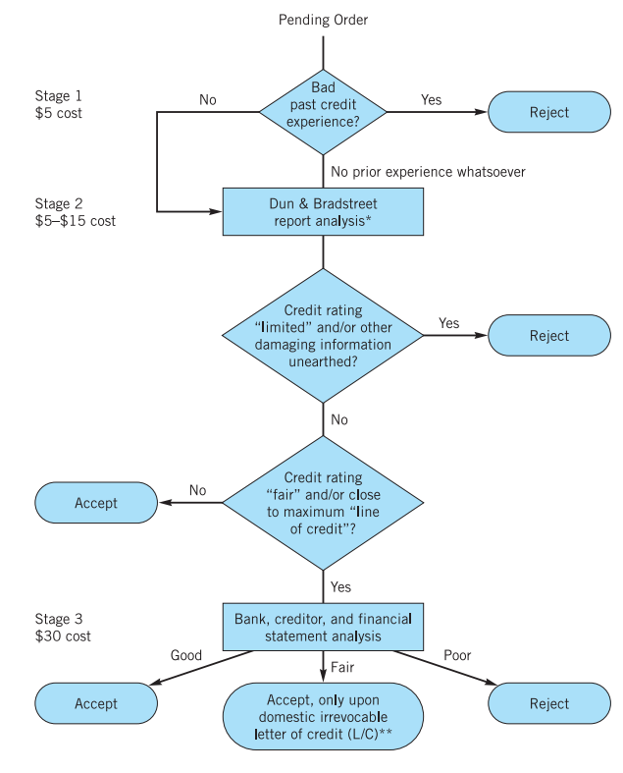
Example Sequential investigation process: who should we accept as a credit customer

Slide 17
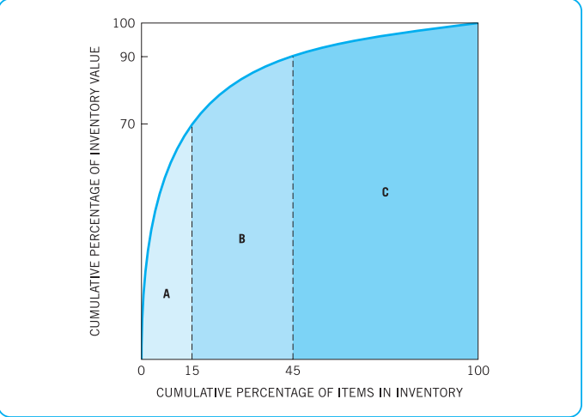
Inventory Management and Control
Classification: What to Control : ABC method of inventory control Method that controls expensive inventory items more closely than less expensive items.

Slide 18
Economic Order Quantity: How Much to Order
component
- Order cost
Carry cost
If usage of an inventory item is at a steady rate over a period of time and there is no safety stock, average inventory (in units) can be expressed as
***************Average inventory = Q/2
where Q is the quantity ordered and is assumed to be constant for the planning period. This situation is illustrated in Figure 10.6. Although the quantity demanded is a step function, we assume for analytical purposes that it can be approximated by a straight line. We see that when a zero level of inventory is reached, a new order of Q items arrives.

Slide 19
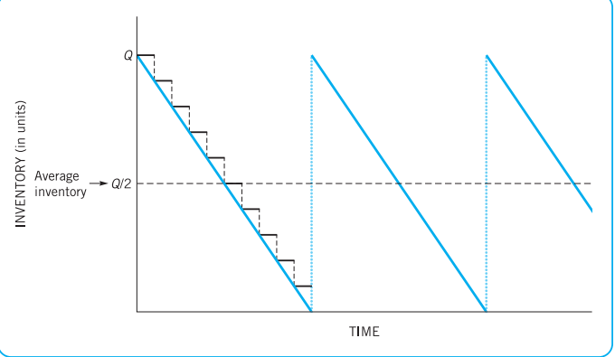
Order quantity example with certain, steady demand and no safety stocK

Slide 20
Economic Order Quantity
high
Total cost
cost
Storage cost
(carry cost)
Order cost
low
high
density

Slide 21
carrying cost = Ordering cost
QC / 2 = SO / Q
2Q = 2SO / C

Slide 22
quantity ordered. Consequently, total ordering costs are represented by the ordering cost per order times the number of orders, or O(S/Q). Total inventory costs, then, are the sum of the total carrying costs plus total ordering costs, or
Total inventory cost (T ) = C(Q/2) + O(S/Q)
Optimal Order Quantity. The optimal quantity of an inventory item to order at any one time is that quantity, Q*, that minimizes total inventory costs over our planning period. We can use calculus to find the lowest point on the total inventory cost curve described by Eq. (10.2) and then solve for Q. 6 The resulting optimal quantity, or EOQ, is

Slide 23

FORMULA

Slide 24

example
To illustrate the use of this EOQ equation, suppose that usage of an inventory item is 2,000 during a 100-day planning period, ordering costs are $100 per order, and carrying costs are $10 per unit per 100 days. The EOQ amount, then, is

Slide 25
Safety Stock
Order point (OP) = Lead time × Daily usage
firm was 200 units, resulting in an order being placed (and filled) every 10 days. This firm thus had a zero lead time and a daily usage of 20 units. If usage remains at a steady rate, the firm would now need to order 5 days before it ran out of stock, or at 100 units of stock on hand. The order point may be expressed as
5 days × 20 units per day = 100 units

Slide 26
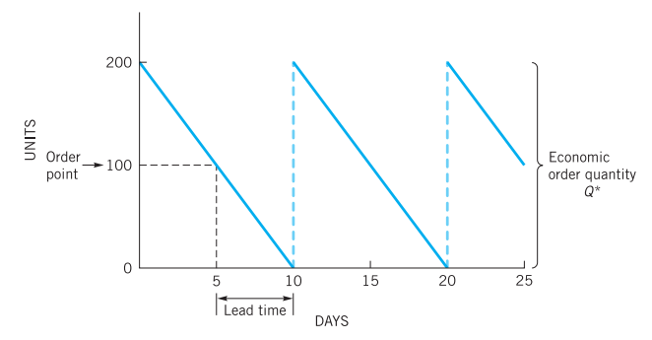
Order point when lead time is non-zero and certain

Slide 27
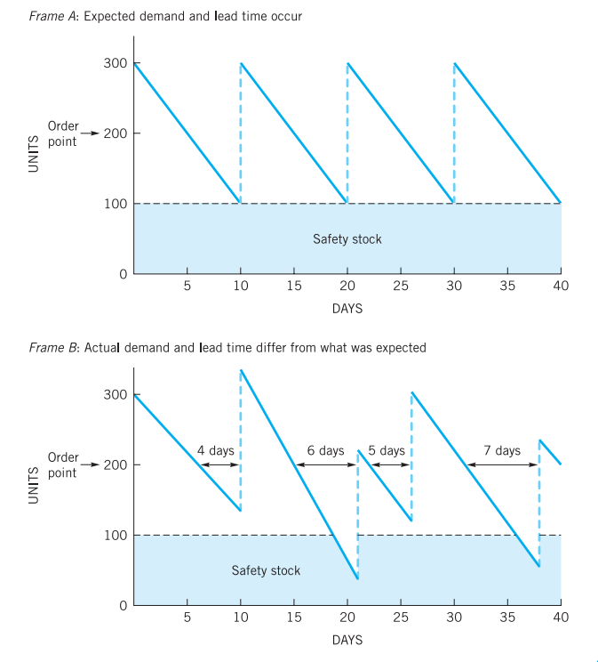
Safety stock and order point when demand and lead time

Slide 28
Questions
1. Is it always good policy to reduce the firm’s bad debts by “getting rid of the deadbeats”?
2. What are the probable effects on sales and profits of each of the following credit policies?
a. A high percentage of bad-debt loss but normal receivable turnover and credit rejection rate.
b. A high percentage of past-due accounts and a low credit rejection rate.
c. A low percentage of past-due accounts but high credit rejection and receivable turnover rates.
d. A low percentage of past-due accounts and a low credit rejection rate but a high receivable turnover rate.
3. Is an increase in the collection period necessarily bad? Explain.
4. What are the various sources of information you might use to analyze a credit applicant?
5. What are the principal factors that can be varied in setting credit policy?
6. If credit standards for the quality of accounts accepted are changed, what things are affected?
7. Why is the saturation point reached in spending money on collections?

